Slide 1

A Six-Step Protocol for Engaging Students in Progress Monitoring
Jenlyn Furey, PhD| Susan Loftus-Rattan, PhD
DECEMBER 2021
16794_12/21

Slide 2

Why We Do What We Do
“To meet its substantive obligation under the IDEA, a school must offer an IEP reasonably calculated to enable a child to make progress appropriate in light of the child’s circumstances.” [emphasis added]
—Endrew F. v. Douglas County School
District RE-1 (2017)

Slide 3
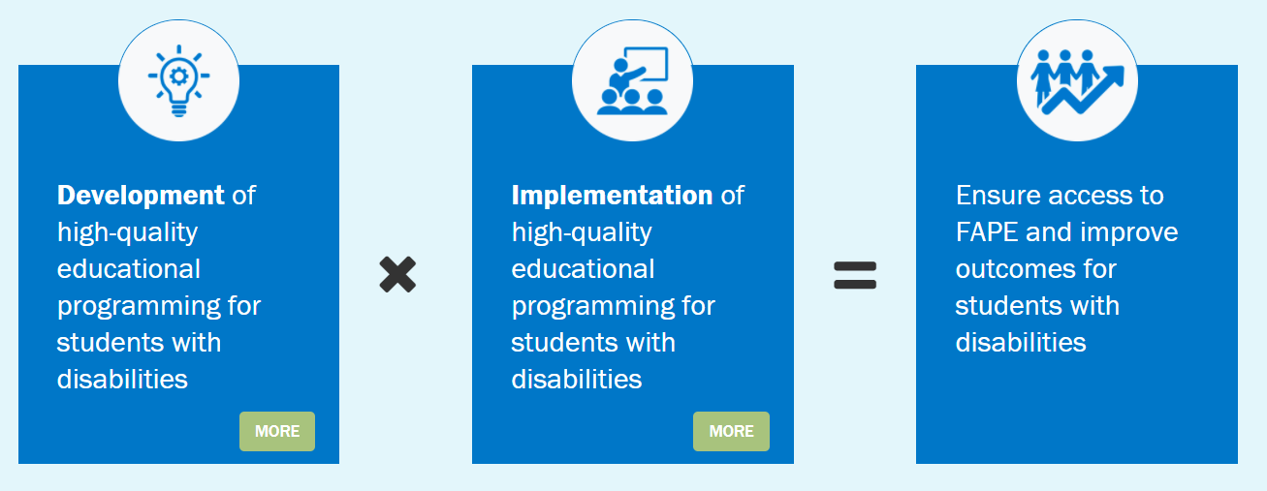
Promoting Progress for Students With Disabilities

Slide 4
Poll
What is your current role that has led you to learn more about the statement of special education and services and aids for students with disabilities?

Slide 5
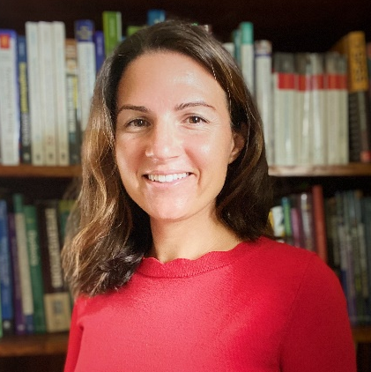
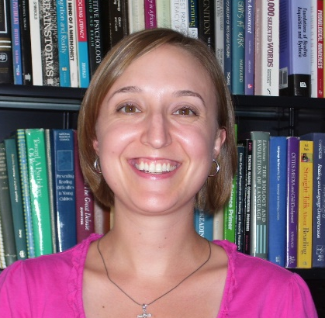
Meet the Presenters
Dr. Jenlyn Furey
Dr. Susan Loftus-Rattan
Rhode Island College
Associate Professor, School Psychology Graduate Program
Duquesne University
Assistant Professor, School Psychology Graduate Program

Slide 6
Objectives
Review progress monitoring research actively involving students.
Introduce six-step progress monitoring routine.
Share Six-Step Protocol: Progress Monitoring Performance Feedback and Goal-Setting Instructional Routine, Note-Taking Log, and Fidelity Checklist.
Evaluate outcomes using the six-step routine and protocol.
Share resources for effectively implementing progress monitoring.

Slide 7
Agenda
Introduction and Review of Research
Six-Step Protocol
  Description
  Materials Needed
  Procedure
Evaluating Outcomes
Conclusion

Slide 8
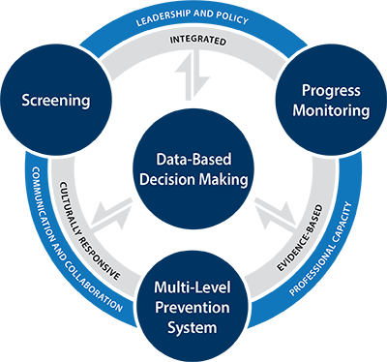
MTSS and Progress Monitoring
CBMs*
PF and GS**
Key components of MTSS
  Assessment
    Screening
    Progress Monitoring
      Curriculum Based Measures (CBMs)*
      Performance Feedback (PF) and Goal Setting (GS)**
  Data-based decision making
  Multiple tiers of intervention
  Evidence-based practices
Source: MTSS Center, www.MTSS4Success.org

Slide 9
Research on Performance Feedback and Goal Setting
Performance feedback and goals setting have been shown to improve
  Academic outcomes
    Reading (Conte & Hintze, 2000; Joseph & Eveleigh, 2009; Morgan & Sideridis, 2006)
    Writing (Barrett et al., 2020; Graham & Harris, 2003; Koenig et al., 2016; Truckenmiller et al., 2014)
    Mathematics (Codding et al., 2005; Fuchs et al., 2003)
  Social-emotional outcomes
    Self-efficacy and motivation (Bandura, 1997; Cleary, 2009; Deci & Ryan, 2012; Pajares, 2006; Reeve, 2002; Schunk, 2003; Wehmeyer et al., 1997)

Slide 10
Rationale for Six-Step Protocol
Cost-effective and low-resource
Effective practice
practitioner-friendly

Slide 11
Description of Six-Step Protocol
Components
  Step 1. Explicit performance feedback
  Step 2. Specific, true, and positive feedback
  Step 3. Collaborative data graphing
    Self-graphing/self-monitoring
  Step 4. Collaborative data analysis
  Step 5. Reflective questioning
  Step 6. Collaborative goal setting
    Self-evaluation
Usage
  One-to-one setting
  Weekly or biweekly
Source: Furey & Loftus-Rattan (2021)

Slide 12
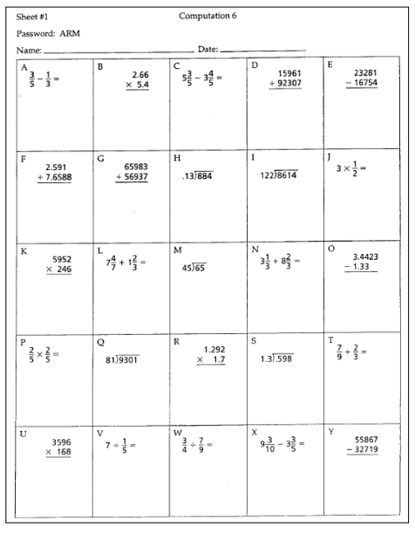


Materials Needed
Progress monitoring administration and scoring materials (e.g., CBMs)
Progress monitoring line graph or bar graph
A pencil, marker, or small stickers
Computation Image Source: https://intensiveintervention.org/sites/default/files/Progress-Monitoring-Handouts_508.pdf

Slide 13
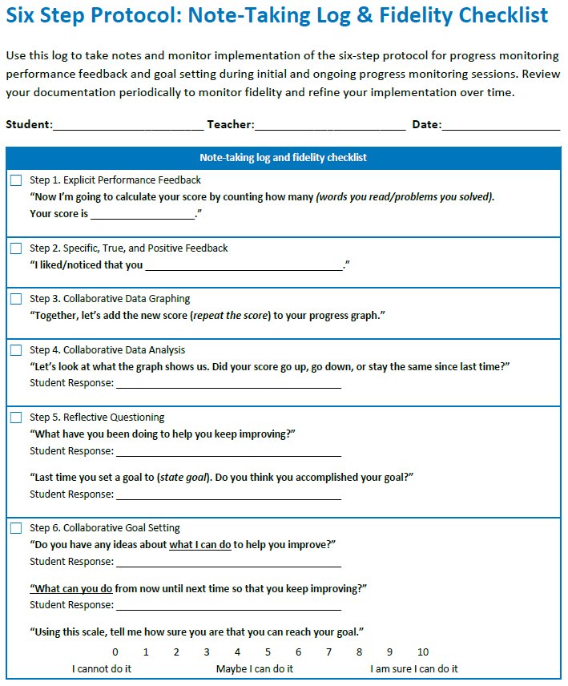
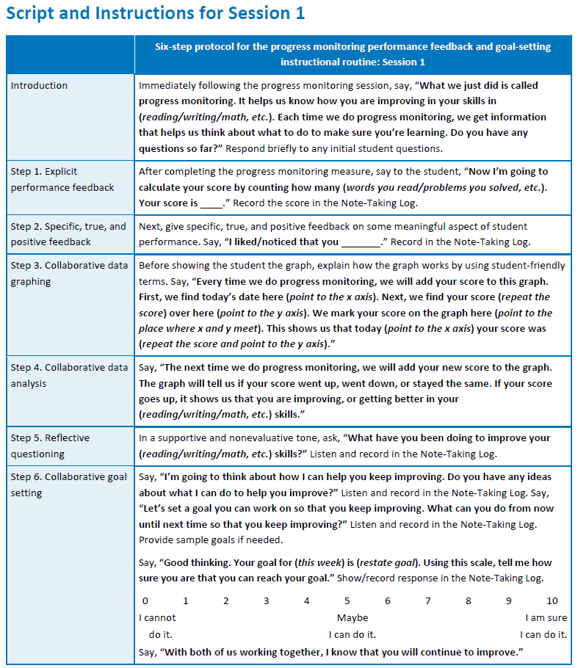
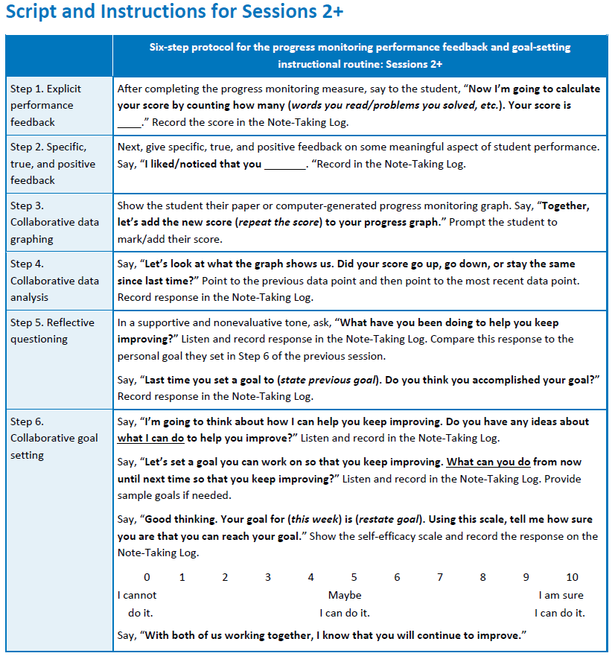
Materials Needed
Script and Instructions for Session 1 or Sessions 2+
Note-Taking Log and Fidelity Checklist for each session

Slide 14
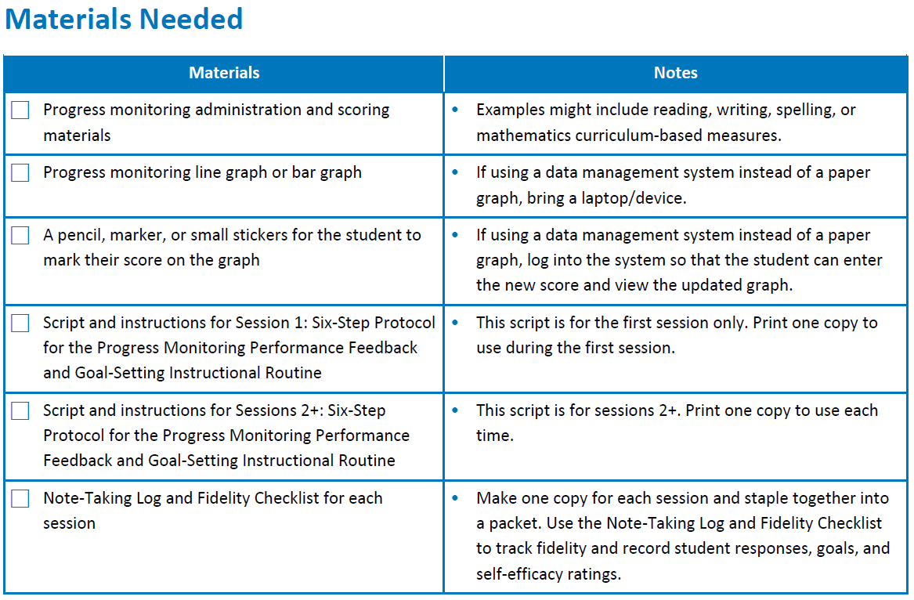

Materials Needed

Slide 15
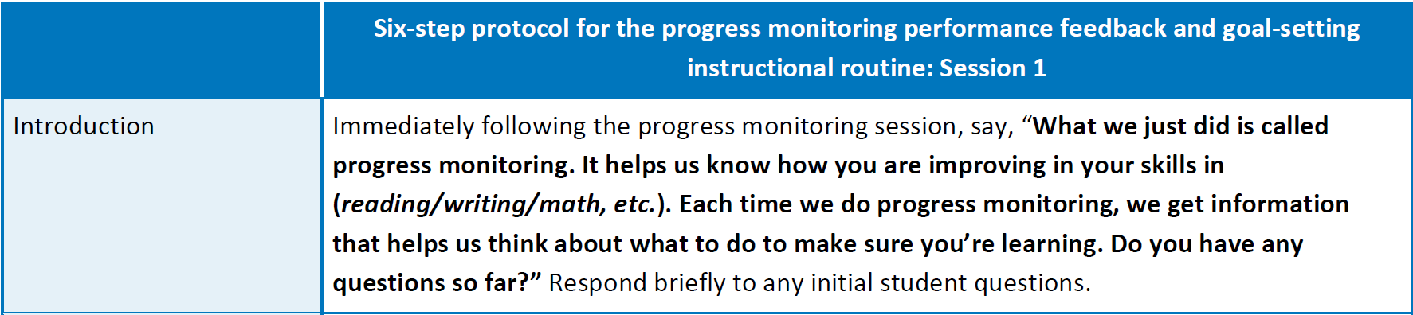


Script and Instructions for Session 1

Slide 16
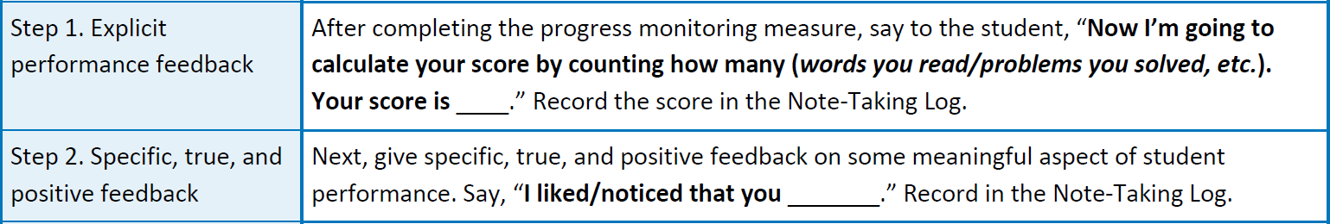


Script and Instructions for Session 1

Slide 17

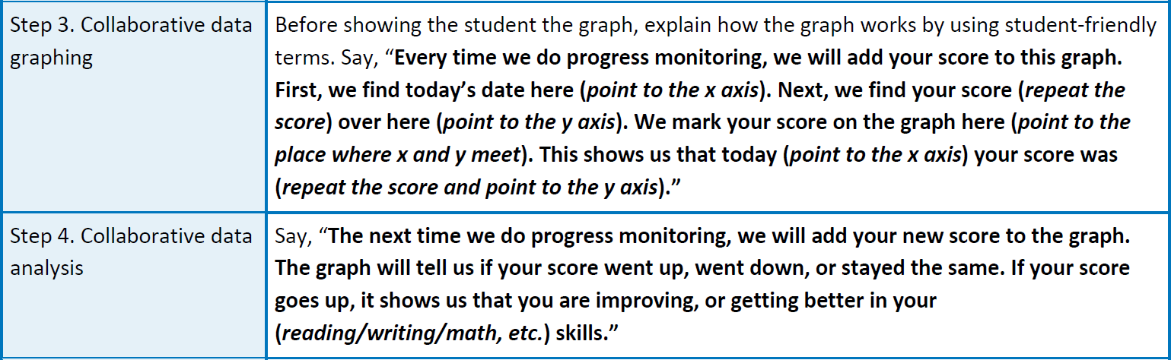
Script and Instructions for Session 1

Slide 18


Script and Instructions for Session 1

Slide 19


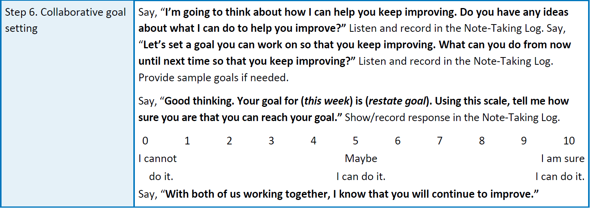
Script and Instructions for Session 1

Slide 20
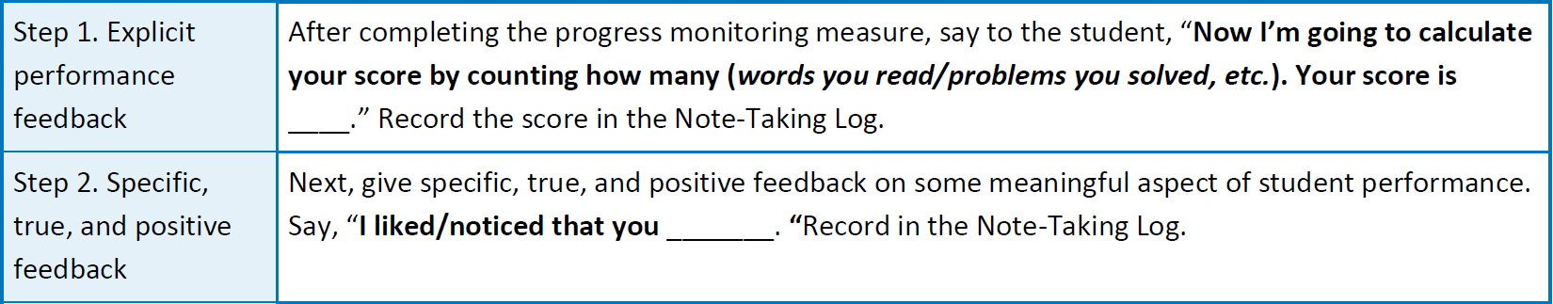
Script and Instructions for Sessions 2+

Slide 21


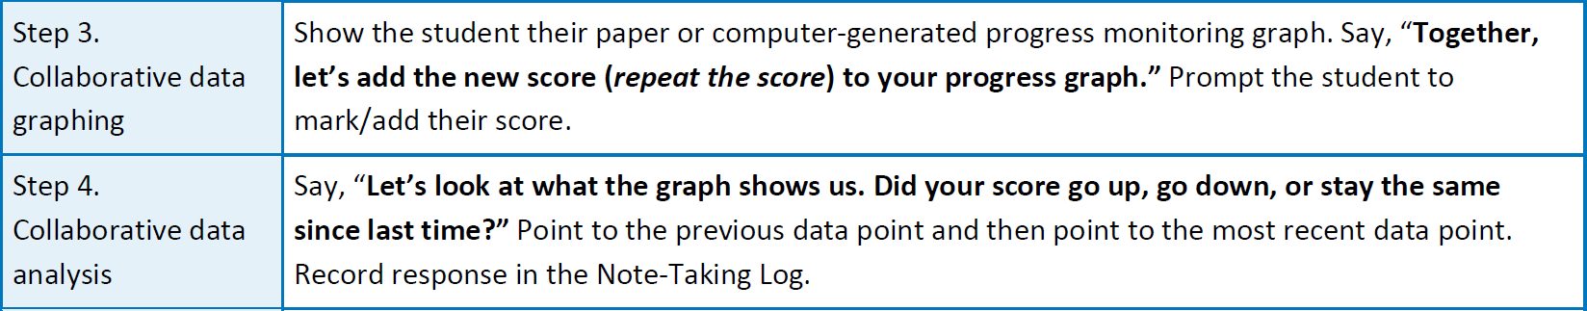
Script and Instructions for Sessions 2+

Slide 22
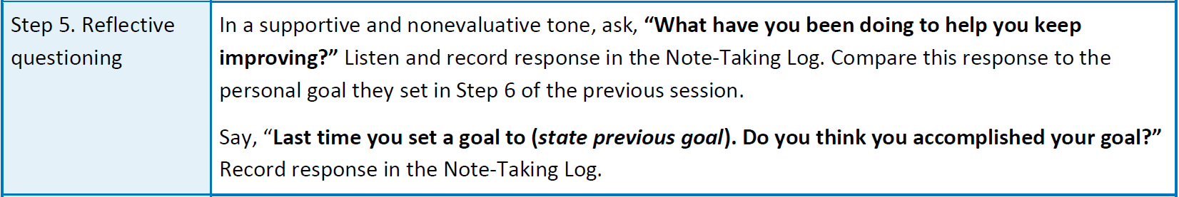
Script and Instructions for Sessions 2+

Slide 23
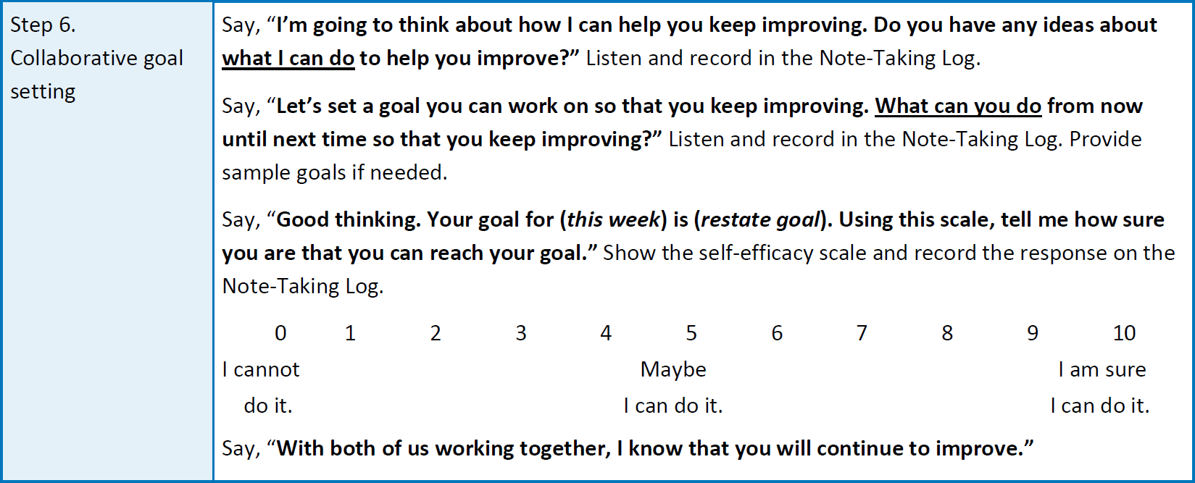
Script and Instructions for Sessions 2+

Slide 24
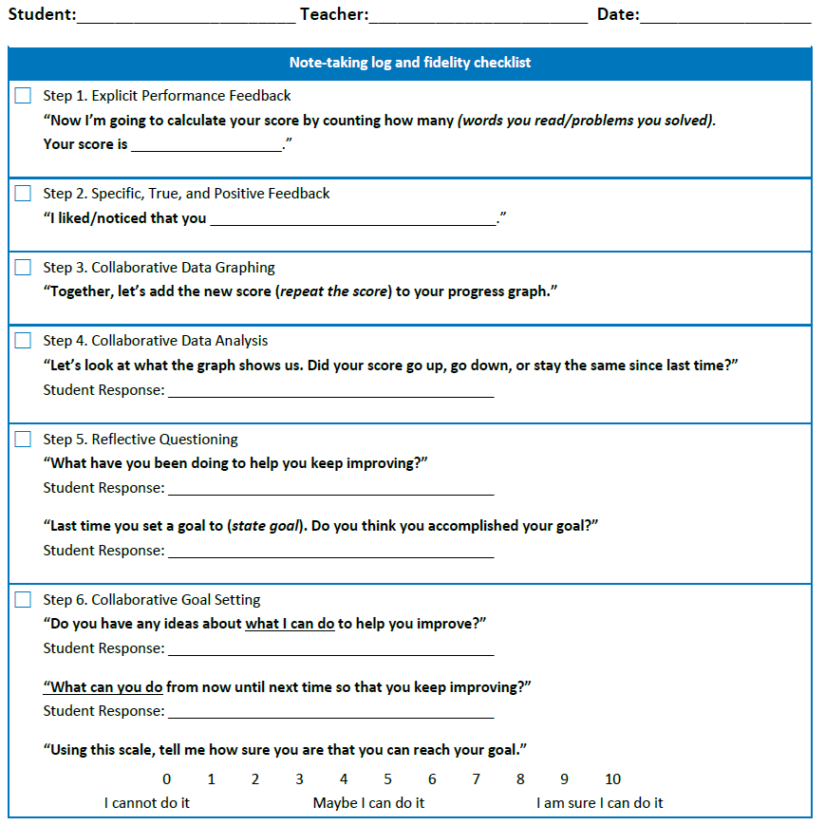
Note-Taking Log and Fidelity Checklist

Slide 25
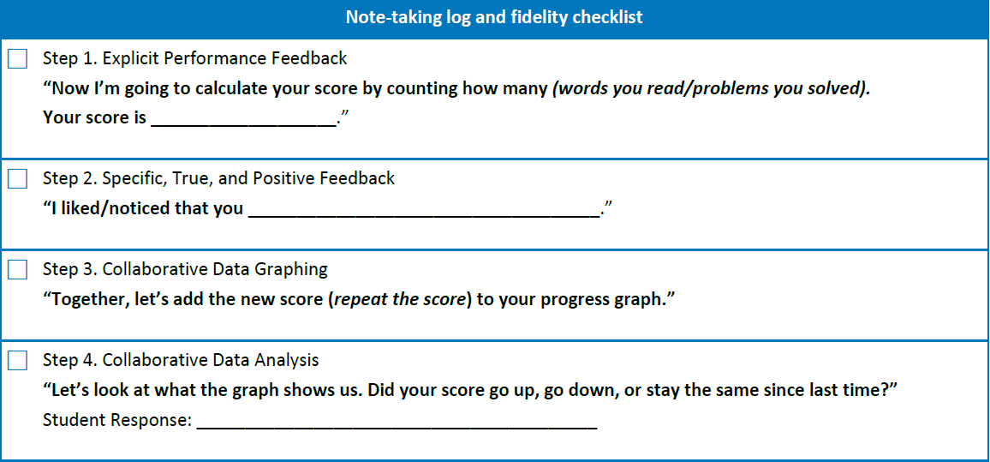
Note-Taking Log and Fidelity Checklist: Steps 1–4
25 words correct in one minute
used a decoding strategy to read the word “glad”
stayed the same (correct)

Slide 26
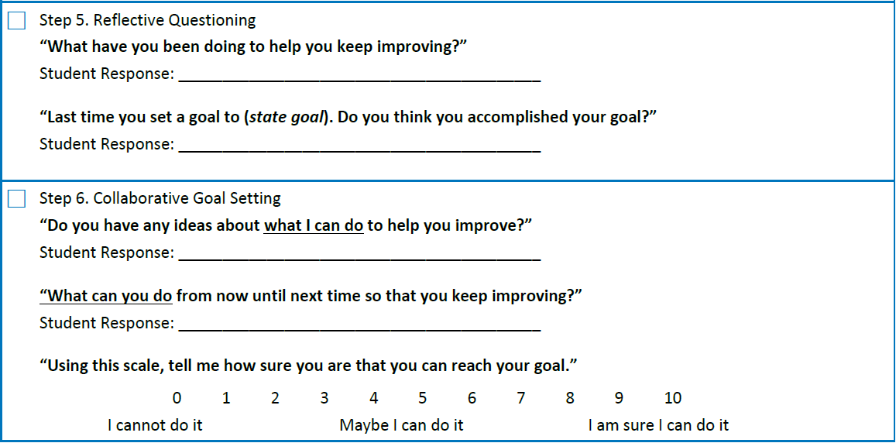
Note-Taking Log and Fidelity Checklist: Steps 5–6
Practicing reading out loud for 10 minutes every night
Yes, mostly.
Let me pick our repeated reading book.
Keep practicing reading at home for 10 minutes a night.

Slide 27
Note-Taking Log and
Fidelity Checklist, Example 1
31 words correct/minute
remembered the “magic e” rule when reading the word “pine”
“It went way up.”
practicing my vowel sounds
Yes
Keep practicing with me.
Practice reading at home for 10 minutes a night.

Slide 28
Note-Taking Log and
Fidelity Checklist, Example 2
34 words correct/minute
Read this line like a question – great prosody!
“It went up.”
Practicing reading every night for 10 minutes.
Yes
Not sure
Practice reading words from our list every night.

Slide 29
Evaluating Outcomes
Academic Outcomes: Progress monitoring CBM Data
  Compare rate of improvement before/after six-step routine is implemented.
Self-Efficacy Outcomes: Step 6 of the performance feedback and goal setting instructional routine
  Review student self-efficacy ratings over time.
Academic Motivation: Many options available, including the following:
  Self-Regulation Questionnaire in Reading (DeNaeghel et al., 2012)
  School Motivation and Learning Strategies Inventory (Stroud, 2014)
  Student Mindset Survey-Revised (Petscher et al., 2017)

Slide 30
Conclusion
Provides an opportunity to actively involve students in understanding and improving their academic outcomes.
An efficient and effective way to improve academic skills, self-efficacy, and academic motivation.
Aligns with growth mindset approach.
  Abilities are improvable through high-quality instruction and student efforts.
Baird et al., 2009; Barrett et al., 2020; Cho et al., 2011; Dweck, 2006

Slide 31
Resources
PROGRESS Center, Monitoring Progress Tip Sheets and Webinar. Visit us at www.promotingPROGRESS.org to learn more.
Center on Multi-Tiered System of Supports, Components of Progress Monitoring. Visit the MTSS Center at www.MTSS4success.org.
National Center on Intensive Intervention, Progress Monitoring Resources. Visit NCII at www.intensiveintervention.org.
Furey, J., & Loftus-Rattan, S. M. (2021, July). Actively involving students with learning disabilities in progress monitoring practices. Intervention in School and Clinic. https://doi.org/10.1177%2F10534512211032618
Sources: Center on MTSS (2021); Furey and Loftus-Rattan (2021); NCII (2021); Progress Center (2021)

Slide 32
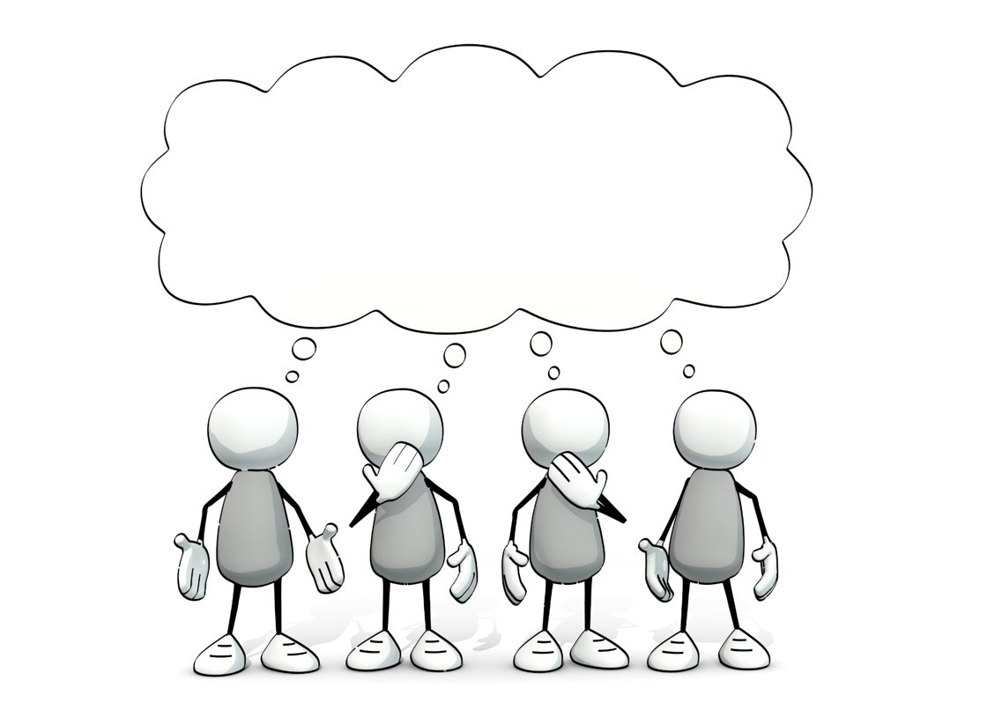
Questions?

Slide 33
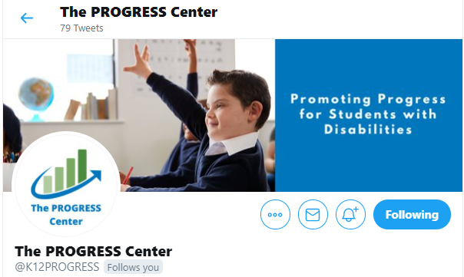
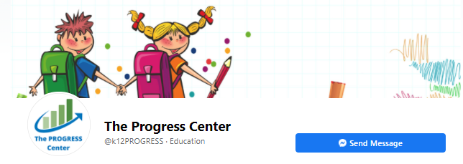

Staying Connected With the
PROGRESS Center
Connect with us on Facebook and Twitter @k12progress.
https://promotingprogress.org/news/connect-progress-center

Slide 34
References
Baird, G. L., Scott, W. D., Dearing, E., & Hamill, S. K. (2009). Cognitive self-regulation in youth with and without learning disabilities: Academic self-efficacy, theories of intelligence, learning vs. performance goal preferences, and effort attributions. Journal of Social and Clinical Psychology, 28(7), 881–908.
Bandura, A. (1997). Self-efficacy: The exercise of control. Freeman.
Barrett, C. A., Truckenmiller, A. J., & Eckert, T. L. (2020). Performance feedback during writing instruction: A cost-effectiveness analysis. School Psychology, 35(3), 193–200. 10.1037/spq0000356
Cho, H., Wehmeyer, M., & Kingston, N. (2011). Elementary teachers’ knowledge and use of interventions and barriers to promoting student self-determination. The Journal of Special Education, 45(3), 149–156. 10.1177/0022466910362588
Cleary, T. J. (2009). Monitoring trends and accuracy of self-efficacy during interventions: Advantages and potential application settings. Psychology in the Schools, 46(2), 154–171. 10.1002/pits.20360
Codding, R. S., Lewandowski, L. J., & Eckert, T. L. (2005). Examining the efficacy of performance feedback and goal setting interventions: A comparison of two methods of goal setting. Journal of Evidence-Based Practices for Schools, 6, 42–58.

Slide 35
References
Conte, K. L., & Hintze, J. M. (2000). The effects of performance feedback and goal setting on oral reading fluency within curriculum-based measurement. Assessment for Effective Intervention, 25, 85–98. https://doi.org/.1177/073724770002500201
Deci, E. L., & Ryan, R. M. (2012). Motivation, personality, and development within embedded social contexts: An overview of self-determination theory. In R. M. Ryan (Ed.), The Oxford handbook of human motivation (pp. 85–110). Oxford University Press.
DeNaeghel, J., Van Keer, H., Vansteenkiste, M., & Rosseel, Y. (2012). The relation between elementary students’ recreational and academic reading motivation, reading frequency, engagement, and comprehension: A self-determination theory perspective. Journal of Educational Psychology, 104(4), 1006–1021. 10.1037/a0027800
Dweck, C. S. (2006). Mindset: The new psychology of success. Random House.
Fuchs, L. S., Fuchs, D., Prentice, K., Burch, M., Hamlett, C. L., Owen, R., & Schroeter, K. (2003). Enhancing third-grade students’ mathematical problem solving with self-regulated learning strategies. Journal of Educational Psychology, 95(2), 306–315. https://doi.org/10.1037/0022-0663.95.2.306

Slide 36
References
Furey, J., & Loftus-Rattan, S. M. (2021). Actively Involving Students With Learning Disabilities in Progress Monitoring Practices. Intervention in School and Clinic, 10534512211032618.
Graham, S., & Harris, K. R. (2003). Students with learning disabilities and the process of writing: A meta-analysis of SRSD studies. In H. L. Swanson, K. R. Harris, & S. Graham (Eds.), Handbook of learning disabilities (pp. 323–344). The Guilford Press.
Joseph, L. M., & Eveleigh, E. L. (2009). A review of the effects of self-monitoring on reading performance of students with disabilities. The Journal of Special Education, 45(1), 43–53. 10.1177/0022466909349145
Koenig, A., Eckert, T., & Hier, B. O. (2016). Using performance feedback and goal setting to improve elementary students’ writing fluency: A randomized controlled trial. School Psychology Review, 45(3), 275–295. 10.17105/SPR45-3.275-295
Morgan, P. L., & Sideridis, G. D. (2006). Contrasting the effectiveness of fluency interventions for students with or at risk for learning disabilities: A multilevel random coefficient modeling meta-analysis. Learning Disabilities Research & Practice, 21(5), 191–210. https://doi.org/10.1111/j.1540-5826.2006.00218.x
Pajares, F. (2006). Self-efficacy during childhood and adolescence: Implications for teachers and parents. In F. Pajares & T. Urdan (Eds.), Self-efficacy beliefs of adolescents (pp. 339–367). Information Age Publishing.

Slide 37
References
Petscher, Y., Al Otaiba, S., Wanzek, J., Rivas, B., & Jones, F. (2017). The relation between global and specific mindset with reading outcomes for elementary school students. Scientific Studies of Reading, 21(5), 376–391. http://dx.doi.org/10.1080/10888438.2017.1313846
Reeve, J. (2002). Self-determination theory applied to educational settings. In E. L. Deci & R. M. Ryan (Eds.), Handbook of self-determination research (pp. 183–203). University of Rochester Press.
Schunk, D. H. (2003). Self-efficacy for reading and writing: Influence of modeling, goal setting, and self-evaluation. Reading & Writing Quarterly, 19(2), 159–172. https://doi.org/10.1080/10573560308219
Stroud, K. C., & Reynolds, C. R. (2014). School Motivation and Learning Strategies (SMALSI). Western Psychological Services.
Truckenmiller, A. J., Eckert, T. L., Codding, R. S., & Petscher, Y. (2014). Evaluating the impact of feedback on elementary aged students’ fluency growth in written expression: A randomized controlled trial. Journal of School Psychology, 52(6), 531–548. https://doi.org/10.1016/j.jsp.2014.09.001
Wehmeyer, M. L., Sands, D. J., Doll, B., & Palmer, S. (1997). The development of self-determination and implications for educational interventions with students with disabilities. International Journal of Disability, Development and Education, 44(4), 305–328. https://doi.org/10.1080/ 0156655970440403

Slide 38
Disclaimer
This material was produced under the U.S. Department of Education, Office of Special Education Programs, Award No. H326C190002. David Emenheiser serves as the project officer. The views expressed herein do not necessarily represent the positions or policies of the U.S. Department of Education. No official endorsement by the U.S. Department of Education of any product, commodity, service, or enterprise mentioned in this webinar is intended or should be inferred.

Slide 39
Contact us
1400 Crystal Drive, 10th Floor
Arlington, VA 22202
202.403.5000
progresscenter@air.org
promotingprogress.org | www.air.org
https://www.facebook.com/k12PROGRESS/
https://twitter.com/K12PROGRESS
Notice of Trademark: “American Institutes for Research” and “AIR” are registered trademarks. All other brand, product, or company names are trademarks or registered trademarks of their respective owners.
This material was produced under the U.S. Department of Education, Office of Special Education Programs, Award No. H326C190002. David Emenheiser serves as the project officer. The views expressed herein do not necessarily represent the positions or policies of the U.S. Department of Education. No official endorsement by the U.S. Department of Education of any product, commodity, service, or enterprise mentioned in this webinar is intended or should be inferred.
16794_12/21

