Slide 1
Prepping for PROGRESS: Adding New Tools to Your Backpack (Toolbox) for the Start of School
August 4, 2022

Slide 2
Welcome

Slide 3
Day 1 Recap
Welcome and Keynote: Path to PROGRESS: What does it take to develop and implement high-quality educational programming for students with disabilities?
Strand Sessions
Making Connections! Ensuring the Parts of the IEP Work Together to Promote Progress
Expanding Your Toolbox for Preparing Educators to Promote Progress!
Optional Networking Time

Slide 4
Share a takeaway or two from yesterday in the chat!
What are you most excited about from what you learned yesterday?
What questions do you still have?

Slide 5
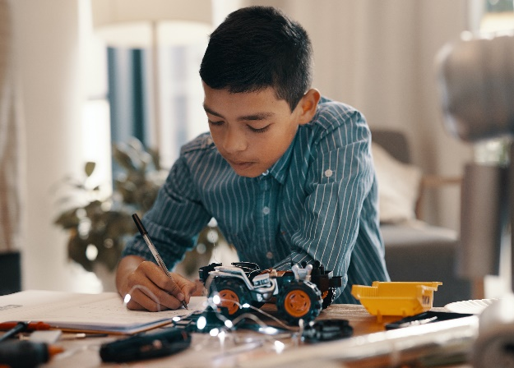
Welcome to the PROGRESS Center!
The PROGRESS Center provides information, resources, tools, and technical assistance services to support local educators in developing and implementing high-quality educational programs that enable children with disabilities to make progress and meet challenging goals.
HOW WILL WE HELP IMPROVE OUTCOMES FOR STUDENTS WITH DISABILITIES?
Share current research,
policies, guidance, success stories, and experiences from students, parents, educators, and
other stakeholders.
Partner with selected
local educators to develop and implement high-quality educational programs.​
Provide tools, resources, and
training materials for ALL educators, leaders, and families.
Visit us at www.promotingPROGRESS.org to learn more!
≈

Slide 6
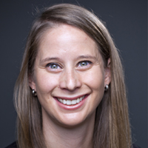
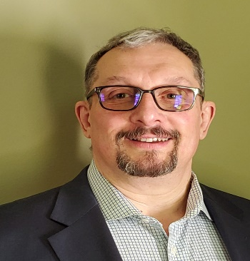
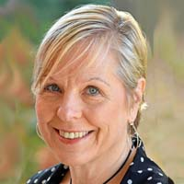
Introductions
Amy Peterson, Senior Researcher, PROGRESS Center Universal Technical Assistance Lead, American Institutes for Research
David Emenheiser, PhD, PROGRESS Center Project Officer, Office of Special Education Programs, U.S. Department of Education
Donna Sacco, PhD, Senior TA Consultant, PROGRESS Center TA Facilitator, American Institutes for Research

Slide 7
Welcome from David Emenheiser
David Emenheiser, PhD, PROGRESS Center Project Officer, Office of Special Education Programs, U.S. Department of Education

Slide 8
Event Orientation
During the Event you will have the opportunity to:
hear from PROGRESS Center experts and stakeholder panels.
join a strand focused on building better individualized education programs (IEPs) or preparing educators to support students with disabilities.
network with others working with students with disabilities.
access concurrent sessions focused on implementation fidelity, belonging, family engagement, and special education law.

Slide 9
Event Schedule Overview: Day 2!
Reminder! You must register for each session independently. Haven’t registered for a session you would like to attend? Don’t worry, there is still time.
Time (ET) | Session
10:15-10:45 a.m. | Optional Networking Discussion
10:45-11:00 a.m. | BREAK
11:00 a.m.-12:00 p.m. | General Session: Panel Discussion (you are here!)
12:00-12:40 p.m. | BREAK
12:40-1:40 p.m. | Concurrent Sessions
1:40-2:00 p.m. | BREAK
2:00-3:00 p.m. | Concurrent Sessions
3:00-3:20 p.m. | BREAK
3:20-4:00 pm | Closing Session

Slide 10
Day 2: Concurrent Sessions
Start the School Year Right by Promoting Belonging of All Students
Collaboration Compass: Engaging Parents on a Path to PROGRESS
Did We Do What We Said We Would? Why Developing a High-Quality IEP Isn’t Enough!
Providing a Free Appropriate Public Education (FAPE): Lessons From the Due Process Hearing Front
These same sessions will occur from 12:40-1:40 p.m. and 2:00-3:00 p.m., so you can choose to attend 2 of the 4 available sessions live. If you are interested in the other sessions, you can listen to their archived recordings after the event!

Slide 11
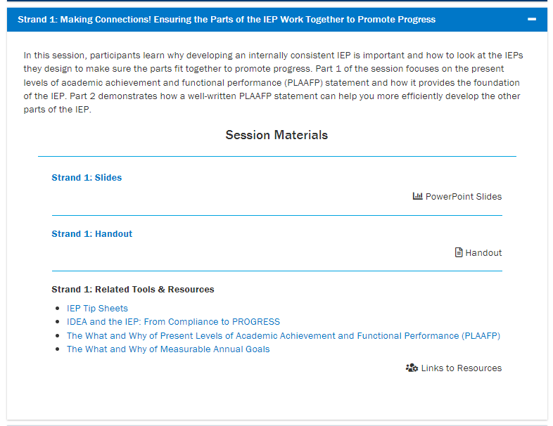
Where can I find event materials and recordings after the event?
https://promotingprogress.org/news-events/prepping-progress-event-2022

Slide 12
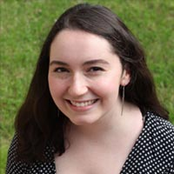
Technical Support
Do you have a question about the technology?
Do you need support in accessing a session?
Do you have questions about accessing materials?
Reach out to Mia Mamone at mmamone@air.org with any challenges! She will do her best to address any needs throughout the event.

Slide 13
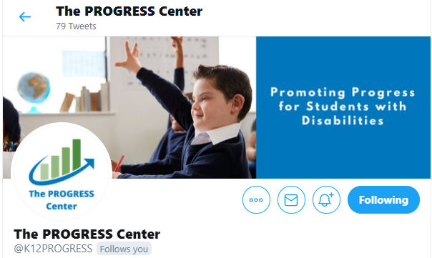
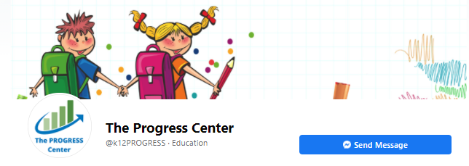
Connect With the PROGRESS Center
Connect to us on Facebook and Twitter @k12progress
Share your learning about the event at #promotingprogress2022

Slide 14
Stories from the Classroom
Panel Discussion

Slide 15
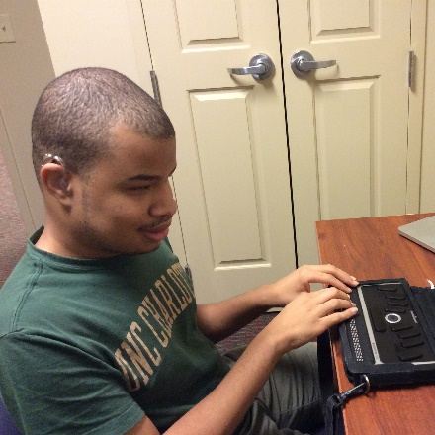
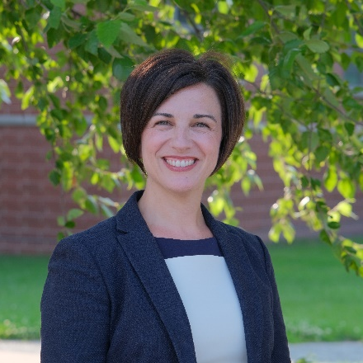
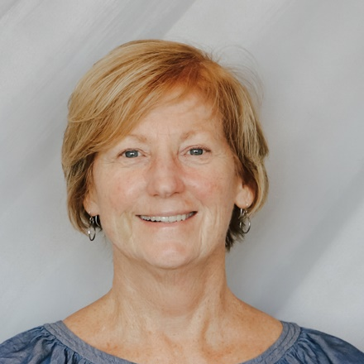
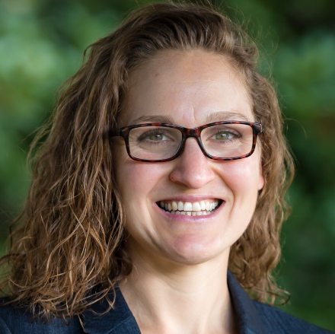
Panel Introductions
Billy Pickens
Nicole Bucka
Shari Dukes, Ph.D.
Andrea Boykin
Amy Campbell
Young Adult
Exceptional Children’s Assistance Center
Parent
MTSS Implementation Specialist, RI
PROGRESS Center Advisor
Director
Student Services
J.O. Combs Unified School District
Manager of Assistive Technology
District of Columbia
Public Schools
Special Educator
2020 WA State Teacher of the Year

Slide 16
Stories from the Classroom Video Series

Slide 17
Don’t Forget
Time (ET) | Session
10:15-10:45 a.m. | Optional Networking Discussion
10:45-11:00 a.m. | BREAK
11:00 a.m.-12:00 p.m. | General Session: Panel Discussion (you are here!)
12:00-12:40 p.m. | BREAK
12:40-1:40 p.m. | Concurrent Sessions
1:40-2:00 p.m. | BREAK
2:00-3:00 p.m. | Concurrent Sessions
3:00-3:20 p.m. | BREAK
3:20-4:00 pm | Closing Session

Slide 18
Reminder! Connect With the PROGRESS Center
Connect to us on Facebook and Twitter @k12progress
Share your learning about the event at #promotingprogress2022

Slide 19
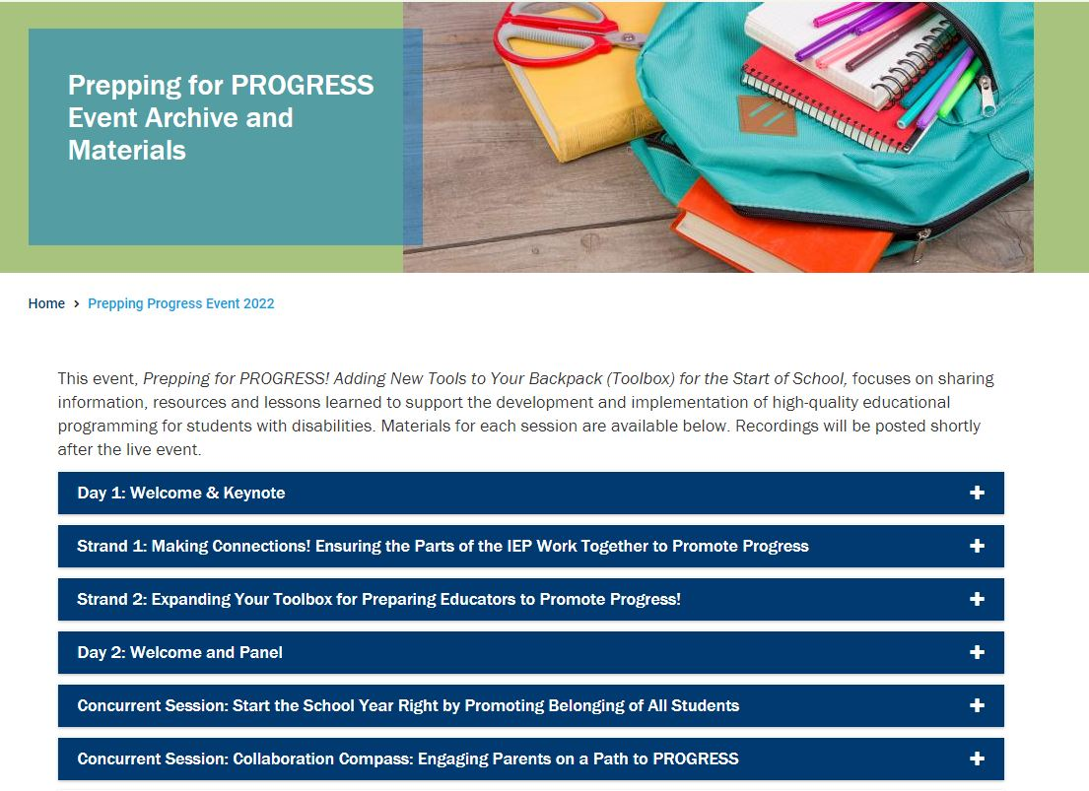
Reminder! Where can I find event materials and recordings after the event?
https://promotingprogress.org/news-events/prepping-progress-event-2022

Slide 20
Disclaimer
This material was produced under the U.S. Department of Education, Office of Special Education Programs, Award No. H326C190002. David Emenheiser serves as the project officer. The views expressed herein do not necessarily represent the positions or policies of the U.S. Department of Education. No official endorsement by the U.S. Department of Education of any product, commodity, service, or enterprise mentioned in this presentation is intended or should be inferred.

Slide 21
PROGRESS Center
progresscenter@air.org
1400 Crystal Drive, 10th Floor
Arlington, VA 22202-3289
202.403.5000
progresscenter@air.org
promotingprogress.org | www.air.org
https://www.facebook.com/k12PROGRESS/
https://twitter.com/K12PROGRESS
Notice of Trademark: “American Institutes for Research” and “AIR” are registered trademarks. All other brand, product, or company names are trademarks or registered trademarks of their respective owners.
This material was produced under the U.S. Department of Education, Office of Special Education Programs, Award No. H326C190002. David Emenheiser serves as the project officer. The views expressed herein do not necessarily represent the positions or policies of the U.S. Department of Education. No official endorsement by the U.S. Department of Education of any product, commodity, service, or enterprise mentioned in this presentation is intended or should be inferred.

