Slide 1
ABCs of IEPs
Steven Prater | Amy Peterson | Riley O’Donnell
August 2023

Slide 2
Welcome
In the chat, share your name, role, and where you come from!

Slide 3
Welcome and Introductions
Steven Prater
Riley O’Donnell
Amy Peterson
Intensive Technical Assistance Lead
Technical Assistance Provider
Universal Technical Assistance Lead

Slide 4
Why did you choose to join us today?
Use the annotate feature in your toolbar to let us know which response resonates with you. Mark all that apply.
I’m new to special education/supporting students with disabilities.
I’m interested in a refresher on the IEP.
I’m looking for resources to share about the IEP.
I’m responsible for training/supporting staff or families who are new to the IEP.
Other (add why in the chat)

Slide 5
Objectives
Identify the requirements of IEPs from IDEA.
Explore how the requirements of the IEP connect and work with each other.
Learn and discuss about present levels of academic achievement and functional performance (PLAAFP) statements.
Learn and discuss about the statement of services and aids.
Learn and discuss about measurable annual goals.

Slide 6
Our beliefs and expectations often determine the path we take or provide for our students.

Slide 7
Why We Do What We Do
Endrew F. v. Douglas County School District RE-1 (2017)
“To meet its substantive obligation under the IDEA, a school must offer an IEP reasonably calculated to enable a child to make progress appropriate in light of the child’s circumstances.” (emphasis added)

Slide 8
Emphasis on Progress
“The IEP must aim to enable the child to make progress. After all, the essential function of an IEP is to set out a plan for pursuing academic and functional advancement.” Endrew F., 2017, p. 11

Slide 9
Need for a Sustainable Ecosystem
We need a sustainable ecosystem with capacity to develop and implement high-quality educational programming for all, including students with disabilities.
We NEED collective efficacy.

Slide 10
Collective Teacher Efficacy
The collective belief of educators in their ability to positively affect students, including students with disabilities.
Collective belief that you can make a difference.
Evidence you are making a difference.
ES = 1.57*
=
X
It is built on evidence of impact.
(Eells, 2011; Hattie, 2017)

Slide 11
Collective efficacy starts with the right questions! 2
What do we want for our students, teachers, and families?
What is the current reality and who are the players?
What do our students, teachers, and families need to be successful?
How can we maximize our resources to support students and families?

Slide 12
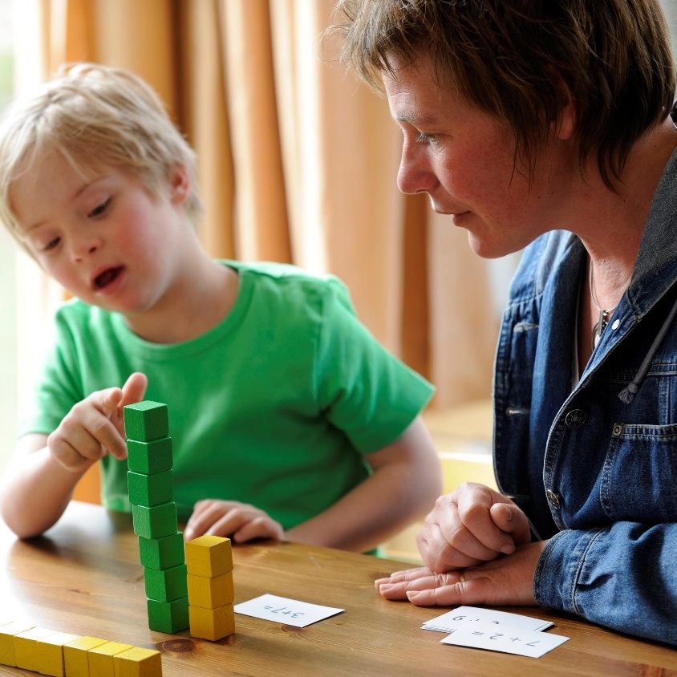
Development times implementation equals improved access and outcomes
Development of high-quality educational programming
Implementation of high-quality educational programming
Improved access and outcomes - FAPE

Slide 13
IDEA FAPE Requirements
Procedural
In the development of an IEP, has the IEP team complied with the procedures set forth in IDEA? (Rowley)
Substantive
Is the IEP reasonably calculated to enable the child to make progress that is appropriate in light of the child’s circumstances? (Endrew F.)
Implementation
In implementing the IEP, were the instructional services and supports outlined in the IEP provided as agreed on during the IEP process?
FAPE Requirements

Slide 14
Program Development: Procedural
Participation Outside Regular Education and in State and Districtwide Assessments
Present Levels of Academic Achievement and Functional Performance (PLAAFP) Statement
Monitoring Plan
Statement of Special Education and Aids and Services
Date, Frequency, Duration and Location of Services
Measurable Goals

Slide 15
Program Development: Substantive
PLAAFP Statement:
Provides an assessment and data-driven baseline
Specially designed instruction (SDI):
Addresses unique needs and ensures access to and progress in the general curriculum
Monitoring Plan:
Informs us if services are leading to progress or if changes are needed
Measurable Annual Goals: Connects to our PLAAFP Statement, SDI, and progress

Slide 16
Connecting the Parts of the IEP
PLAAFP
Annual Goals
Measuring Progress Toward Annual Goals
Date, Frequency, Duration, and Location of Services
Participation Outside Regular Education and in State and Districtwide Assessments
Statement of Special Education and Aids and Services

Slide 17
IEPs: Same Essential Ingredients but Individualized Based on Student Need

Slide 18
What good is a great IEP if it doesn’t guide implementation?

Slide 19
FAPE and Implementation
Fidelity of Implementation
Capacity to Implement

Slide 20
Implementing High-Quality Educational Programming: Building a Sustainable Ecosystem
Ongoing Teaming
Progress
Family Engagement
Effective Instruction
Educator Support
IEP
Feeling of Belonging

Slide 21
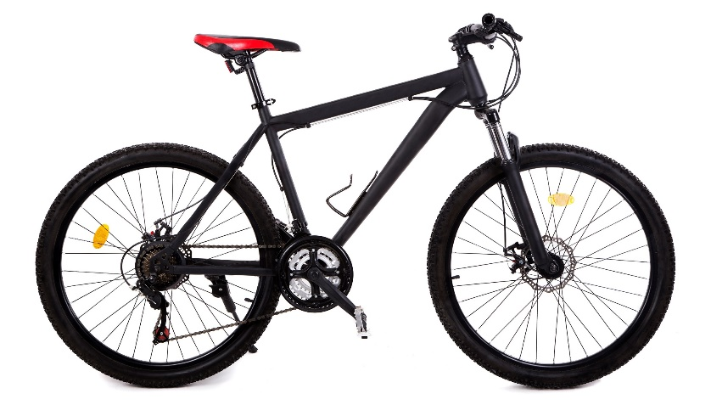
Where Do You Have The Most Challenges?
Developing high-quality educational programming that meets procedural requirements?
Developing high-quality educational programming that meets substantive requirements?
Implementing high-quality educational programming and creating a system to support implementation?

Slide 22
Per the IDEA, How Many Requirements Do All IEPs Have?
5
7
9
11
Present Levels of Academic Achievement and Functional Performance (PLAAFP)
Explanation of Education Setting
Participation in Assessment
Date, Frequency, Duration, and Location of Services
Statement of Special Education and Aids and Services
Measurable Annual Goals
Measuring Progress Toward Annual Goals
IDEA = Individuals with Disabilities Education Act.

Slide 23
Present Levels of Academic Achievement and Functional Performance (PLAAFP) Statement

Slide 24
PLAAFP Activity
Read the PLAAFP Tip Sheet on your own.
In your small groups, share 2 things that you learned or found interesting from the Tip Sheet.
Be prepared to share with the large group.

Slide 25
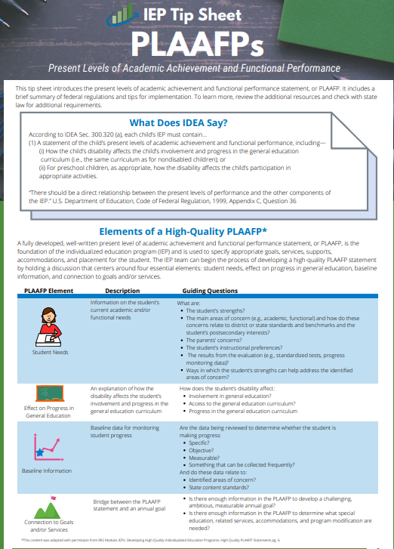
Where Do We Start? The PLAAFP Statement
(1) A statement of the child’s present levels of academic achievement and functional performance, including—
(i) How the child’s disability affects the child’s involvement and progress in the general education curriculum (i.e., the same curriculum as for nondisabled children); or
(ii) For preschool children, as appropriate, how the disability affects the child’s participation in appropriate activities.
IDEA Section 300.320(a)

Slide 26
What Is Meant by Present Levels of Academic Achievement?
“Academic achievement” generally refers to a child’s performance in academic areas. It could vary depending on a child’s circumstance or situation; therefore, a definition of academic achievement is not included in the IDEA regulations.
Academic Achievement
Writing
Science
History
Math
Reading
Source: 71 Fed. Reg. at 46662.

Slide 27
What Is Meant by Present Levels of Functional Performance?
Functional performance generally refers to activities that are not considered academic or related to a child’s academic achievement.
Functional often is used in the context of routine activities of everyday living.
What are some skills that that would be considered as “functional performance?”
Source: 71 Fed. Reg. at 46661

Slide 28
What Are Some Examples of Functional Skills?
Functional Performance
Eating
Behavior
Social Skills
Toileting
Dressing
Communication Skills
Mobility
Executive Functioning
Source: 71 Fed. Reg. at 46661

Slide 29
What If a Student Doesn’t Require Functional Annual Goals?
The PLAAFP statement must still include a statement about the student’s current functional performance and its impact on progress in the general education curriculum.
Stop and Reflect: Do your PLAAFP statements always address both academic and functional present levels?

Slide 30
What Is the Big Deal About the PLAAFP Statement?
If designed well, it prevents us from experiencing the dreaded and harmful
Assumacide is when we make decisions about programming or identify practices or supports based on our assumptions, rather than evidence.
“Assumacide”

Slide 31
What Does the U.S. Department of Education Say?
A district cannot lawfully prepare IEPs with the same statement of current levels of performance for all students in a specific program.
It is impermissible for districts to have the IEP for each student in a class/disability category contain identical statements of present levels of educational performance.
OSEP Letter, 1987 211 IDELR 464

Slide 32
Present levels and needs are not based on the disability category. They are based on the individual needs that a child experiences because of the disability.

Slide 33
Applying the Four Questions for Collective Efficacy to PLAAFP Development
What do we want for our student?
What is the child’s current reality and unique circumstances (described in PLAAFP statement)?
What does the student need to be successful (described in PLAAFP statement)?
How can we maximize our resources to support our student?

Slide 34
What Are the Four Essential Elements of a High-Quality PLAAFP?
Student Needs
Baseline Information
Effect on Progress in General Education
Connection to Goals and/or Services
This content was adapted with permission from the IRIS Center module titled IEPs: Developing High-Quality Individualized Education Programs. High-Quality PLAAFP Statements (p. 6).

Slide 35
Essential Element 1: Student Needs
Information on the student’s current academic and/or functional needs.

Slide 36
PLAAFP Example: Student Needs
Student Needs
Effect on Progress in General Education
Baseline
Connection to Goals and Services
In January 2019, G.H. was identified as a student with a learning disability in the area of math calculation. Current data, indicate that G.H. continues to need specially designed instruction in the areas of math calculation to benefit from grade level math curriculum. On recent standardized math benchmark tests conducted in January 2022, G.H. scored at the 9th percentile, which is well below average. On three standardized measures of mixed-math fact fluency administered on 2/7 and 2/8, G.H. accurately recalled, on average, 18 facts compared with grade-level expectations of 75 facts in 2 minutes. Specifically, G.H. recalled about three multiplication mixed facts (0–9), 15 addition facts (0–9), and 0 division and subtraction facts (0–9) in the 2 minutes. This affects his ability to complete sixth-grade math assignments at the same rate as his peers and efficiently use mental math calculation skills to complete word problems. To complete grade-level math assignments, G.H. currently benefits from shortened assignments, peer support, and the use of a calculator. Increasing his math fact proficiency would increase his ability to independently access and benefit from grade-level math instruction. Review of current intervention implementation data suggests that G.H. benefits from daily direct one-on-one instruction distributed across the school day. G.H. would like to graduate with his peers and attend college.

Slide 37
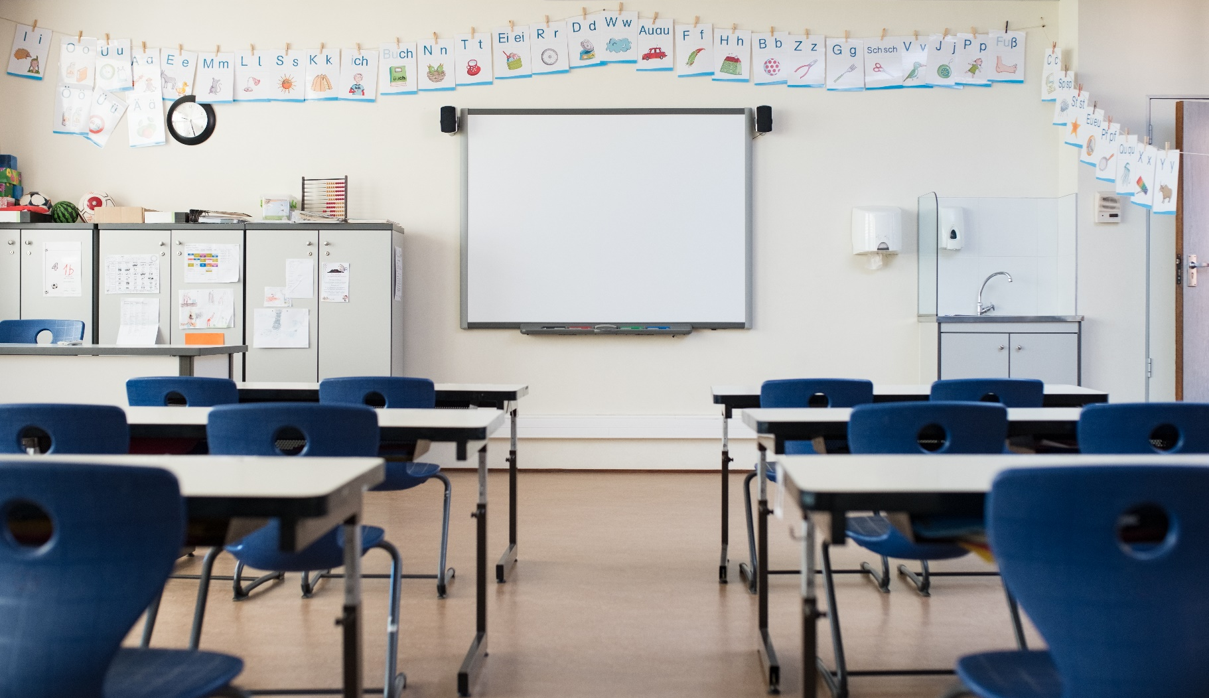
Element 2: Effect on Progress in General Education
An explanation of how the disability affects the student’s involvement and progress in the general education curriculum.

Slide 38
PLAAFP Example: Effects on Progress
Student Needs
Effect on Progress in General Education
Baseline
Connection to Goals and Services
In January 2019, G.H. was identified as a student with a learning disability in the area of math calculation. Current data, indicate that G.H. continues to need specially designed instruction in the areas of math calculation to benefit from grade level math curriculum. On recent standardized math benchmark tests conducted in January 2022, G.H. scored at the 9th percentile, which is well below average. On three standardized measures of mixed-math fact fluency administered on 2/7 and 2/8, G.H. accurately recalled, on average, 18 facts compared with grade-level expectations of 75 facts in 2 minutes. Specifically, G.H. recalled about three multiplication mixed facts (0–9), 15 addition facts (0–9), and 0 division and subtraction facts (0–9) in the 2 minutes. This affects his ability to complete sixth-grade math assignments at the same rate as his peers and efficiently use mental math calculation skills to complete word problems. To complete grade-level math assignments, G.H. currently benefits from shortened assignments, peer support, and the use of a calculator. Increasing his math fact proficiency would increase his ability to independently access and benefit from grade-level math instruction. Review of current intervention implementation data suggests that G.H. benefits from daily direct one-on-one instruction distributed across the school day. G.H. would like to graduate with his peers and attend college.

Slide 39
Element 3: Baseline Information
Baseline data for monitoring student data.
Specific
Objective
Measurable

Slide 40
PLAAFP Example: Baseline
Student Needs
Effect on Progress in General Education
Baseline
Connection to Goals and Services
In January 2019, G.H. was identified as a student with a learning disability in the area of math calculation. Current data, indicate that G.H. continues to need specially designed instruction in the areas of math calculation to benefit from grade level math curriculum. On recent standardized math benchmark tests conducted in January 2022, G.H. scored at the 9th percentile, which is well below average. On three standardized measures of mixed-math fact fluency administered on 2/7 and 2/8, G.H. accurately recalled, on average, 18 facts compared with grade-level expectations of 75 facts in 2 minutes. Specifically, G.H. recalled about three multiplication mixed facts (0–9), 15 addition facts (0–9), and 0 division and subtraction facts (0–9) in the 2 minutes. This affects his ability to complete sixth-grade math assignments at the same rate as his peers and efficiently use mental math calculation skills to complete word problems. To complete grade-level math assignments, G.H. currently benefits from shortened assignments, peer support, and the use of a calculator. Increasing his math fact proficiency would increase his ability to independently access and benefit from grade-level math instruction. Review of current intervention implementation data suggests that G.H. benefits from daily direct one-on-one instruction distributed across the school day. G.H. would like to graduate with his peers and attend college.

Slide 41
Element 4: Connection to Goals and/or Services
Bridge between the PLAAFP statement and an annual goal, service, or supports listed in the IEP.

Slide 42
PLAAFP Example: Connection to Goals & Services
Student Needs
Effect on Progress in General Education
Baseline
Connection to Goals and Services
In January 2019, G.H. was identified as a student with a learning disability in the area of math calculation. Current data, indicate that G.H. continues to need specially designed instruction in the areas of math calculation to benefit from grade level math curriculum. On recent standardized math benchmark tests conducted in January 2022, G.H. scored at the 9th percentile, which is well below average. On three standardized measures of mixed-math fact fluency administered on 2/7 and 2/8, G.H. accurately recalled, on average, 18 facts compared with grade-level expectations of 75 facts in 2 minutes. Specifically, G.H. recalled about three multiplication mixed facts (0–9), 15 addition facts (0–9), and 0 division and subtraction facts (0–9) in the 2 minutes. This affects his ability to complete sixth-grade math assignments at the same rate as his peers and efficiently use mental math calculation skills to complete word problems. To complete grade-level math assignments, G.H. currently benefits from shortened assignments, peer support, and the use of a calculator. Increasing his math fact proficiency would increase his ability to independently access and benefit from grade-level math instruction. Review of current intervention implementation data suggests that G.H. benefits from daily direct one-on-one instruction distributed across the school day. G.H. would like to graduate with his peers and attend college.

Slide 43
Sample PLAAFP Statement Structure With Key Ingredients
Data from [includes source] indicate Student [performs in this way—objective data] _______________ which affects _________________ [must include impact on involvement and progress in the general education curriculum]. As a result, he needs _____________________ [justifies proposed services and supports].

Slide 44
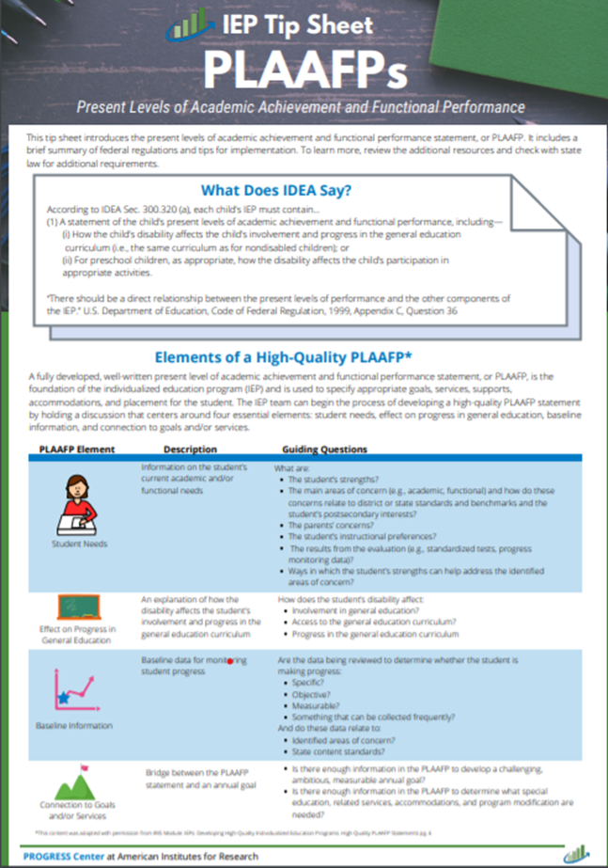
Tips for Developing PLAAFP Statements
Address all of the student’s educational needs identified in the evaluation.
Include a description of changes in student functioning since the last IEP was developed.
Include objective, measurable data to describe current performance.
Explain how specific accommodations and modifications are needed and will be used by the student.

Slide 45
Tips for Developing PLAAFP Statements 2
Structure the baseline statement using the same structure as the annual goal.
Compare the student’s baseline performance to grade-level expectations.
Include administration dates and names of measurement tools to the extent possible.

Slide 46
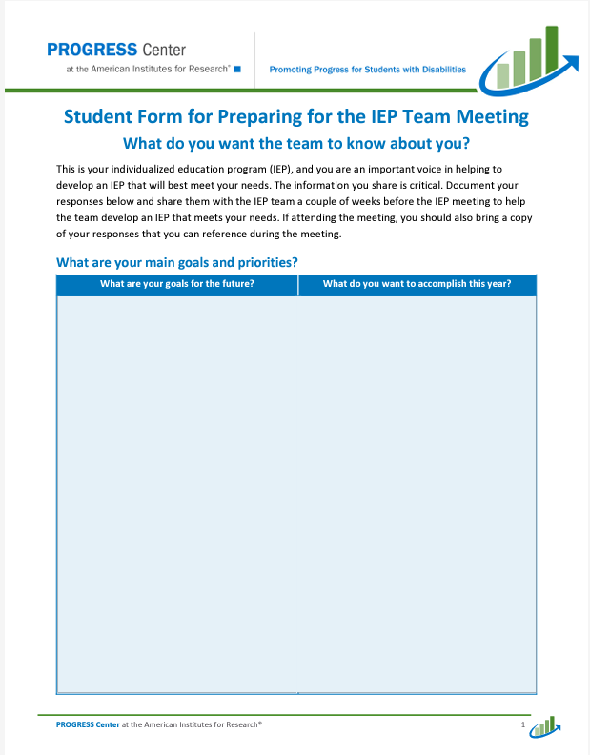
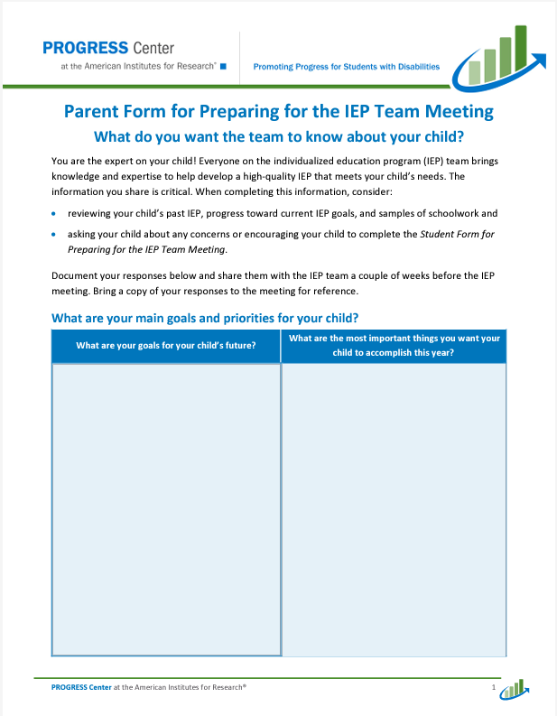
The Power of Teams to Develop High-Quality PLAAFP Statements
Tip for PROGRESS!
Collect and summarize data for the development of the PLAAFP statement prior to the IEP meeting to help facilitate more robust discussion.

Slide 47
Connecting the PLAAFP to the Parts of the IEP
PLAAFP
Annual Goals
Measuring Progress Toward Annual Goals
Date, Frequency, Duration, and Location of Services
Participation Outside Regular Education and in State and Districtwide Assessments
Statement of Special Education and Aids and Services
“There should be a direct relationship between the present levels of performance and the other components of the IEP. Thus, if the statement describes a problem with the child’s reading level and points to a deficiency in reading skills, the problem should be addressed under both goals and specific special education and related services provided to the child.” [U.S. Department of Education, Code of Federal Regulations, 1999, Appendix C, Question 36. emphasis added]

Slide 48
What Is On Your Mind?

Slide 49
BREAK!
10 minutes

Slide 50
Statement of Services and Aids

Slide 51
Remember!
All students are general education students first.
Some students require special education aids and services to access and benefit from general education similarly to their peers.

Slide 52
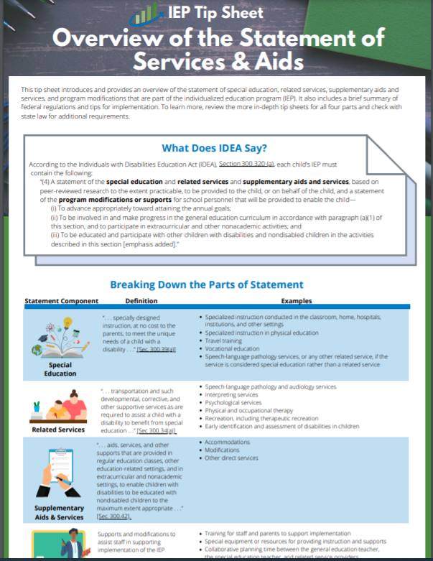
What Does IDEA Say About the Statement of Services and Aids?
According to IDEA, Section 300.320 (a), each child’s IEP must contain the following:
“(4) A statement of the special education and related services and supplementary aids and services, based on peer-reviewed research to the extent practicable, to be provided to the child, or on behalf of the child, and a statement of the program modifications or supports for school personnel that will be provided to enable the child—… ″
IDEA, Sec. 300.320(a)(4), emphasis added

Slide 53
What Does IDEA Say About the Statement of Services and Aids? Cont.
“(i) To advance appropriately toward attaining the annual goals;
(ii) To be involved in and make progress in the general education curriculum in accordance with paragraph (a)(1) of this section, and to participate in extracurricular and other nonacademic activities; and
(iii) To be educated and participate with other children with disabilities and nondisabled children in the activities described in this section.” [emphasis added]
IDEA, Sec. 300.320(a)(4), emphasis added

Slide 54
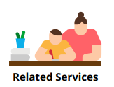
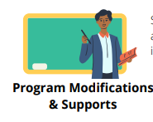
Let’s break down the statement of services and aids

Slide 55
Special Education = SDI
(3) Specially designed instruction means adapting, as appropriate to the needs of an eligible child under this part, the content, methodology, or delivery of instruction—
(i) To address the unique needs of the child that result from the child’s disability; and
(ii) To ensure access of the child to the general curriculum, so that the child can meet the educational standards within the jurisdiction of the public agency that apply to all children.
IDEA, Sec. 300.39, emphasis added

Slide 56
Key Considerations for SDI
What it Is | What it Isn’t
A service to increase access to and benefit from core instruction How or what the teacher teaches Intentionally designed and linked to the student’s needs in the PLAAFP statement and goals Instruction designed and adapted based on individual student data | Something you can purchase (but it can use a purchased program) A place (e.g., special class, co-teaching) Actions the student takes The same for all students in a resource setting or with a disability by default An accommodation or other supplementary aid or service
Adapted from Utah’s Guidance on Specially Designed Instruction

Slide 57
Related Services
“Related services means transportation and such developmental, corrective, and other supportive services as are required to assist a child with a disability to benefit from special education, and includes speech-language pathology and audiology services, interpreting services, psychological services, physical and occupational therapy, recreation, including therapeutic recreation, early identification and assessment of disabilities in children, counseling services, including rehabilitation counseling, orientation and mobility services, and medical services for diagnostic or evaluation purposes.
IDEA Sec. 300.34, emphasis added

Slide 58
Supplementary Aids and Services
“Supplementary aids and services means aids, services, and other supports that are provided in regular education classes, other education-related settings, and in extracurricular and nonacademic settings, to enable children with disabilities to be educated with nondisabled children to the maximum extent appropriate...”
IDEA Sec. 300.42, emphasis Added.

Slide 59
Did You Know?
The purpose of modifications or accommodations is to increase ACCESS to the general curriculum that a child, because of the disability, can not access alone.
Under IDEA, an accommodation or modification is not sufficient for progress. These should be paired with specially designed instruction, to the extent appropriate, to reduce the need for these supplementary aids and services.

Slide 60
Program Modifications & Supports
(4) . . . a statement of the program modifications or supports for school personnel that will be provided to enable the child—
(i) To advance appropriately toward attaining the annual goals;
(ii) To be involved in and make progress in the general education curriculum in accordance with paragraph (a) (1) of this section, and to participate in extracurricular and other nonacademic activities; and
(iii) To be educated and participate with other children with disabilities and nondisabled children in the activities described in this section.”
IDEA Sec. 300.320 (a), emphasis Added

Slide 61
Same Need, Same Goal, Different Aids and Services
6th grade student with a learning disability that impacts the student’s ability to decode and fluently read connected text.
Type of Service | Sample Proposed Services
SDI | Daily 30-minute direct instruction in phonics and reading fluency taught by the special education teacher
Related Service | Speech services to address disfluency/stutter impacting fluent reading of connected text
Supplementary | Access to audio books or peer reader in the classroom
Program modifications and supports for staff | Special education teacher’s participation in training on a specific reading program required for implementation of SDI

Slide 62
Same Need, Same Goal, Different Services
9th grade student with an other health impairment that impacts the student’s ability to attend and to manage sensory input.
Type of Service | Sample Proposed Services
SDI | Daily, 15-min explicit instruction on cognitive and metacognitive strategies to increase stamina and ability to independently regulate behaviors.
Related Service | Occupational therapy (OT) to provide sensory integration therapy 30-minutes weekly.
Supplementary | Use of noise canceling headphones, wobble cushion for seat, shortened assignments
Program modifications and supports for staff | Collaborative planning time for OT, general education teacher, and special education teacher to plan appropriate sensory activities in special and general education environments.

Slide 63
Connecting the Statement of Services and Aids to the Parts of the IEP
PLAAFP
Annual Goals
Measuring Progress Toward Annual Goals
Date, Frequency, Duration, and Location of Services
Participation Outside Regular Education and in State and Districtwide Assessments
Statement of Special Education and Aids and Services

Slide 64
What Is On Your Mind? 2

Slide 65
Break! 2
5 minutes

Slide 66
Measurable Annual Goals

Slide 67
Measurable Annual Goals & Goal Setting
(i) A statement of measurable annual goals, including academic and functional goals designed to—
(A) Meet the child’s needs that result from the child’s disability to enable the child to be involved in and make progress in the general education curriculum; and
(B) Meet each of the child’s other educational needs that result from the child’s disability;
(ii) For children with disabilities who take alternate assessments aligned to alternate academic achievement standards, a description of benchmarks or short-term objectives;
IDEA Section 300.320(a)(2)

Slide 68
Did You Know?
A single goal can address multiple needs!

Slide 69
How Should Our Team Start Writing a Goal?
Start with the academic and functional needs identified in the PLAAFP statement.
Identify the needed skills to access and progress in grade level standards.
Discuss what the student should be able to achieve during the next 12 months.
Develop an individualized, ambitious, but attainable goal.

Slide 70
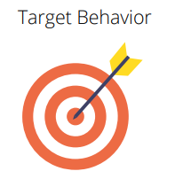
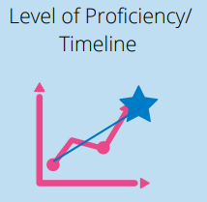
What Are the Three Essential Elements of Measurable Annual Goals?
Measurable

Slide 71
What’s Missing?: Academic Goal
Academic goals should focus on skills necessary for the students to access and benefit from general education instruction that is aligned with state standards.
Revised Goal: Given a third-grade reading passage, Doug will read 90 words read correctly in 1 minute with 95% accuracy on three consecutive probes.
Draft Goal: Given a third-grade reading passage, Doug will read 90 words read correctly per minute.
Essential Element of Goals
Condition
Target Behavior
Level of proficiency/ timeline

Slide 72
What’s Missing? Functional Goal
Functional goals should increase access, participation, and/or independence in the general education curriculum or setting.
Revised Goal: During each 40-minute class period, José will remain academically engaged at least 70% of the class for five consecutive days as monitored by Direct Behavior Ratings. ​
Draft: José will pay attention and be engaged.
Essential Element of Goals
Condition
Target Behavior
Level of proficiency/ timeline

Slide 73
Caution: Goals That Are Not Measurable Cont.
Is it measurable?
Carefully consider the words you use in goals and make sure they can be measured.
If you can’t graph it, it is not measurable.
Can it pass the stranger test? Could other educators, the parent, or the student know if the goal has been achieved.
Percentages by themselves are meaningless.

Slide 74
Most Importantly, Keep Your Annual IEP Goals FAIR
Feasible | Is the goal appropriately ambitious given the students unique circumstances? Can the goal realistically be achieved during the school year reflected in the IEP?
Acceptable | Is the goal acceptable to the student, family, and educators on the IEP team?
Impactful | Will achieving the goal, positively impact the student access and benefit from the general curriculum and other educational outcomes?
Relevant | Does the goal connect to a meaningful outcome for the student and his or her family?
Adapted from the National Center for Systemic Improvement https://ncsi-library.wested.org/resources/732

Slide 75
We Must Continue to Ask Ourselves:
Are the goals we write adequate and appropriate to determine effectiveness of our special education services?

Slide 76
Connecting the Goals to the Parts of the IEP
PLAAFP
Annual Goals
Measuring Progress Toward Annual Goals
Date, Frequency, Duration, and Location of Services
Participation Outside Regular Education and in State and Districtwide Assessments
Statement of Special Education and Aids and Services

Slide 77
What Is On Your Mind? 3

Slide 78
Bringing It Together

Slide 79
Bringing it Together Activity: Elevator Pitch
How would you explain to a co-worker in a minute or less how all parts of the IEP fit and work together?
Take turns in your small group sharing your elevator pitch.
Be prepared to share with the larger group.

Slide 80
Connecting the Parts of the IEP Revisited
PLAAFP
Annual Goals
Measuring Progress Toward Annual Goals
Date, Frequency, Duration, and Location of Services
Participation Outside Regular Education and in State and Districtwide Assessments
Statement of Special Education and Aids and Services

Slide 81
Four Big Takeaways
Clarifying student needs in the PLAAFP statement is critical for the development of a high-quality IEP.
02
Proposed services and aids should address all of the student needs in the PLAAFP statement.
03
Goals should focus on knowledge or skills the student needs to develop to access and progress in the general curriculum.
04
IDEA outlines seven requirements in all IEPs.
01

Slide 82
Where Can I Learn More?

Slide 83
Find Additional Resources and Connections with PROGRESS Center
https://www.facebook.com/k12PROGRESS/
https://twitter.com/K12PROGRESS
https://promotingprogress.org/news/connect-progress-center
www.promotingPROGRESS.org

Slide 84
Tip Sheet Series
Includes Tip Sheets of all the required sections of the IEP.
They include—
brief summaries of federal regulations
tips for implementation
resources

Slide 85
Self-Paced Training Modules

Slide 86
Dr. David Bateman, PROGRESS Center Advisor

Slide 87
Staying Connected With the PROGRESS Center
Connect to us on Facebook and Twitter @k12progress
https://promotingprogress.org/news/connect-progress-center

Slide 88
Disclaimer
This material was produced under the U.S. Department of Education, Office of Special Education Programs, Award No. H326C190002. David Emenheiser serves as the project officer. The views expressed herein do not necessarily represent the positions or policies of the U.S. Department of Education. No official endorsement by the U.S. Department of Education of any product, commodity, service, or enterprise mentioned in this presentation is intended or should be inferred.

