Slide 1
PROGRESS Center Private School Forum
Classroom Behavior Supports for Promoting PROGRESS in Private School
August 29, 2023

Slide 2
Welcome to the PROGRESS Center!
The PROGRESS Center provides information, resources, tools, and technical assistance services to support local educators in developing and implementing high-quality educational programs that enable children with disabilities to make progress and meet challenging goals.
HOW WILL WE HELP IMPROVE OUTCOMES FOR STUDENTS WITH DISABILITIES?
Share current research,
policies, guidance, success stories, and experiences from students, parents, educators, and
other stakeholders.
Partner with selected
local educators to develop and implement high-quality educational programs.​
Provide tools, resources, and
training materials for ALL educators, leaders, and families.
Visit us at www.promotingPROGRESS.org to learn more!
≈

Slide 3
Event Outcomes
Increase knowledge focused on classroom management in the areas of setting clear expectations, behavior specific praise, opportunities to respond and intensifying supports for all learners in the classroom setting.
Hear experiences of practitioners in the private and non-public school settings on their experiences about promoting progress for students with disabilities.
Share freely available tools and resources from federally funded Centers to support classroom management and behavioral supports.

Slide 4
Classroom Management
August 2023
Creating Classroom Environments That Cultivate Community and Learning
Caitlyn Majeika, PhD

Slide 5
Welcome!

Slide 6
Who’s in the Room?
Share the following in the chat:
What is your name, location, and role?
What is your familiarity/comfort with classroom management strategies?
0 | 1 | 2 | 3 | 4
None | Very Little | Somewhat | Pretty Good | I Got This!
6

Slide 7
Agenda
Setting the Stage
Understanding Behavior
Classroom Management Tips
Strategy 1: Setting Clear Behavioral Expectations
Strategy 2: Behavior-Specific Praise
Strategy 3: Opportunities to Respond
Learners With More Intensive Needs
Additional Resources and Wrap Up

Slide 8
Setting the Stage

Slide 9
What Is Your “Why”?
Take a moment to reflect on your “why.”

Slide 10
Purpose
Strong classroom management improves access to and enhances benefit from the general curriculum for students with disabilities.

Slide 11
Classroom Management

Slide 12
What Word First Comes to Mind When You Hear “Classroom Management”?
Type your response in the chat.

Slide 13
What Is Classroom Management?
Classroom management is
a system to create an environment that facilitates learning,
a framework for teacher behavior, and
a way to benefit all learners, especially those with disabilities.
Classroom management is not
rewards, tangibles, bribes;
a way to control or punish students;
sticks and carrots;
needed only in specific settings or types of schools (e.g., public); or
only for students with disabilities.

Slide 14
Who Is Classroom Management Important For?
Teachers
Shapes teacher behavior
Helps teachers create a structured environment
Makes expectations explicit
Students
Provides a predictable environment with clear expectations
Cultivates a positive environment
Facilitates access to instruction

Slide 15
Who Is Classroom Management Important For?
Teachers
Shapes teacher behavior
Helps teachers create a structured environment
Makes expectations explicit
Students
Provides a predictable environment with clear expectations
Cultivates a positive environment
Facilitates access to instruction
Students with disabilities particularly benefit from a structured, predictable environment that promotes access to the general curriculum.
Notes:
Add something SWDs

Slide 16
How Can Classroom Management Cultivate a Classroom Community?
Sets students up for success in learning.
Creates structure for all students, including those with disabilities.
Uses student voice and perspectives to create expectations.
Provides opportunities for students to build positive relationships with adults and peers.

Slide 17
Understanding Behavior

Slide 18
Behavior Is Learned
Do not assume that children know the rules, expectations, or social skills in your setting.
Every social interaction you have with a child teaches the child something.
Notes:
The most basic concept in behavior is that it is learned.
Read the slide.

Slide 19
Three-Term Contingency
A
B
C
Antecedent
Behavior
Consequence
Notes:
Let’s review the three-term contingency. The three-term contingency helps to put behavior in context by describing the relationship among a behavior, the events immediately preceding it, the consequences following it, and the environmental context. The three-term contingency is sometimes referred to as the ABCs of behavior or the ABC model. Antecedent, Behavior, Consequence. We will look at each element of the contingency.

Slide 20
Why Does This Matter?
Antecedents and consequences can be changed as part of your classroom management plan to help reduce problem behavior and increase prosocial behavior.
A
B
C
Antecedent
Behavior
Consequence
Notes:
Read the slide.

Slide 21
Today’s Classroom Management Tips
A
B
C
Antecedent
Behavior
Consequence
Notes:
Read the slide.
Send Sara links to and slides when presenting. Slide # and link.

Slide 22
Strategy 1: Setting Clear Behavioral Expectations

Slide 23
What Are Behavioral Expectations?
Statements of behaviors you expect all students to engage in
Class-wide behavioral expectations should
be linked to school-wide expectations,
be stated positively, and
include a list of three to five definitions.

Slide 24
Why Are Expectations Important?
“Classroom management makes seen your unseen expectations.”
—Linda Thompson

Slide 25
Examples of Positive Expectations
Elementary level
Use materials in the way they are supposed to be used.
Stay in your area.
Be respectful to other students by keeping your body, hands, and feet to yourself.
Secondary level
Be responsible and complete work as expected.
Use appropriate and respectful language when speaking with teachers and peers.
Arrive to class on time and with all materials.

Slide 26
Considerations for Setting Behavioral Expectations
Explain the purpose for setting expectations.
Create expectations with students, keeping the needs of students with disabilities in mind.
Consider elements of intersection of disability, race, ethnicity, culture, and community.
Make clear to students that behavioral expectations vary by setting/context.
Share examples of how behavior may differ in various contexts.
Teach, model, and reinforce expectations multiple times!

Slide 27
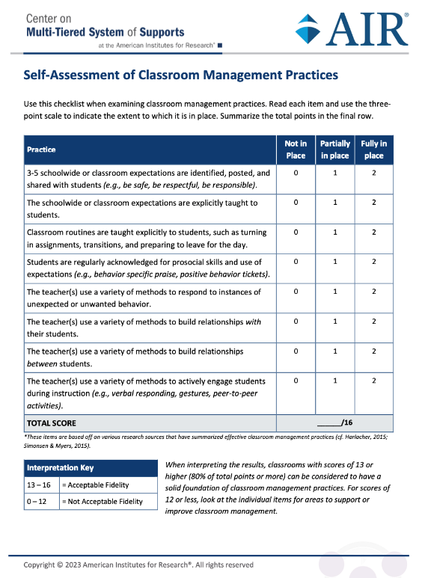
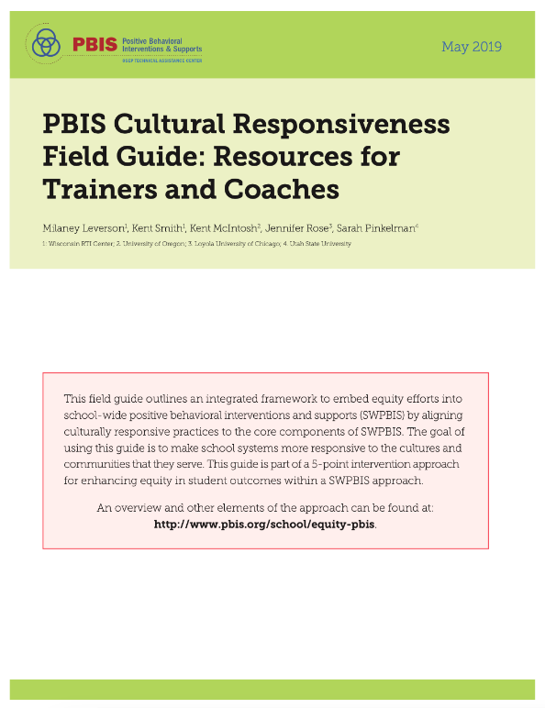
Resources
Center on Multi-Tiered System of Supports (MTSS)
https://mtss4success.org/resource/self-assessment-classroom-management
National Center on Intensive Intervention (NCII)
https://intensiveintervention.org/antecedent-and-instructional-strategies-behavior-course
Center on Positive Behavioral Interventions & Supports (PBIS)
https://www.pbis.org/resource/pbis-cultural-responsiveness-field-guide-resources-for-trainers-and-coaches

Slide 28
Strategy 2: Behavior-Specific Praise

Slide 29
What Is Positive Reinforcement?
Reinforcement increases behavior
Positive reinforcement: adding something pleasant or desirable to make a target behavior more likely to occur

Slide 30
Why Is Behavior-Specific Praise Important?
Positively acknowledges the expected and appropriate behavior in which a student engaged
Behavior-specific praise | Nonspecific statements
Great job bringing materials for class. Thank you for keeping your hands and feet to yourself. Nice work turning in your work on time. Yes! That is the way we walk down the hall. Well done sharing your computer during centers. | Great job. Thank you. Nice. Yes! Well done!

Slide 31
Why Is Behavior-Specific Praise Important?
Acknowledges when students engage in behavioral expectations
Clarifies when student behavior aligns with expectations
Helps establish 4:1 praise-to-reprimand ratio
Cultivates a positive learning environment

Slide 32
Considerations for Behavior-Specific Praise
Ensure that praise is developmentally and age appropriate.
Ensure that praise matches student preferences.
Some students may want verbal praise, whereas others may not.
Some students may want praise in front of other students, whereas others may prefer that it be delivered in private.
Modify delivery of praise as needed for students with disabilities.

Slide 33
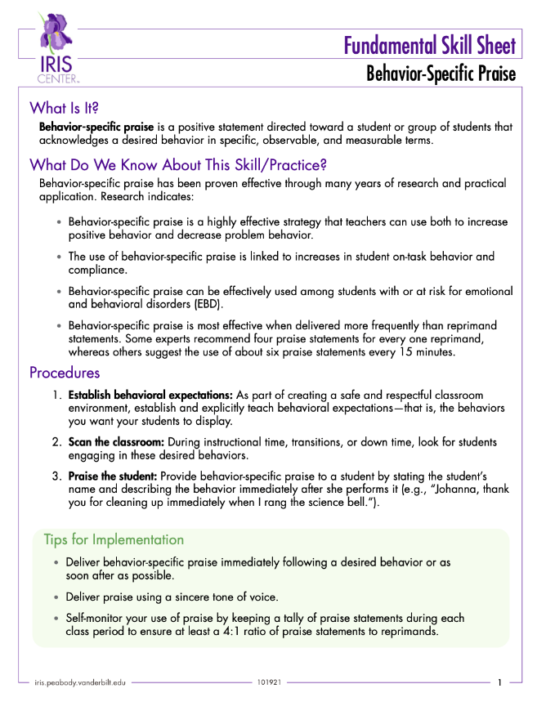
Resources
IRIS Center
https://iris.peabody.vanderbilt.edu/wp-content/uploads/misc_media/fss/pdfs/2018/fss_behaviro_specific_praise.pdf

Slide 34
Strategy 3: Opportunities to Respond

Slide 35
What Is an “Opportunity to Respond”?
An opportunity to respond is a question, statement, or prompt that solicits a student response.
Student responses can be verbal or nonverbal.
Examples:
Sarah, what is the name of this element?
Raise your hand if you agree with this statement.
Write your answer on your mini whiteboard and hold it up.
Turn and talk with a peer.
Answer this Kahoot! poll.

Slide 36
Why Are Opportunities to Respond Important?
“An engaging lesson is one of the most effective classroom management plan[s].”
—Kim Paulsen

Slide 37
Considerations for Opportunities to Respond
Vary the type of opportunities to respond used throughout each lesson.
Offer opportunities to the whole class (“Raise your hand if…”) or an individual student (“Min, can you…”).
Use opportunities as formative assessments.
Use response types that accommodate the needs of students with disabilities.

Slide 38
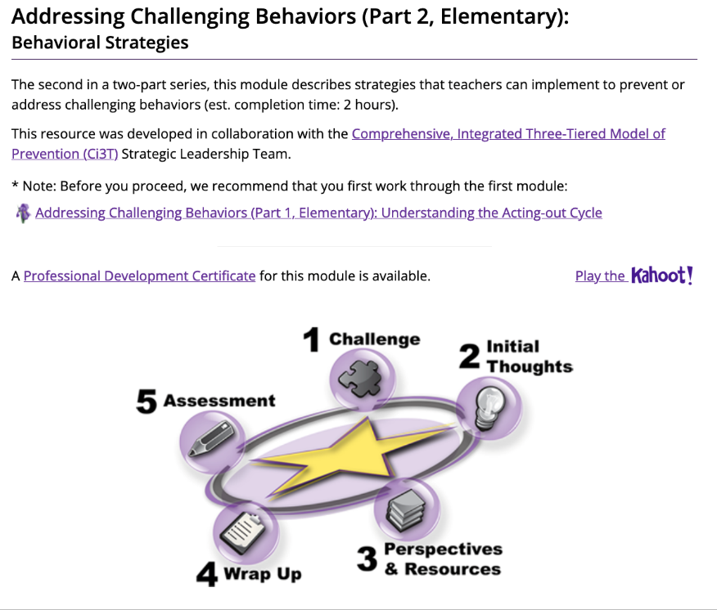
Resources for Opportunities to Respond
Center on MTSS
https://mtss4success.org/resource/assessment-opportunities-respond
IRIS Center
https://iris.peabody.vanderbilt.edu/module/bi2-elem/cresource/q1/p06/

Slide 39
Learners With More Intensive Needs

Slide 40
What If Students Need More?
No one strategy or system is going to be 100% effective for all students on all days.

Slide 41
More Intensive Classroom Management Strategies
Class-wide supports
Token economy
Class-wide function-based intervention teams (CW-FITs)
Good behavior game
Individual student support
Adult mentor
Peer buddy
Check-in, check-out
Social skills lessons

Slide 42
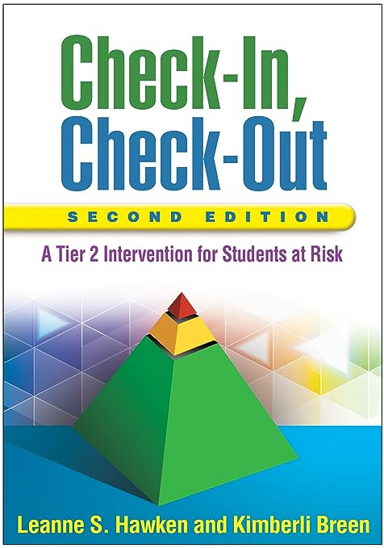
Resources
CW-FIT
https://cwfit.ku.edu/

Slide 43
Additional Resources

Slide 44
Center on MTSS: Self-Assessment of Classroom Management Practices
https://mtss4success.org/resource/self-assessment-classroom-management

Slide 45
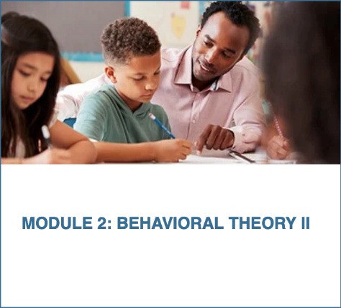
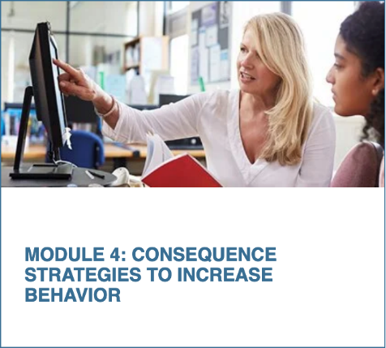
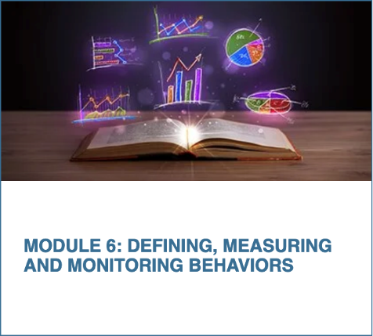
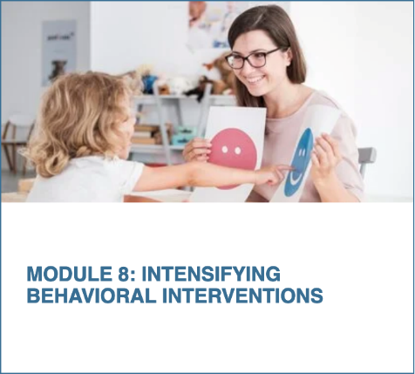
NCII: Behavior Support for Intensive Intervention
An eight-module course focused on enhancing educators’ skills in behavior support for intensive intervention
https://intensiveintervention.org/training/course-content/behavior-support-intensive-intervention
45

Slide 46
Wrap Up

Slide 47
What Is One Thing That Stuck With You From Today’s Session?
Type your response in the chat.

Slide 48
Questions

Slide 49
49

Slide 50
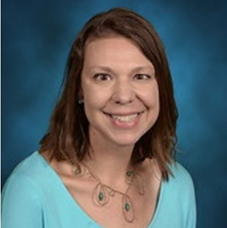
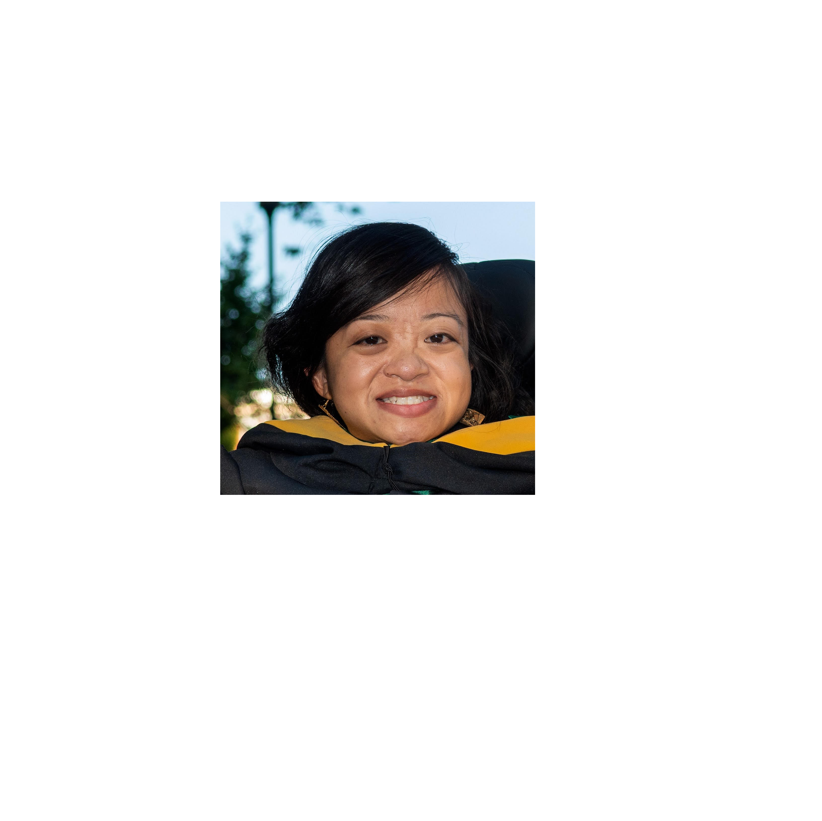
Panel Presentation: Educators in Residence
Dr. Kara Bratton
Erin Rupe
Andrea Bergener
Gabi Aragon
Assistant Professor in the School of Education, Concordia University Irvine
Michigan
kara.bratton@cui.edu
Middle School Learning Support Specialist
Colorado
erupe@sesden.org
Math Specialist
Texas
abergener@popschool.net
Student Support Specialist
Texas
garagon@staustinschool.org

Slide 51
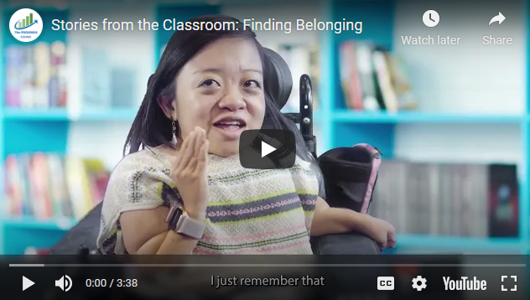
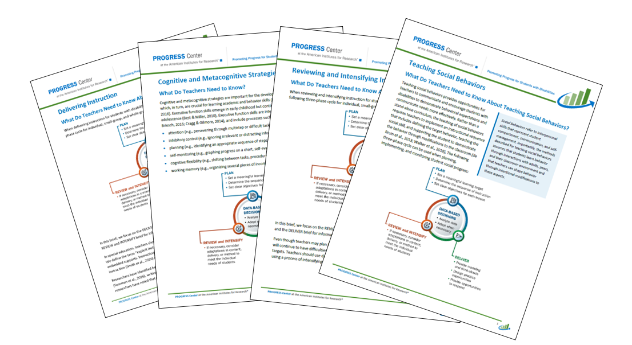
PROGRESS Resources to Promote Progress

Slide 52
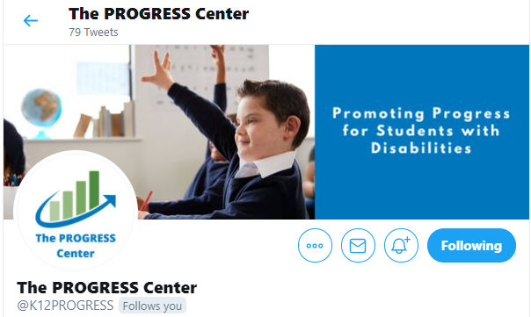
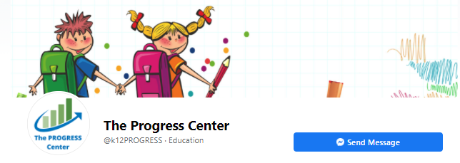
Staying Connected With the PROGRESS Center
Connect with us on Facebook and Twitter @k12progress
https://promotingprogress.org/news/connect-progress-center

Slide 53
Disclaimer
This material was produced under the U.S. Department of Education, Office of Special Education Programs, Award No. H326C190002. David Emenheiser serves as the project officer. The views expressed herein do not necessarily represent the positions or policies of the U.S. Department of Education. No official endorsement by the U.S. Department of Education of any product, commodity, service, or enterprise mentioned in this presentation is intended or should be inferred.

