Slide 1
Special Educator Preparation:
Promising Strategies to Promote Recruitment and Retention
September 2023
22623_09/23
Notes:
For the best results, use high resolution (300 ppi), square images or ones where the “action” is to the right of center.
Delete existing images and reset the slide layout if needed, rather than replacing an existing image.
Insert a new image
Click the picture icon in the center of an empty picture placeholder to open the Insert Picture dialog.
Navigate to the folder that contains the desired image, and
Double-click on the image.
If the placeholder becomes an oval, click on the Reset icon in the Slides group of the Home menu.
To zoom in on another portion of the image
Right click on the image, and choose Crop from the context menu.
Zoom out the slide view so that the entire image, especially the white "handles" at the corners of the image, is visible in the main PPT window.
With the mouse, click and drag one of the handles to resize the image.
To shift the focal point of an image
Right click on the image, and choose Crop from the context menu.
When the mouse pointer is a four-headed arrow, click and drag the image to a new position.
The image on this slide is only to assess final appearance and placement and must be replaced by a purchased image. For assistance with purchasing photos or art, please contact Martha Mater, Pubs Creative Services Manager, at mmater@air.org, 301-592-3329.

Slide 2
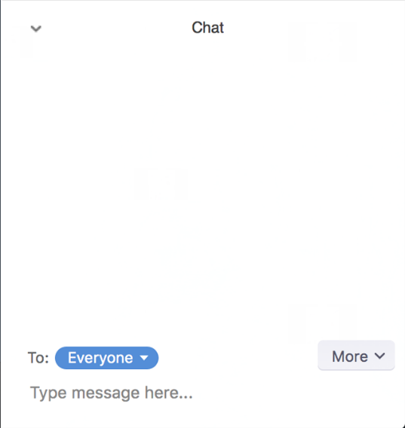
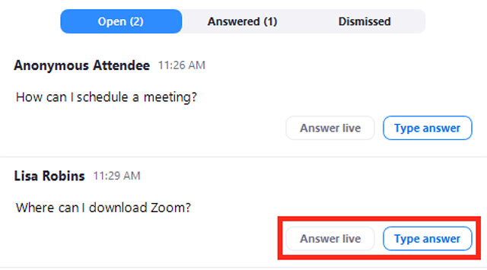
Webinar Format and Questions
Throughout the presentation,
Submit any questions into the Q&A box.
For technical issues and questions, a webinar team member will try to assist you as soon as possible.
For content questions, we will answer your questions directly or include them within the Q&A discussion with panelists toward the end of the event.
Use the Chat for any comments or reactions.
Closed captioning is available. Click on CC in your tool bar if desired.
Notes:
Throughout the presentation, you are free to submit any comments or questions related to today’s content.
Please submit any questions into the Q&A box, which can be accessed by clicking on the Q&A icon. This is only visible to the presenters.
For technical issues/questions, a webinar team member will try to assist you as soon as possible.
For content questions, we will answer your questions directly or include them in the Q&A at the end of the event. Although we will try to get to all the questions, due to time, we may not be able to get to everyone’s. Please note that we will only be able to respond to those questions that are related to today’s content.
Please use the Chat for any comments or reactions and note that everyone can see what you post.
Closed captioning is available. Click on CC in your tool bar if desired.
We will be starting the formal recording now.

Slide 3
Where are you from?
Share in the Chat!

Slide 4
Recording Notice
The American Institutes for Research (AIR) allows for the recording of audio, visuals, participants, and other information sent, verbalized, or utilized during business-related meetings. By joining a meeting, you automatically consent to such recordings. Any participant who prefers to participate via audio only should disable their video camera so that only their audio will be captured. Video and/or audio recordings of any AIR session shall not be transmitted to an external third party without permission.

Slide 5
Special Educator Preparation:
Promising Strategies to Promote Recruitment and Retention
September 2023
XXXXX_MO/22
Notes:
For the best results, use high resolution (300 ppi), square images or ones where the “action” is to the right of center.
Delete existing images and reset the slide layout if needed, rather than replacing an existing image.
Insert a new image
Click the picture icon in the center of an empty picture placeholder to open the Insert Picture dialog.
Navigate to the folder that contains the desired image, and
Double-click on the image.
If the placeholder becomes an oval, click on the Reset icon in the Slides group of the Home menu.
To zoom in on another portion of the image
Right click on the image, and choose Crop from the context menu.
Zoom out the slide view so that the entire image, especially the white "handles" at the corners of the image, is visible in the main PPT window.
With the mouse, click and drag one of the handles to resize the image.
To shift the focal point of an image
Right click on the image, and choose Crop from the context menu.
When the mouse pointer is a four-headed arrow, click and drag the image to a new position.
The image on this slide is only to assess final appearance and placement and must be replaced by a purchased image. For assistance with purchasing photos or art, please contact Martha Mater, Pubs Creative Services Manager, at mmater@air.org, 301-592-3329.

Slide 6
Agenda
Time ET | Activity
1:00-1:10 pm | Welcome and Opening Remarks Tessie Bailey, Ph.D., PROGRESS Center Director David Emenheiser, Ed.D., OSEP Project Officer
1:10-2:10 pm | Special Education Preparation: Recent Research Roddy Theobald, Ph.D., Center for Analysis of Longitudinal Data in Education Research Elizabeth Bettini, Ph.D., Boston University Allison Gilmour, Ph.D., American Institutes for Research Melinda Leko, Ph.D., University of Florida
2:10-2:50 pm | Retaining Special Education Personnel at All Levels: Georgia’s Approach Lynn Holdheide, M.Ed., American Center on Great Teachers and Leaders and CEEDAR Center Amy Colpo, M.P.P., American Center on Great Teachers and Leaders and CEEDAR Center Wina Low, Ed.S., Georgia Department of Education State Director Katherine Johnson, Ph.D., Georgia Department of Education Program Manager
2:50-3:00 pm | PROGRESS Resources and Closing Remarks Amy Peterson, M.Ed., PROGRESS Universal Technical Assistance Lead Tessie Bailey, Ph.D., PROGRESS Center Director
First Column: Time ET
Second Column: Activity
1:00-1:10 pm
Welcome and Opening Remarks
Tessie Bailey, Ph.D., PROGRESS Center Director
David Emenheiser, Ed.D., OSEP Project Officer
1:10-2:10 pm
Special Education Preparation: Recent Research
Roddy Theobald, Ph.D., Center for Analysis of Longitudinal Data in Education Research
Elizabeth Bettini, Ph.D., Boston University
Allison Gilmour, Ph.D., American Institutes for Research
Melinda Leko, Ph.D., University of Florida
2:10-2:50 pm
Retaining Special Education Personnel at All Levels: Georgia’s Approach
Lynn Holdheide, M.Ed., American Center on Great Teachers and Leaders and CEEDAR Center
Amy Colpo, M.P.P., American Center on Great Teachers and Leaders and CEEDAR Center
Wina Low, Ed.S., Georgia Department of Education State Director
Katherine Johnson, Ph.D., Georgia Department of Education Program Manager
2:50-3:00 pm
PROGRESS Resources and Closing Remarks
Amy Peterson, M.Ed., PROGRESS Universal Technical Assistance Lead
Tessie Bailey, Ph.D., PROGRESS Center Director

Slide 7
Objectives
During the event, presenters will share:
recent research about recruitment, preparation, and retention of special education teachers.
a Georgia partnership and guidance promoting recruitment, preparation, and retention for educators supporting students with disabilities.
practice-based resources to build the knowledge and capacity of special educators developing and implementing high-quality educational programming.

Slide 8
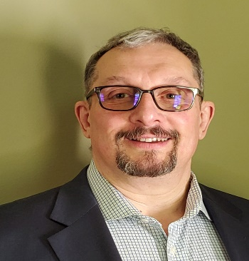
Welcome Introductions
Tessie Bailey, PhD, Project Director, PROGRESS Center, American Institutes for Research
David Emenheiser, PhD, PROGRESS Center Project Officer, Office of Special Education Programs, U.S. Department of Education

Slide 9
How do we ensure that every student is on the path to PROGRESS?
Progress

Slide 10
Welcome to the PROGRESS Center!
The PROGRESS Center provides information, resources, tools, and technical assistance services to support local educators in developing and implementing high-quality educational programs that enable children with disabilities to make progress and meet challenging goals.
HOW WILL WE HELP IMPROVE OUTCOMES FOR STUDENTS WITH DISABILITIES?
Share current research, policies, guidance, success stories, and experiences from students, parents, educators, and other stakeholders.
Partner with selected local educators to develop and implement high-quality educational programs.
Provide tools, resources, and training materials for ALL educators, leaders, and families.
Visit us at www.promotingPROGRESS.org to learn more!
Share current research,
policies, guidance, success stories, and experiences from students, parents, educators, and
other stakeholders.
Partner with selected
local educators to develop and implement high-quality educational programs.​
Provide tools, resources, and
training materials for ALL educators, leaders, and families.

Slide 11
Implementing High-Quality Educational Programming: Building a Sustainable Ecosystem
Ongoing Teaming
Progress
Family Engagement
Effective Instruction
Educator Support
IEP
Belonging
Notes:
As noted in the formula, it takes both development and implementation to help us on the path to progress. Although it is very possible that we will hit hills, roadblocks, or potholes along the way, we can be prepared for these obstacles. We can ensure our riders, or staff, are well trained and have the necessary skills, knowledge, and support from leaders to prevent or respond to potential challenges, implement effective instruction and services, collect and analyze data, and work collaboratively with families and other educators to problem-solve and readjust as needed.
If you think about it, just like a bicycle, the quality of the program will determine how much progress is made. If it is missing parts or is not put together well, we will struggle, we will have more stops and starts, and it will be more costly.

Slide 12
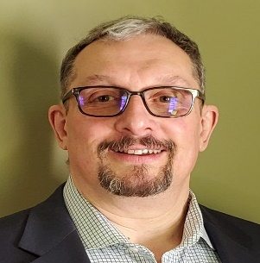
Welcome from David Emenheiser
David Emenheiser, PhD,
PROGRESS Center Project Officer, Office of Special Education Programs, U.S. Department of Education

Slide 13
Special Education Preparation: Recent Research

Slide 14
Jamboard Link
Throughout the presentations, please use the Jamboard link to make connections and note your local-, state-, national-, and university- level 1) barriers/challenges and 2) strategies/solutions.
Notes:
https://jamboard.google.com/d/1DpS_PGa58E9LqM7SH7_zvJTmiBLRx9lnBTo8MeTpUyc/viewer?f=0

Slide 15
Meet the Research Presenters
Roddy Theobald
Allison Gilmour
Elizabeth Bettini
Melinda Leko
CALDER and American Institutes for Research
American Institutes for Research
Boston University
University of Florida
Notes:
The image placeholders are 2” by 2” square. Please use high resolution photos (300 ppi) that have been cropped to a minimum size of 2” square (150x150 pixels). Photos should be head and shoulder only with a plain background. To insert an image in a blank picture placeholder, click the picture icon to open the Insert Picture dialog, navigate to the folder that contains the desired image and double-click the image. Delete an existing image, rather than changing it. If square images aren’t used, it may be necessary to reset the slide layout by clicking on the Reset option in the Slides group of the Home menu.
Delete unused presenter placeholders and re-center the remaining placeholders if necessary.

Slide 16
The Special Education Teacher Pipeline: Lessons from Washington, Pennsylvania, & Hawai`i
Do We Have a Special Education Teacher Shortage, or a Shortage of Special Education Teachers Teaching Special Education?
Roddy Theobald
Center for Analysis of Longitudinal Data in Education Research (CALDER)
American Institutes for Research
Some of the research reported here was supported by the Institute of Education Sciences, U.S. Department of Education, through Grant R324A170016 to the American Institutes for Research. The opinions expressed are those of the authors and do not represent views of the Institute or the U.S. Department of Education.

Slide 17
The Special Education Teacher Workforce in Washington
Source: Theobald, R., Goldhaber, D., Naito, N., & Stein, M. (2021). The special education teacher pipeline: Teacher preparation, workforce entry, and retention. Exceptional Children, 88(1), 65-80.

Slide 18
The Special Education Teacher Workforce in Washington
Source: Theobald, R., Goldhaber, D., Naito, N., & Stein, M. (2021). The special education teacher pipeline: Teacher preparation, workforce entry, and retention. Exceptional Children, 88(1), 65-80.

Slide 19
The Special Education Teacher Workforce in Washington
Source: Theobald, R., Goldhaber, D., Naito, N., & Stein, M. (2021). The special education teacher pipeline: Teacher preparation, workforce entry, and retention. Exceptional Children, 88(1), 65-80.

Slide 20
Attrition Rates in Washington
Source: Theobald, R., Goldhaber, D., Naito, N., & Stein, M. (2021). The special education teacher pipeline: Teacher preparation, workforce entry, and retention. Exceptional Children, 88(1), 65-80.

Slide 21
Job Postings Data
Source: Goldhaber, D., Falken, G., & Theobald, R. (2023). What do teacher job postings tell us about school hiring needs and equity? CALDER Working Paper No. 282-0323.

Slide 22
Sources of special education teacher shortages in WA & PA
Declining numbers of special education program graduates
Certified candidates who never enter workforce at all
Graduates of special education dual license programs who never teach in special education
Higher attrition in special education than other subjects
Considerable movement out of special education into general education positions in first five years
Sources: Theobald, R., Goldhaber, D., Naito, N., & Stein, M. (2021). The special education teacher pipeline: Teacher preparation, workforce entry, and retention. Exceptional Children, 88(1), 65–80.
Theobald, R., Aniagyei-Cobbold, E., & Stein, M. (2023). The special education teacher pipeline in Pennsylvania: Year 1 report. CALDER Working Paper No. 289-0723.

Slide 23
Attract, Prepare, and Retain Successes
As you think about the special education teacher pipeline in your setting, what is the single biggest challenge that needs to be addressed?
Attracting individuals to pursue a career in special education
Preparing special education candidates for success in the classroom
Retaining special educators in the workforce and in special education positions

Slide 24
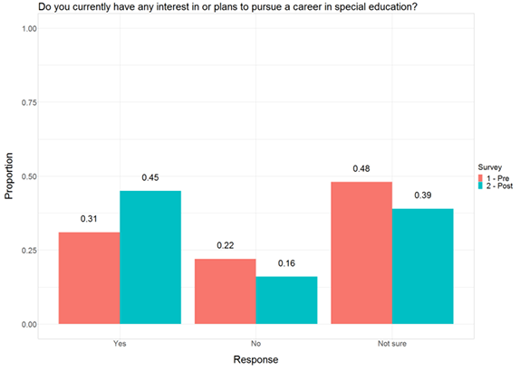
Developing Future Special Educators Grants in Pennsylvania
Survey data from participants in programs developed through Developing Future Special Educators Grants in PA

Slide 25
Dual Endorsement Policy in Washington
Source: Theobald, R., Goldhaber, D., Naito, N., & Stein, M. (2021). The special education teacher pipeline: Teacher preparation, workforce entry, and retention. Exceptional Children, 88(1), 65-80.

Slide 26
Dual Endorsement Policy in Washington
Source: Theobald, R., Goldhaber, D., Naito, N., & Stein, M. (2021). The special education teacher pipeline: Teacher preparation, workforce entry, and retention. Exceptional Children, 88(1), 65-80.

Slide 27
Dual Endorsement Policy in Washington
Source: Theobald, R., Goldhaber, D., Naito, N., & Stein, M. (2021). The special education teacher pipeline: Teacher preparation, workforce entry, and retention. Exceptional Children, 88(1), 65-80.

Slide 28
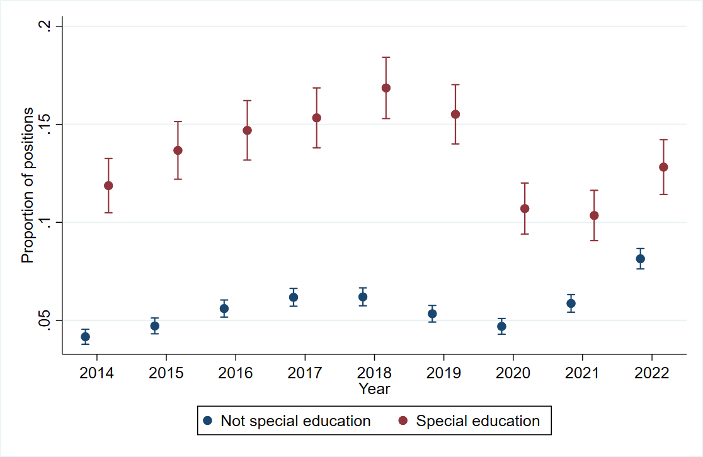
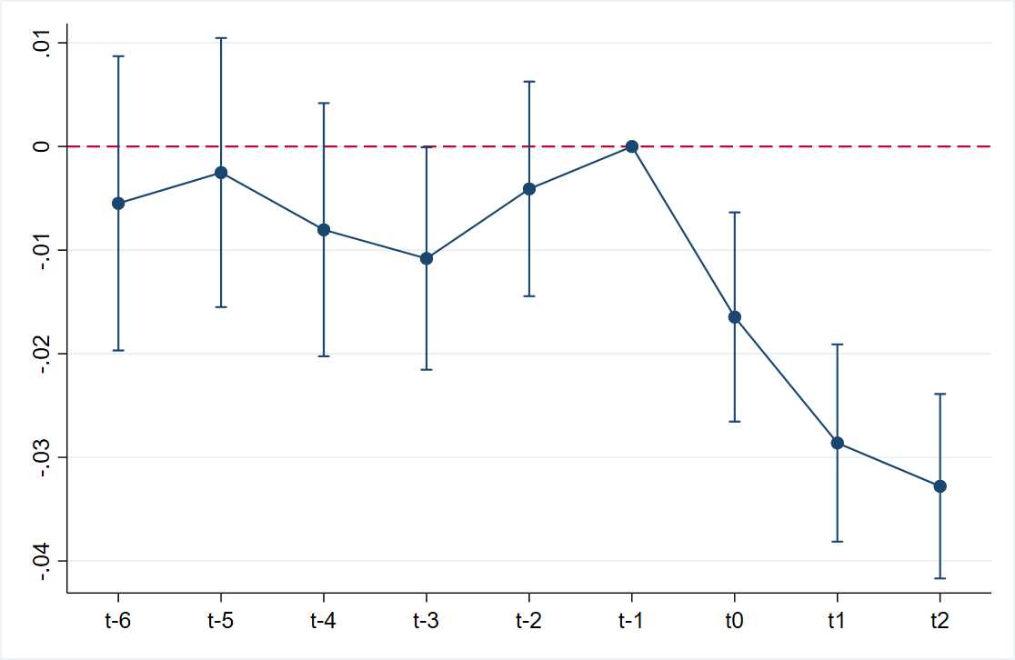
$10,000 Special Education Teacher Bonus Policy in Hawaiʻi
Proportion positions vacant or filled by unlicensed teacher
Source: Theobald, R., Xu, Z., Gilmour, A., Lachlan-Hache, L., Bettini, E., & Jones, N. (2023). The impact of a $10,000 bonus of special education teacher shortages in Hawai`i. CALDER Working Paper No. 290-0823.

Slide 29
Thank you!
Roddy Theobald, rtheobald@air.org

Slide 30
Teaching Quality
An Unexamined Element of Special Education Teacher Turnover
Allison F. Gilmour, Ph.D.
American Institutes for Research

Slide 31
Teaching Quality and Turnover
Who leaves or moves matters
Less effective teachers have higher probabilities of turnover (Cowen & Winters, 2013; Feng & Sass, 2017; Goldhaber et al., 2011; Henry et al., 2011)
Effective teachers may sort into schools with more desirable working conditions (Clotfelter et al., 2011; Feng & Sass, 2017)
Movement to general education
Older estimates quite high (5.5-10.2%; Boe et al., 2008)
Potential effect on students is unclear
Notes:
If the least effective teachers are leaving, it could be good for students if the replacements are more effective
effective teacher sorting- results in decreased access for some students
Atteberry et al., 2017- negative 0.02 SD in math and ELA
- Boe- 1990s to 2000

Slide 32
Teaching Quality in Special Education
Value-added scores
Students who participate in the regular state assessment
Teach enough students to obtain stable estimates (Steinbrecher et al., 2014)
Students’ goals may be unrelated to state assessment or achievement may be below grade level (Jones et al., 2013)
Teaching observation scores
Rubrics assume a single definition of effective teaching that may not align with effective special education instruction (Gilmour & Jones, 2020)
Notes:
Challenges to measuring teaching quality in special education
Value added scores attempt to isolate the contributions of teachers to test score gains
Value-added- tested grades and subjects- a similar challenge for special educators. May perform so far below grade level that growth is not captures by state assessment
Observation scores- more face validity- capture what happens in the classroom more generally
Observation scores on FFT vs. sped instruction only correlated at .43, with special educators receiving systematically lower scores (Jones et al., 2022)
Despite limitations and challenges, these are the systems used in practices and they have consequences for special educators.

Slide 33
Research Question
What is the association between teaching quality and special educator turnover after accounting for teacher, classroom, and school characteristics?

Slide 34
Sample and Models
Tennessee’s statewide longitudinal dataset, 2012/13-2016/17
Samples
All special educators (n= 8,406); special educators linked to students with value-added scores (n= 1,130); special educators linked to students with observation scores (n= 4,248)
Multinomial logistic regression and logistic regression
Dependent variable: Moving within district, moving between districts, leaving teaching in the state, or switching to a general education position
Independent variables: Value-added scores or observation scores
Covariates: Teacher, classroom, and school characteristics
Notes:
With the last year used for calculating turnover from 2015/16 year- so stacking 4 years of data
Excluding 2015/16 for value-added samples
All special educators- 21,072 teacher-by-year observations
Value-added scores- 1,599
Observation- 8,655 teacher by year observations
Categorical variable with types of turnover
Switched- excludes teachers who left teaching in TN
Value-added scores- Tennessee Value-Added Assessment System (TVAAS) if they taught a tested subject and grade and were linked to six or more students. Accounts for prior achievement in multiple subjects (if available), percentage of instructional time teacher responsible for student. Used TVAAS index, averaged, then standardized in the full sample
Observation scores- Tennessee Educator Acceleration Model (TEAM). – score of 1-5 (high) in 4 areas- (1) designing and planning instruction, (2) the learning environment, (3) instruction, and (4) professionalism. Used first score
Notably- special educators have lower VA scores (-.10SD) and observation scores (-.4 SD)
Teacher- race/ethnicity, experience (first three years, 30+), certification (alt, not certified in sped, dual-certified)
Classroom - % of students with specific disabilities, female, El, race/ethnicity, FRL, number of students.
Schools- % SWD, % female, % EL, % race/ethnicity, % FRPL, Grade level
Year FE
Pre-registered study at the Open Science Framework

Slide 35
Results
Notes:
Across 4 years

Slide 36
Moving to General Education
Notes:
Stayed- 6.6%
Moved within district- 18.31%
Moved between districts- 28.01%

Slide 37
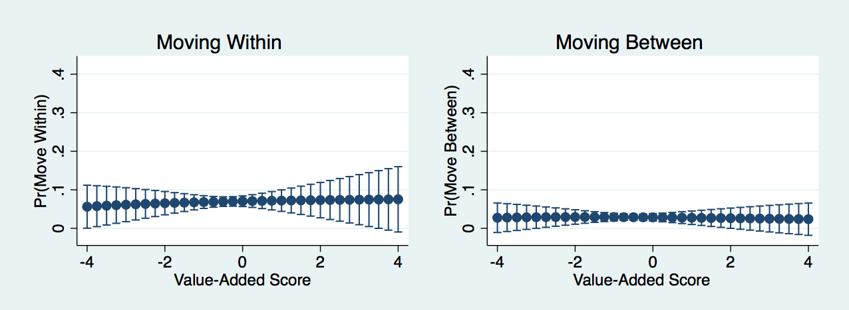
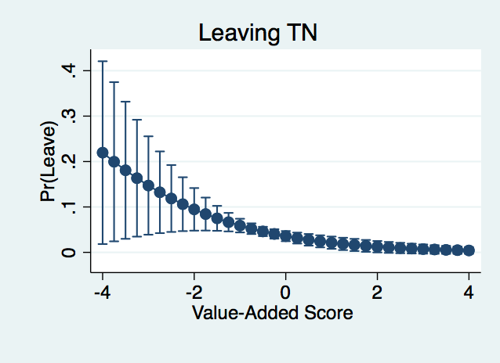
Value-added scores were associated with special educators leaving teaching in TN.
Notes:
Just use leaving graph?
Leaving- 1 SD change associated with 43% decrease in the risk of leaving. Predicted probability at -1 was .06, at 1 it was .02.

Slide 38
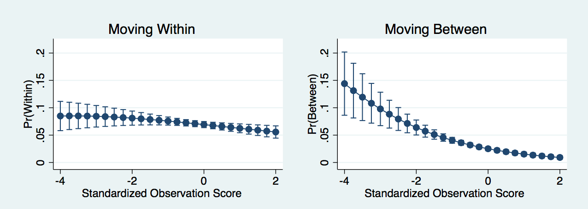
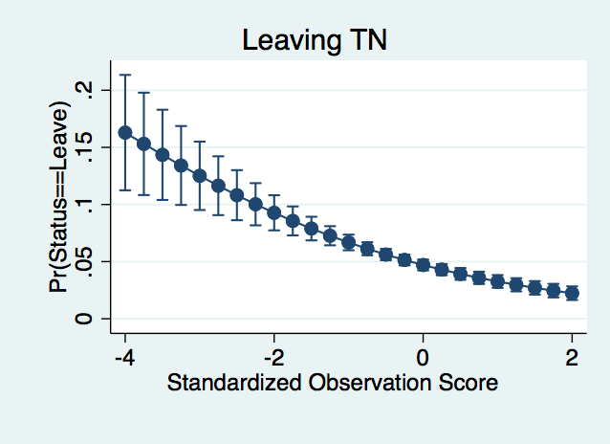
Observation scores were associated with special educators moving within, moving between, and leaving teaching in TN.
Notes:
Moving within: 1 SD increase, 13% decrease in the risk; +1 SD pp= .062, -1 SD pp=.076
Moving between: 42% decrease; +1 SD pp= .015; -1 SD pp .041
Leaving: 34% decrease; +1 SD pp=.033, -1 SD pp=0.067
Moving between districts was going from SPED to GE

Slide 39
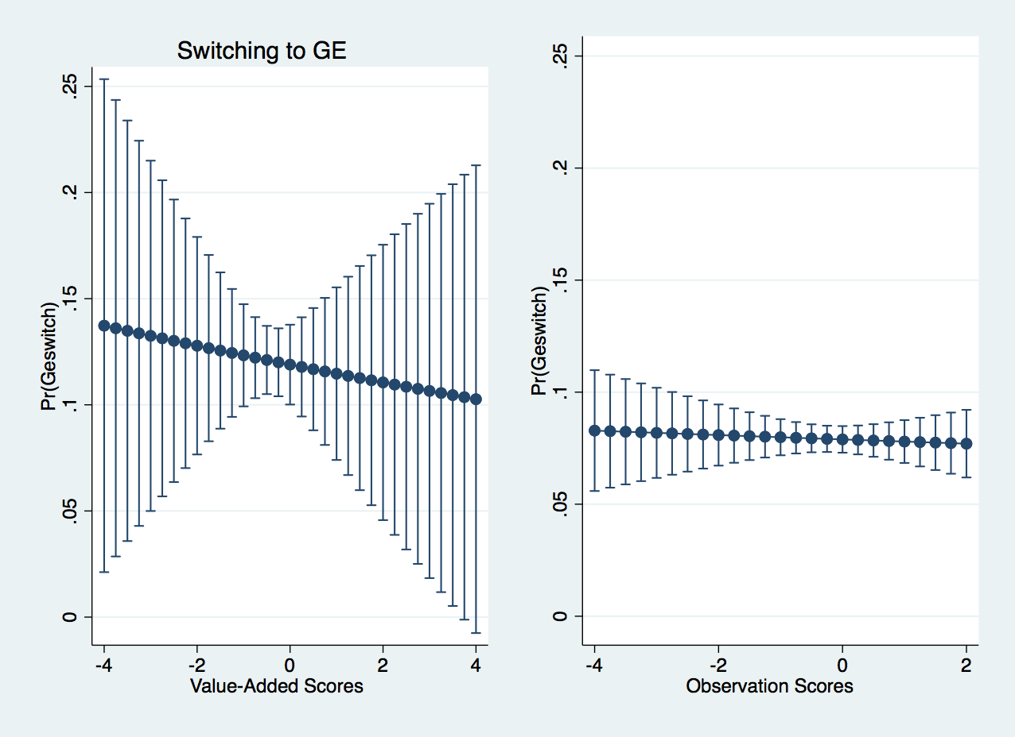
Value-added scores and observation scores were not associated with switching to general education.
Notes:
Supplemental analyses-
District fixed effects
Quartiles to examine non-linearity

Slide 40
Implications and Future Directions
Past estimates of special educator turnover may be underestimations.
Overall turnover rate was 23% when switching to general education was included
Switchers present a potential pool of special educators
Why do special educators with lower scores leave?
Low scores could induce special educators to leave, but observation scores may not reflect special education teaching quality (Gilmour & Jones, 2020)
Is a “low-quality” special educator better than no special educator?
Notes:
Demonstrates how policy (evaluation) interacts with personnel in a way that can ultimately influence the practices used in schools
Potential pool- understand why they switch.
Dual-cert- 68% increase in the odds of switching to special education (39% of the sample)
Need future studies to examine if former special educators are more effective at supporting students in general education
Does potential positive impact outweigh the negatives of churn
Low score inducing leaving- Who has access to information?
School administrators- unlikely to give a low score if they want to retain a teacher
45% of schools reporting vacancies
Correlation between VA and obs was .22

Slide 41
References
Boe, E. E., Cook, L. H., & Sunderland, R. J. (2008). Teacher turnover: Examining exit attrition, teaching area transfer, and school migration. Exceptional Children, 75(1), 7–31. https://doi.org/10.1177/001440290807500101
Clotfelter, C. T., Ladd, H. F., & Vigdor, J. L. (2011). Teacher mobility, school segregation, and pay-based policies to level the playing field. Education Finance and Policy, 6(3), 399–438. https://doi.org/10.1162/EDFP_a_00040
Cowen, J. M., & Winters, M. A. (2013). Do charters retain teachers differently? Evidence from elementary schools in Florida. Education Finance and Policy, 8(1), 14-42.
Feng, L., & Sass, T. R. (2017). Teacher quality and teacher mobility. Education Finance and Policy, 12(3), 396–418. https://doi.org/10.1162/EDFP_a_00214
Gilmour, A. F. (2023). Teaching quality: An unexamined element of special education teacher turnover. Journal of Education Human Resources.
Gilmour, A. F., & Jones, N. (2020). Policies that define instruction: A systematic review of states’ and districts’ recommendations for evaluating special educators. Educational Researcher, 49(9), 645-655. https://doi.org/10.3102/0013189X20935039
Goldhaber, D., Gross, B., & Player, D. (2011). Teacher career paths, teacher quality, and persistence in the classroom: Are public schools keeping their best? Journal of Policy Analysis and Management, 30(1), 57–87. https://doi.org/10.1002/pam.20549
Henry, G. T., Bastian, K. C., & Fortner, C. K. (2011). Stayers and leavers: Early-career teacher effectiveness and attrition. Educational Researcher, 40(6), 271–280. https://doi.org/btdks2
Jones, N. D., Buzick, H. M., & Turkan, S. (2013). Including students with disabilities and English learners in measures of educator effectiveness. Educational Researcher, 42(4), 234–241. https://eric.ed.gov/?id=EJ1003288
Steinbrecher, T. D., Selig, J. P., Cosbey, J., & Thorstensen, B. I. (2014). Evaluating Special Educator Effectiveness: Addressing Issues Inherent to Value-Added Modeling. Exceptional Children, 80(3), 323–336. https://doi.org/10.1177/0014402914522425

Slide 42
Improving Working Conditions to improve retention
Elizabeth Bettini, Boston University
42

Slide 43
Funding
The research reported here was supported by the Institute of Education Sciences, U.S. Department of Education, through Grant R324B170017 to the Trustees of Boston University. The opinions expressed are those of the authors and do not represent views of the Institute or the U.S. Department of Education.
The research reported here was supported by Spencer Foundation, through two grants (No. 201800060 & No. 201900101) to the Trustees of Boston University and Wake Forest University. The opinions expressed are those of the authors and do not represent views of the Spencer Foundation.
43

Slide 44
Working Conditions & Attrition
Billingsley & Bettini (2019) systematic review of research on special education teacher attrition & retention: “The strongest findings relate to working conditions.” (p.35)
“The strongest findings relate to working conditions.” (p. 35)
44

Slide 45
Working Conditions
Demands
Resources
Balance
45

Slide 46
Demands and Resources
Instructional Responsibilities
Caseload Characteristics
Instructional Grouping
Paperwork Expectations
Extra Duties (e.g., bus duty)
Social Resources
Admin, Colleague, & Para Support
School Culture
Logistical Resources
Planning & Instructional Time
Curricula & Materials
Informational Resources
Coaching & Mentoring
Professional Development
Demands:
Instructional Responsibilities
Caseload Characteristics
Instructional Grouping
Paperwork Expectations
Extra Duties (e.g., bus duty)
Resources:
Social Resources
Admin, Colleague, & Para Support
School Culture
Logistical Resources
Planning & Instructional Time
Curricula & Materials
INFORMATIONAL Resources
Coaching & Mentoring
Professional Development
Demands
Resources
Balance
46

Slide 47
What happens when your work life looks like this?
Triaging Responsibilities
Resources
Triaging Responsibilities
Lower Quality Instruction
Stress & Burnout
Attrition
Allinder, 1996; Bettini, Crockett et al., 2016; Bettini, Wang et al., 2019; Brunsting, Bettini et al., 2022; Lillis et al., in prep; Mathews et al., 2021; Miesner, 2022; Siuty et al., 2017
Lower Quality Instruction
Demands
Stress & Burnout
Attrition
Balance
Allinder, 1996; Bettini, Crockett et al., 2016; Bettini, Wang et al., 2019; Brunsting, Bettini et al., 2022; Lillis et al., in prep; Mathews et al., 2021; Miesner, 2022; Siuty et al., 2017
47

Slide 48
What happens when your work life looks like this?
[Planning is] usually all in the moment…. I open the book that day and go "All right, what are we going to learn today?" Because I don't have any prepping time. And if I did [careful prep] for all 4 grade levels, I'd be sitting there after school until 6:00… -Alana
I end up feeling like I'm never really doing my job, and I'm always letting the kids down
-Diedre
Resources
[Planning is] usually all in the moment…. I open the book that day and go "All right, what are we going to learn today?" Because I don't have any prepping time. And if I did [careful prep] for all 4 grade levels, I'd be sitting there after school until 6:00… -Alana
I end up feeling like I'm never really doing my job, and I'm always letting the kids down
-Diedre
Demands
Balance
48
Notes:
I feel like I’m always complaining about… the lunches and prep but… it also makes my fuse a lot shorter… even just like being with the same student from 8:30 to 3 when they're having behaviors the entire day…your fuse does get short when they
“I can’t hit every grade level and every subject. So I end up feeling like I’m never really doing my job, and I’m always letting the kids down.
and it's like you get to the end of the day and it's like, "Well, here we are. Everyone's standing." It does, it makes it hard to even plan for the academics to know like okay what did they do today?
it's usually all in the moment because it's just I open the book that day and go, "All right, what are we going to learn today?" Because I don't have any prepping time. And if I did that for all four grade levels, I'd be sitting there after school until six o'clock

Slide 49
Working Conditions & Attrition
Survey of special educators teaching students with EBD:
Working conditions explained 65% of variance in emotional exhaustion (a component of burnout) and 58% of variance in intent to leave their jobs:
Planning Time
Instructional Grouping
Curricular Resources
Administrator Support
Effects Mediated by Perception That Their Workload is Manageable | These Conditions are Also Important for Instructional Quality (e.g., Cumming et al., 2021; Lillis et al., in prep; Mathews et al., 2021; Siuty et al., 2017)
Effects Mediated by Perception That Their Workload is Manageable
These Conditions are Also Important for Instructional Quality
(e.g., Cumming et al., 2021; Lillis et al., in prep; Mathews et al., 2021; Siuty et al., 2017)
49

Slide 50
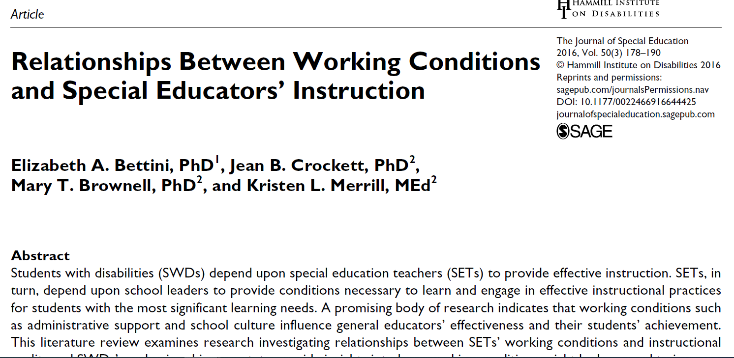
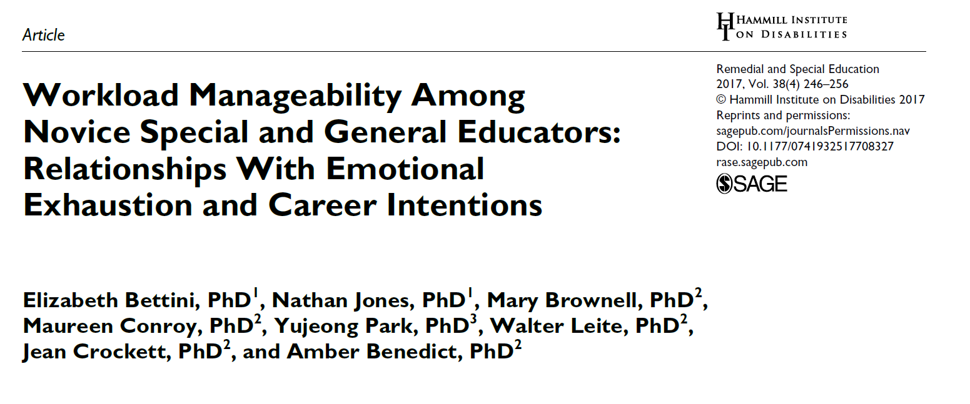
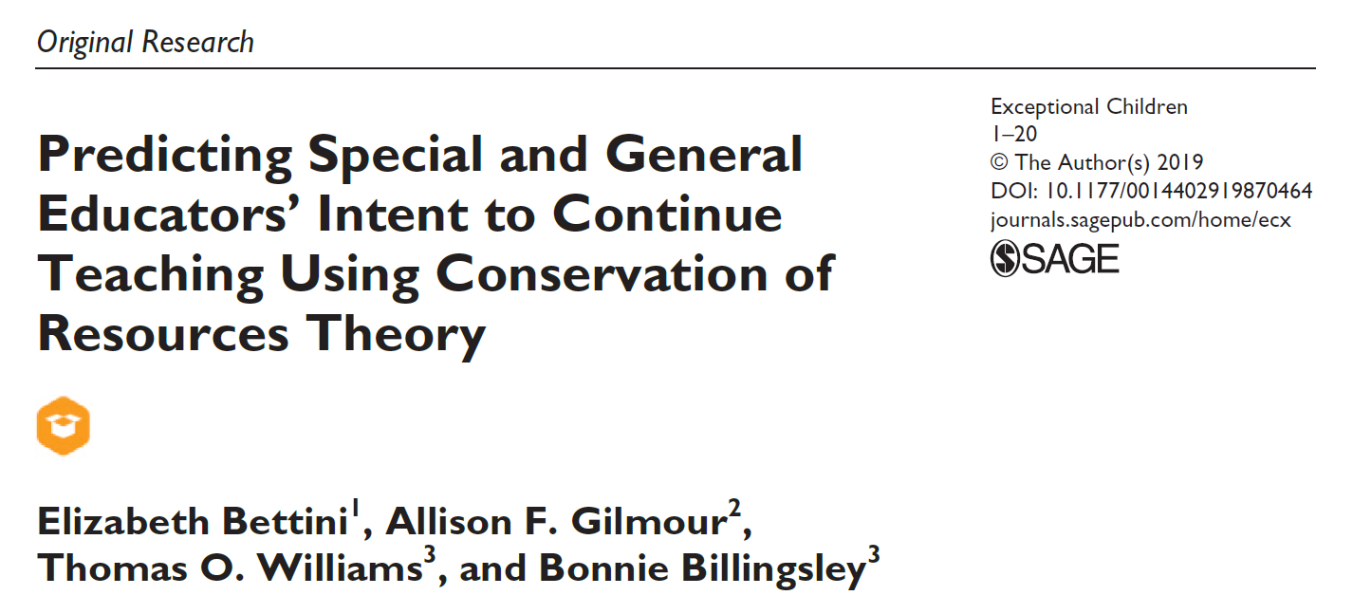
Working Conditions & Attrition
50

Slide 51
Improving Working Conditions
51

Slide 52
Improving Working Conditions
Challenging Working Conditions
Sacrificial Teacher Narrative
Schools Oriented Toward “Typical Learners”
Challenging Working Conditions
Schools Oriented Toward “Typical Learners”
Sacrificial Teacher Narrative
52

Slide 53
Improving Working Conditions
Challenging Working Conditions:
No Planning Time
Sacrificial Teacher Narrative: “Good Teachers” Sacrifice for Kids
School Oriented To “Typical Learners”: Inadequate Skilled Supervision During Planning
Teachers by contract you get… a prep everyday, planning time. Often times with these little cherubs that planning time doesn’t work out, right?...So that’s something I… struggle with because… of the difference between the kids…..The barriers are really the kids… and often times their needs are very different than the need of a child in a mainstream classroom that can go into another room and not have any issues, right? That’s not always the case. Especially with the relationships that they’ve built with these children, those relationships don’t always carry over to other adults right, so…you may have to give up some of that planning time, your lunch time to be there for that child right? And I don’t think [the special educators] would give that up. And I, I’ve even asked them at times “Do you have to take up a…” “No I’m not gonna leave my child over here struggling in a crisis because I need a planning time.”
-Howard, Elementary School Principal
Teachers by contract you get… a prep everyday, planning time. Often times with these little cherubs that planning time doesn’t work out, right?...So that’s something I… struggle with because… of the difference between the kids…..The barriers are really the kids… and often times their needs are very different than the need of a child in a mainstream classroom that can go into another room and not have any issues, right? That’s not always the case. Especially with the relationships that they’ve built with these children, those relationships don’t always carry over to other adults right, so…you may have to give up some of that planning time, your lunch time to be there for that child right? And I don’t think [the special educators] would give that up. And I, I’ve even asked them at times “Do you have to take up a…” “No I’m not gonna leave my child over here struggling in a crisis because I need a planning time.”
-Howard, Elementary School Principal
Challenging Working Conditions: No Planning Time
School Oriented To “Typical Learners”: Inadequate Skilled Supervision During Planning
Sacrificial Teacher Narrative: “Good Teachers” Sacrifice for Kids
53
Notes:
Howard deflected responsibility for equitable planning time, in two ways. First, he deflected responsibility by locating the barrier within children with EBD as part of their disability, and second, he deflected responsibility by locating the responsibility within the perspective of a special educator who would, according to him, prefer to give up their planning and lunch time in order to meet student needs. Thus, the conclusion to this challenge was for the special educator to sacrifice their planning and lunch time, rather than him taking responsibility for finding a systemic solution (e.g., skilled supervision during that time) so that the teacher could take a planning period without pitting her needs against the needs of her student.

Slide 54
Improving Working Conditions
Challenging Working Conditions:
No Planning Time
Sacrificial Teacher Narrative: “Good Teachers” Sacrifice for Kids
School Oriented To “Typical Learners”: No Skilled Supervision During Planning
I often feel like I just have to check my needs at the door… I just can’t think about myself until the kids are gone…. Alex
And… if you're not comfortable with that, then this is the wrong job
-C. A.
Challenging Working Conditions: No Planning Time
School Oriented To “Typical Learners”: No Skilled Supervision During Planning
Sacrificial Teacher Narrative: “Good Teachers” Sacrifice for Kids
I often feel like I just have to check my needs at the door… I just can’t think about myself until the kids are gone…. Alex
And… if you're not comfortable with that, then this is the wrong job -C. A.
54
Notes:
Howard deflected responsibility for equitable planning time, in two ways. First, he deflected responsibility by locating the barrier within children with EBD as part of their disability, and second, he deflected responsibility by locating the responsibility within the perspective of a special educator who would, according to him, prefer to give up their planning and lunch time in order to meet student needs. Thus, the conclusion to this challenge was for the special educator to sacrifice their planning and lunch time, rather than him taking responsibility for finding a systemic solution (e.g., skilled supervision during that time) so that the teacher could take a planning period without pitting her needs against the needs of her student.

Slide 55
Improving Working Conditions
Challenging Working Conditions:
No Planning Time
Sacrificial Teacher Narrative: “Good Teachers” Sacrifice for Kids
School Oriented To “Typical Learners”: No Skilled Supervision During Planning
Challenging Working Conditions: No Planning Time
School Oriented To “Typical Learners”: No Skilled Supervision During Planning
Sacrificial Teacher Narrative: “Good Teachers” Sacrifice for Kids
How have you seen this narrative show up about teachers’ work?
How have you seen this narrative show up about teachers’ work?
55
Notes:
Howard deflected responsibility for equitable planning time, in two ways. First, he deflected responsibility by locating the barrier within children with EBD as part of their disability, and second, he deflected responsibility by locating the responsibility within the perspective of a special educator who would, according to him, prefer to give up their planning and lunch time in order to meet student needs. Thus, the conclusion to this challenge was for the special educator to sacrifice their planning and lunch time, rather than him taking responsibility for finding a systemic solution (e.g., skilled supervision during that time) so that the teacher could take a planning period without pitting her needs against the needs of her student.

Slide 56
Improving Working Conditions
Positive Working Conditions
Teachers Treated as Professional Workers
Schools Oriented Towards All Learners
Positive Working Conditions
Schools Oriented Towards All Learners
Teachers Treated as Professional Workers
Leaders engaged in regular interactions with special education teachers about their work
Teachers empowered to communicate about challenges
Challenges are assumed to be rooted in structural problems, not teacher problems or student problems
Leaders engaged in regular interactions with special education teachers about their work
Teachers empowered to communicate about challenges
Challenges are assumed to be rooted in structural problems, not teacher problems or student problems
56

Slide 57
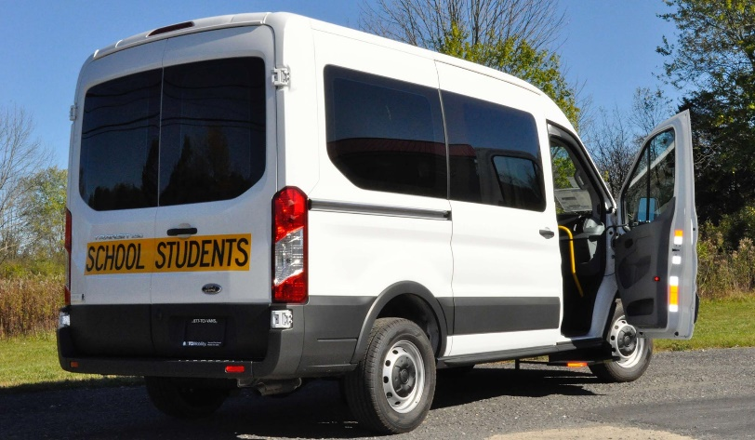
Improving Working Conditions
Positive Working Conditions: Materials for Transition Services
Teachers Treated as Professional Workers
Assuming the System Needs to Change
School Oriented to All Students’ Needs: Purchase Order Oriented To Student Needs
I remember [the teacher] saying, “If I could just get a van. Can we JUST get a van!”…and now we have a fleet of vehicles and we have students doing meaningful things you know across the community.
-Jason, Assistant Superintendent in High Achieving Inclusive District
Positive Working Conditions: Materials for Transition Services
School Oriented to All Students’ Needs: Purchase Order Oriented To Student Needs
Teachers Treated as Professional Workers Assuming the System Needs to Change
I remember [the teacher] saying, “If I could just get a van. Can we JUST get a van!”…and now we have a fleet of vehicles and we have students doing meaningful things you know across the community.
-Jason, Assistant Superintendent in High Achieving Inclusive District
57

Slide 58
Demands and resources
Instructional Responsibilities
Caseload Characteristics
Class Size & Student Needs
Paperwork Expectations
Extra Duties (e.g., bus duty)
Identify Problems
Social Resources
Admin, Colleague, & Para Support
School Culture
Logistical Resources
Planning & Instructional Time
Curricula & Materials
Structural Solutions
Informational Resources
Coaching & Mentoring
Professional Development
Demands:
Instructional Responsibilities
Caseload Characteristics
Class Size & Student Needs
Paperwork Expectations
Extra Duties (e.g., bus duty)
Identify Problems
Structural Solutions
Resources:
Social Resources
Admin, Colleague, & Para Support
School Culture
Logistical Resources
Planning & Instructional Time
Curricula & Materials
INFORMATIONAL Resources
Coaching & Mentoring
Professional Development
Demands
Resources
Balance
58

Slide 59
Thank you!
59

Slide 60
Centering practice in special education teacher preparation
Melinda Leko
60

Slide 61
PRACTICE
As a practice-based profession, to improve teaching, educators must have opportunities to

Slide 62
Practice makes perfect is not always true
Cohesive
(appropriate scope and sequence)
Focused
(most essential skills; not random)
Repeated
(multiple opportunities to try again)
Deliberate
(Brownell et al., 2019; Ericsson, 2014)
It depends on the quality of the practice.

Slide 63
Deliberate practice
Modeling:
I need to see what good practice looks like.
Feedback:
I need input on how I am doing.
Reflection & Analysis:
I need to think about my own practice and what I might do differently in the future.
(Ericsson, 2014; Leko et al., in press)
(Ericsson, 2014; Leko et al., in press)

Slide 64
Which practice-based pedagogies hold promise?

Slide 65
Which practice-based pedagogies hold promise?
Simulations
Video Analysis
Tutoring
Coaching
Lesson Study
Simulations
Video Analysis
Tutoring
Coaching
Lesson Study

Slide 66
Which practice-based pedagogies hold promise?
Simulations → Imitation or role playing in a controlled setting
Video Analysis → Viewing video recorded instruction and analyzing practice
Tutoring → Providing small group instruction or intervention to P–12 students
Coaching → Receiving performance feedback from an expert
Lesson Study → Collaborative planning of instruction and analysis of student learning
Simulations
Video Analysis
Tutoring
Coaching
Lesson Study
Imitation or role playing in a controlled setting
Viewing video recorded instruction and analyzing practice
Providing small group instruction or intervention to P–12 students
Receiving performance feedback from an expert
Collaborative planning of instruction and analysis of student learning

Slide 67
Which practice-based pedagogies hold promise?
Improves SE teacher candidate teaching practices implementation fidelity, & student achievement
(Dieker et al., 2014;
Durst et al., 2019)
Improves SE teacher candidate teaching practices & teacher-student interactions
(Nagro & Cornelius, 2013)
Improves SE teacher candidate knowledge acquisition & instructional and assessment practices
(Englert et al., 2020;
Hoffman et al. 2019;
Peltier et al., 2020)
Improves SE teacher candidate instruction, implementation fidelity, & student achievement
(Brock & Carter, 2017;
Kraft et al., 2018 )
Increases GE & SE teachers’ knowledge in science & mathematics & leads to positive outcomes for students
(Lewis & Perry, 2017;
Mutch-Jones et al., 2017)
Improves SE teacher candidate teaching practices implementation fidelity, & student achievement (Dieker et al., 2014; Durst et al., 2019)
Simulations → Imitation or role playing in a controlled setting
Improves SE teacher candidate teaching practices & teacher-student interactions (Nagro & Cornelius, 2013)
Video Analysis → Viewing video recorded instruction and analyzing practice
Improves SE teacher candidate knowledge acquisition & instructional and assessment practices (Englert et al., 2020; Hoffman et al. 2019; Peltier et al., 2020)
Tutoring → Providing small group instruction or intervention to P–12 students
Improves SE teacher candidate instruction, implementation fidelity, & student achievement (Brock & Carter, 2017; Kraft et al., 2018 )
Coaching → Receiving performance feedback from an expert
Increases GE & SE teachers’ knowledge in science & mathematics & leads to positive outcomes for students (Lewis & Perry, 2017; Mutch-Jones et al., 2017)
Lesson Study → Collaborative planning of instruction and analysis of student learning
Simulations
Video Analysis
Tutoring
Coaching
Lesson Study
Imitation or role playing in a controlled setting
Viewing video recorded instruction and analyzing practice
Providing small group instruction or intervention to P–12 students
Receiving performance feedback from an expert
Collaborative planning of instruction and analysis of student learning

Slide 68
Which of these would work well in your context?
Which of these would work well in your context?
Simulations
Video Analysis
Tutoring
Coaching
Lesson Study
Simulations
Video Analysis
Tutoring
Coaching
Lesson Study

Slide 69
Which practice-based pedagogies hold promise?
Simulations
Video Analysis
Tutoring
Coaching
Lesson Study
(Brownell et al., 2019; Leko et al., in press)
Simulations
Video Analysis
Tutoring
Coaching
Lesson Study
Controlled
Authentic
(Brownell et al., 2019; Leko et al., in press)

Slide 70
What is most important in your decision-making?
Authentic
Supports more complex teaching practices
Requires more resources
Requires partnerships between educator preparation programs and P–12 settings
Controlled
Often limited to discrete skills
Requires fewer resources
Does not require partnerships between educator preparation programs and P–12 settings
Controlled
Authentic

Slide 71
Which of these would work well in your context?
Which of these would work well in your context?
Authentic
Supports more complex teaching practices
Requires more resources
Requires partnerships between educator preparation programs and P–12 settings
Controlled
Often limited to discrete skills
Requires fewer resources
Does not require partnerships between educator preparation programs and P–12 settings
Controlled
Authentic

Slide 72
Thank you
Melinda Leko
leko@coe.ufl.edu

Slide 73
Retaining Special Education Personnel at All Levels: Georgia’s Approach

Slide 74
Meet the Georgia Presenters
Lynn Holdheide
Wina Low
Katherine Johnson
Amy Colpo
CEEDAR Center
Center on Great Teachers and Leaders
Georgia Department of Education
Georgia Department
of Education
CEEDAR Center
Center on Great Teachers
and Leaders
Notes:
The image placeholders are 2” by 2” square. Please use high resolution photos (300 ppi) that have been cropped to a minimum size of 2” square (150x150 pixels). Photos should be head and shoulder only with a plain background. To insert an image in a blank picture placeholder, click the picture icon to open the Insert Picture dialog, navigate to the folder that contains the desired image and double-click the image. Delete an existing image, rather than changing it. If square images aren’t used, it may be necessary to reset the slide layout by clicking on the Reset option in the Slides group of the Home menu.
Delete unused presenter placeholders and re-center the remaining placeholders if necessary.

Slide 75
Retaining Special Education Personnel at All Levels: Georgia's Approach
75

Slide 76
Today’s Educator Workforce
New teachers who are poorly supported or underprepared are more likely to leave the profession within the first five years.
Students are more likely than ever before to be placed in classrooms with new teachers.
about one in five teachers in U.S. classrooms are in their first three years
many teachers are now entering through an alternative certification program.
Source: Learning Policy Institute (LPI) analysis of state-reported data sources (see Table 2) and Common Core of Data. National Center for Education Statistics (2022). Common Core of Data, nonfiscal date for SY 2021–22. All estimates were calculated by LPI using the state-level data files.

Slide 77
Teacher Licensing By State
Notes:
Test In State: Test in states only require candidates to have taken and passed one course on exceptional children. This course can be done either through a traditional teacher preparation program or through completion of requirement of the states alternative routes to teacher licensure. Require Endorsement with Coursework. States that require an endorsement with coursework for teachers to obtain special education licensure require candidates to complete a minimum of number of hours on content dedicated to teaching students with disabilities. State require anywhere from 24 - 36 hours of coursework to obtain the endorsement. Dual Enrollment Bachelor's Degree States that require dual enrollment offers teaching candidates the option to complete the coursework required for general education and special education in a combines bachelors degree. These requirement for hours in special education vary depending on the college or university. Bachelors or Masters Degree Required. These states require teaching candidates to have successfully completed a bachelors or masters degree in special education. Colleges and universities design undergraduate or graduate programs around content and pedagogical skills needed to teach students with disabilities. These schools usually differentiate between a high or low incidence track so candidates take course with pertaining to the student population they are going to work with.

Slide 78
Induction as a Retention Strategy
The quality of induction for novice special educators is a powerful predictor of their intention to stay in their schools.¹
Practitioners indicated strong mentorship and induction in early career as the most effective method of improving teacher retention.²
¹ Billingsley, B., & Bettini, E. (2019). Special Education Teacher Attrition and Retention: A Review of the Literature. Review of Educational Research, 89(5), 697–744. https://doi.org/10.3102/0034654319862495
² Fowler, S. A., Coleman, M. R. B., & Bogdan, W. K. (2019). The State of the Special Education Profession Survey Report. TEACHING Exceptional Children, 52(1), 8–29. https://doi.org/10.1177/0040059919875703

Slide 79
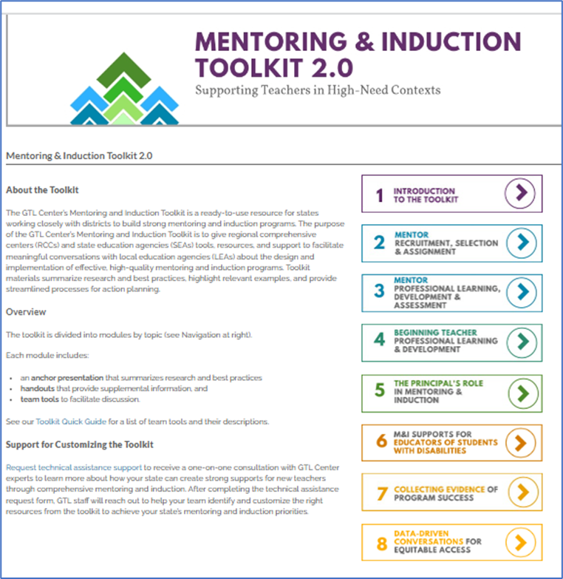
High-Quality Mentoring and Induction Practices
Rigorous mentor selection based on the qualities of an effective mentor
Ongoing professional development and support for mentors
Sanctioned time for mentor-teacher interactions
Multiyear mentoring
Intensive and specific guidance moving teaching practice forward
Professional teaching standards and data-driven conversations
Ongoing professional development for beginning teachers
Clear roles and responsibilities for administrators
Collaboration with all stakeholders
https://gtlcenter.org/technical-assistance/toolkits/mi-toolkit

Slide 80
Georgia Teacher/Provider Retention Program (TPRP)
The purpose of this project is to improve the retention of special education teachers and early intervention providers in Georgia – Part B and C.
USED Office of Special Education Programs Grant
Awarded $500,000 per year for up to five years

Slide 81
Special Education Teacher Retention Data
In 2019, Georgia had 3,400 vacancies in special education teacher positions.
Between 2018 and 2020, Georgia hired 1,235 new special education teachers and lost approximately the same number of special education teachers.
A large proportion of Georgia’s teacher workforce is within their first three years of their teaching career.
www.teachgeorgia.org
81
Notes:
Meaning the gap in the number of vacancies and number of hires has not narrowed.
Often a challenge for a field with high turnover and limited numbers of teachers

Slide 82
High Leverage Practices
https://www.gadoe.org/Curriculum-Instruction-and-Assessment/Special-Education-Services/Pages/High LeveragePracticesSpEd.aspx

Slide 83
CEEDAR AVATAR Lab – Pilot FY21
Statewide Pilot “Train the Trainers” Induction program using the Kennesaw State University AVATAR Lab.

Slide 84
CEEDAR AVATAR Lab – Pilot FY21
Regional GLRS directors and coaches learn how to use Mixed Reality Simulation and existing HLP resources to design and use professional learning experiences for induction teachers.
New special education directors practice complex and difficult conversations with teachers and leaders.
84

Slide 85
Highlights for Part B (K–12) of TPRP Grant
Professional Learning
Center on Great Teachers and Leaders to develop a model induction program for K–12 special education teachers to support induction and retention based on HLPs.
Coaching Component for new Special Education Teachers
Mixed Reality Simulation to support practice for new special education teachers in a safe environment with constructive feedback for professional growth.

Slide 86
Highlights for Part B (K–12) of TPRP Grant (Cont’d)
Mixed Reality Simulation to support practice for building and district leaders in a safe environment to support inclusive practice.
Mixed Reality Simulation to support practice for special education leaders in a safe environment with feedback for professional growth.
Executive coaching for new Special Education Directors (1st year directors)
Develop a comprehensive personnel network to support birth-five for children with disabilities.

Slide 87
Sample of Partners’ Logos
87
Notes:
Logos form several of the partners listed in the last four slides.

Slide 88
The Georgia Teacher/Provider Retention Program (GA-TPRP) Part B (K–12)
Develop a pool of competent instructors/coaches (GLRS staff)
Train-the-trainer model, including
Facilitator’s guide
Meeting agenda with recommended time allotments
Slide presentation
Professional learning activity handouts
Community of Practice
Monthly CoPs to:
Targeted follow up support
Clarifications
Problem solving
Sharing successes
Provide new teachers professional development, mentoring, and coaching
Deliver training to new teachers
Grounded in the high-leverage practices for students with disabilities
Use high-leverage practices self-assessment
Practice-based opportunities
Create lesson plans using the high-leverage practices
Simulate practice with avatars
On-going Coaching
Coaching guidance
HLP Observation & Coaching Tool; Model Induction Coaching Guidance
Coaching logs
88

Slide 89
Supporting and Retaining Special Education Teachers
Provide the tools needed through induction and mentoring.
Content developed by GaDOE, Center on Great Teachers and Leaders, and Kennesaw State University
Georgia Learning Resource System (GLRS) staff trained
Targeted support such as coaching and training on content
Practicing skills using Mixed Reality Simulation (MRS) — a virtual reality practice setting that allows for role-playing.

Slide 90
Induction Program is based on High Leverage Practices (HLPs)
2021-2022 Six HLPs
2022-2023 Six HLPs
2023-2024 Six HLPs
Add three additional HLPs
Cohort 1 & 2
Notes:
Pay for ebook

Slide 91
Coaching To Support Retention
Leverage discretionary funds to support coaching of induction level teachers participating.
$1,800,000: $100,000 x 18 GLRS regions
91

Slide 92
2023-24 Additional Coaching Component
FY 24 Additional funds dedicated to coaching
Requested 18 GLRS to draft a coaching plan
Funds only spent on coaching
Increased monitoring of funds
1.8 million dollar investment (above the grant funds)

Slide 93
Strategic Coaching Plan for Southwest GLRS
PREPARATION FOR COACHES
DELIVERY OF PROFESSIONAL LEARNING
DELIVERY OF COACHING

Slide 94
Sample Coaching Plan
AIR Coaching | Quarter 1 (July–Sept) | Quarter 2 (Oct–Dec) | Quarter 3 (Jan–Feb) | Quarter 4 (Mar–May)
Task: Frequency, pre-observation, observing, modeling, PL | Baseline observation PL session MRS | Observation PL session MRS | Observation PL session MRS | Observation PL session (IEP) MRS
Measurements: # of visits, Surveys | 1 in-person 1 virtual TPRP Pre-survey GLRS evaluation of PL session | 1 in-person 1 virtual GLRS evaluation of PL session | 1 in-person 1 virtual GLRS evaluation of PL session | 1 in-person 1 virtual TPRP Post-survey GLRS evaluation of PL session
Costs: coaching, visits, materials | See budget form | See budget form | See budget form | See budget form
AIR Coaching
Task: Frequency, pre-observation, observing, modeling, PL Baseline observation
Measurements: # of visits, Surveys
Costs: coaching, visits, materials
Quarter 1 (July–Sept) Task: Baseline observation, PL session, MRS
Quarter 1 (July–Sept) Measurements: 1 in-person, 1 virtual, TPRP Pre-survey, GLRS evaluation of PL session
Quarter 1 (July–Sept) Costs: See budget form
Quarter 2 (Oct–Dec) Task: Observation, PL session, MRS
Quarter 2 (Oct–Dec) Measurements: 1 in-person, 1 virtual, GLRS evaluation of PL session
Quarter 2 (Oct–Dec) Costs: See budget form
Quarter 3 (Jan–Feb) Task: Observation, PL session, MRS
Quarter 3 (Jan–Feb) Measurements: 1 in-person, 1 virtual, GLRS evaluation of PL session
Quarter 3 (Jan–Feb) Costs: See budget form
Quarter 4 (Mar–May) Task: Observation, PL session (IEP), MRS
Quarter 4 (Mar–May) Measurements: 1 in-person, 1 virtual, TPRP Post-survey GLRS evaluation of PL session
Quarter 4 (Mar–May) Costs: See budget form

Slide 95
Goal 1 – Teacher Induction Activities
Annual Performance Report Results (2022–2023)
95

Slide 96
Percentage of Completers and All Special Education Participants by Grade Level
96

Slide 97
Teacher Induction: Pre/Post HLP Self-Assessment Results
97

Slide 98
Percentage of TPRP Participants in Agreement that the TPRP Training and Coaching Increased Their Capacity to Use HLPs in Their Teaching
98

Slide 99
Percentage of TPRP Participants in Agreement that the Professional Learning (Training, Coaching, MRS Labs) Influenced Their Plans to Continue Teaching
99

Slide 100
Characteristics of Retained Teachers
100

Slide 101
Characteristics of Retained Teachers (Cont’d)
370 total participants
Completed more than one training or MRS session
Only special education teachers included in retention analyses.
101

Slide 102
Years Since Certification: 77% of program participants received an initial teaching certificate within the prior three years

Slide 103
2021-2022 Retention Analyses
Percentage of participants retained by variable
* Indicates statistically significant differences
103

Slide 104
Certified*: Special education teachers who were certified in special education were 48% more likely to be retained than those not certified.

Slide 105
Georgia Teacher Academy for Preparation and Pedagogy (TAPP): Those in TAPP were 10% less likely to be retained than those who went through a different pathway.

Slide 106
Exceptional Children Course: Those who completed the course were 14% more likely to be retained.

Slide 107
High-Need Schools: Teachers in high-need schools were 2% less likely to be retained than teachers not in high-need schools.

Slide 108
Program Completers: Those who completed 75% or more of the Teacher Induction Program were 10% more likely to be retained.

Slide 109
Mixed-Reality Simulation Training for Administrators
Faculty at UWG developed three MRS sessions to use for training and coaching new directors of special education and other school, district, and regional administrators. The sessions focus on the role of school leaders in retaining special education teachers.
Co-Teaching Collaborative Meeting Mediation
Special Education Leadership Support
Family Conference- Addressing Concerns with IEP
109

Slide 110
Completion of TPRP Training and MRS: Retained teachers more likely to complete Teacher Induction Program components.

Slide 111
To retain teachers, many factors must be considered.
To have strong teachers, we need to have strong leaders.
Strong leadership is needed to retain teachers.
Retaining special education directors is a priority.
Knowledge of special education by leadership is paramount.
To have strong teachers, we need to have strong leaders.
Strong leadership is needed to retain teachers.
Retaining special education directors is a priority.
Knowledge of special education by leadership is paramount.

Slide 112
Retaining Special Education Directors
Special Education Leadership Development Academy (SELDA)
Special Education School Administrators Academy (SESAA)
112

Slide 113
Special Education Leadership Development Academy (SELDA)
Over 20 years of supporting new Special Education Directors
Supports directors with three or less years of experience
Builds capacity for LEA's
Has evolved over the years to what it currently is today
In-Person Sessions
Virtual Sessions
Pre-Conference Sessions
113

Slide 114
Special Education Leadership Development Academy (SELDA)
SELDA Sessions are held monthly beginning in July and ending in April.
July, October, and April sessions are two days sessions.
Sessions use a hybrid model.
114
Notes:
Make link to pre-conference sessions and importance of attending the conferences

Slide 115
Directors’ Support
Reminders sent out prior to meeting
Presentations posted on the website prior to meetings
Recordings posted shortly after meeting
Registration links are provided at end of the previous school year
District liaisons
Georgia Learning Resource System (GLRS)
Immediate response to questions and requests

Slide 116
SELDA Training: Quality and usefulness ratings averaged 96% in 2022–2023.

Slide 117
SELDA Competency Scores: Higher ratings for post knowledge than experience. Largest gain in budget knowledge.

Slide 118
SELDA Training: Self-assessed learning gains averaged 16% gain pre-to-post in 22–23.

Slide 119
Impact of SELDA Training and Coaching on Skills as a Director of Special Education or Capacity to Support Directors of Special Education
Average
As a result of the coaching, my skills as a director of special education, or to support our district’s director of special education, have…..
The SELDA training increased my skills as a director of special education, or my capacity to support our district’s director of special education…

Slide 120
Impact of SELDA Training and Coaching on Plans to Continue as a Director of Special Education, or Current Role
Average
The coaching positively influenced my plans to continue serving as a director of special education, or to continue in my current…
The SELDA training influenced my plans to continue serving as a director of special education, or continue in my current…

Slide 121
SELDA End-of-Year Participating Personnel Survey (PPS)
In March 2023, a link to the Participating Personnel Survey was given to Directors of Special Education and other district or school administrators who participated in 2022–23 SELDA training.
The purpose of the survey was to gather feedback on the impact of the training and coaching they received. The survey included items to collect both quantitative and qualitative data.

Slide 122
Special Education Leadership Development (SELDA) Executive Coach
Provide ongoing coaching and mentoring support to new directors
Establish credibility and build trust
Build supportive relationships
Recommend methods, resources and high impact practices and information
Notes:
Notes
Provide ongoing coaching and mentoring support including providing relevant information and advice to support improvement, transformation and sustainability.
Establish credibility and build trust through on-going demonstration of a deep knowledge of the work and the underlying research and best practices to facilitate solutions.
Build supportive relationships with special education directors by initiating and sustaining dialogue between individuals and the SELDA group
Recommend methods, resources, and high impact practices and information about what works to address the factors impacting performance.
Facilitate the development of sound improvement and transformation plans with related action or project plans and progress measures.
Ask question to cause reflection so that others surface new possibilities and recognize self-imposed barriers.
Facilitate sharing of learning that leads to improved practices, innovation and positive change.
Document practices and progress so that best practices can be replicated with fidelity, taught and disseminated to others
(Executive coach idea is a version of Mississippi).
From Mentor to Executive coach

Slide 123
SELDA Executive Coach
FACILITATE THE DEVELOPMENT OF SOUND IMPROVEMENT
ASK QUESTIONS TO CAUSE REFLECTION
FACILITATE SHARING OF LEARNING
DOCUMENT PRACTICES AND PROGRESS
123
Notes:
Notes
Provide ongoing coaching and mentoring support including providing relevant information and advice to support improvement, transformation and sustainability.
Establish credibility and build trust through on-going demonstration of a deep knowledge of the work and the underlying research and best practices to facilitate solutions.
Build supportive relationships with special education directors by initiating and sustaining dialogue between individuals and the SELDA group
Recommend methods, resources, and high impact practices and information about what works to address the factors impacting performance.
Facilitate the development of sound improvement and transformation plans with related action or project plans and progress measures.
Ask question to cause reflection so that others surface new possibilities and recognize self-imposed barriers.
Facilitate sharing of learning that leads to improved practices, innovation and positive change.
Document practices and progress so that best practices can be replicated with fidelity, taught and disseminated to others

Slide 124
Executive Coaching: More coaching in 2022–2023, and greatest focus on coaching and mentoring supports.

Slide 125
Impact of Executive Coaching (2021–2023)
Average
Proposed strategies and answers to my questions fit the specific needs of my district.
I am better able to interpret district-level special education data.
The feedback I received was helpful.
Communication was clear.

Slide 126
PPS: 95% of participating directors reported coaching and training increased their skills.

Slide 127
PPS: Directors who were coached rated all coaching components highly.

Slide 128
Retention of Goal 2 Participants: One and two years post-participation

Slide 129
Georgia Council of Administrators of Special Education (G-CASE)
Georgia Council of Administrators of Special Education (G-CASE) is a partner of SELDA.
G-CASE provides a leadership session in August prior to the beginning of the Data and Cybersecurity Conference.
Assigns a mentor from the Executive Board and Advisory Board to each new Special Education Director participating in SELDA
129

Slide 130
Georgia Council of Administrators of Special Education (G-CASE)
Georgia Council of Administrators of Special Education (G-CASE) is a partner of SELDA.
Sponsors the legal session prior to the beginning of the Fall Conference each November.
Appreciation gift and recognition of SELDA participants at the Fall Conference.
Spring Legal Conference meeting space prior to the beginning of the conference.
130

Slide 131
Targeted Supports and Communication to LEA's
Directors' Webinar
Weekly Email Blast
Collaborative Communities
District Liaisons
131

Slide 132
Collaborative Communities
Collaborative Communities are held monthly in each of the 18 GLRS Regions across the state. Each of the regions is required to have at least 7 meetings per year.
The District Liaison(DL) and the Georgia Learning Resource System(GLRS) Director collaboratively plan each of the meetings based on the information from the state as well as the specific focus of the GLRS.
132

Slide 133
District Liaison
A District Liaison (DL) is assigned to each LEA in the state.
The DL communicates with the LEA so that information is stream-lined from the state agency.
The DL supports—
Collaborative Communities
Cross Functional Monitoring
Disproportionality/CCEIS Plans
Corrective Action Plans
Dispute Resolution
Timelines
133

Slide 134
SELDA Contacts
Lynn Holland
lholland@doe.k12.ga.us
Belinda Tiller
belinda.tiller@doe.k12.ga.us
Elise James
Ejames@doe.k12.ga.us
Annette Murphy
Executive Coach
murphyeducationalconsulting@gmail.com

Slide 135
Special Education and School Based Administrators (SESSA)
135
Notes:
Instruction and Systemic Improvement Team: and variety of backgrounds discussed

Slide 136
Special Education and the School Based Administrators’ Academy
The GaDOE developed a 19-part training series to assist school-based leaders in building their knowledge and skills around special education
Participants had the opportunity to attend the WGU MRS labs
The GaDOE provides an executive coach to support the implementation of the training content in participants’ districts and schools.
A total of 305 administrators registered for the cohort.
On average, 103 participants attended each session.
Participants included special education district-level leaders, assistant principals, principals, and other district-level leaders.
Participants found the training high-quality, relevant, and useful and increased their knowledge and skills of the training content. The average session rating was 4.72 out of 5 (94%).

Slide 137
Special Education and School Based Administrators (SESSA)
What support is needed for administrators?
Gain knowledge of resources, processes, and procedures
Georgia’s Systems of Continuous Improvement and ways GaDOE can lead school administrators through this process.
Learn how to ensure that teachers are implementing EBPs and HLPs with fidelity.
Explore special education data reports and the Data Analytics Tool.
Notes:
Understand Georgia’s Systems of Continuous Improvement and ways GaDOE can lead school administrators through this process

Slide 138
Special Education School Administrators Academy (SESAA)
All sessions are recorded.
309 district/school administrators registered for FY23 SESAA Cohort 2.
1,813 school administrator participants have attended SESAA PL and UWG LivePL (Avatar Lab).
Executive coaches made over 12,000 contacts with building administrators since July 1, 2022.

Slide 139
SESSA Professional Learning Align with TPRP
HLP # 14 Utilizing Cognitive and Metacognitive Strategies to Support Memory, Attention and Self-Regulation
HLP # 7 & 16 Establishing a Supportive Learning Environment Utilizing Explicit Instructional Strategies
Being the Instructional Leader for Special Education
Specially Designed Instruction Explained for Administrators
Co-Teaching
139

Slide 140
Sample Webinar Schedule
2022–2023
SPECIAL EDUCATION AND SCHOOL ADMINISTRATOR ACADEMY (SESAA)
DATE | WEBINAR | DATE | WEBINAR
July 27 | Kickoff Special Education Leadership Support | November 2 | State Defined Alternate Diploma and Students with SCD and Autism
August 10 | Special Ed Law 101 Avatar Lab | November 9 | ELL/SWD Dually Identified Students
August 11 | Parental Rights, Complaints, and Due Process | December 7 | Special Education Determinations and Disproportionality
August 31 | MTSS, SST, and Intensive Interventions | January 26 | Master Scheduling Workshop
September 7 | Special Education Areas of Eligibility | February 22 | What It Means to be the LEA in IEP Meetings
September 14 | Instructional Leadership for Special Education | March 8 | School Admin Impact on the Academic Success of SWDs Part 1
September 21 | Special Education Discipline and Positive, Proactive Approaches | March 22 | Assistive Technology and Accessible Educational Materials
September 27 | Avatar Lab – Classroom Management | March 29 | School Admin Impact on the Academic Success of SWDs Part 2
September 30 | Avatar Lab – Special Ed. Teacher Burnout | April 19 | Understanding Student Record
October 20 & 21 | Co-Teaching Part 1&2 Avatar Lab- Co-Teacher Mediation
July 27 Kickoff Special Education Leadership Support
August 10 Special Ed Law 101 Avatar Lab
August 11 Parental Rights, Complaints, and Due Process
August 31 MTSS, SST, and Intensive Interventions
September 7 Special Education Areas of Eligibility
September 14 Instructional Leadership for Special Education
September 21 Special Education Discipline and Positive, Proactive Approaches
September 27 Avatar Lab – Classroom Management
September 30 Avatar Lab – Special Ed. Teacher Burnout
October 20 & 21 Co-Teaching Part 1&2 Avatar Lab- Co-Teacher Mediation
November 2 State Defined Alternate Diploma and Students with SCD and Autism
November 9 ELL/SWD Dually Identified Students
December 7 Special Education Determinations and Disproportionality
January 26 Master Scheduling Workshop
February 22 What It Means to be the LEA in IEP Meetings
March 8 School Admin Impact on the Academic Success of SWDs Part 1
March 22 Assistive Technology and Accessible Educational Materials
March 29 School Admin Impact on the Academic Success of SWDs Part 2
April 19 Understanding Student Record

Slide 141
Teacher Participant Retention Program and Special Education School Based Administrator Academy Contacts
Dr. Katherine Johnson
Katherine.Johnson@doe.k12.ga.us
Alisha Williamson
Alisha.Williamson@doe.k12.ga.us
James Vaughn
James.Vaughn@doe.k12.ga.us

Slide 142
Resource Spotlight
Georgia Special Education Leadership Development Academy Website The Agenda for each meeting as well as all presentations and handouts prior to the sessions are posted on this site. The presentations are available for all directors to access.
Special Education Leadership Development Academy
Directors Webinar Webpage The presentations and handouts are posted on this site prior to the webinar. All recordings on the webinar are also posted to the website and available for reference.
Special Education Directors' Webinar

Slide 143
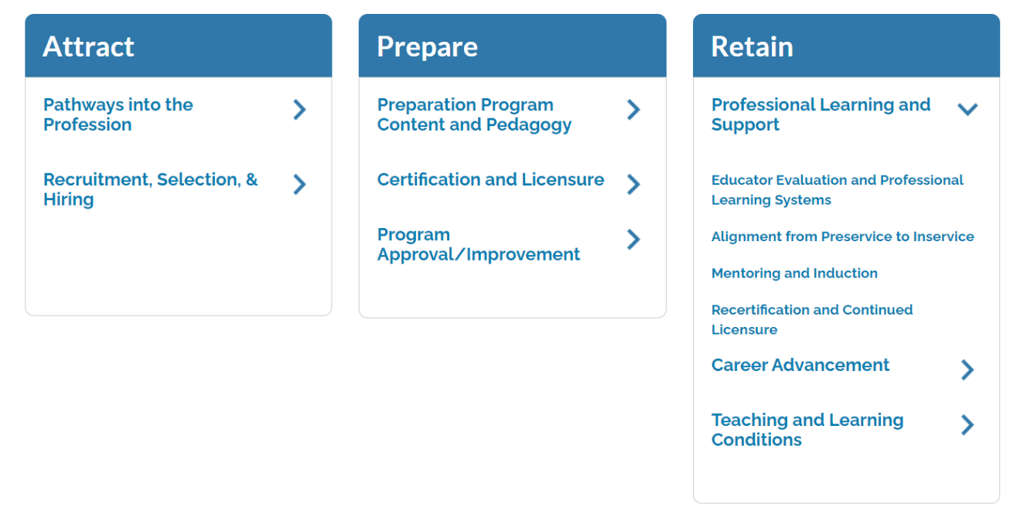
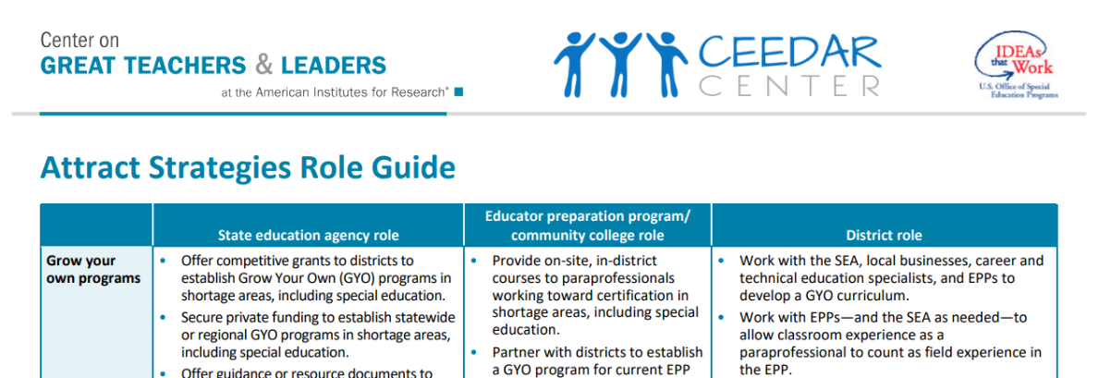
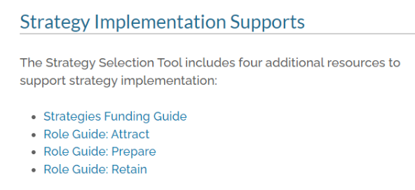
Educator Shortages in Special Education
Four images of text from Shortage Strategy Selection Tool webpage (https://gtlcenter.org/technical-assistance/toolkits/educator-shortages-special-education/selection-tool)
First image of navigation links:
Attract
Pathways into the Profession
Recruitment, Selection & Hiring
Prepare
Preparation Program Content and Pedagogy
Certification and Licensure
Program Approval/Improvement
Retain
Professional Learning and Support
Education Evaluation and Professional Learning Systems
Alignment from Preservice to Inservice
Mentoring and Induction
Recertification and Continued Licensure
Career Advancement
Teaching and Learning Conditions
Second image of text:
Strategy Implementation Supports
The Strategy Selection Tool includes four additional resources to support strategy implementation:
Strategies Funding Guide
Role Guide: Attract
Role Guide: Prepare
Role Guide: Retain
Third image of a table:
Product Types: Briefs, Modules, Program Exemplar;
Title: Arizona Teach Camp;
Description: This program, aimed towards novice special education teachers, provides these teachers with day-long training sessions and ongoing year-long virtual and face-to-face professional development.
Product Types Program Exemplar, Reports, Tools;
Title: Indiana Department of Education Mentoring and Induction Module;
Description: This module, from the Indiana Department of Education’s Office of Innovation, provides guidance to districts looking to develop strong mentorship processes for new teachers.
Fourth image of just the first row of a table:
GROW YOUR OWN PROGRAMS:
State education agency role:
Offer competitive grants to districts to establish Grow Your Own (GYO) programs in shortage areas, including special education.
Secure private funding to establish statewide or regional GYO programs in shortage areas, including special education.
Offer guidance or resource documents to…
Educator preparation program/community college role:
Provide on-site, in-district courses to paraprofessionals working toward certification in shortage areas, including special education.
Partner with districts to establish a GYO program for current EPP…
District role:
Work with the SEA, local businesses, career and technical education specialists, and EPPS to develop a GYO curriculum.
Work with EPPs—and the SEA as needed—to allow classroom experience as a paraprofessional to count as field experience in the EPP.
https://gtlcenter.org/technical-assistance/toolkits/educator-shortages-special-education/selection-tool
143
Notes:
https://gtlcenter.org/technical-assistance/toolkits/educator-shortages-special-education/selection-tool

Slide 144
Resource Spotlight
Weekly Email Blast The Email Blast is sent weekly to all Special Education Directors.
Weekly Email Blast
Individuals with Disabilities Education Act (IDEA) website
Brings together IDEA information and resources from the Department and its grantees.
https://sites.ed.gov/idea/
144

Slide 145
Resource Spotlight
CEEDAR Center University of Florida
The CEEDAR Center at the University of Florida | The CEEDAR Center (ufl.edu)
AIR
Home | American Institutes for Research (air.org)
IDEAS That Work
For information from research to practice initiatives funded by OSEP that address the provisions of IDEA and ESSA. This website includes resources, links, and other important information relevant to OSEP’s research to practice efforts.
https://osepideasthatwork.org/
145

Slide 146
Contact Information
Wina Low, State Director
wlow@doe.k12.ga.us
Katherine Johnson, Program Manager
katherine.johnson@doe.k12.ga.us
Lynn Holland, Program Manager
lholland@doe.k12.ga.us
Elise James, Program Specialist
ejames@doe.k12.ga.us
Belinda Tiller, Program Specialist
btiller@doe.k12.ga.us
Annette Murphy, SELDA Executive Coach
murphyeducationalconsulting@gmail.com
146

Slide 147
Questions
147

Slide 148
PROGRESS Center Resources
Supporting Special Education Preparation
148

Slide 149
PROGRESS Center Website
https://www.promotingprogress.com
https://promotingprogress.org/

Slide 150
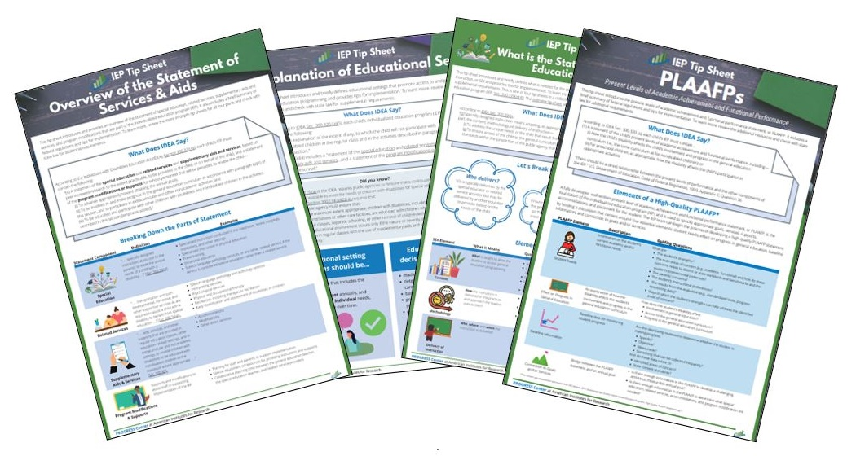
PROGRESS Resources to Support the Development of High-Quality Educational Programming
Notes:
IEP Tip Sheet: Overview of Statement of Services and Aids: https://promotingprogress.org/resources/iep-tip-sheet-overview-statement-services-and-aids

Slide 151
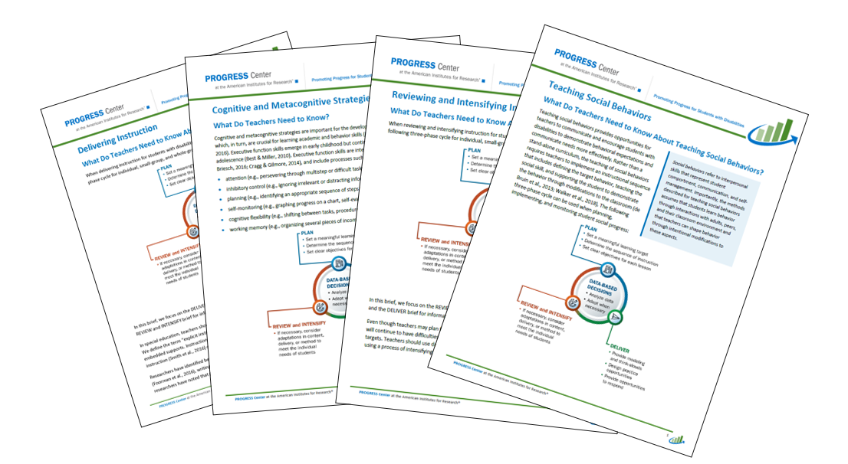
PROGRESS Resources to Support the Implementation of High-Quality Educational Programming

Slide 152
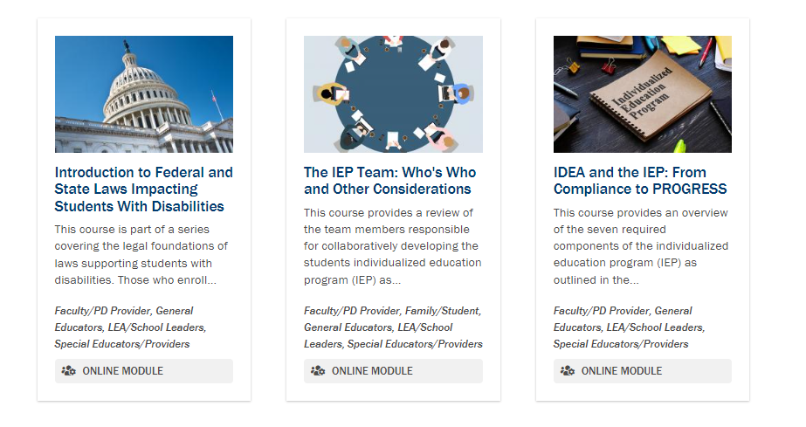
Self-Paced Training Modules

Slide 153
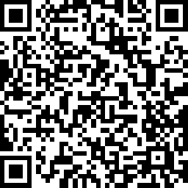
Event Reflection
Notes:
https://www.research.net/r/PROGRESS-Aug2-3

Slide 154
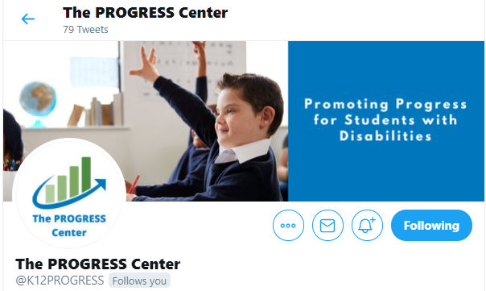
Staying Connected With the PROGRESS Center
Connect to us on Facebook and Twitter @k12progress
https://promotingprogress.org/news/connect-progress-center
Notes:
If you want to stay up to date, sign up for out newsletter on our home page or follow up on Twitter and Facebook.

Slide 155
Thank You
155

Slide 156
Disclaimer
This material was produced under the U.S. Department of Education, Office of Special Education Programs, Award No. H326C190002. David Emenheiser serves as the project officer. The views expressed herein do not necessarily represent the positions or policies of the U.S. Department of Education. No official endorsement by the U.S. Department of Education of any product, commodity, service, or enterprise mentioned in this presentation is intended or should be inferred.

Slide 157
Thank You
1400 Crystal Drive, 10th Floor
Arlington, VA 22202-3289
202.403.5000
progresscenter@air.org
promotingprogress.org | www.air.org
https://www.facebook.com/k12PROGRESS/
https://twitter.com/K12PROGRESS
Notice of Trademark: “American Institutes for Research” and “AIR” are registered trademarks. All other brand, product, or company names are trademarks or registered trademarks of their respective owners.
This material was produced under the U.S. Department of Education, Office of Special Education Programs, Award No. H326C190002. David Emenheiser serves as the project officer. The views expressed herein do not necessarily represent the positions or policies of the U.S. Department of Education. No official endorsement by the U.S. Department of Education of any product, commodity, service, or enterprise mentioned in this presentation is intended or should be inferred.
22623_09/23

