Slide 1
Indicators of Progress in the Wake of Endrew F.
Tessie Bailey| Perry A. Zirkel | Mitchell L. Yell
November 2023

Slide 2
Welcome to the PROGRESS Center!
The PROGRESS Center provides information, resources, tools, and technical assistance services to support local educators in developing and implementing high-quality educational programs that enable children with disabilities to make progress and meet challenging goals.
HOW WILL WE HELP IMPROVE OUTCOMES FOR STUDENTS WITH DISABILITIES?
Share current research,
policies, guidance, success stories, and experiences from students, parents, educators, and
other stakeholders.
Partner with selected
local educators to develop and implement high-quality educational programs.​
Provide tools, resources, and
training materials for ALL educators, leaders, and families.
Visit us at www.promotingPROGRESS.org to learn more!
≈

Slide 3
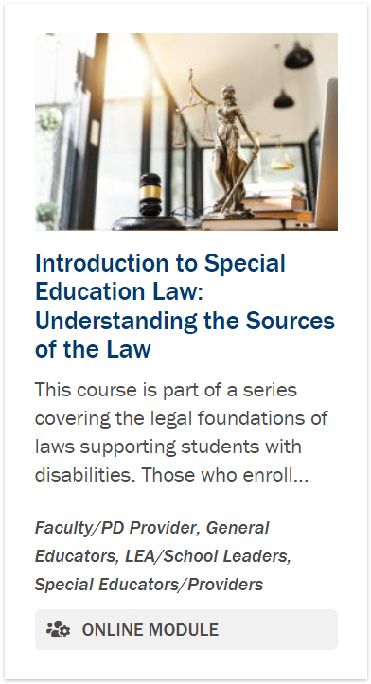
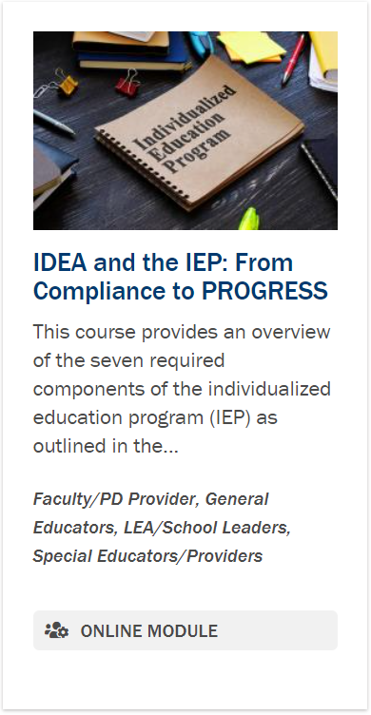
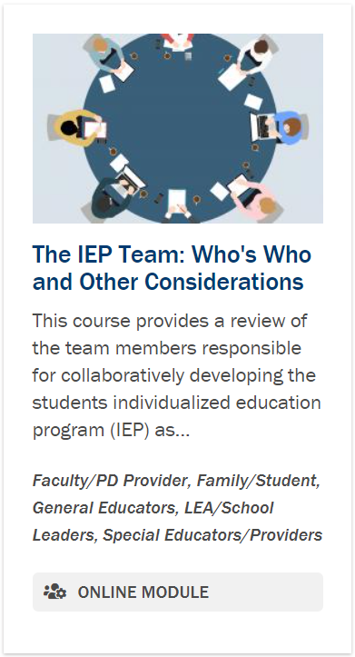
PROGRESS Center Special Education Law Modules

Slide 4
Why We Do What We Do
“To meet its substantive obligation under the IDEA, a school must offer an IEP [individualized education program] that is reasonably calculated to enable a child to make progress appropriate in light of the child’s circumstances.” [emphasis added]
—Endrew F. v. Douglas County School District RE-1 (2017)

Slide 5
Reflection: What is appropriate progress for students with disabilities?
What is appropriate progress for students with disabilities?

Slide 6
Meet the Presenters
Tessie Bailey
Perry A. Zirkel
Mitchell L. Yell
PROGRESS Center Director
PROGRESS Center Advisor
www.perryzirkel.com
PROGRESS Center Advisor
www.spedlawblog.com/author/mitchellyell/
Notes:
What is Appropriate Progress for Students with Disabilities?

Slide 7
How Familiar Are you with the Endrew F. Decision?
Use the chat to tell us how familiar you are with the Endrew F. decision.
0 | 1 | 2 | 3 | 4
Not Familiar | Very Little | Somewhat | Pretty Good | Very Familiar

Slide 8
Overview of Session
Thesis: The coverage in the special education literature often does not distinguish between legal requirements, as established by the courts, and professional best practices, as determined by special education experts.
Illustrative Focus: The indicators of progress that courts identify in applying Endrew F. and the differentiation from the professional literature.
Article available at: https://doi.org/10.1177/00144029231165500
Citation: Zirkel, P.A. & Yell, M.L. (2023). Indicators of progress in the wake of Endrew F.: The distinction between judicial rulings and professional recommendations. Exceptional Children. https://doi.org/10.1177/00144029231165500

Slide 9
Substantive Std. for FAPE under Rowley and Endrew F.
The Supreme Court in Endrew F. v. Douglas County School District RE-1 (2017) refined the substantive standard for a free appropriate public education (FAPE) under the IDEA.
Board of Education v. Rowley (1982): required IEPs to be “reasonably calculated to enable the child to receive educational benefit.”
Endrew F. v. Douglas County School District RE-1 (2017): required IEPs to be “reasonably calculated to enable the child to make progress in light of the child’s circumstances.”
Emphasis added.

Slide 10
Initial Indicators: Rowley
The Rowley Court identified two indicators of progress:
“[I]f the child is being educated in the regular classrooms of the public education system, [the IEP] should be reasonably calculated to enable the child to achieve passing marks and advance from grade to grade [i.e., promotion].”
with clarifying dicta (i.e., side comments):
not automatic
deference to local and state school authorities
Emphasis added.

Slide 11
Initial Indicators: Rowley Progeny
The lower courts’ application of the substantive standard of Rowley Court identified limited other indicators of progress:
Various rulings did not focus on specific indicators based on the “reasonable calculation” component and the “snapshot” approach.
Those rulings that identified indicators largely relied on the two in Rowley only to confirm the positive snapshot or to add other purportedly “objective evidence” – test scores, progress reports, and teacher testimony.
Emphasis added.

Slide 12
Endrew F.: Selective Reaffirmations
snapshot approach: “The ‘reasonably calculated’ qualification reflects a recognition that crafting an appropriate program of education requires a prospective judgment by school officials.”
differentiation: The legal focus is on “whether the IEP is reasonable, not whether the court regards it as ideal.”
progress indicators: “[F]or a child fully integrated in the regular classroom, an IEP typically should, as Rowley put it, be “reasonably calculated to enable the child to achieve passing marks and advance from grade to grade.”

Slide 13
Endrew F.: Nuanced Refinements
For “a student who is not fully integrated in the regular classroom and not able to achieve on grade level,” the reasonably calculated analog to passing grades and promotion is an “appropriately ambitious” IEP, including “challenging objectives.”
Repeated judicial deference but with judicial expectation that school authorities provide “a cogent and responsive explanation” for their decisions to show that the IEP meets the substantive FAPE standard.

Slide 14
Framework of This Analysis
Categories of progress indicators:
grades and promotion
standardized tests
other tests not covered in the “standardized” category
progress reports
other evidence of academic, functional, and behavioral advancement
Comparison of:
the “should” of the professional literature
the “must” of the judicial rulings applying Endrew F.

Slide 15
Overall Attributes from the Professional Literature
The “should” dimension is based on the professional literature in special education and related fields (e.g., school psychology).
The primary use of progress indicators is for formative purposes to guide instruction.
Progress indicators should have strong psychometric properties.
Progress indicators should be time-efficient and easy for the teacher to administer.
Progress indicators should directly sample the behaviors of interest.
Progress indicators should provide meaningful data in relation to a student's needs.
Progress indicators should inform instruction in different ways, thus accounting for multiple categories.
Source: https://charts.intensiveintervention.org/aprogressmonitoring

Slide 16
Overall Features of the Judicial Rulings
Court rulings during 5 years after Endrew F. (3/22/17) that (a) applied its substantive standard and (b) identified at least one progress indicator: 58 (13%) of 461 court decisions that cited Endrew F.
The outcomes distribution of the 58 substantive FAPE rulings was 88% in favor of school district and 12% in favor of parents.
The rulings largely did not rely on the more nuanced distinctions in the Endrew F. decision.
The courts were generally holistic and relatively relaxed rather than particularistic and rigorous in the approach to progress indicators.

Slide 17
Comparison of Professional & Judicial Interpretations: Grades and Promotion
Professional Recommendations
Grades should (a) focus solely on student proficiency, (b) adhere to clearly described performance standards, (c) be consistent from teacher to teacher, and (d) communicate useful and concrete information to students and their parents.
Judicial Rulings
Grades were the most frequent progress indicator in the court rulings.
The courts accorded negligible considerations to the limitations of these measures.
The absence of best practice standards for grades and promotion were likely attributable to the filtering factors endemic to the judiciary.
Yet, teachers often rely on informal and idiosyncratic adaptations, which lead to validity problems.
Thus, the use of grades or promotions is not suggested for use as a progress indicator.

Slide 18
Comparison of Professional & Judicial Interpretations: Standardized Test Scores
Professional Recommendations
Standardized tests refer to any measures that are administered, scored, and interpreted a consistent or standard manner across different times and places.
Judicial Rulings
Standardized tests were the second most frequently identified progress indicators.
Include norm-referenced tests of achievement and proficiency assessments.
Include general outcome measurement (GOM).
Questionable indicators of progress.
Caveats: e.g., use of percentile ranks, such as grade equivalent scores.
Those most commonly identified were standardized achievement measures and state proficiency tests.
Critical assessment of the limitations of these measures was absent.

Slide 19
Comparison of Professional & Judicial Interpretations: Other “Tests” (e.g., mastery measures)
Professional Recommendations
Judicial Rulings
The 58 rulings identified these other tests much less frequently than standardized instruments.
Mastery monitoring assessments can be standardized or teacher-made tests.
Teacher-made tests do not have known psychometric properties.
The empirical research on mastery monitoring tests warns against the overreliance or incautious use as progress indicators.
Standardized mastery monitoring may have manuals that report psychometric data.
These tests received negligible critical examination.

Slide 20
Comparison of Professional & Judicial Interpretations: Progress Reports
Professional Recommendations
Judicial Rulings
The court rulings specifically identified progress reports almost as frequently as standardized tests but less than expected in light of the statutory IEP requirement.
Progress reports should
A key qualifier for progress reports is high frequency.
Include in the IEP, with systematic implementation, analysis, and reporting.
This difference may be attributable to the limited scope and specificity of this requirement.
provide data specific to the IEP goals,
explain the data clearly for the service providers and parents, and
predict whether a student will meet his or her goals.

Slide 21
Comparison of Professional & Judicial Interpretations: Other Progress Indicators
Professional Recommendations
Judicial Rulings
Although the court rulings occasionally address other indicators (e.g., behavioral records or work samples), the most heavily weighted progress indicator was the testimony of teachers and other district personnel.
Data-based decision making procedures share the following data characteristics:
The literature refers to data-based judgments as integral for assessing student progress.
collected,
displayed,
interpreted, and
used for instructional decisions.
This preeminence is largely attributed to (a) the institutional nature of courts, in which witnesses serve as the primary source of evidence, and (b) the Rowley-Endrew F. emphasis on judicial deference to school authorities.

Slide 22
One Reason for the Discrepancy
Institutional Characteristics of the Judiciary:
Courts are not only congested, but also generalists.
The adjudication system of the IDEA allocates a reviewing, not trial, role to the courts.
Courts are oriented to procedural, not policy, analysis.
Courts are increasingly unlikely to engage in activism, leaving such matters to the other two branches.

Slide 23
Implications
Do not fuse or confuse the minimum “musts” of the case law with the higher “should” of the education profession.
To the extent that closing the gap is sought, the appropriate ways are via (a) effective lobbying at state or federal levels and (b) serving as an expert witness in due process hearings to educate the courts in the identification, evaluation, and application of progress indicators.
Conversely, the emphasis should be on developing and disseminating evidence-based best practice that yields professionally appropriate progress in collaboration with parents, thus proactively exceeding and superseding the legal standard.

Slide 24
Reflection: What is Progress for Students With Disabilities?
IEP Goal Progress
--
“advance appropriately toward attaining annual goals”
[IDEA Sec. 300.320(4)(i)]
Grade Level Progress
--
“make progress in the general education curriculum”
[IDEA Sec. 300.320]
Performance on National and State Accountability Measures
--
Academic Proficiency and Graduation
(SPP Indicators 1, 3B, & 3C)
Post-School Success
--
Enrollment in higher education, or in some other postsecondary
education or training program; or competitively employed or in
some other employment
(SPP Indicator 14)

Slide 25
Questions and Reflections

Slide 26
Resource Spotlight
Q&A: Endrew F. v. Douglas County School District Case Q&A (Dec. 7, 2017), https://sites.ed.gov/idea/idea-files/qa-endrew-f-v-douglas-county-school-district-case-qa/
Individuals with Disabilities Education Act (IDEA) website, https://sites.ed.gov/idea/
Brings together IDEA information and resources from the Department and its grantees.
IDEAS That Work, https://osepideasthatwork.org/
For information from research to practice initiatives funded by OSEP that address the provisions of IDEA and ESSA. This website includes resources, links, and other important information relevant to OSEP’s research to practice efforts.

Slide 27
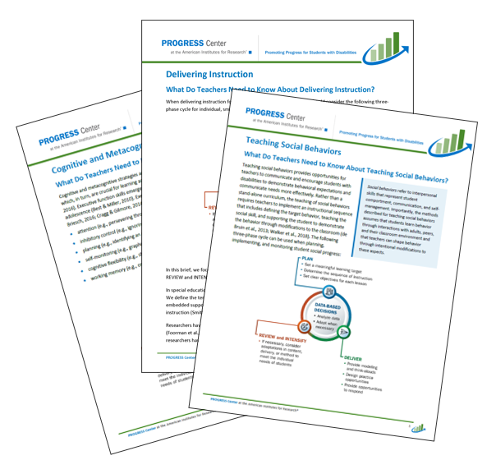
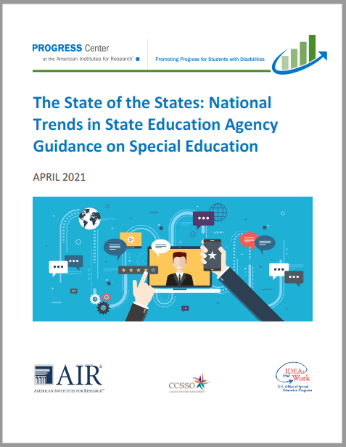
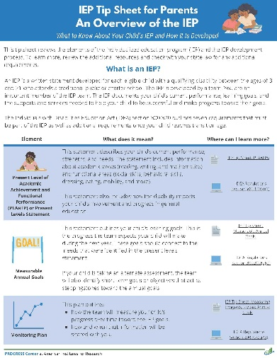
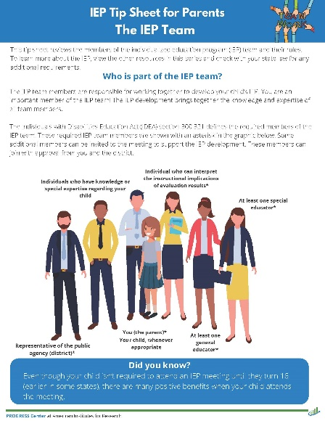
PROGRESS Center Resources
https://promotingprogress.org/

Slide 28
References
Zirkel, P. A. (2020). Legal information in special education: Accuracy with transparency. Exceptionality, 28(4), 312–315.
Zirkel, P.A. (2022a). Legal requirements for progress monitoring under the IDEA: What do the courts say? Exceptionality, 30, 297–309.
Zirkel, P. A. (2022b). Which progress indicators do court use in applying the Endrew F. substantive standard for FAPE under the IDEA? West’s Education Law Reporter, 399, 1–10
Zirkel, P.A. & Yell, M.L. (2023). Indicators of progress in the wake of Endrew F.: The distinction between judicial rulings and professional recommendations. Exceptional Children. https://doi.org/10.1177/00144029231165500

Slide 29
Disclaimer
This material was produced under the U.S. Department of Education, Office of Special Education Programs, Award No. H326C190002. David Emenheiser serves as the project officer. The views expressed herein do not necessarily represent the positions or policies of the U.S. Department of Education. No official endorsement by the U.S. Department of Education of any product, commodity, service, or enterprise mentioned in this presentation is intended or should be inferred.

Slide 30
PROGRESS Center
progresscenter@air.org
1400 Crystal Drive, 10th Floor
Arlington, VA 22202-3289
202.403.5000
progresscenter@air.org
promotingprogress.org | www.air.org
https://www.facebook.com/k12PROGRESS/
https://twitter.com/K12PROGRESS
Notice of Trademark: “American Institutes for Research” and “AIR” are registered trademarks. All other brand, product, or company names are trademarks or registered trademarks of their respective owners.
This material was produced under the U.S. Department of Education, Office of Special Education Programs, Award No. H326C190002. David Emenheiser serves as the project officer. The views expressed herein do not necessarily represent the positions or policies of the U.S. Department of Education. No official endorsement by the U.S. Department of Education of any product, commodity, service, or enterprise mentioned in this presentation is intended or should be inferred.
XXXXX_MO/22

