Slide 1
Classroom Management Strategies to Support All Learners
Caitlyn Majeika, PhD
January 2024
XXXXX_MO/22

Slide 2
Welcome from PROGRESS & NCII!
www.promotingPROGRESS.org
www.intensiveintervention.org
Notes:
PROGRESS Center: https://promotingprogress.org/
National Center on Intensive Intervention: https://intensiveintervention.org/

Slide 3
Welcome!
Caitlyn is a Senior Researcher at American Institutes for Research (AIR), where she supports a portfolio of research and evaluation efforts related to special education and multi-tiered system of supports (MTSS). She has extensive expertise in classroom management and positive behavioral interventions and supports (PBIS). She also has expertise in intensive intervention and provides knowledge development for the National Center on Intensive Intervention. Previously, she worked as a special education teacher, behavior analyst, and assistant professor.

Slide 4
Who’s In The Room?
Share the following in the chat:
name, location, and role
A fast casual restaurant that feels nostalgic to your childhood

Slide 5
What Is Your Familiarity/Comfort With Classroom Management Strategies?
0 | 1 | 2 | 3 | 4
None | Very Little | Somewhat | Pretty Good | I Got This!
5

Slide 6
Agenda
Setting the Stage
Understanding Behavior
Classroom Management Tips
Strategy 1: Setting Clear Behavioral Expectations
Strategy 2: Behavior-Specific Praise
Strategy 3: Opportunities to Respond
Learners With More Intensive Needs
Additional Resources and Wrap Up

Slide 7
Setting the Stage

Slide 8
Fast Casual Restaurants

Slide 9
Connecting fast casual and classroom management
What do fast casual restaurants have to do with classroom management?

Slide 10
Purpose of Today’s Webinar
Well-structured and predictable classroom environments can reduce behavior problems and improve access to and enhance benefit from the general curriculum for all students, including students with disabilities and intensive needs.

Slide 11
Classroom Management

Slide 12
What Word First Comes to Mind When You Hear “Classroom Management”?
Type your response in the chat.

Slide 13
What Is Classroom Management?
Classroom management is
a system to create an environment that facilitates learning;
a framework for teacher behavior; and
a way to benefit all learners, especially those with disabilities.
Classroom management is not
rewards, tangibles, bribes;
a way to control or punish students,
sticks and carrots;
needed only in specific settings or types of schools (e.g., public); or
only for students with disabilities.

Slide 14
Who Is Classroom Management Important For? 2
Teachers
Shapes teacher behavior
Helps teachers create a structured environment
Makes expectations explicit
Students
Provides a predictable environment with clear expectations
Cultivates a positive environment
Facilitates access to instruction
Students with disabilities particularly benefit from a structured, predictable environment that promotes access to the general curriculum.
Notes:
Add something SWDs

Slide 15
Understanding Behavior

Slide 16
Behavior Is Learned
Do not assume that children know the rules, expectations, or social skills in your setting.
Every social interaction you have with a child teaches the child something.

Slide 17
Three-Term Contingency
A
B
C
Antecedent
Behavior
Consequence

Slide 18
Why Does This Matter?
Antecedents and consequences can be changed as part of your classroom management plan to help reduce problem behavior and increase prosocial behavior.
A
B
C
Antecedent
Behavior
Consequence

Slide 19
Today’s Classroom Management Tips
A
B
C
Antecedent
Behavior
Consequence

Slide 20
Strategy 1: Setting Clear Behavioral Expectations

Slide 21
What Are Behavioral Expectations?
Statements of behaviors you expect all students to engage in
Class-wide behavioral expectations should
be linked to school-wide expectations,
be stated positively, and
include a list of three to five definitions.

Slide 22
Why Are Expectations Important?
“Classroom management makes seen your unseen expectations.”
—Linda Thompson, 3rd grade teacher, Whitsitt Elementary School

Slide 23
Examples of Positive Expectations
Elementary level
Use materials in the way they are supposed to be used.
Stay in your area.
Be respectful to other students by keeping your body, hands, and feet to yourself.
Secondary level
Keep cell phone in designated area.
Be responsible and complete work as expected.
Use appropriate and respectful language when speaking with teachers and peers.
Arrive to class on time and with all materials.

Slide 24
Considerations for Setting Behavioral Expectations
Explain the purpose for setting expectations.
Create expectations with students, keeping the needs of students with disabilities in mind.
Consider elements of the intersection of disability, race, ethnicity, culture, and community.
Make clear to students that behavioral expectations vary by setting/context.
Share examples of how behavior may differ in various contexts.
Teach, model, and reinforce expectations multiple times!

Slide 25
Apply Strategy 1
Let’s think about a classroom setting. Respond in the chat.
What can you do in your classroom tomorrow to ensure you have clear behavioral expectations?
What can you do over the next month?

Slide 26
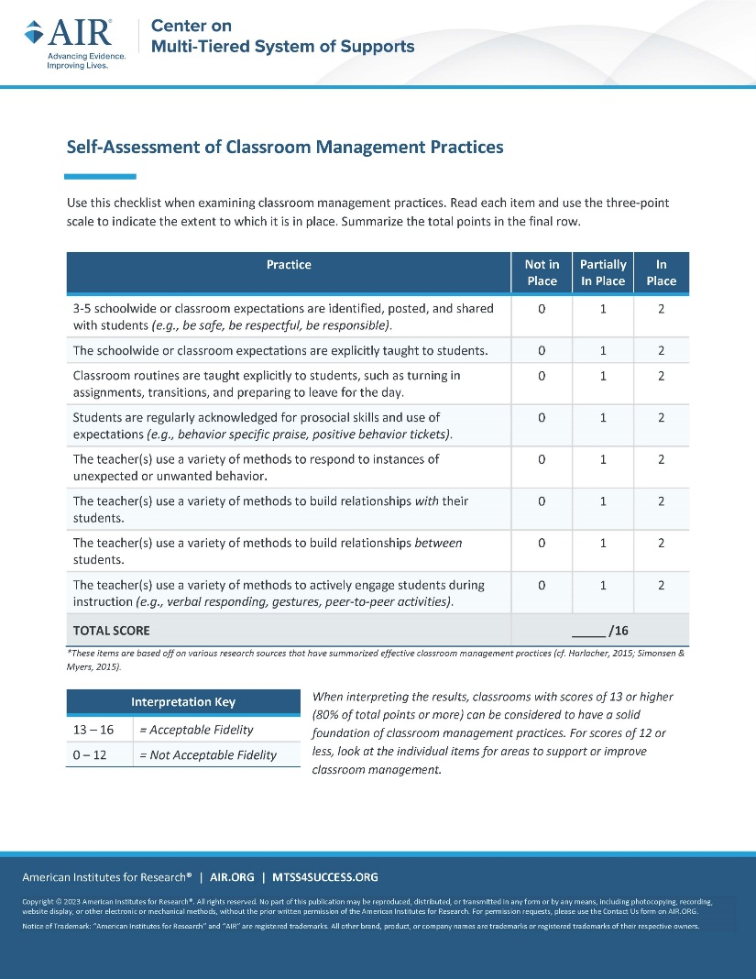
Resources
Notes:
Center on Multi-Tiered System of Supports (MTSS)
https://mtss4success.org/resource/self-assessment-classroom-management
National Center on Intensive Intervention (NCII)
https://intensiveintervention.org/antecedent-and-instructional-strategies-behavior-course
Center on Positive Behavioral Interventions & Supports (PBIS)
https://www.pbis.org/resource/pbis-cultural-responsiveness-field-guide-resources-for-trainers-and-coaches

Slide 27
Strategy 2: Behavior-Specific Praise

Slide 28
What Is Positive Reinforcement?
Reinforcement increases behavior
Positive reinforcement: adding something pleasant or desirable to make a target behavior more likely to occur

Slide 29
Why Is Behavior-Specific Praise Important?
Positively acknowledges the expected and appropriate behavior in which a student engaged
Behavior-specific praise | Nonspecific statements
Great job bringing materials for class. Thank you for keeping your hands and feet to yourself. Nice work turning in your work on time. Yes! That is the way we walk down the hall. Well done sharing your computer during centers. | Great job. Thank you. Nice. Yes! Well done!

Slide 30
Why Is Behavior-Specific Praise Important?
Acknowledges when students engage in behavioral expectations
Clarifies when student behavior aligns with expectations
Helps establish 4:1 praise-to-reprimand ratio
Cultivates a positive learning environment

Slide 31
Considerations for Behavior-Specific Praise
Ensure that praise is developmentally and age appropriate.
Ensure that praise matches student preferences.
Some students may want verbal praise, whereas others may not.
Some students may want praise in front of other students, whereas others may prefer that it be delivered privately.
Modify delivery of praise as needed for students with disabilities.

Slide 32
Apply Strategy 2
Let’s think about a classroom setting now. Respond in the chat.
What can you do in your classroom tomorrow to improve your delivery of praise?
What can you do over the next month?

Slide 33
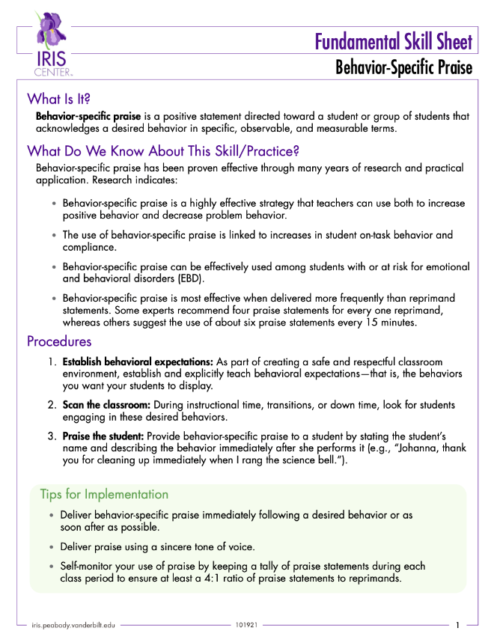
Resources
Notes:
IRIS Center
https://iris.peabody.vanderbilt.edu/wp-content/uploads/misc_media/fss/pdfs/2018/fss_behaviro_specific_praise.pdf

Slide 34
Strategy 3: Opportunities to Respond

Slide 35
What Is an “Opportunity to Respond”?
A question, statement, or prompt that solicits a student response.
Student responses can be verbal or nonverbal.
Examples:
Sarah, what is the name of this element?
Raise your hand if you agree with this statement.
Write your answer on your mini whiteboard and hold it up.
Turn and talk with a peer.
Answer this Kahoot! poll.

Slide 36
Why Are Opportunities to Respond Important?
“An engaging lesson is one of the most effective classroom management plan[s].”
—Kim Paulsen, Professor of the Practice, Vanderbilt University

Slide 37
Considerations for Opportunities to Respond
Vary the type of opportunities to respond used throughout each lesson.
Offer opportunities to the whole class (“Raise your hand if…”) or an individual student (“Min, can you…”).
Use responses as formative assessment data.
Use response types that accommodate the needs of students with disabilities.
Praise and reinforce students who meet classroom behavioral expectations while engaging in opportunities to respond.

Slide 38
Opportunities to Respond and Students with Disabilities or Intensive Needs
The more intensive a student’s needs, the more opportunities to respond and practice are needed.
Tips for setting students up for success and making opportunities to respond more predictable:
Use signals
Use multiple mediums
Turn & talk before asking for response
Use opportunities that are accessible to all

Slide 39
Apply Strategy 3
Let’s think about a classroom setting now. Respond in the chat.
What can you do in your classroom tomorrow to increase or enhance opportunities to respond?
What can you do over the next month?

Slide 40
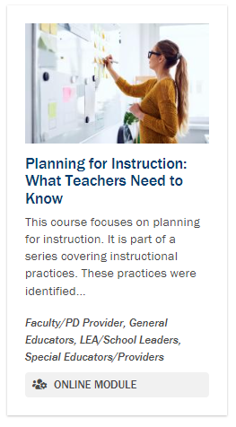
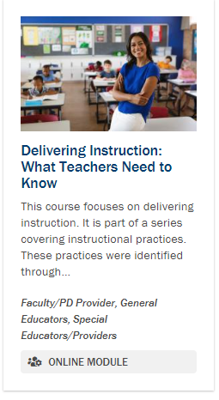
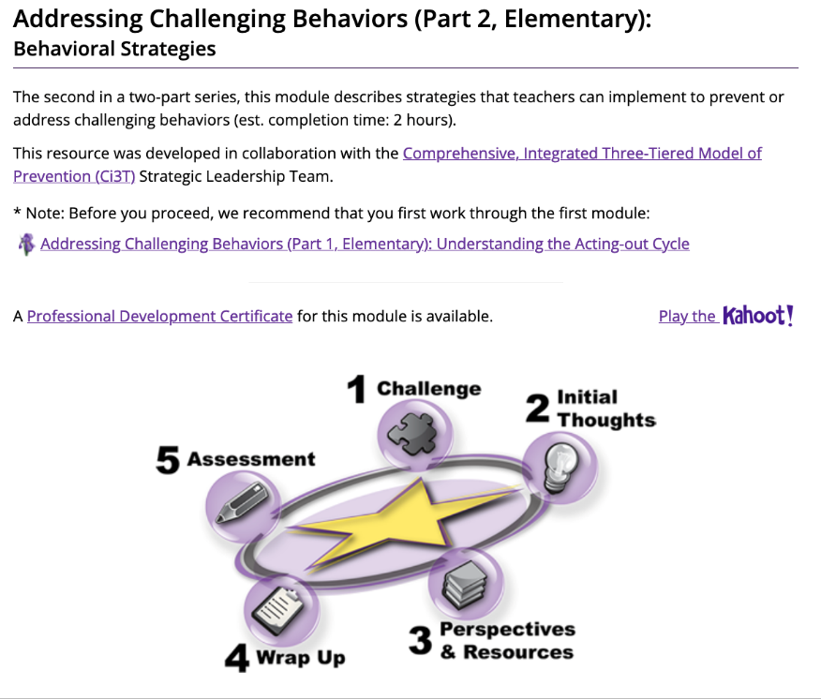
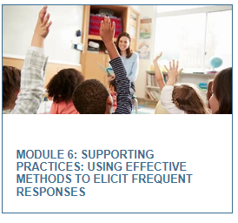
Resources for Opportunities to Respond
Notes:
Center on MTSS
https://mtss4success.org/resource/assessment-opportunities-respond
IRIS Center
https://iris.peabody.vanderbilt.edu/module/bi2-elem/cresource/q1/p06/
PROGRESS Center
https://promotingprogress.org/training/planning-instruction
https://promotingprogress.org/training/delivering-instruction
NCII
https://intensiveintervention.org/explicit-instruction-frequent-responses

Slide 41
Learners With More Intensive Needs

Slide 42
What If Students Need More?
No one strategy or system is going to be 100% effective for all students on all days.

Slide 43
More Intensive Classroom Management Strategies
Class-wide supports
Token economy
Class-wide function-based intervention teams (CW-FIT)
Good behavior game
Individual student support
Adult mentor
Peer buddy
Check-in, check-out
Social skills lessons

Slide 44
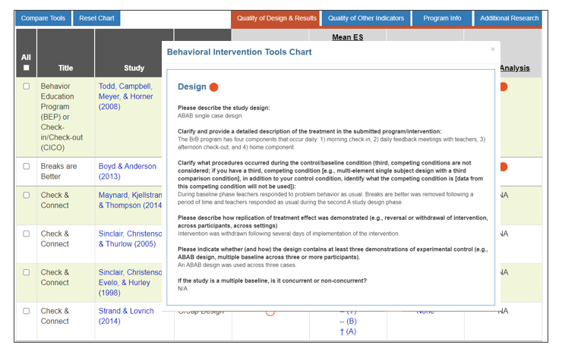
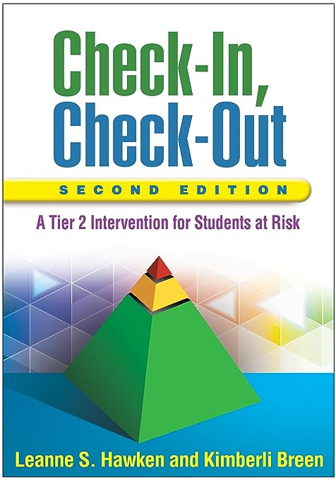
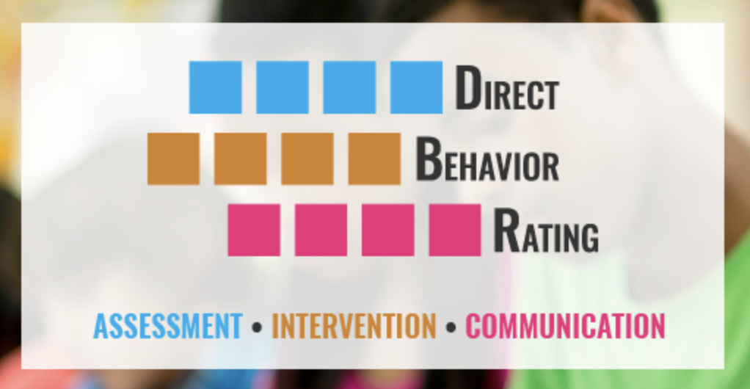
Resources
Notes:
CW-FIT
https://cwfit.ku.edu/
DBR
https://direct-behavior-ratings.education.uconn.edu/
NCII
https://charts.intensiveintervention.org/bintervention

Slide 45
Additional Resources

Slide 46
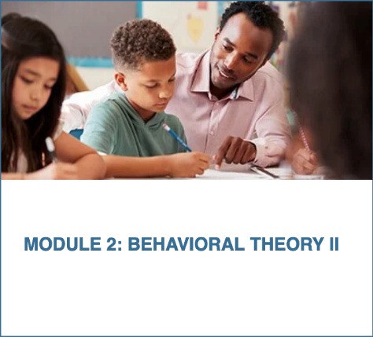
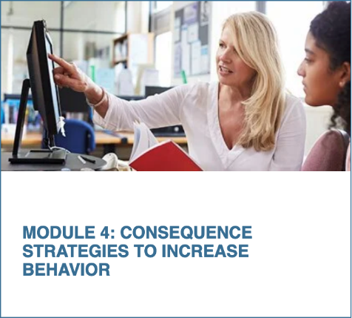
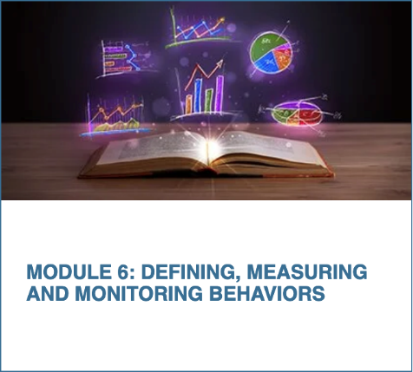
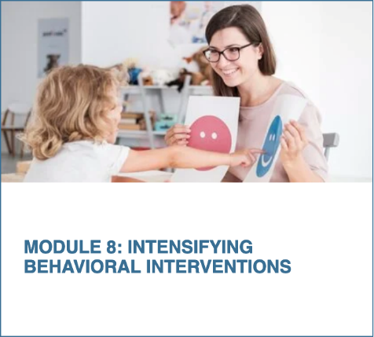
NCII: Behavior Support for Intensive Intervention
An eight-module course focused on enhancing educators’ skills in behavior support for intensive intervention
46
Notes:
NCII:
https://intensiveintervention.org/training/course-content/behavior-support-intensive-intervention

Slide 47
NCII: Taxonomy of Intervention Intensity
Notes:
NCII:
https://intensiveintervention.org/implementation-intervention/taxonomy-intervention-intensity

Slide 48
PROGRESS Center: Teaching Social Behavior
Notes:
PROGRESS Center:
Module: https://promotingprogress.org/training/teaching-social-behaviors
Brief: https://promotingprogress.org/resources/social-behaviors-brief

Slide 49
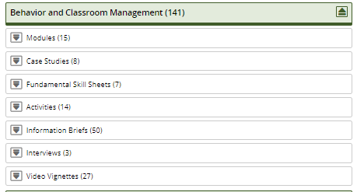
IRIS Center
Notes:
IRIS Center:
https://iris.peabody.vanderbilt.edu/
IRIS Behavior Modules Collection: https://promotingprogress.org/resources/behavior-and-classroom-management-modules

Slide 50
Wrap Up

Slide 51
What Is One Thing That Stuck With You From Today’s Session?
Type your response in the chat.

Slide 52
Questions

Slide 53
contact
1400 Crystal Drive, 10th Floor
Arlington, VA 22202-3289
202.403.5000
ncii@air.org
intensiveintervention.org
1400 Crystal Drive, 10th Floor
Arlington, VA 22202-3289
202.403.5000
progresscenter@air.org
promotingprogress.org
https://www.facebook.com/TheNCII https://www.facebook.com/k12PROGRESS
https://twitter.com/TheNCII https://twitter.com/K12PROGRESS

Slide 54
Disclaimer
This material was produced under the U.S. Department of Education, Office of Special Education Programs, Award No. H326C190002 and H326Q210001. David Emenheiser and Celia Rosenquist serve as the project officers. The views expressed herein do not necessarily represent the positions or policies of the U.S. Department of Education. No official endorsement by the U.S. Department of Education of any product, commodity, service, or enterprise mentioned in this webinar is intended or should be inferred.
National Center on Intensive Intervention at the American Institutes for Research

