Slide 1

Building Blocks of Progress:
The Role of the IEP
Steven Prater| Amy Peterson| Riley O’Donnell
August 2025
23664_01/24

Slide 2
Welcome
In the chat, share your name, role, and where you come from!

Slide 3
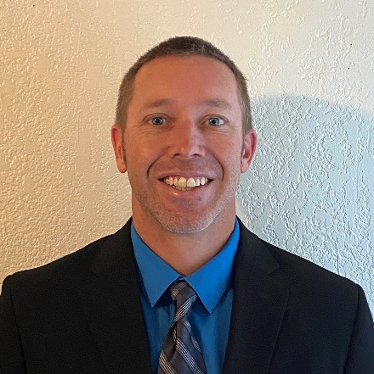


Presenter Introductions
Steven Prater
Amy Peterson
Riley O’Donnell
Intensive Technical Assistance Lead
PROGRESS Center
Universal Technical Assistance Lead
PROGRESS Center
Technical Assistance Provider
PROGRESS Center

Slide 4
Welcome Activity: Why did you choose to join us today?
Use the annotate feature in your toolbar to let us know which response resonates with you. Mark all that apply.
I’m new to special education/supporting students with disabilities.
I’m interested in a refresher on the IEP.
I’m looking for resources to share about the IEP.
I’m responsible for training/supporting staff or families who are new to the IEP.
Other (add why in the chat)

Slide 5
Session Outcomes
At the conclusion of the session, participants will be able to
Identify the essential components of an IEP as outlined in the Individuals with Disabilities Education Act (IDEA).
Explain how the IEP provides the foundation for promoting progress for students with disabilities.
Understand how parts of the IEP fit together to develop high-quality educational programming.
Apply tips and resources for developing and implementing IEPs that promote progress.

Slide 6

The Role of the IEP on the Path to PROGRESS

Slide 7

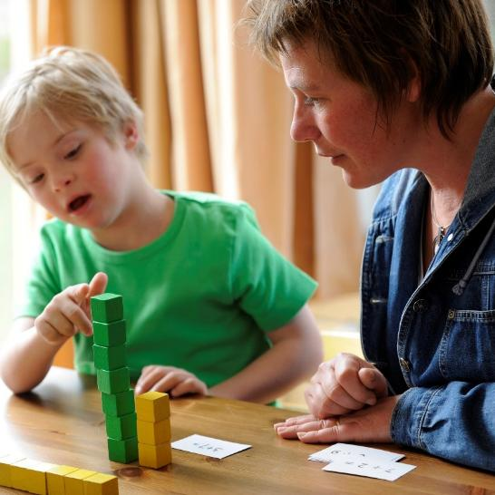

Equation
Development of high-quality instructional programming
Implementation of high-quality instructional programming
Improved access and outcomes— FAPE

Slide 8


Considerations for High-Quality Instructional Programming
How well is your core programming developed and delivered to promote progress and belonging for students with disabilities?
How well are your IEPs designed and delivered to promote progress for each student with a disability?

Slide 9
What are the necessary ingredients for designing and delivering high-quality instructional programming?
Believe in our collective ability to positively impact students and maintain high expectations for all students.
Know the students and their circumstances.
Know what knowledge, skills, and strategies students need to meet ambitious goals and show success in the general education classroom.
Ensure that all students feel like they belong in our school community.
Articulate what we want students to do.

Slide 10
IDEA Requirements for High-Quality Instructional Programming
Procedural
In the development of an IEP, has the IEP team complied with the procedures set forth in IDEA? (Rowley)
Substantive
Is the IEP reasonably calculated to enable the child to make progress that is appropriate in light of the child’s circumstances? (Endrew F.)
Implementation
In implementing the IEP, were the instructional services and supports outlined in the IEP provided as agreed on during the IEP process?
FAPE Requirements

Slide 11
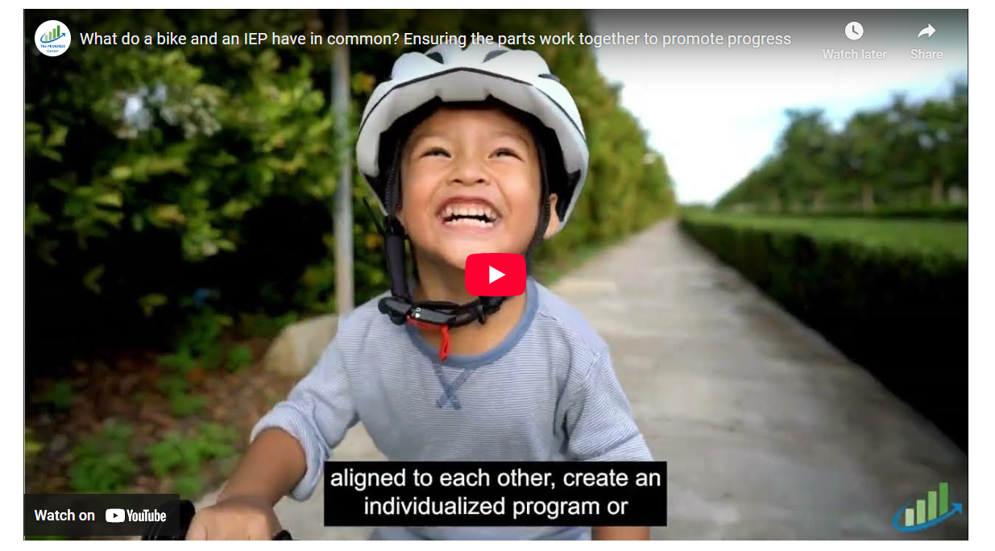
What do a bike and an IEP have in common? Ensuring the Parts Work Together to Promote Progress
Notes:
Video available at: https://promotingprogress.org/resources/bike-and-iep

Slide 12

IEPs: Same Essential Ingredients, but Individualized Based on Student Need

Slide 13


What good is a great IEP if it does not guide implementation?

Slide 14
Implementation of High-Quality IEPs
Fidelity of Implementation
Capacity to Implement

Slide 15


Implementing High-Quality Instructional Programming: Building a
Successful System
Staff Collaboration
Progress
Individualized Instruction and Supports
Effective General Curriculum with Supports
Educator Supports
IEP
Student Belonging

Slide 16

Back to Basics: The IEP

Slide 17

Per the IDEA, How Many Requirements Do All IEPs Have?
5
7
9
11
Present Levels of Academic Achievement and Functional Performance (PLAAFP)
Explanation of Education Setting
Participation in Assessment
Date, Frequency, Duration, and Location of Services
Statement of Special Education and Aids and Services
Measurable Annual Goals
Measuring Progress Toward Annual Goals
IDEA = Individuals with Disabilities Education Act.

Slide 18
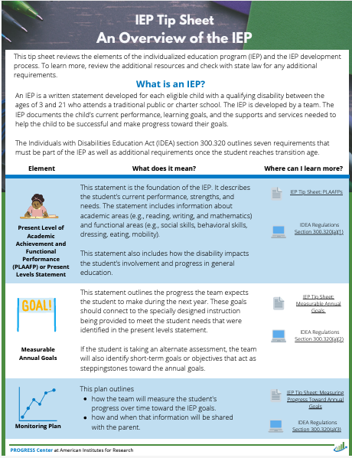
Analyzing the IEP Tip Sheet: Overview of the IEP
Individually, highlight or take note of the key features of the IEP (3 minutes).
In your small group, discuss the following (5 minutes):
  What stood out to you?
  What questions or wonderings do you have?
Discuss the questions as a whole group.

Slide 19
Did you know?
IDEA outlines the required components of the IEP, but it does not define what the IEP document must look like.
All states must meet the minimum requirements set by IDEA, but many states go above and beyond by establishing additional requirements for the development and implementation of the IEP for students with disabilities.

Slide 20
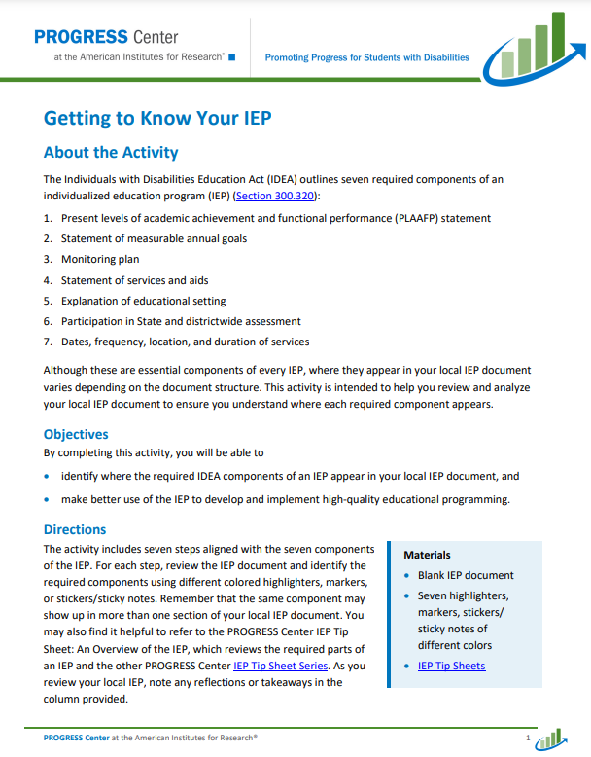
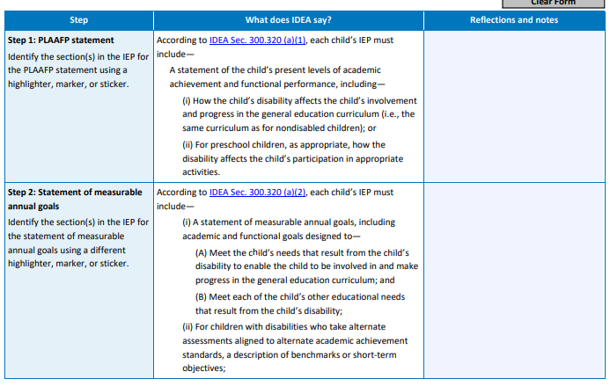
Getting to Know Your IEP

Slide 21
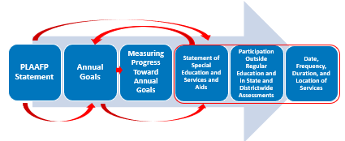
Internal Consistency: Connecting the Parts of the IEP

Slide 22
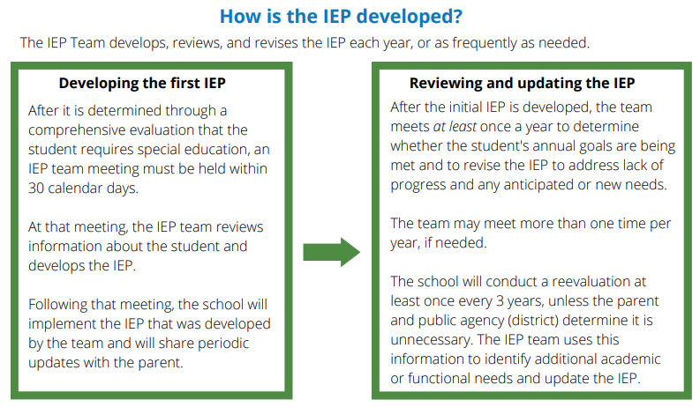
IEP Development

Slide 23
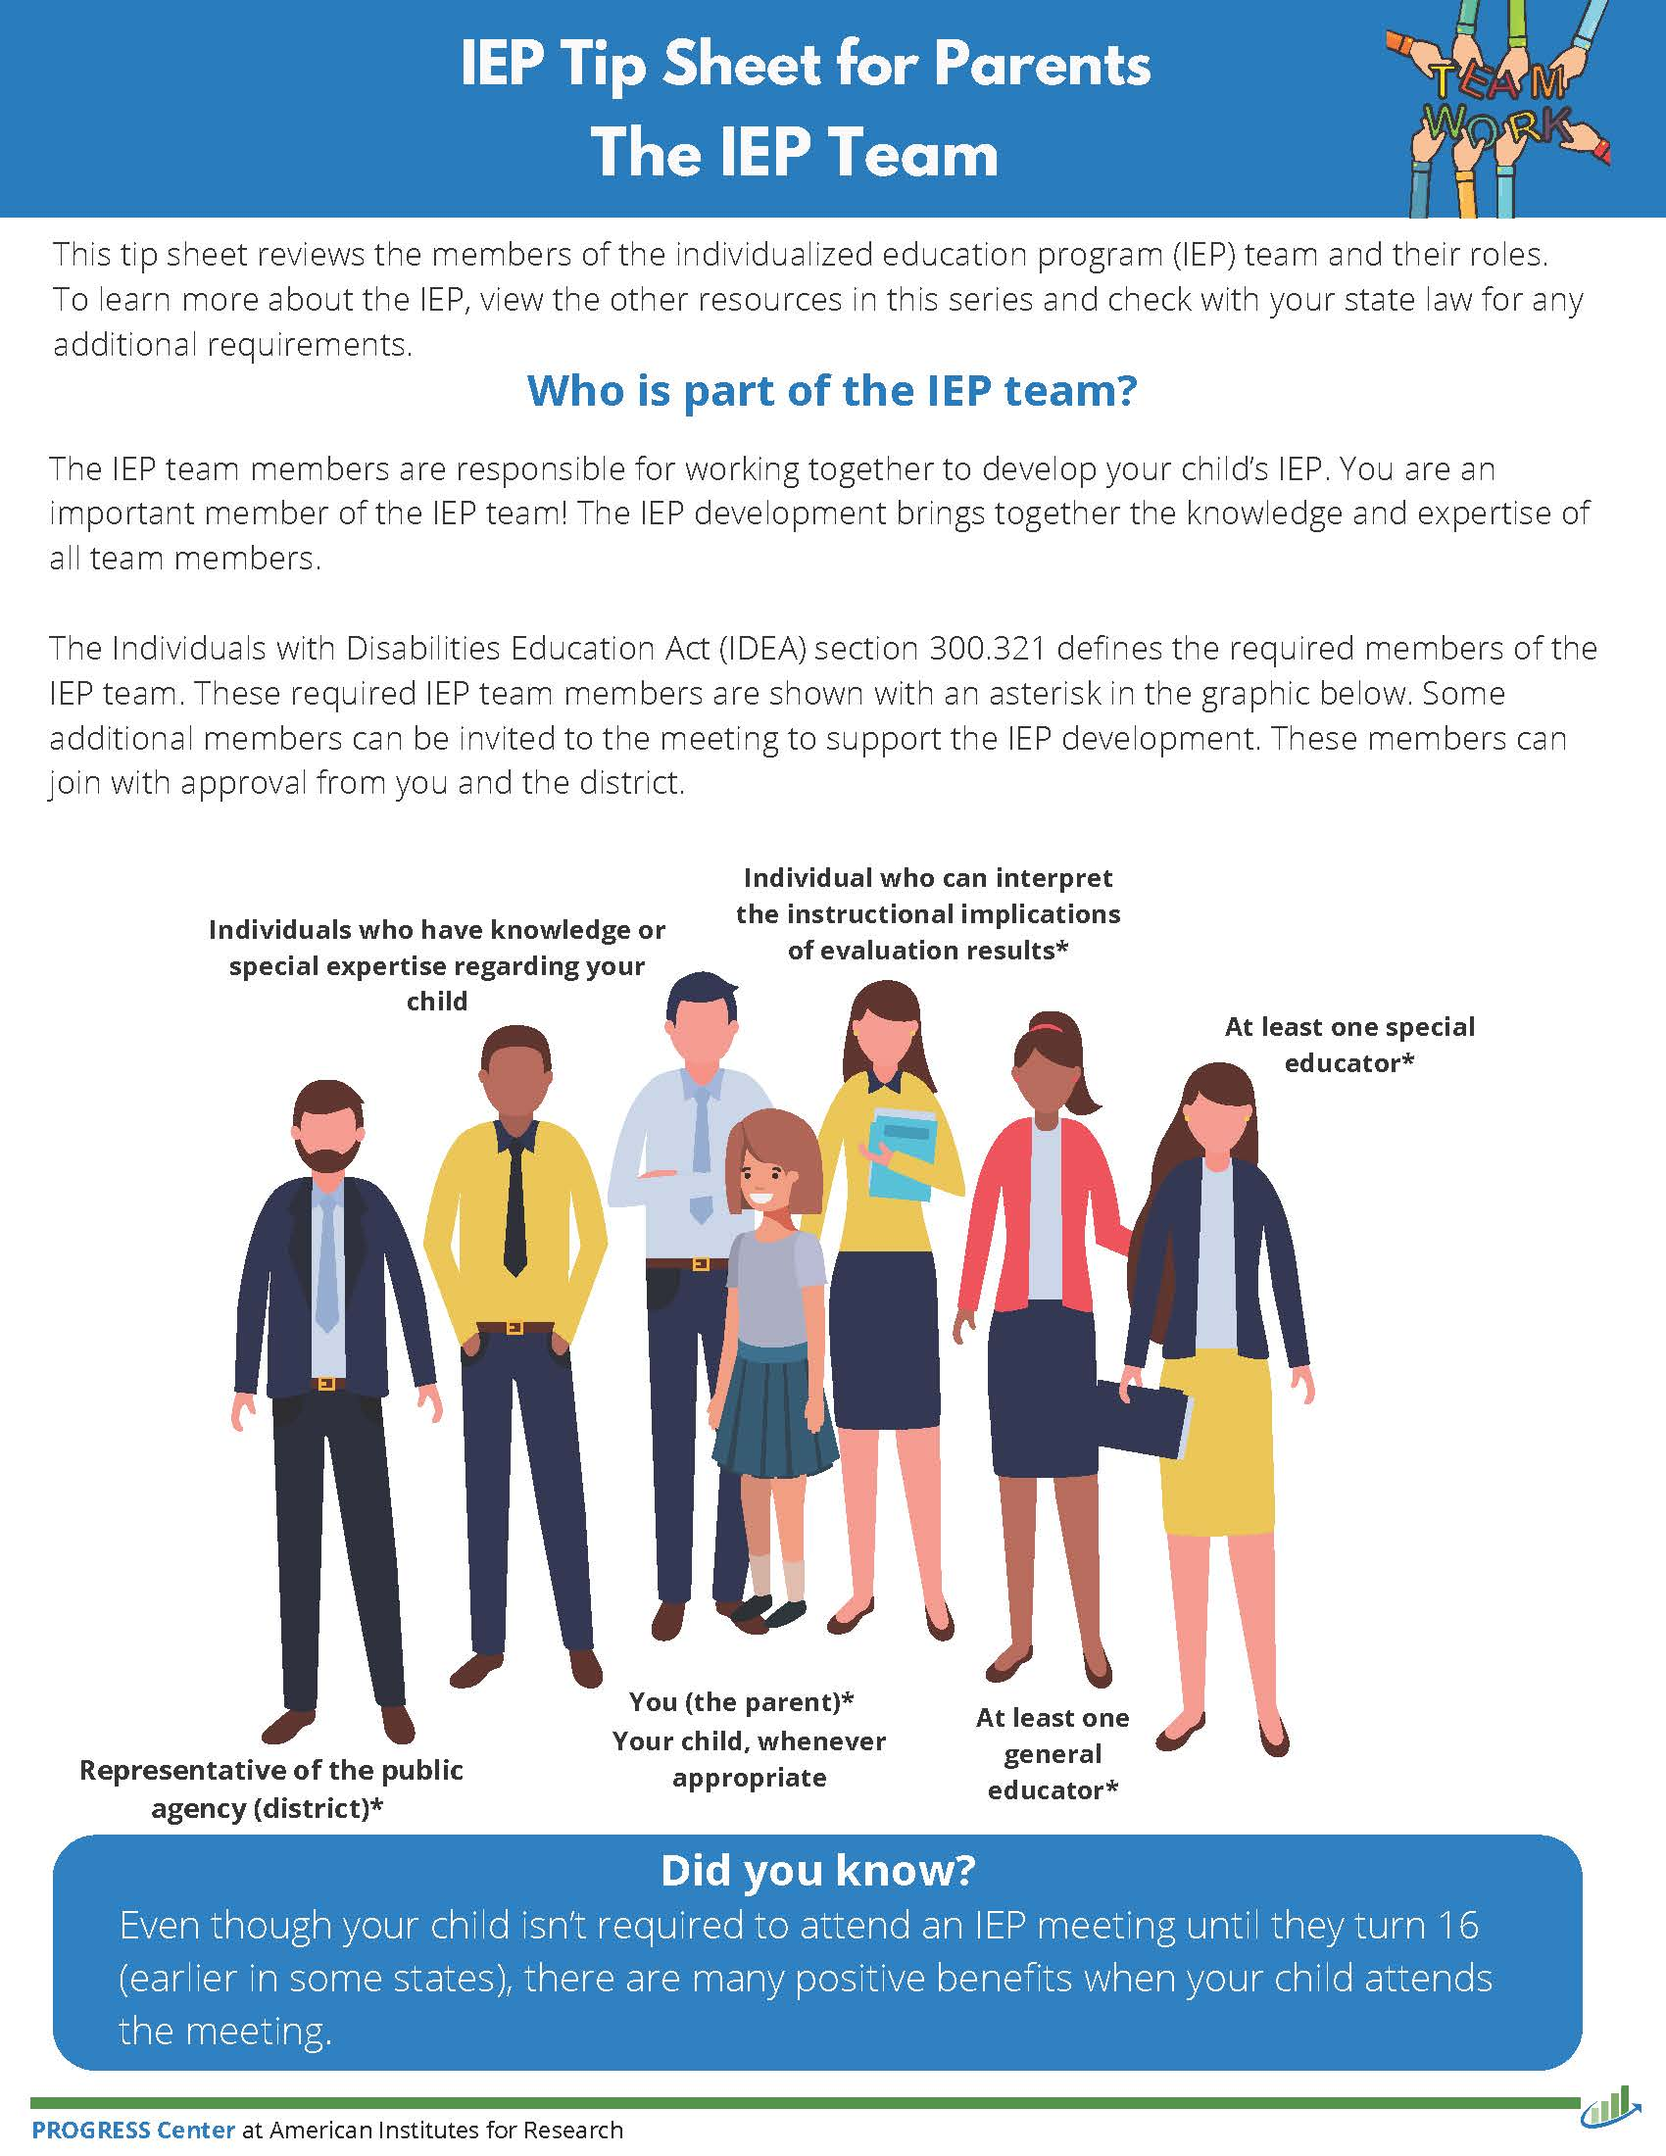
Who should be on the IEP Team?
The parents of the child;
Not less than one regular education teacher of the child . . .;
Not less than one special education teacher of the child, or where appropriate, not less than one special education provider of the child;
A representative of the public agency . . .;
An individual who can interpret the instructional implications of evaluation results . . .;
. . . other individuals who have knowledge or special expertise regarding the child . . .;
Whenever appropriate, the child with a disability.
Source: IDEA Sec. 300.321(a)

Slide 24
Did You Know? 1
It is possible for an IEP Team member to serve in multiple roles. For example, the special education teacher may have specific knowledge regarding the child in addition to expertise in interpreting the evaluation results.

Slide 25

Why is collective efficacy so important for IEP development and implementation?
There is no way a single teacher
has all the time,
all the knowledge,
and all the skills
to meet all the needs of
every child in his or her class(es).
Source: Buffman et al., 2009

Slide 26










We Are Better Together!
Special Education Teacher
Principal
General Education Teacher
Related Service Provider
Alex
Medical Professional
Family
Additional Staff
Paraprofessional

Slide 27

What is on your mind?

Slide 28

Developing High-Quality IEPs That Promote Progress
Knowing the Student’s Circumstances

Slide 29
What are the necessary ingredients for designing and delivering high-quality instructional programming? PLAAFP
Believe in our collective ability to positively impact students and maintain high expectations for all students.
Know the students and their circumstances.
Know what knowledge, skills, and strategies students need to meet ambitious goals and show success in the general education classroom.
Ensure that all students feel like they belong in our school community.
Articulate what we want students to do.

Slide 30
Connecting the PLAAFP to the Parts of the IEP
PLAAFP Statement
Annual Goals
Measuring Progress Toward Annual Goals
Date, Frequency, Duration, and Location of Services
Participation Outside Regular Education and in State and Districtwide Assessments
Statement of Special Education and Aids and Services
“There should be a direct relationship between the present levels of performance and the other components of the IEP. Thus, if the statement describes a problem with the child’s reading level and points to a deficiency in reading skills, the problem should be addressed under both goals and specific special education and related services provided to the child” (U.S. Department of Education, Code of Federal Regulations, 1999, Appendix C, Question 36. emphasis added).

Slide 31

Ensuring Appropriate Progress
Endrew F. v. Douglas County School District RE-1 (2017):
“To meet its substantive obligation under the IDEA, a school must offer an IEP that is reasonably calculated to enable a child to make progress appropriate in light of the child’s circumstances” (emphasis added, p. 16).
Source: Endrew F. v. Douglas County School District, 580 U.S. 16 (2017)

Slide 32
Ensuring Appropriate Progress 2
Endrew F. v. Douglas County School District RE-1 (2017):
“To meet its substantive obligation under the IDEA, a school must offer an IEP that is reasonably calculated to enable a child to make progress appropriate in light of the child’s circumstances” (emphasis added, p. 16).
Source: Endrew F. v. Douglas County School District, 580 U.S. 16 (2017)

Slide 33
Ensuring Appropriate Progress 3
Endrew F. v. Douglas County School District RE-1 (2017):
“To meet its substantive obligation under the IDEA, a school must offer an IEP that is reasonably calculated to enable a child to make progress appropriate in light of the child’s circumstances” (emphasis added, p. 16).
Source: Endrew F. v. Douglas County School District, 580 U.S. 16 (2017)

Slide 34
Breakout Activity: Knowing Your Student
Person 1
Listen while Person 1 shares and notes the impact of the disability as well as the primary and secondary needs.
Person 2 and 3
Identify a student with a disability who you know well.
When Person 1 finishes, take 2 minutes to ask questions for clarification.
Together
Take 2 minutes to confirm your description of the student, their needs, and what supports would be best.
In 3 minutes or less, describe the student’s disability, how it affects the student’s education, and what you think needs to happen for the student to be successful.
Introductions & Assignments
Share a short introduction
Number off 1-2-3

Slide 35

Group Discussion: Knowing Your Students
What are some key takeaways from this activity?
How easy or difficult was it to describe the student?
How does this activity facilitate meaningful engagement of families and other educators in the planning and development?

Slide 36
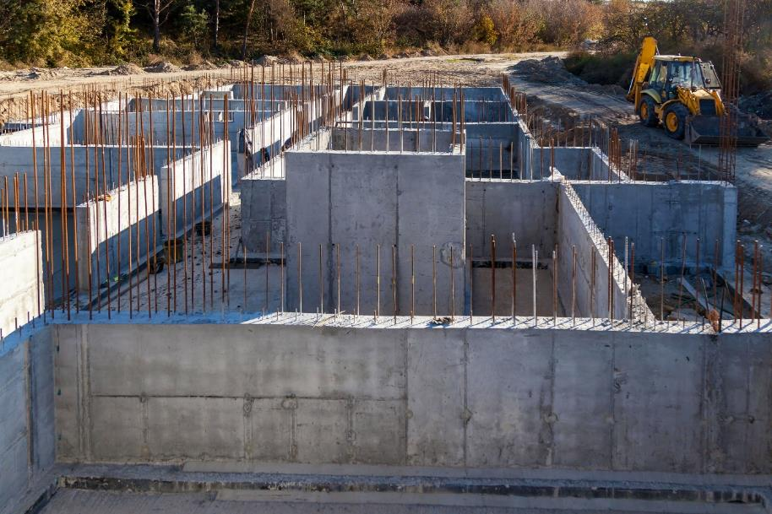
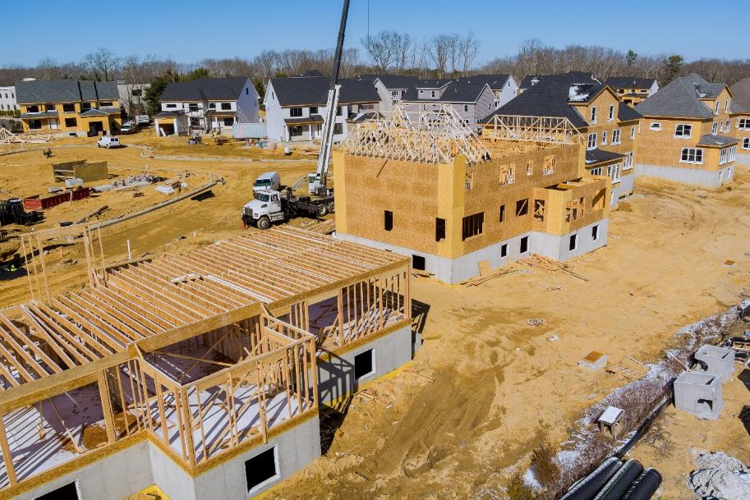
The PLAAFP Statement is the Foundation for the IEP

Slide 37
Key Questions for Designing the PLAAFP Statement
What do we want for our student? (described in the PLAAFP statement and measurable annual goals)
What is the student’s current reality and unique circumstances? (described in the PLAAFP statement)
What does the student need to be successful? (described in the PLAAFP statement and outlined in IEP aids/services)
How can we maximize our resources to support the student? (described in the placement and implementation of the IEP)
Essential for knowing the student and to collaboratively develop the PLAAFP statement with the family, student, related service providers, and educators.

Slide 38
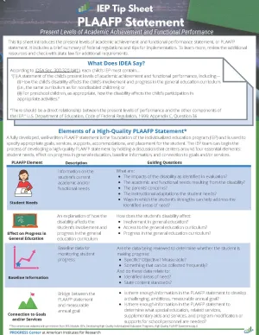
What does IDEA say about the PLAAFP statement?
(1) A statement of the child’s present levels of academic achievement and functional performance, including—
(i) How the child’s disability affects the child’s involvement and progress in the general education curriculum (i.e., the same curriculum as for nondisabled children); or
(ii) For preschool children, as appropriate, how the disability affects the child’s participation in appropriate activities.
Source: IDEA, Sec. 300.320 (a)(1); emphasis added

Slide 39
What is meant by present levels of academic achievement?
Examples of Areas Covered by
Academic Achievement
“Academic achievement” generally refers to a child’s performance in academic areas. It could vary depending on a child’s circumstance or situation; therefore, a definition of academic achievement is not included in the IDEA regulations.
History
Math
Reading
Writing
Science
Source: 71 Fed. Reg. at 46662.

Slide 40
What is meant by present levels of functional performance?
“Functional performance” generally refers to activities that are not considered academic or related to a child’s academic achievement.
“Functional” often is used in the context of routine activities of everyday living.
“The range of functional skills is as varied as the individual needs of children with disabilities.”
What are examples of functional skills that you typically see in your IEPs?
Source: 71 Fed. Reg. at 46662.

Slide 41
Examples of Functional Skills
Mobility
Dressing
Eating
Toileting
We commonly think of these
BUT…
Behavior
Social Skills
Communication
Executive Function
Did you think about these?

Slide 42




What are the four components of a high-quality PLAAFP statement?
Student Needs
Baseline Information
Effect on Progress in General Education
Connection to Goals and/or Services
This content was adapted with permission from the IRIS Center module titled IEPs: Developing High-Quality Individualized Education Programs. High-Quality PLAAFP Statements (p. 6).

Slide 43
Avoiding Assumptions!
If designed well, the PLAAFP statement prevents us from making decisions about programming or identifying practices/supports based on our assumptions rather than evidence.

Slide 44
Considerations for Developing the PLAAFP Statement
The PLAAFP statement is based on the individual needs that a child experiences because of their disability.
The PLAAFP statement is not based on the disability category.

Slide 45
What does the U.S. Department of Education say?
A district cannot lawfully prepare IEPs with the same statement of current levels of performance for all students in a specific program.
It is impermissible for districts to have the IEP for each student in a class/disability category contain identical statements of present levels of educational performance.
Source: OSEP Letter, 1987, 211 IDELR 464

Slide 46

The Power of Teams to Develop a High-Quality PLAAFP Statement
The PLAAFP statement is a collective statement that should include multiple perspectives from the
  student,
  parents,
  general educators,
  related service providers,
  special educators, and
  others who know and work with the student.
Tip for PROGRESS!
Collect and summarize data for the development of the PLAAFP statement prior to the IEP meeting to help facilitate more robust discussion.

Slide 47

Indicators of Progress

Slide 48
What are the necessary ingredients for designing and delivering high-quality instructional programming? Goals
Believe in our collective ability to positively impact students and maintain high expectations for all students.
Know the students and their circumstances.
Know what knowledge, skills, and strategies students need to meet ambitious goals and show success in the general education classroom.
Ensure that all students feel like they belong in our school community.
Articulate what we want students to do.

Slide 49
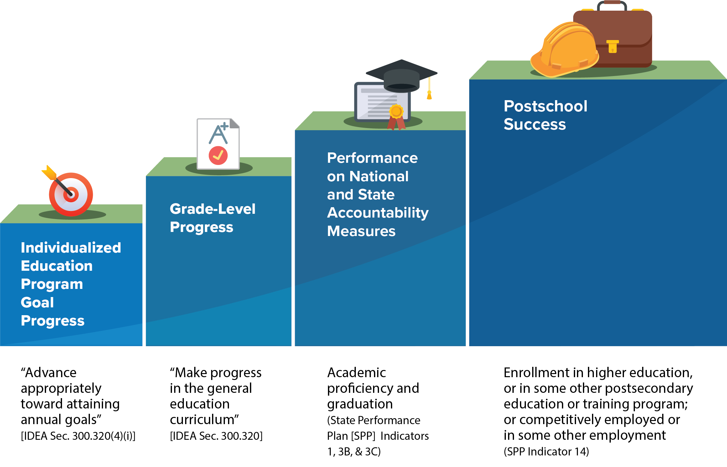
What is progress for students with disabilities?
Note: State Performance Plan (SPP)

Slide 50
The Role of the Goal
PLAAFP
Statement
Annual Goals
Measuring Progress Toward Annual Goals
Date, Frequency, Duration, and Location of Services
Participation Outside Regular Education and in State and Districtwide Assessments
Statement of Special Education and Aids and Services

Slide 51

Remember Endrew F.
Endrew F. v. Douglas County School District RE-1 (2017):
“To meet its substantive obligation under the IDEA, a school must offer an IEP that is reasonably calculated to enable a child to make progress appropriate in light of the child’s circumstances” (emphasis added, p. 16).
Source: Endrew F. v. Douglas County School District, 580 U.S. 16 (2017)

Slide 52
Why are measurable annual goals important?
Address individual academic and functional needs outlined in the PLAAFP statement.
Ensure high expectations and grade-level alignment, in light of the child's circumstances.
Assess whether the special education program is enabling the student to make progress, in light of the student’s circumstances.

Slide 53
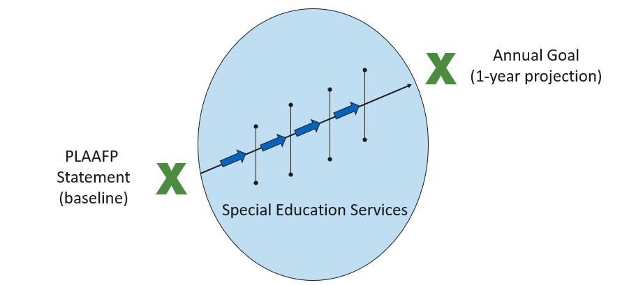
How do goals connect to the other components in the IEP?

Slide 54
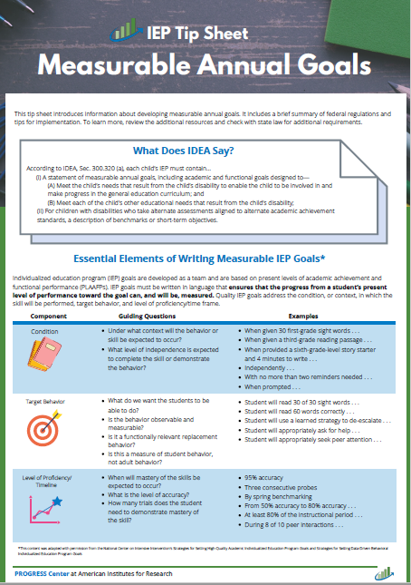
What does IDEA say about goals?
(i) A statement of measurable annual goals, including academic and functional goals designed to—
    (A) Meet the child’s needs that result from the child’s disability to enable the child to be involved in and make progress in the general education curriculum; and
    (B) Meet each of the child’s other educational needs that result from the child’s disability;
(ii) For children with disabilities who take alternate assessments aligned to alternate academic achievement standards, a description of benchmarks or short-term objectives
Source: IDEA, Sec. 300.320(a)(2)(i-ii)

Slide 55
IEP goals should….
focus on student behavior, not educator behavior.
be monitored with enough frequency to determine progress and make timely instructional/intervention decisions.
be measured using an objective, valid, and reliable measure (e.g., curriculum-based measure, Direct Behavior Rating (DBR), systematic direct observation) rather than a more subjective measure (e.g., teacher anecdotal notes).
be realistic, yet ambitious.

Slide 56

Did you know? 2
A single IEP goal can address multiple needs outlined in the PLAAFP statement.
For example:
An oral reading fluency goal related to reading proficiency might support students with needs related to sight words, phonics, and fluency.

Slide 57
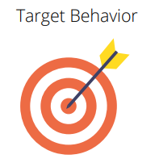

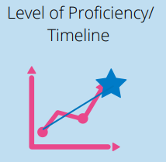
What are the three essential elements of measurable annual goals?
Measurable

Slide 58

Academic Goal Example
Academic goals should focus on skills necessary for the student to access and benefit from general education instruction that is aligned with state standards.
Revised Goal: Given a second-grade reading probe, Jesse will read 65 words correctly in
1 minute with
95% accuracy on three consecutive probes.
Draft Goal: Jesse will read 65 words per minute.
Essential Elements of Goals
Condition
Target behavior
Level of proficiency/ timeline

Slide 59

Functional Goal Example
Functional goals should increase access, participation, and/or independence in the general education curriculum or setting.
Revised Goal: During each 40-minute class period, José will remain academically engaged at least 70% of the class for five consecutive days as monitored by daily DBRs.
Draft: During each 40-minute class, José will pay attention and be engaged 95% of the time.
Essential Elements of Goals
Condition
Target behavior
Level of proficiency/ timeline

Slide 60
Most Importantly, Keep Your Annual IEP Goals FAIR
Feasible | Is the goal appropriately ambitious given the students unique circumstances? Can the goal realistically be achieved during the school year reflected in the IEP?
Acceptable | Is the goal acceptable to the student, family, and educators on the IEP team?
Impactful | Will achieving the goal, positively impact the student access and benefit from the general curriculum and other educational outcomes?
Relevant | Does the goal connect to a meaningful outcome for the student and his or her family?
Adapted from the National Center for Systemic Improvement https://ncsi-library.wested.org/resources/732

Slide 61
What is progress for students with disabilities? revisited
Note: State Performance Plan (SPP)

Slide 62
What is on your mind? 2

Slide 63

Developing High-Quality IEPs That Promote Progress
Statement of Services and Aids

Slide 64
What are the necessary ingredients for designing and delivering high-quality instructional programming? services
Believe in our collective ability to positively impact students and maintain high expectations for all students.
Know the students and their circumstances.
Know what knowledge, skills, and strategies students need to meet ambitious goals and show success in the general education classroom.
Ensure that all students feel like they belong in our school community.
Articulate what we want students to do.

Slide 65
How does the statement of services and aids connect to the other parts of the IEP?
PLAAFP
Statement
Annual Goals
Measuring Progress Toward Annual Goals
Date, Frequency, Duration, and Location of Services
Participation Outside Regular Education and in State and Districtwide Assessments
Statement of Special Education and Aids and Services

Slide 66
Remember!
All students are general education students first.
Some students require special education aids and services to access and benefit from general education similarly to their peers.

Slide 67





Did you know the IEP’s statement of services and aids includes four parts?
Special Education
Related Services
Supplementary Aids and Services
Program Modifications or Supports for School Personnel

Slide 68

The Statement of Services and Aids
Notes:
Link to video: https://youtu.be/ipCpc_Sw4As?si=heJFRqQPJIpFqKY4&t=8

Slide 69
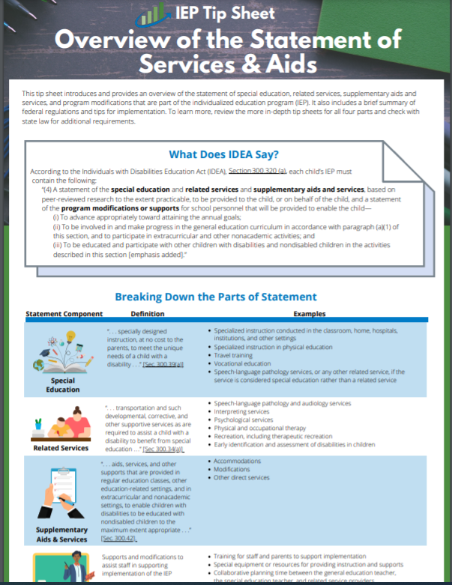
What does IDEA say about the statement of services and aids?
According to IDEA, Section 300.320 (a), each child’s IEP must contain the following:
“(4) A statement of the special education and related services and supplementary aids and services, based on peer-reviewed research to the extent practicable, to be provided to the child, or on behalf of the child, and a statement of the program modifications or supports for school personnel that will be provided to enable the child—… ″
Source: IDEA, Sec. 300.320(a)(4), emphasis added

Slide 70
What does IDEA say about the statement of services and aids? Cont.
“(i) To advance appropriately toward attaining the annual goals;
(ii) To be involved in and make progress in the general education curriculum in accordance with paragraph (a)(1) of this section, and to participate in extracurricular and other nonacademic activities; and
(iii) To be educated and participate with other children with disabilities and nondisabled children in the activities described in this section.”
Source: IDEA, Sec. 300.320(a)(4), emphasis added

Slide 71
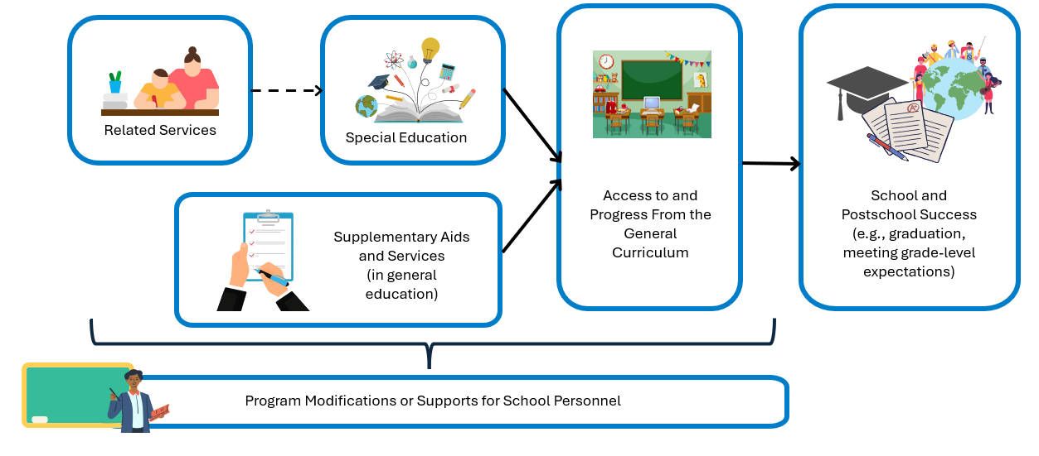
How do the parts of the statement of services and aids fit together?

Slide 72
Did you know?
The purpose of modifications or accommodations is to increase ACCESS to the general curriculum that a child, because of the disability, can not access alone.
Under IDEA, an accommodation or modification is not sufficient for progress. These should be paired with specially designed instruction, to the extent appropriate, to reduce the need for these supplementary aids and services.

Slide 73
Example: One Statement of Services and Aids
A sixth-grade student with a learning disability that impacts the student’s ability to decode and fluently read connected text
Type of Service | Sample Proposed Services
Special Education/SDI | Daily 30-minute direct instruction in phonics and reading fluency taught by the special education teacher
Related Service | Speech services to address the disfluency and stutter impacting fluent reading of connected text
Supplementary Aids and Services | Access to audio books or a peer reader
Program Modifications or Supports for School Personnel | Special education teacher meets 30 minutes each month with the speech and language pathologist to ensure the speech services assist the student in benefiting from special education

Slide 74
What is on your mind? 3

Slide 75

Bringing it Together

Slide 76
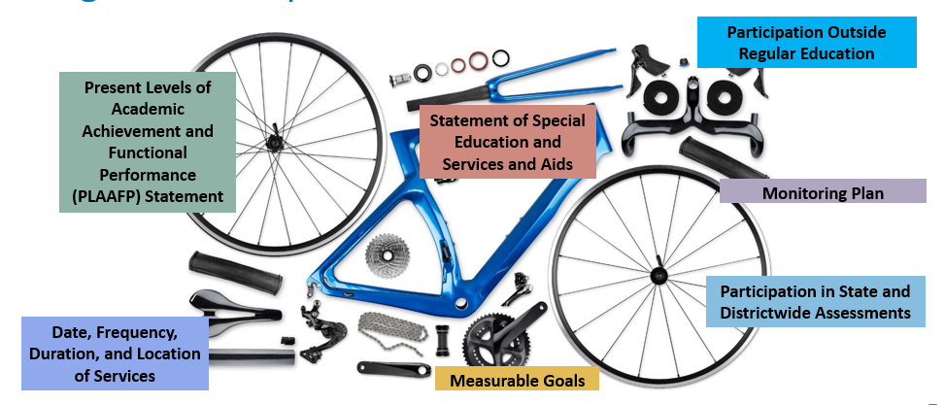
Program Development: Procedural Revisited

Slide 77

Program Development: Substantive Revisited

Slide 78
Internal Consistency: Connecting the Parts of the IEP Review
PLAAFP
Statement
Annual Goals
Measuring Progress Toward Annual Goals
Date, Frequency, Duration, and Location of Services
Participation Outside Regular Education and in State and Districtwide Assessments
Statement of Special Education and Services and Aids

Slide 79
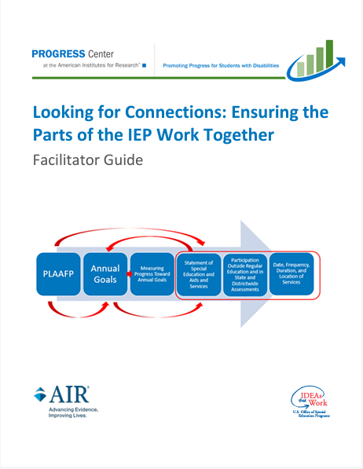
How do we know if the parts of our IEP connect?
Identify the needs
  Highlight each with a unique color
Identify aids and services
  Select one of the needs you identified
  Highlight the special education, related services, supplementary aids and services, or program modifications and supports for school personnel using the same color highlighter
  Repeat for other needs
Identify the goals
  Select one of the needs you identified
  Highlight the corresponding annual goal
  Repeat

Slide 80
How do we know if the parts of our IEP connect? Cont.
Reflect
  To what extent are the needs clearly identified in the PLAAFP statement?
  Are all the needs identified in the PLAAFP statement addressed in the goals and proposed services?
  Are there proposed goals and/or services that do not have a corresponding need?

Slide 81
Implementing High-Quality Instructional Programming: Building a
Successful System Revisited
Staff Collaboration
Progress
Individualized Instruction and Supports
Effective General Curriculum with Supports
Educator Supports
IEP
Student Belonging

Slide 82

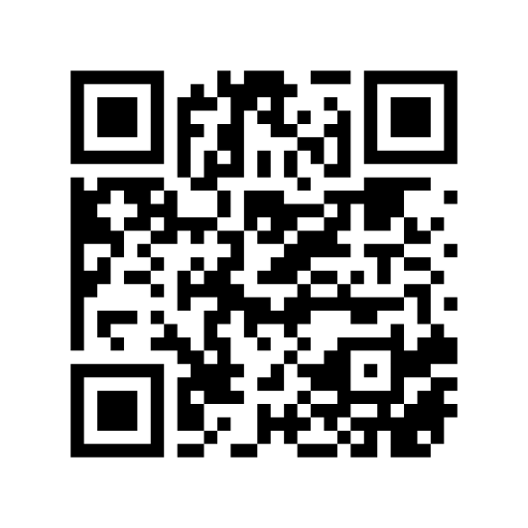
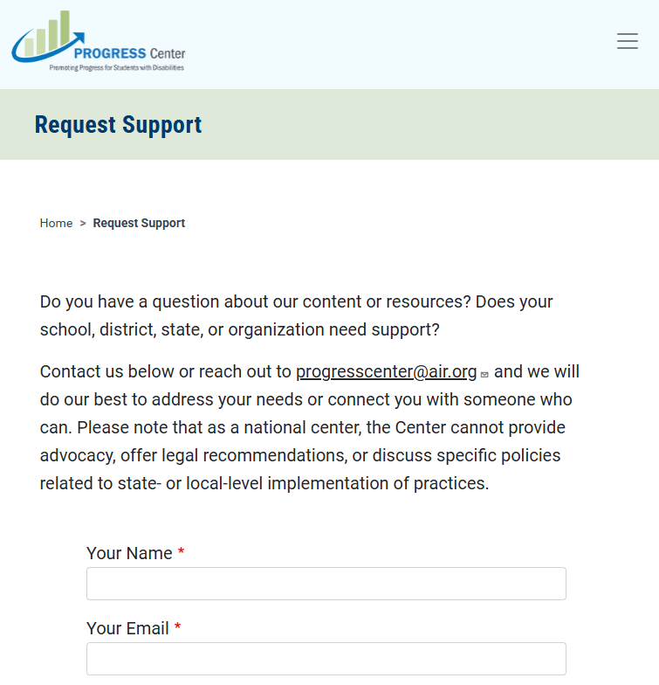
Find Additional Resources and Request Support
Visit our website
promotingprogress.org

Slide 83
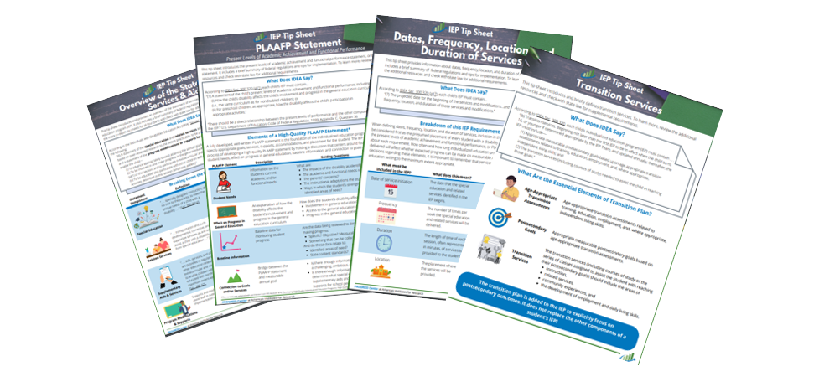
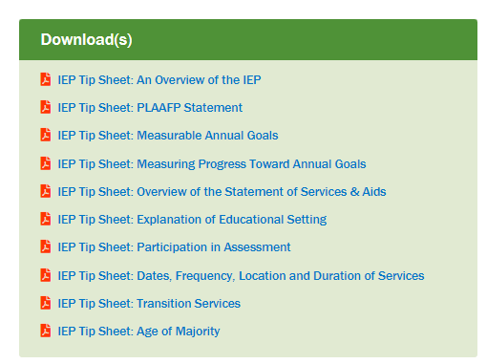
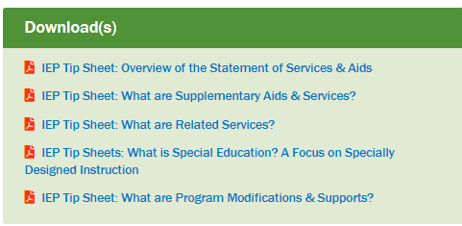
Tip Sheet Series

Slide 84
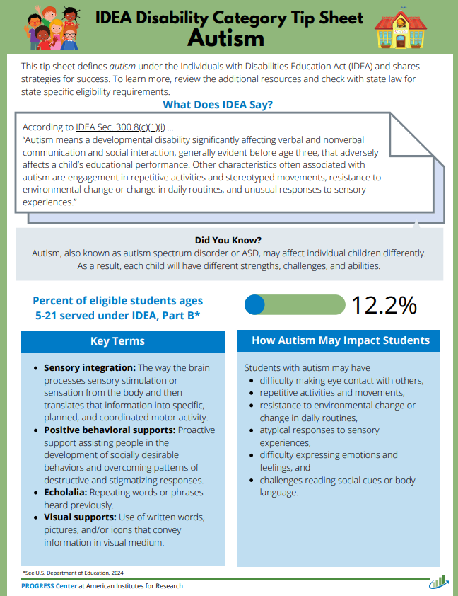
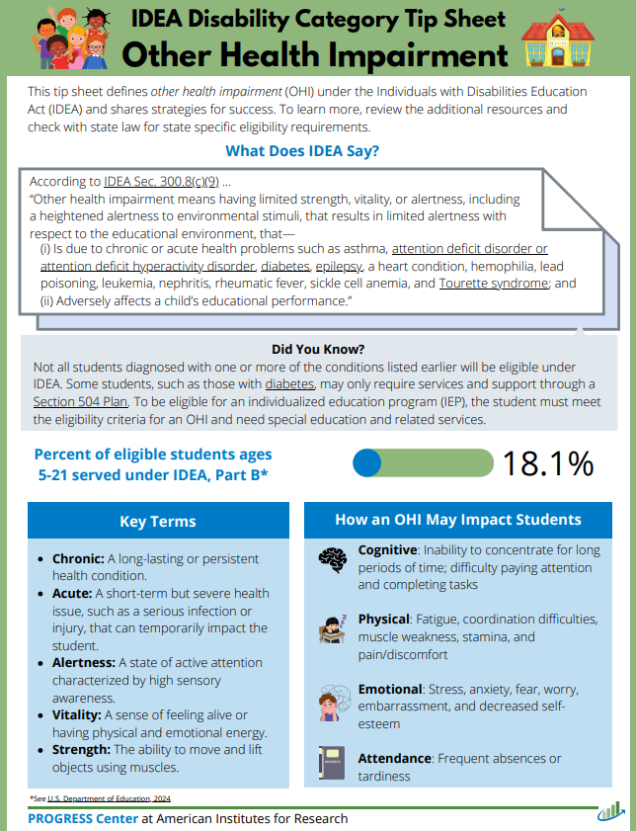
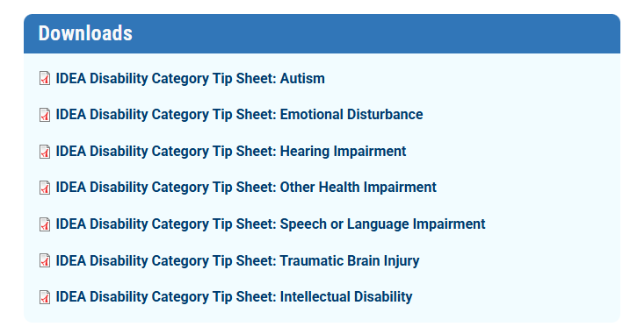
IDEA Disability Category Tip Sheet Series

Slide 85
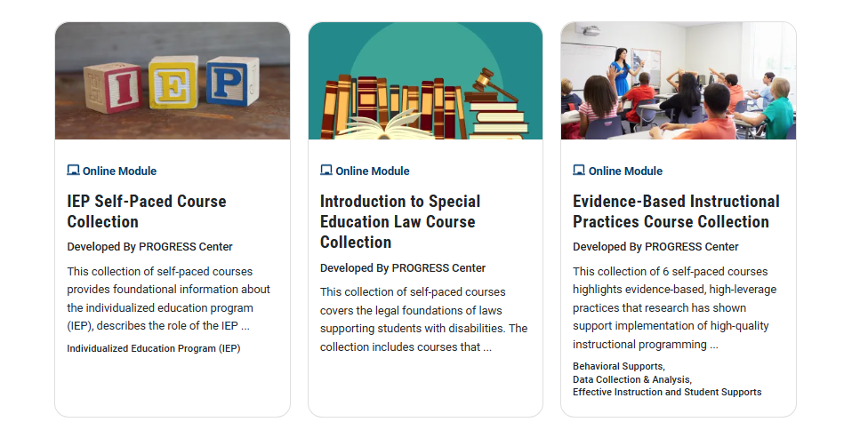
PROGRESS Center Self-Paced Online Learning Courses

Slide 86

Activities to Support IEP Development

Slide 87
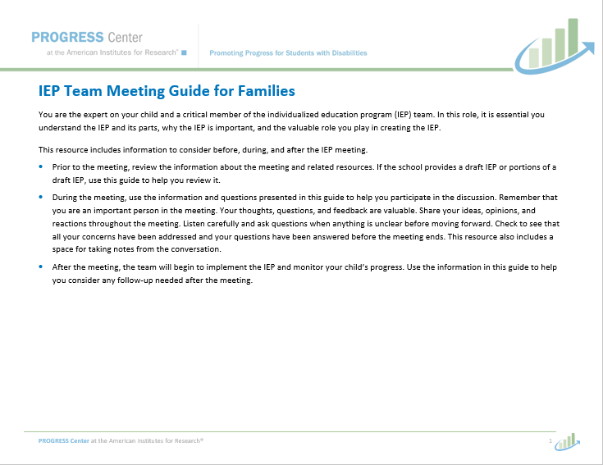
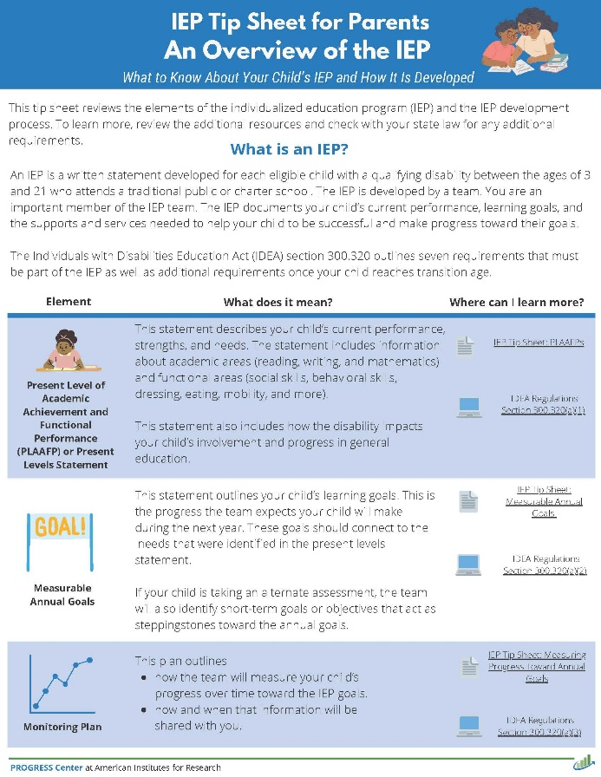

Resources to Support Engaging Parents as Partners in the IEP Development

Slide 88
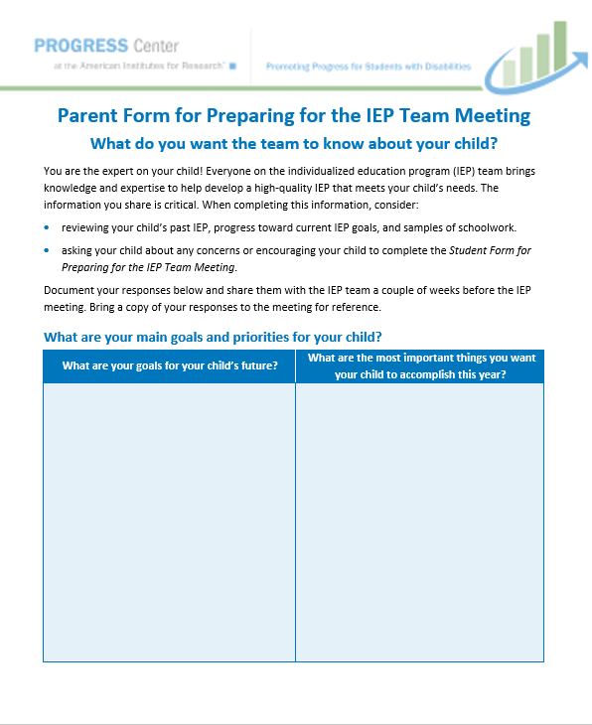
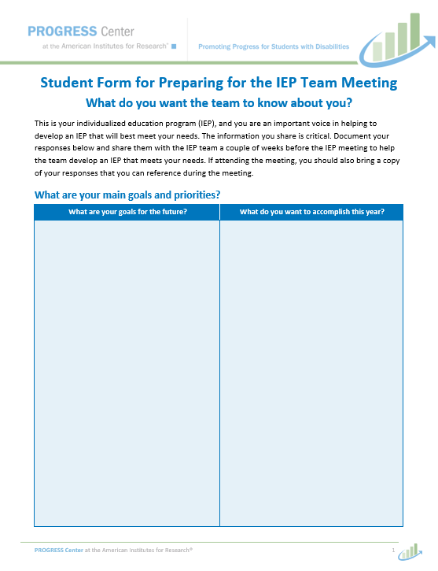
Resources to Engage Students and Families for Input Prior to the IEP Meeting

Slide 89
3-2-1 Reflection
3 things you learned from today’s session that you want to remember. | 2 things from today’s session that you will implement. | 1 thing from today’s session that you would like more information on.

Slide 90









Promoting Progress for Students with Disabilities

Slide 91

Returning to the Idea: Why We Do What We Do
Notes:
Video link https://youtu.be/p4LDwafrQDc

Slide 92
What is on your mind?

Slide 93
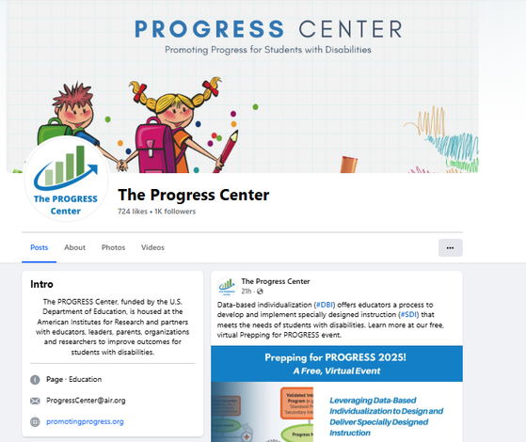
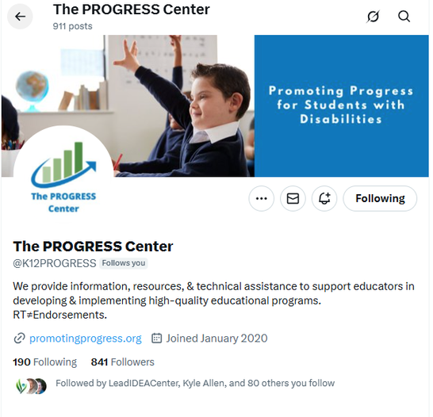
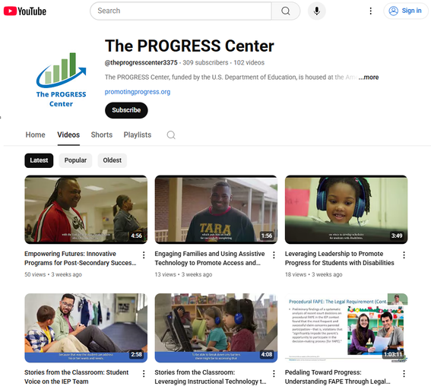



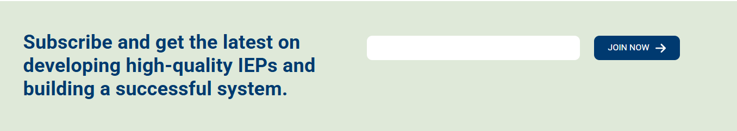
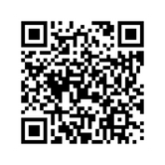
Stay connected with the PROGRESS Center!
@k12PROGRESS
@K12PROGRESS
@theprogresscenter3375

Slide 94
PROGRESS Center
1400 Crystal Drive, 10th Floor
Arlington, VA 22202-3289
202.403.5000
progresscenter@air.org
promotingprogress.org | www.air.org
https://www.facebook.com/k12PROGRESS/
https://twitter.com/K12PROGRESS
Notice of Trademark: “American Institutes for Research” and “AIR” are registered trademarks. All other brand, product, or company names are trademarks or registered trademarks of their respective owners.
This material was produced under the U.S. Department of Education, Office of Special Education Programs, Award No. H326C190002. David Emenheiser serves as the project officer. The views expressed herein do not necessarily represent the positions or policies of the U.S. Department of Education. No official endorsement by the U.S. Department of Education of any product, commodity, service, or enterprise mentioned in this presentation is intended or should be inferred.
23664_-01/24

