Slide 1

Supporting Students with Disabilities Access to and Progress in the General Curriculum
Timara Davis | Sara Evans
August 2025

Slide 2
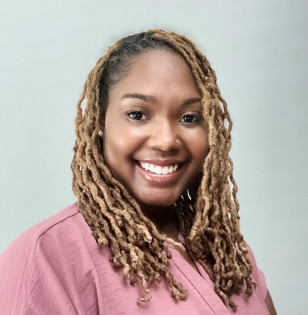
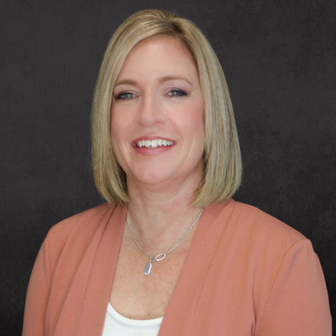
Meet the Presenters
Timara Davis
Sara Evans
PROGRESS Center
Special Education Expert
PROGRESS Center
Special Education Expert

Slide 3
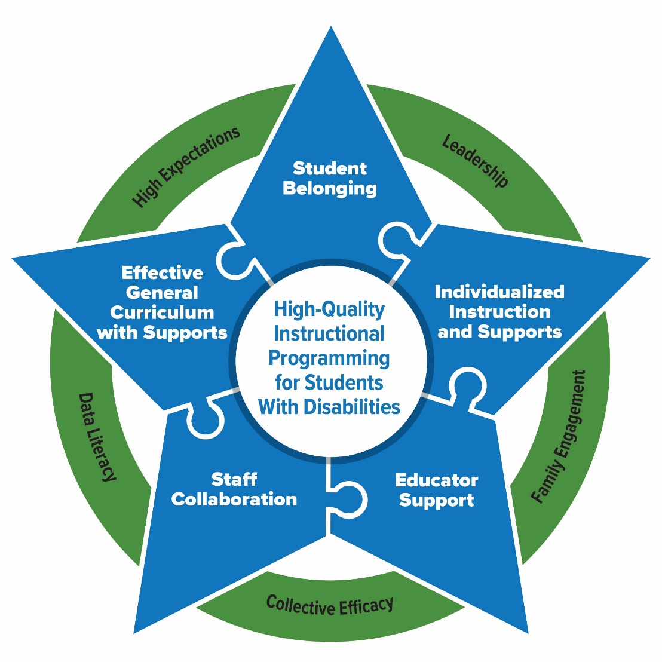
Essential Elements for Sustainable School Systems
The PROGRESS Center has identified Essential Elements in schools that support high-quality instructional programming for students with disabilities.

Slide 4
Section Outcomes
Participants will be able to do the following:
Identify key facilitators for promoting access to and progress in the general curriculum for students with disabilities.
Understand how promoting belonging for students with disabilities increases access and progress in the general education setting.
Access resources to support belonging for students with disabilities.
Understand how supplementary aids and services remove barriers for students with disabilities in the general education setting.
Identify instructional and behavioral practices that support access to the general education curriculum for students with disabilities.

Slide 5
5 Ways to Ensure Access and Progress
Promoting Belonging
Provide Adequate Support
Teach Cognitive and Metacognitive Strategies
Teach Social Behaviors
Use Instructional Technology

Slide 6
Setting the Stage

Slide 7
Remember!
All students are general education students first.
Some students need, because of the impact of the disability, special education and related or supplementary aids and services to fully access and progress in general education similar to their peers.

Slide 8
What have we learned from national research?
Effective general instruction and supports depends on…
Consistency: Delivering consistently good teaching and grade-level content for all students.
Coherence: Building a unified instructional program and setting priorities that are clear to all.
TNTP, 2025; SWIFT Center, 2025; PROGRESS Center, 2025

Slide 9

The Foundation for What We Do
“To meet its substantive obligation under the IDEA, a school must offer an IEP [individualized education program] that is reasonably calculated to enable a child to make progress appropriate in light of the child’s circumstances.” [emphasis added]
—Endrew F. v. Douglas County School
District RE-1 (2017)

Slide 10
Important IDEA Terms to Know
“Regular class” refers to a location/placement
34 C.F.R. § 300.114(a)(2)(ii): Special classes … or other removal of children with disabilities from the regular educational environment occurs only if the nature or severity of the disability is such that education in regular classes…
“General education” primarily refers to the general education curriculum
34 C.F.R. § 300.320(a)(1)(i): How the child's disability affects the child's involvement and progress in the general education curriculum (i.e., the same curriculum as for nondisabled children)

Slide 11
Examples of Misinformation Impacting Access and Progress
Once as a child has an IEP, all other nonspecial education supports are no longer provided.
To improve outcomes for students with IEPs, we only need to improve special education.
Improvement on IEP goals is all that matters for students with disabilities.
Special education is separate from general education or special education is a “place” where students get caught-up on missing work in their general ed classes
Providing services and technologies for students with disabilities is cheating.
General education teachers don’t need to focus on the needs of students with disabilities because students with disabilities are the sole responsibility of special education teachers.

Slide 12
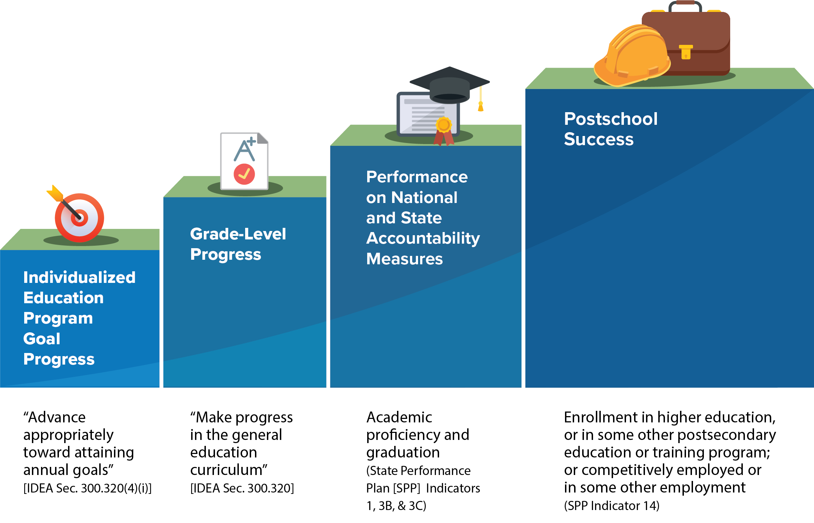
What is progress for students with disabilities?

Slide 13

Facilitators of a Sustainable System
Effective Leadership: Leaders proactively establish the working conditions necessary for collaborative planning and delivery of high-quality core and specialized instruction.
High Expectations: Educators and leaders believe all students, regardless of disability or circumstances, can achieve high expectations.
Family Engagement: Families are active and meaningful partners in the development and implementation of their child’s educational programming.
Data Literacy: Educators are equipped to engage in data-based decision making to drive instruction and continuous improvement.
Collective Efficacy: Educators and leaders believe they can positively affect student achievement, including students with disabilities.
PROGRESS Center, 2024

Slide 14

Waterfall Activity: High Expectations and Collective Efficacy
1. Think about the following question:
What does it mean for all staff to have high expectations for students with disabilities?
2. Type your response in the chat box, but do not hit enter yet!
3. When you hear, “waterfall,” press enter to add your response to the chat.

Slide 15


Why is collective efficacy so important?
There is no way a single teacher
has all the time,
all the knowledge,
and all the skills
to meet all the needs of
every child in his or her class(es).
Alex
Special Education Teacher
Source: Buffman et al., 2009

Slide 16








We Are Better Together!
Special Education Teacher
Principal
General Education Teacher
Related Service Provider
Alex
Medical Professional
Family
Additional Staff
Paraprofessional

Slide 17


The Impact of Collective Efficacy
Hinge Point
Effect Size
Sources: Eells, 2011; Hattie, 2017

Slide 18

Collective Efficacy Starts With the Right Questions!
What do we want for our students, educators, and families?
What is the current reality, and who are the players?
What do our students and families need to be successful?
How can we maximize our resources to support students and families?

Slide 19

Chat Discussion: Appreciating High Expectations
  In the chat…
  Share what you feel needs to happen to ensure that all students with disabilities in your school or local context are being held to high expectations.

Slide 20
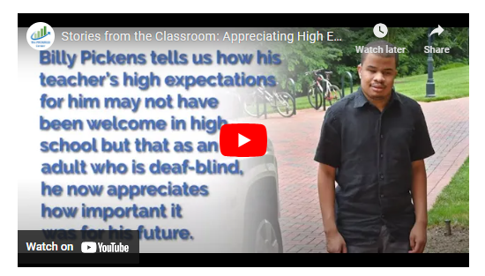
Appreciating High Expectations

Slide 21
Did you know?
Teachers and parents hold significantly lower educational expectations for adolescents labeled with disabilities than they do for similarly achieving and behaving adolescents not labeled with disability, and these lower expectations contribute to labeled adolescents’ lower educational expectations for themselves.
Source: Shifrer (2013)

Slide 22
Promoting Belonging

Slide 23
Chat Discussion: Belonging
Think about a time when you really felt like you fit in or belonged. Write up to five words that describe how you felt.

Slide 24
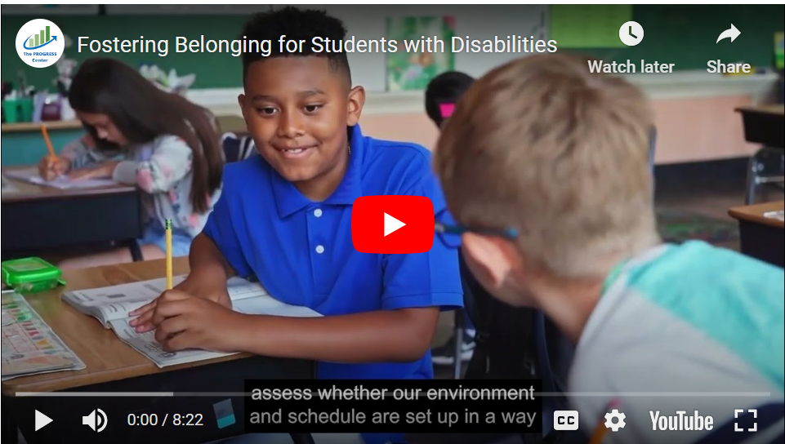
Fostering Belonging for Students with Disabilities

Slide 25
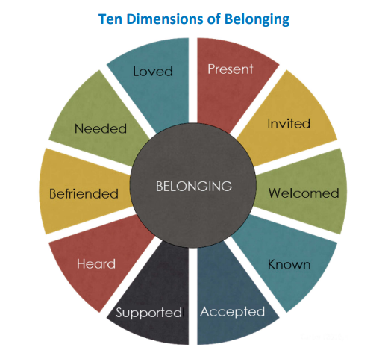
Ten Dimensions Of Belonging
Sources: Carter, 2021; Carter & Biggs, 2021

Slide 26
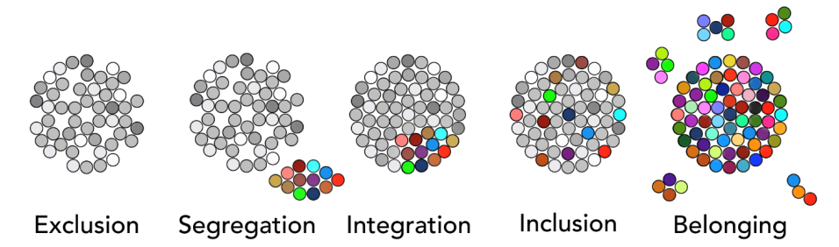
What is belonging?

Slide 27
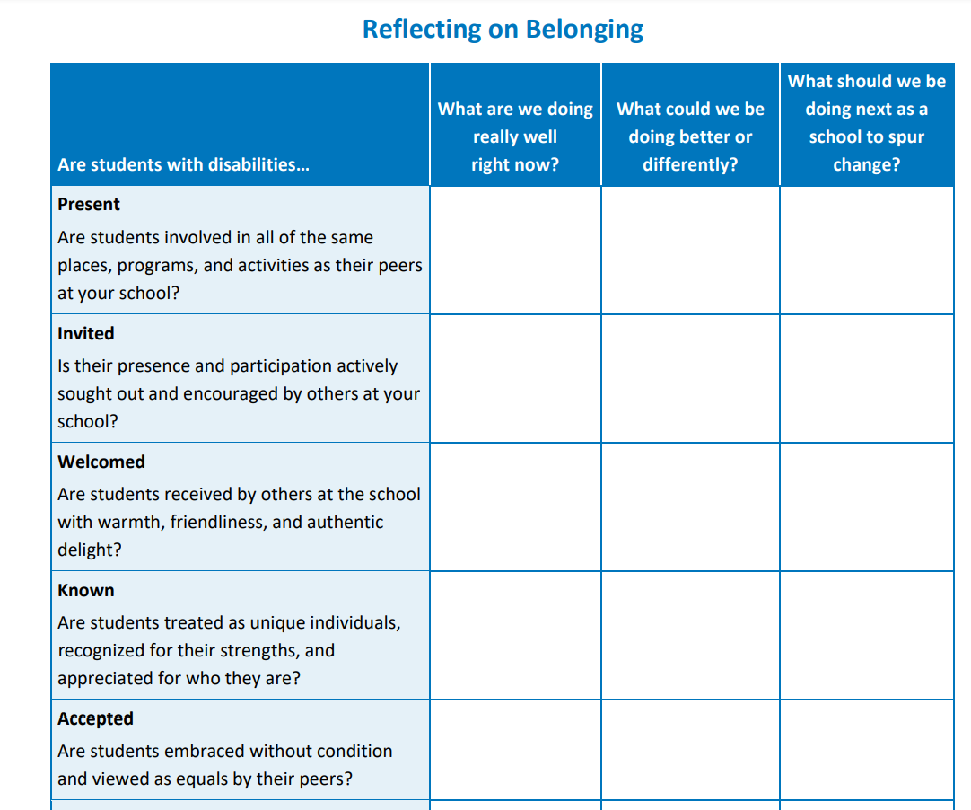
Reflection Activity:
What dimensions do you feel like your school exemplifies to promote access through belonging for all students, including students with disabilities?
Notes:
https://promotingprogress.org/resources/reflecting-practice-belonging-foster-belonging

Slide 28
Resources to Promote Belonging

Slide 29
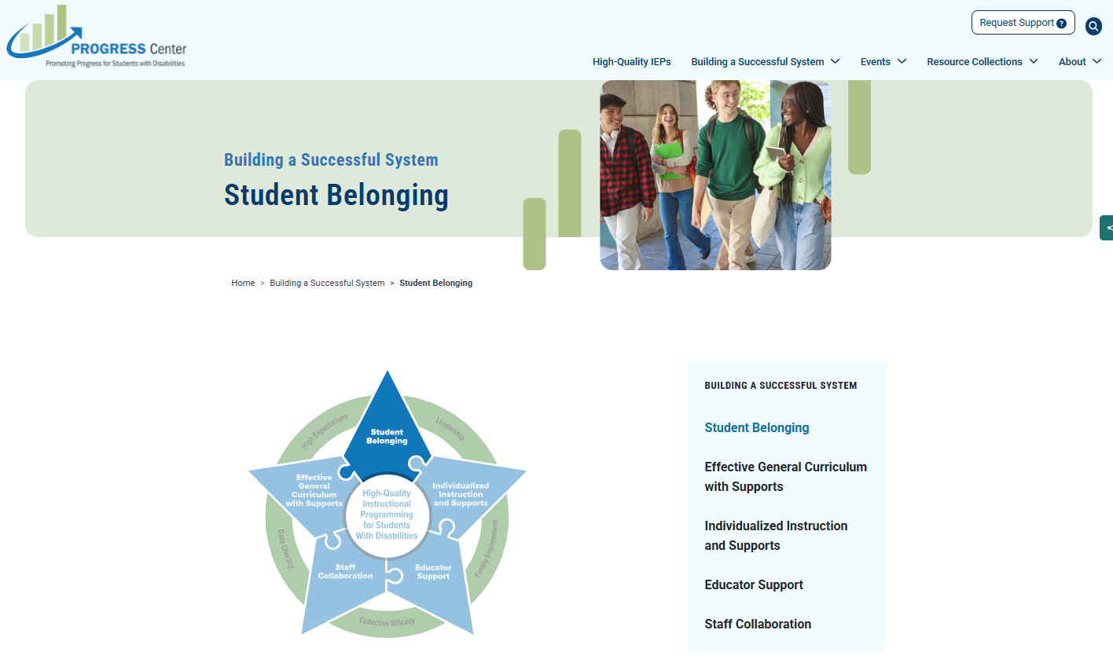
Belonging Resources from PROGRESS Center
Notes:
https://promotingprogress.org/building-successful-system/student-belonging

Slide 30
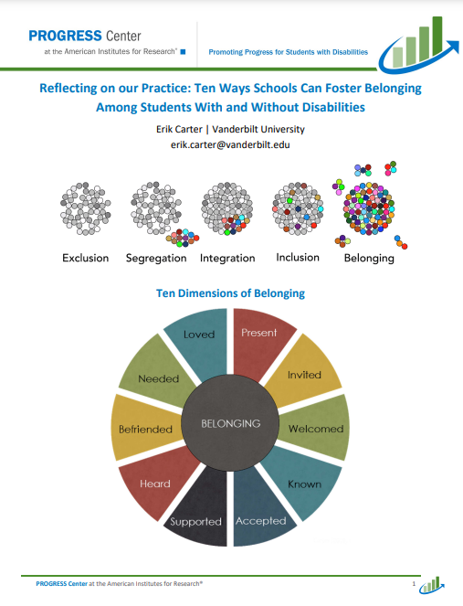
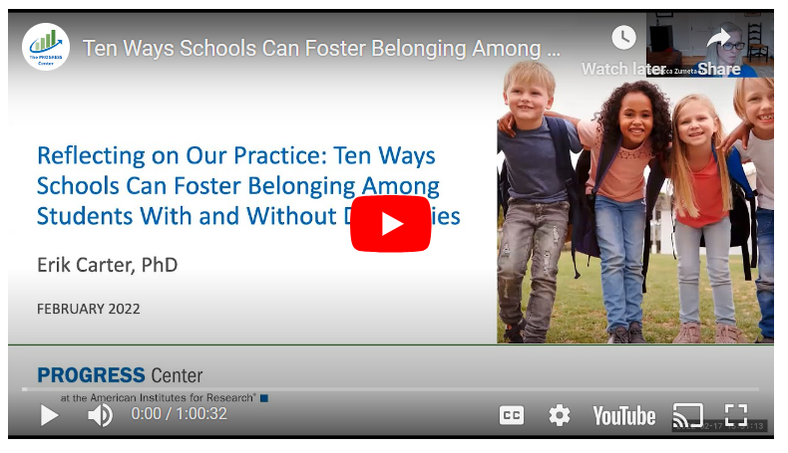
Ten Ways Schools Can Foster Belonging Among Students With and Without Disabilities
Notes:
https://promotingprogress.org/resources/ten-ways-schools-can-foster-belonging

Slide 31
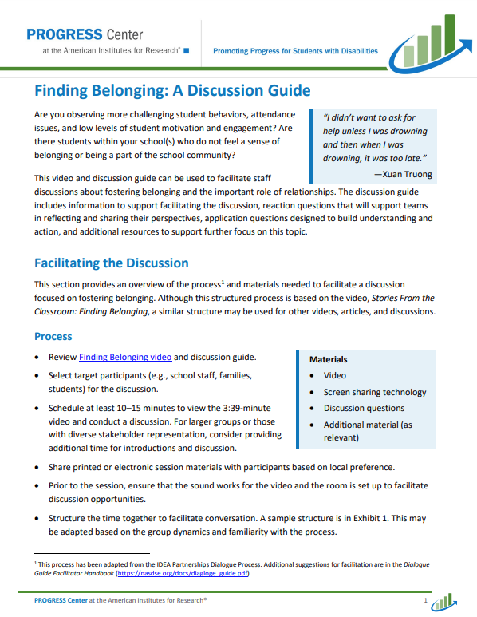
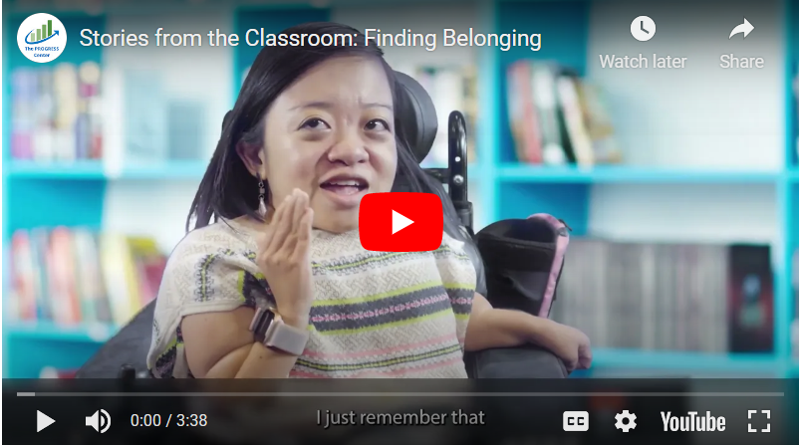
Finding Belonging Video and Discussion Guide
Notes:
https://promotingprogress.org/resources/stories-classroom-finding-belonging

Slide 32
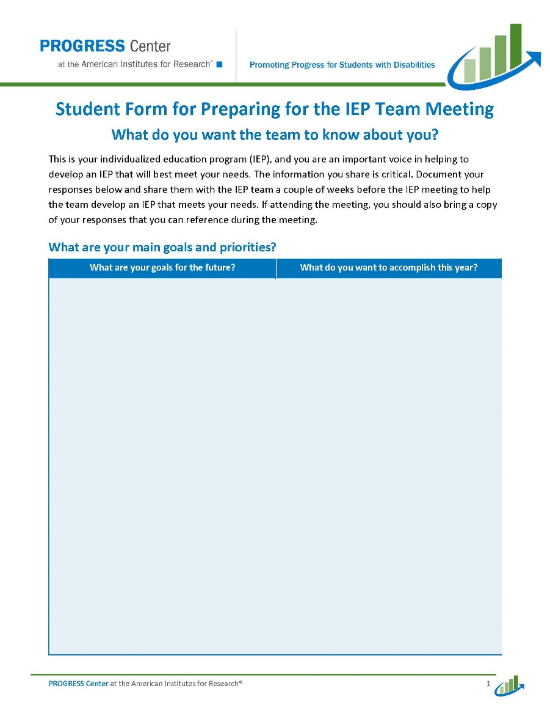
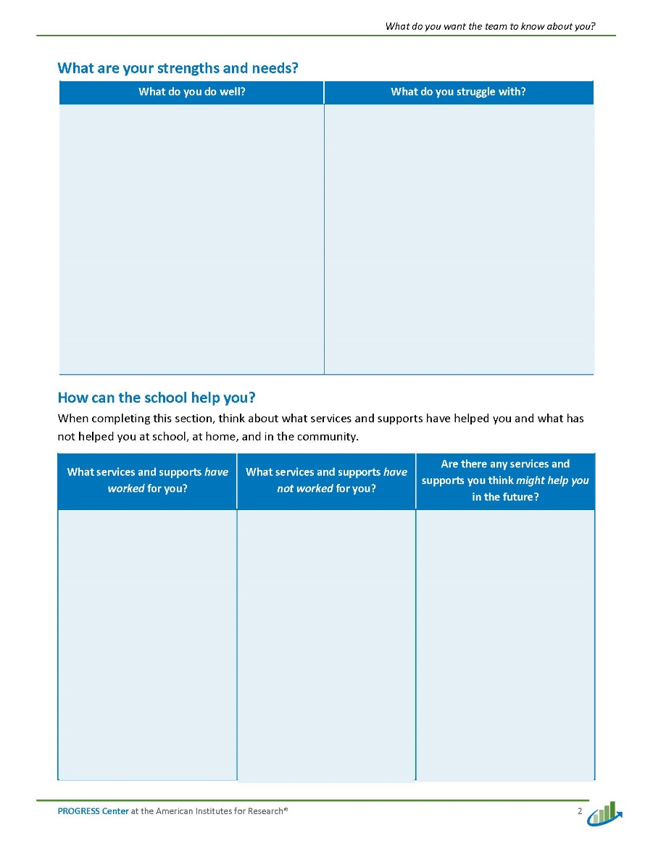
Ask Students to Share Input Prior to IEP Team Meetings
Notes:
https://promotingprogress.org/resources/parent-student-forms-IEP-meeting

Slide 33
Using Supplementary Aids and Services to Promote Access

Slide 34
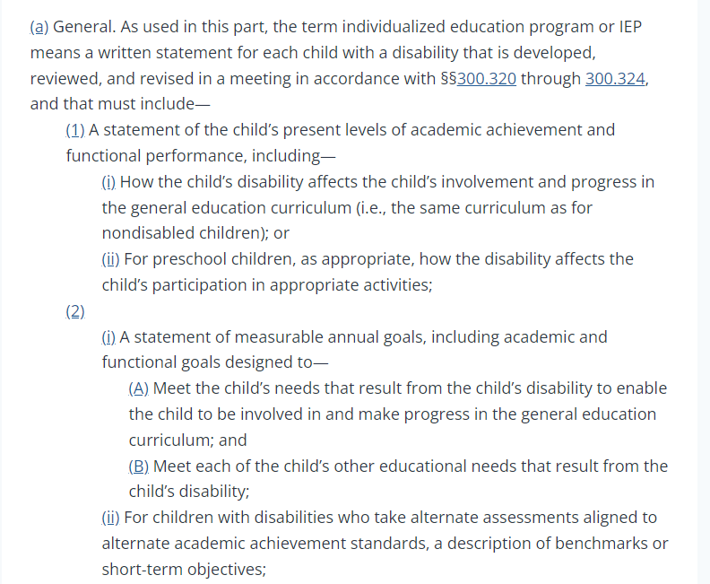
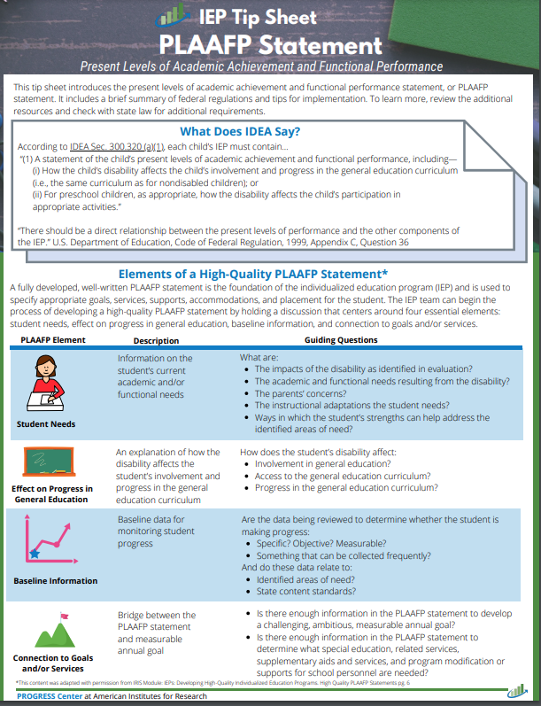
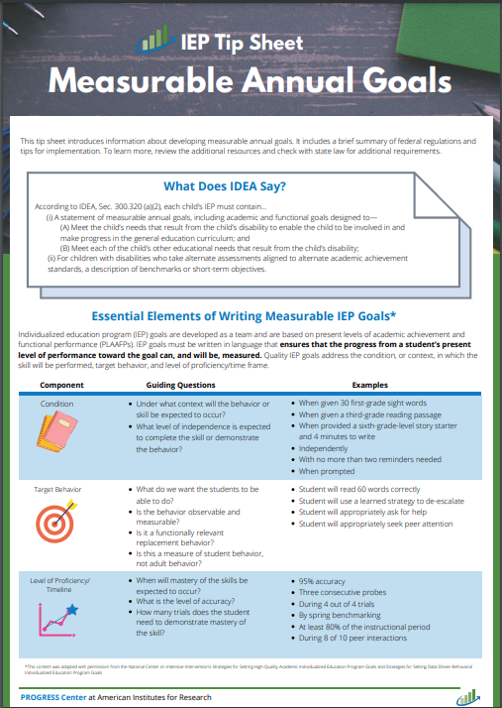
What does the IDEA say about access and progress?
Examples from Sec. 300.320 (a) definition of individualized education program
Image from https://sites.ed.gov/idea/regs/b/d/300.320/a

Slide 35
What is progress for students with disabilities? 2

Slide 36
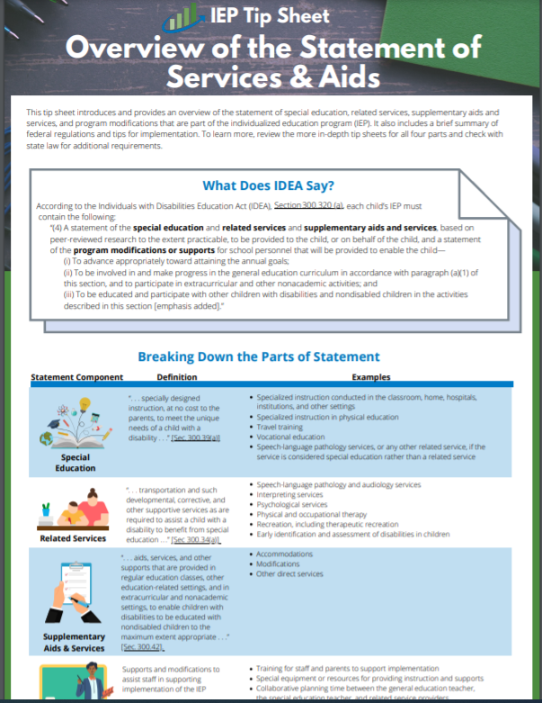
What are other examples of the IDEA requirements for IEPs that promote access and progress?
According to IDEA, Section 300.320 (a), each child’s IEP must contain the following:
“(4) A statement of the special education and related services and supplementary aids and services, based on peer-reviewed research to the extent practicable, to be provided to the child, or on behalf of the child, and a statement of the program modifications or supports for school personnel that will be provided to enable the child—… ″
Source: IDEA, Sec. 300.320(a)(4), emphasis added

Slide 37
What are other examples of the IDEA requirements for IEPs that promote access and progress? (cont.)
“(i) To advance appropriately toward attaining the annual goals;
(ii) To be involved in and make progress in the general education curriculum in accordance with paragraph (a)(1) of this section, and to participate in extracurricular and other nonacademic activities; and
(iii) To be educated and participate with other children with disabilities and nondisabled children in the activities described in this section.”
Source: IDEA, Sec. 300.320(a)(4), emphasis added

Slide 38
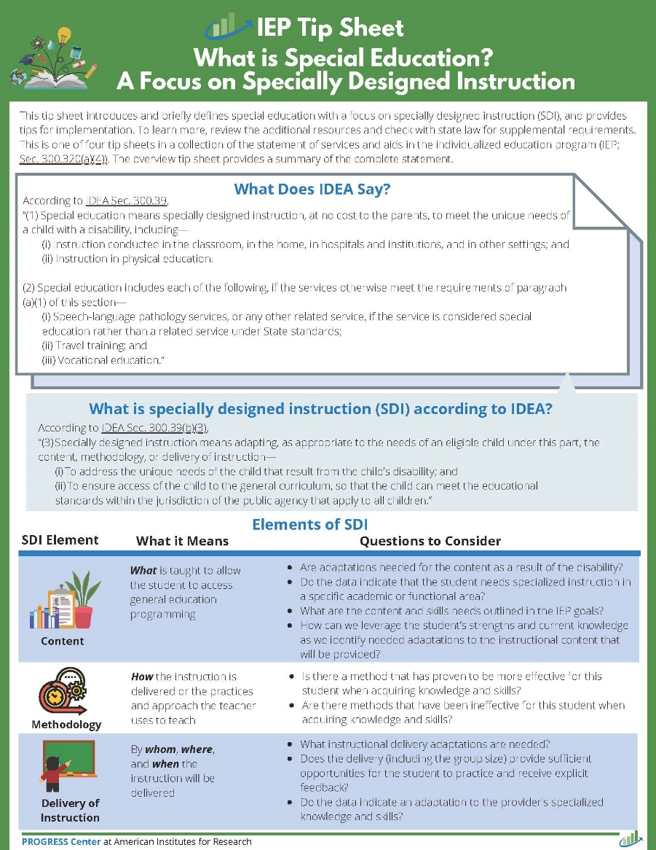
What does the IDEA say about SDI, the core element of special education?
“Specially designed instruction means adapting, as appropriate to the needs of an eligible child under this part, the content, methodology, or delivery of instruction—
  (i) To address the unique needs of the child that result from the child’s disability; and
  (ii) To ensure access of the child to the general curriculum, so that the child can meet the educational standards within the jurisdiction of the public agency that apply to all children.”
Source IDEA, Sec. 300.39(b)(3), emphasis added

Slide 39
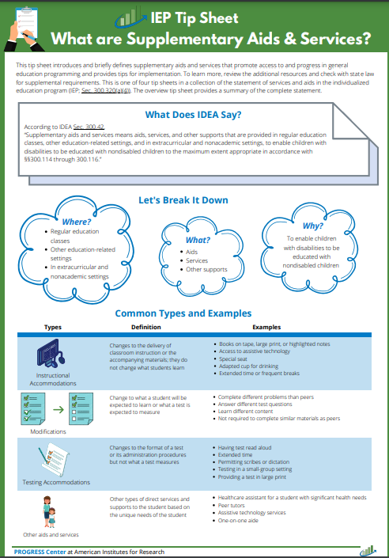
What does the IDEA say about supplementary aids and services?
“Supplementary aids and services means aids, services, and other supports that are provided in regular education classes, other education-related settings, and in extracurricular and nonacademic settings, to enable children with disabilities to be educated with nondisabled children to the maximum extent appropriate...”
Source IDEA Sec. 300.42, emphasis added

Slide 40









How do the parts of the statement of services and aids fit together to provide access to and progress in the general curriculum?
Related Services
Special Education
Access to and Progress in the General Curriculum
School and Postschool Success (e.g., graduation, meeting grade-level expectations)
Supplementary Aids and Services
(in general education)
Program Modifications or Supports for School Personnel

Slide 41
Instructional and Behavioral Practices to Promote Access

Slide 42
Evidence-Based Instructional Practices –to other 1
Cognitive and Metacognitive Strategies
Teaching Social Behaviors
Instructional Technology

Slide 43
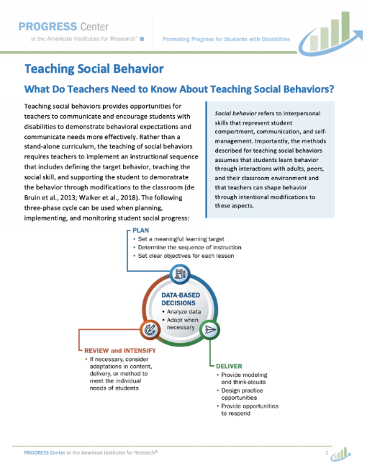
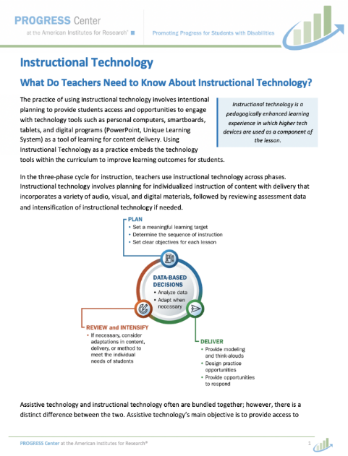
PROGRESS Center Instructional Practice Briefs
Downloadable practice briefs
Each brief covers the following:
  What do teachers need to know?
  Planning and individualizing instruction
  Access to the general education classroom
  How to get started

Slide 44
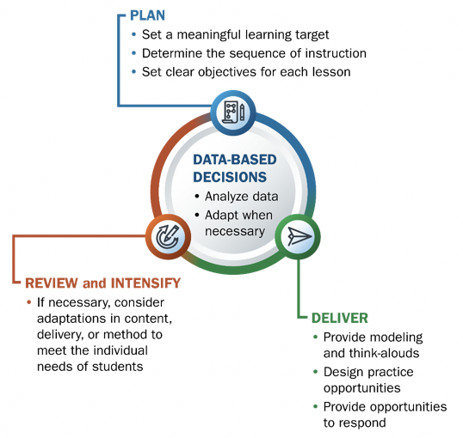
What do you need to know?-2
Across resources, we rely on this cycle about data-based decisions.
Teachers need to plan their instruction, deliver instruction, review data, and then intensify instruction to meet the needs of individual students.
This cycle should be used in both academics and behavior.

Slide 45
Evidence-Based Practice: Cognitive and Metacognitive Strategies –Cognitive Strategies
Cognitive and Metacognitive Strategies
Teaching Social Behaviors
Instructional Technology

Slide 46
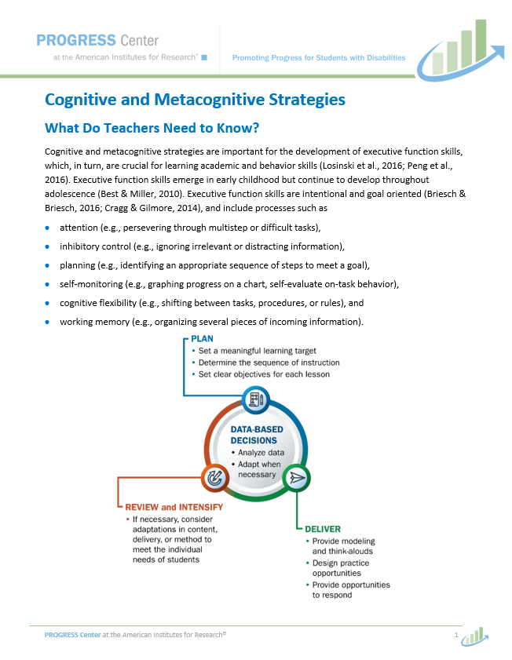
Cognitive and Metacognitive Strategies
In Cognitive and Metacognitive Strategies, we focus on different strategies to help focus on executive functions, such as attention, self-monitoring, and working memory.

Slide 47
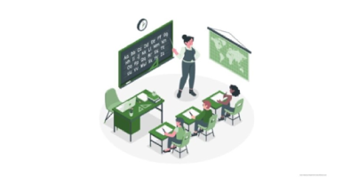
Examples of Cognitive and Metacognitive Strategies
Notes:
Video available in https://promotingprogress.org/resource-collections/online-learning-courses/cognitive-and-metacognitive-strategies

Slide 48
Individualizing Instruction Using Cognitive and Metacognitive Strategies
Set goals.
Engage in self-monitoring and self-management.
Use graphic organizers.

Slide 49
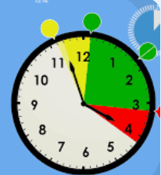
Connections to the Classroom: Cognitive and Metacognitive Strategies
“Get Ready, Do, Done” model to support executive functioning skills
3. GET READY: What do I need? | 2. DO: What steps do I need to take to be done? | 1. What will it look like when I am DONE?
Get Ready Worksheet Class notes Markers | Do Step 1 Step 2 Step 3 | Done Finished task Turn in by..
Sample image from Sarah Ward, Cognitive Connections.

Slide 50
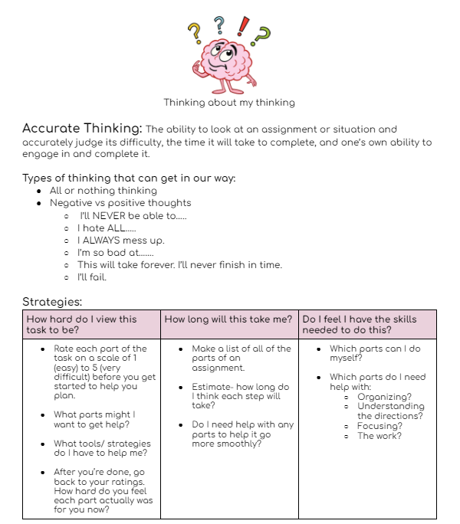
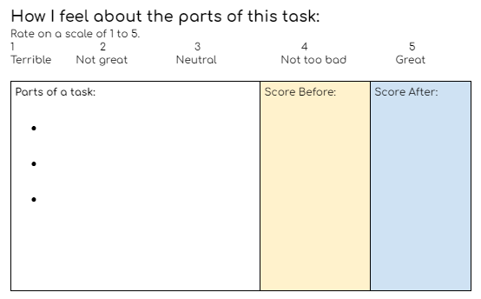
Connections to the Classroom: Cognitive and Metacognitive Strategies Continued
Use tools to support cognitive and metacognitive strategies.
Original work by Erin Rupe.

Slide 51
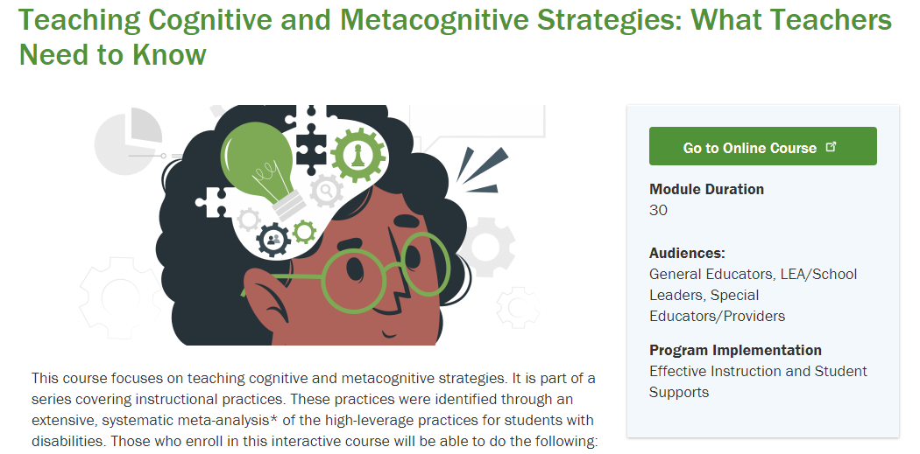
Resources: Cognitive and Metacognitive Strategies
PROGRESS Center instructional practice brief on Cognitive and Metacognitive Strategies
PROGRESS Center self-paced course on Teaching Cognitive and Metacognitive Strategies
CEEDAR Center practice-based learning module on Cognitive and Metacognitive Strategies
IRIS Center self-paced modules on Executive Functions (two parts)

Slide 52
Evidence-Based Practice: Teaching Social Behaviors
Cognitive and Metacognitive Strategies
Teaching Social Behaviors
Instructional Technology

Slide 53
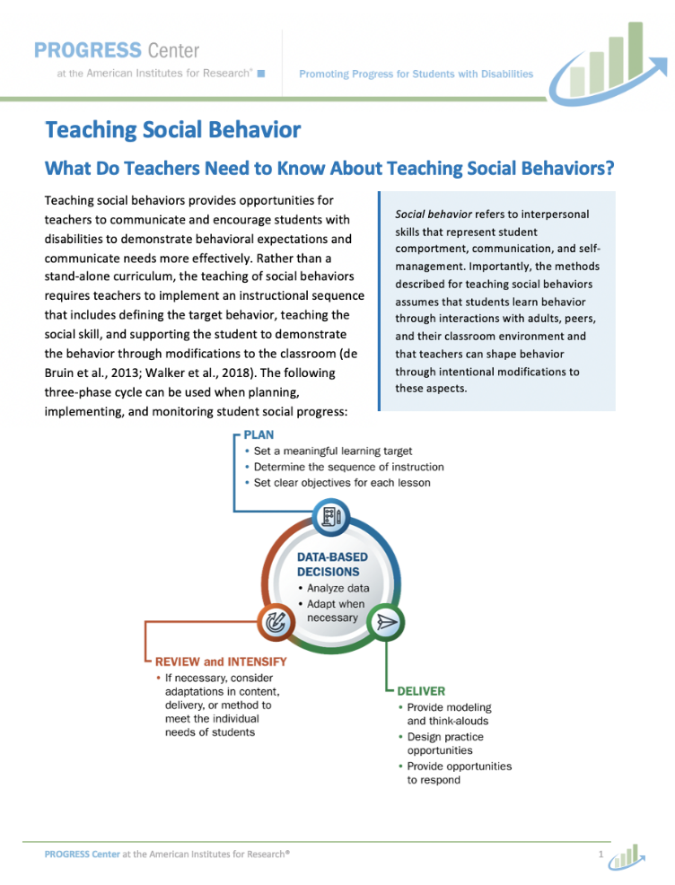
Teaching Social Behaviors
In Teaching Social Behavior, we focus on behavioral expectations for struggling learners or students with disabilities.

Slide 54
What are social behaviors?
Self-awareness
Self-management
Responsible decision-making
Relationship skills
Social awareness
Social behaviors refer to interpersonal skills that represent student comportment, communication, and self-management.
Social behaviors are . . .
  Communication
  Learned
  Reinforced
Image from PROGRESS Center Teaching Social Behaviors module.

Slide 55
Teaching Social Behaviors Examples
Keys for explicitly teaching behavioral expectations for struggling learners:
Select a replacement behavior.
Modify the classroom.
Implement a system to promote replacement behaviors.

Slide 56
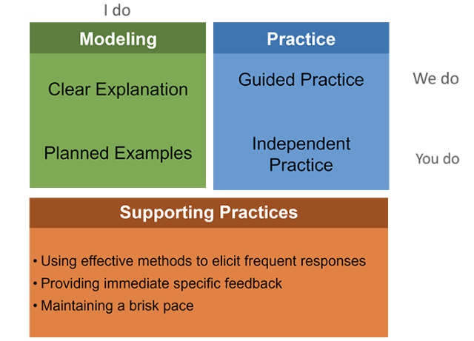
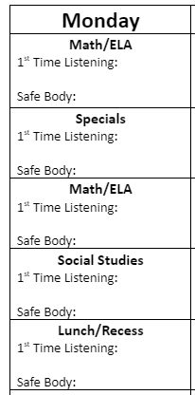
Connections to the Classroom: Teaching Social Behaviors
Tools to model and track social behaviors in the classroom
Image (left) from NCII explicit instruction module. Image (right) created by Gabi Aragon.

Slide 57
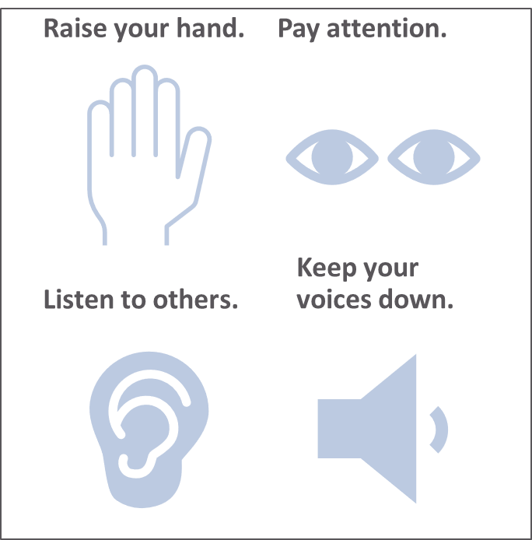
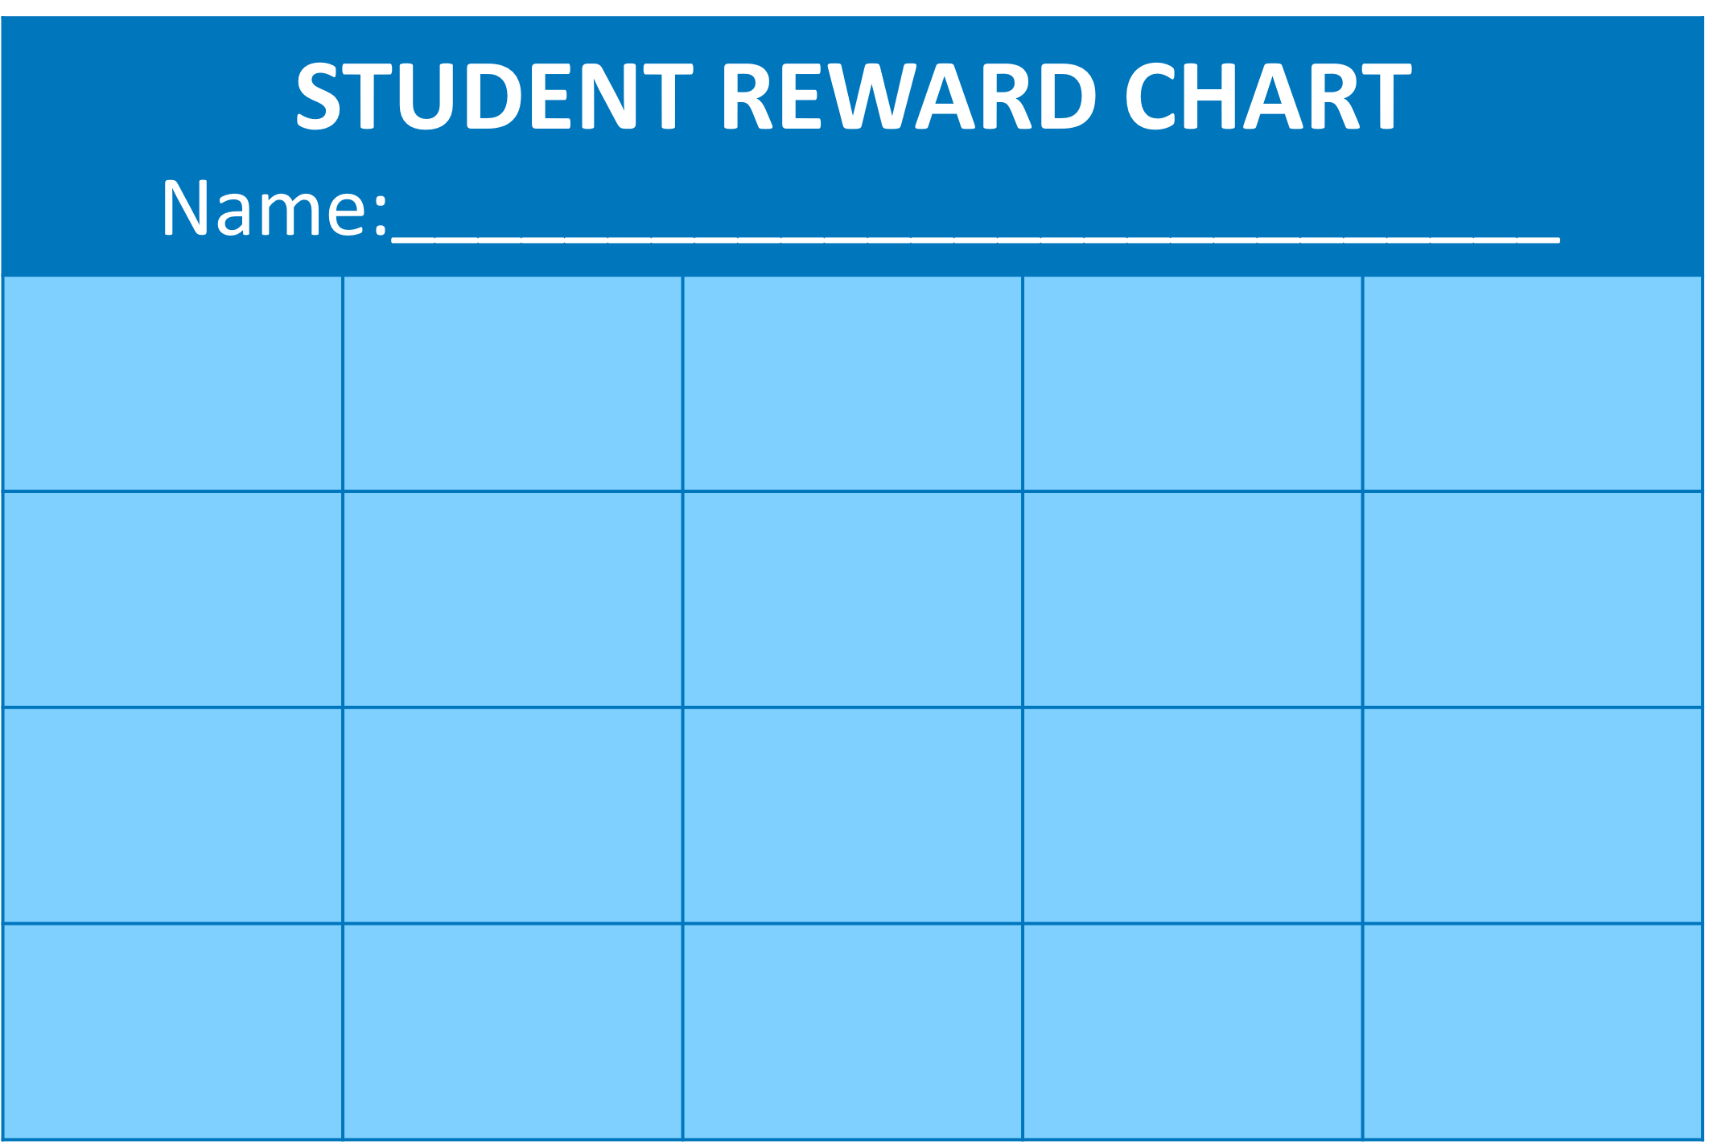
Connections to the Classroom: Teaching Social Behaviors Continued
Reminders of behavior expectations
Positive reinforcement for appropriate classroom behavior

Slide 58
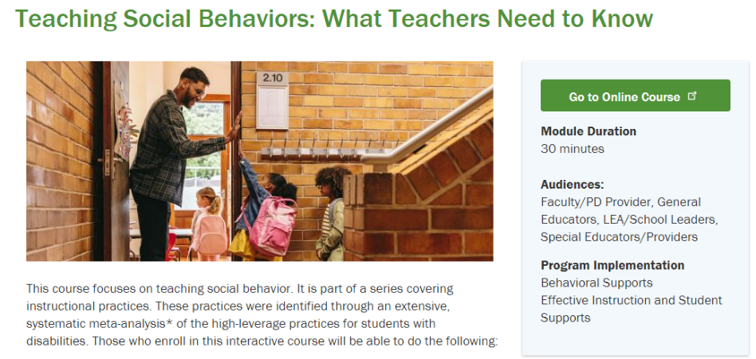
Resources: Teaching Social Behaviors
PROGRESS Center instructional practice brief on Teaching Social Behavior
PROGRESS Center self-paced course on Teaching Social Behavior
NCII self-paced courses on Behavior Support for Intensive Intervention
Center on PBIS practice guide on Supporting Students’ Social, Emotional, and Behavioral Needs

Slide 59
Evidence-Based Practice: Instructional Technology
Cognitive and Metacognitive Strategies
Teaching Social Behaviors
Instructional Technology

Slide 60
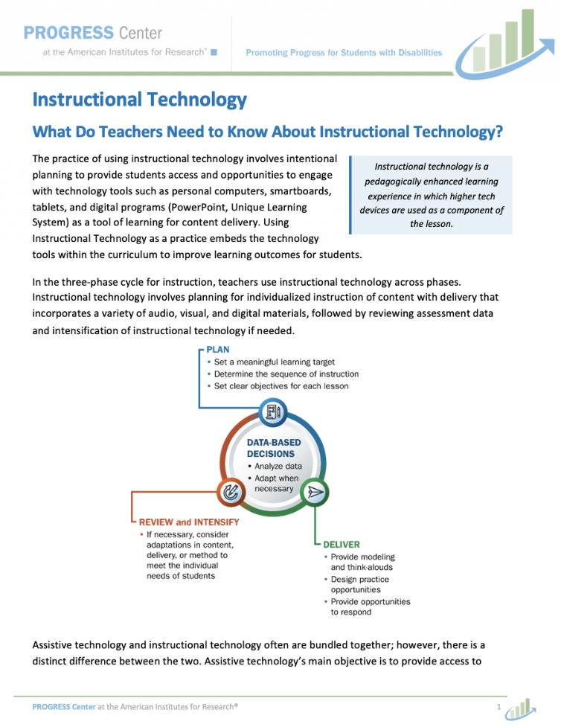
Instructional Technology
In Instructional Technology, we focus on how instructional technology can boost academic and behavior instruction.

Slide 61
Instructional Technology Within Instruction
Plan to use clear, measurable objectives that incorporate the use of technology for the learning outcomes.
Evaluate instructional technology for its appropriateness.
Use formative assessment to monitor student progress, specific to the learning outcomes as well as student technology use.
Review the formative or summative data.
Intensify and individualize instruction.

Slide 62

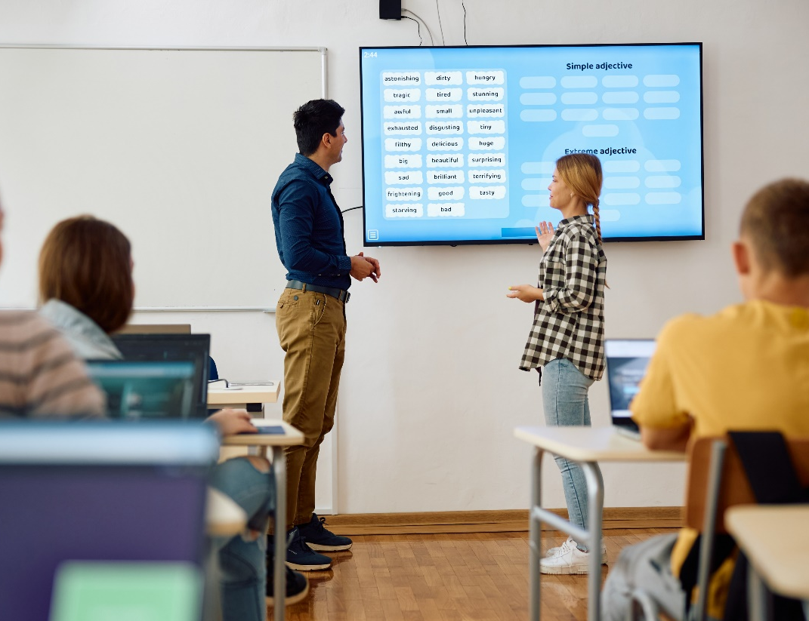
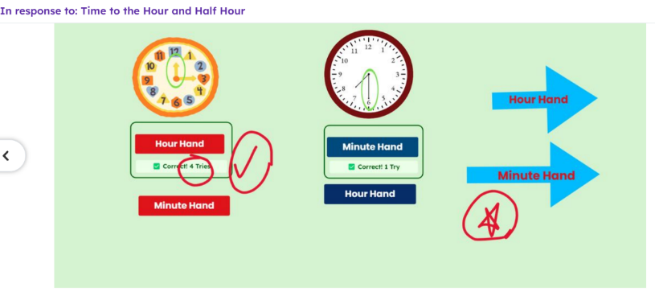
Connections to the Classroom: Instructional Technology
Instructional technology for student practice, providing feedback, and engagement
Sample Quizziz and Seesaw lessons conducted by Andrea Bergener.

Slide 63
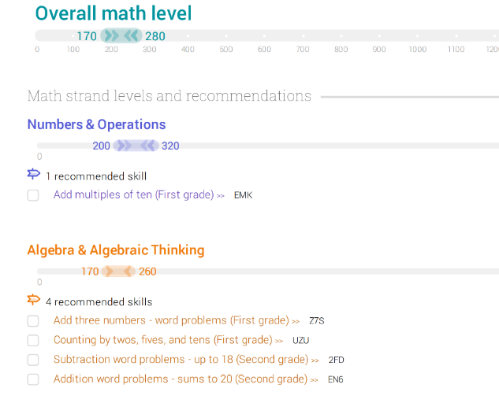
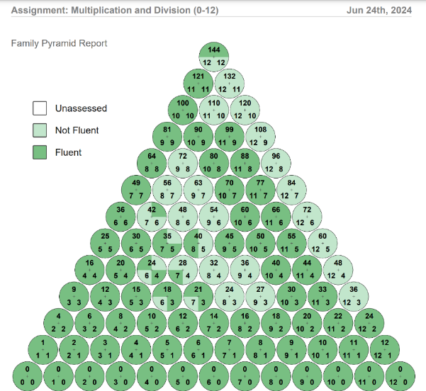
Connections to the Classroom: Instructional Technology Continued
Instructional technology for progress monitoring and individualized goal setting
Sample IXL and Reflex lessons conducted by Andrea Bergener.

Slide 64
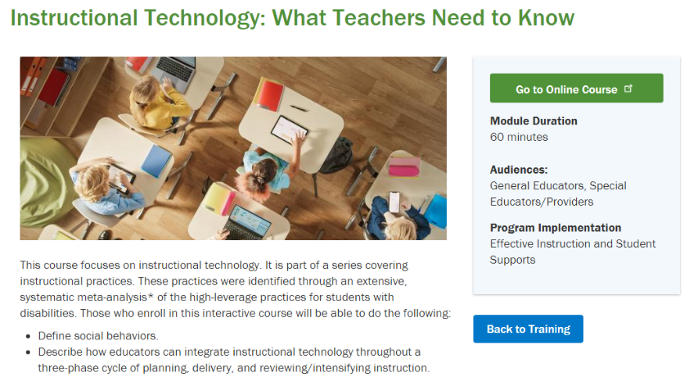
Resources: Instructional Technology
PROGRESS Center instructional practice brief on Instructional Technology
PROGRESS Center self-paced course on Instructional Technology
U.S. Department of Education, Office of Educational Technology teacher guide on Digital Learning
Center on Inclusive Technology & Education Systems teaching practices for Teaching in Inclusive Technology Systems

Slide 65
Closing

Slide 66
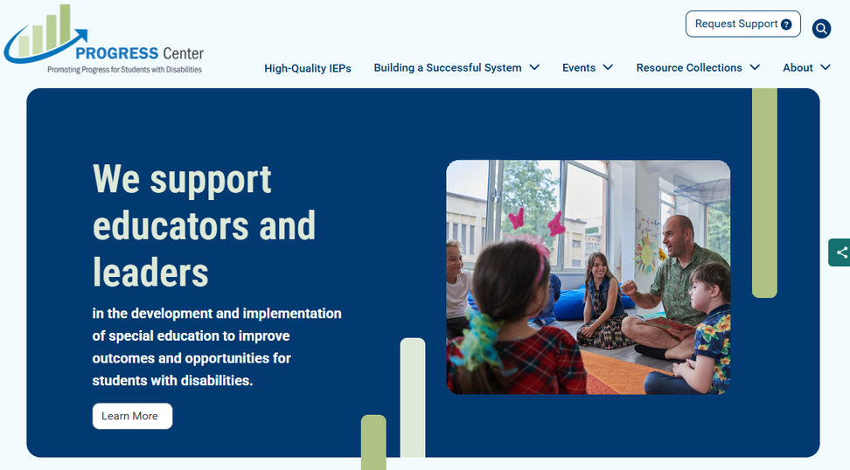
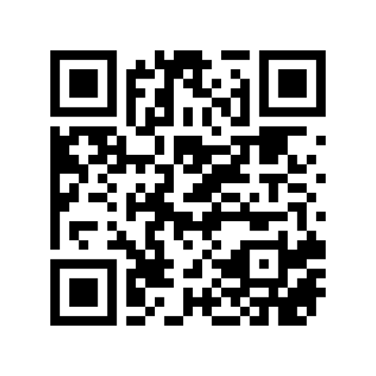
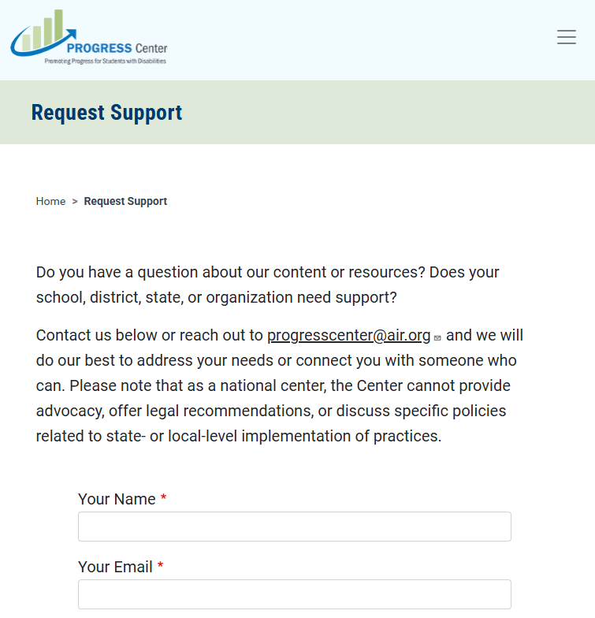
Find Additional Resources and Request Support
Visit our website
promotingprogress.org

Slide 67
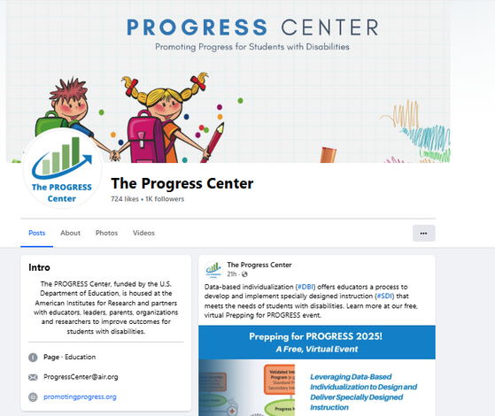
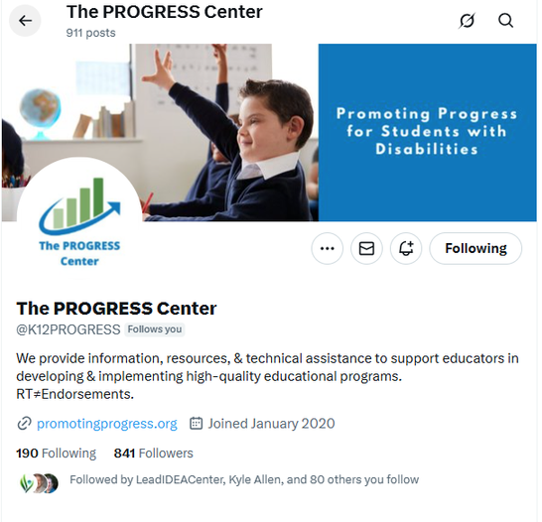
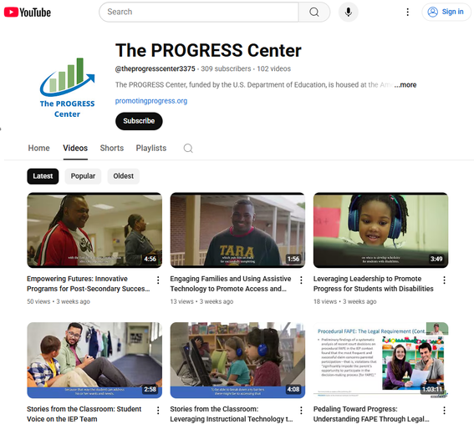



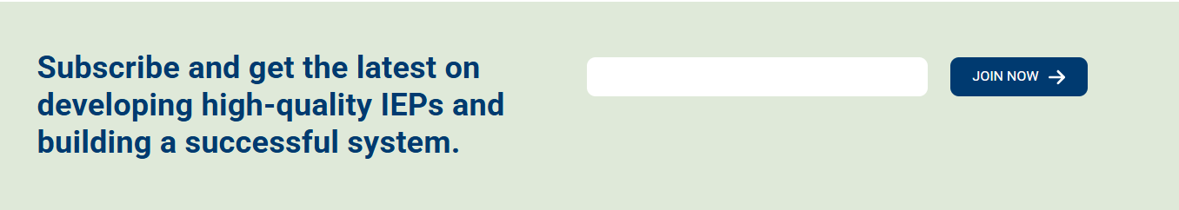

Stay connected with the PROGRESS Center!
@k12PROGRESS
@K12PROGRESS
@theprogresscenter3375

Slide 68
XXXXX_MO/22
1400 Crystal Drive, 10th Floor
Arlington, VA 22202-3289
202.403.5000
progresscenter@air.org
promotingprogress.org | www.air.org
https://www.facebook.com/k12PROGRESS/
https://twitter.com/K12PROGRESS
Notice of Trademark: “American Institutes for Research” and “AIR” are registered trademarks. All other brand, product, or company names are trademarks or registered trademarks of their respective owners.
This material was produced under the U.S. Department of Education, Office of Special Education Programs, Award No. H326C190002. David Emenheiser serves as the project officer. The views expressed herein do not necessarily represent the positions or policies of the U.S. Department of Education. No official endorsement by the U.S. Department of Education of any product, commodity, service, or enterprise mentioned in this presentation is intended or should be inferred.

