Slide 1
Doing More with Less: Strategic Blending and Braiding of IDEA Funds Amid Fiscal Shifts
Amber McCollum, Ed.S.

Slide 2
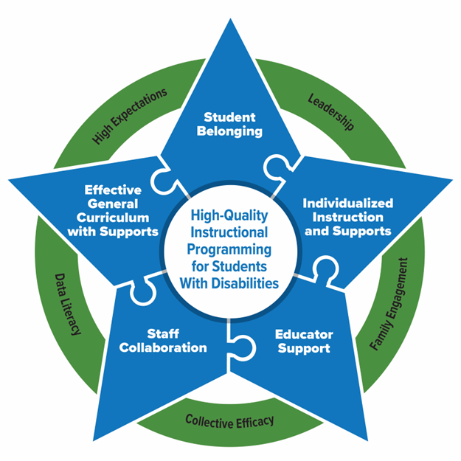
How can we strategically use IDEA funds to implement the essential elements necessary for success?
The PROGRESS Center has identified Essential Elements in schools that support high-quality instructional programming for students with disabilities.

Slide 3
Myths
Students with disabilities will not have access to critical individualized education program (IEP) services if Individuals with Disabilities Education Act (IDEA) funds are consolidated.
State education agencies (SEAs) cannot monitor Schoolwide Programs effectively.
It is difficult to consolidate IDEA funds because they are not allocated at the school level.
Schoolwide Programs will have maintenance of effort (MOE) concerns if IDEA funds are consolidated.

Slide 4
What do "braiding and blending" mean?
Braiding funds
Coordinated to meet one purpose
Individual funding stream maintains identity for eligibility and reporting
Blending funds
Consolidated into one funding stream to meet one purpose
Individual funding stream loses its identity

Slide 5

Braiding
Braiding is coordinating multiple funding streams to support a common initiative, but each stream is kept separate for reporting purposes.
All funds keep their identity and requirements.

Slide 6

Blending
Blending is the most flexible. It is used to combine multiple funding streams into one pool to support a common goal. Each funding source loses its identity.
A schoolwide program allows the most flexibility for blending.

Slide 7
Why consider braiding or blending?
  "Fund your plan" rather than "plan for your funds"
  Optimize the ability to serve students with complex needs by providing access to streamlined services rather than services from multiple separate programs
  Differentiate fiscal and human resources based on need and not program eligibility
  Reduce arbitrary routines of fractioning staff FTE based on funding streams rather than maximizing FTE to support students
  Minimize duplication of human and fiscal resources
FTE: Full Time Equivalent

Slide 8
Which funds may be braided and blended?
Braiding funds
Unrestricted state and local funds
Restricted state funds
Federal funds
  ESEA Titles I, II, III, and IV
  IDEA including IDEA CEIS
Blending funds
Unrestricted state and local funds
Some restricted state funds (depends on state rule)
Federal funds
  ESEA Titles I, II, III, and IV
  IDEA
IDEA – Individuals with Disabilities Education Act; ESEA – Elementary and Secondary Education Act; CEIS – Coordinated Early Intervening Services

Slide 9
Blending of IDEA Part B Funds
34 CFR 300.206 (a) - Schoolwide programs under title I of the ESEA.
“….an LEA may use funds received under Part B of the Act for any fiscal year to carry out a schoolwide program under section 1114 of the ESEA...”

Slide 10
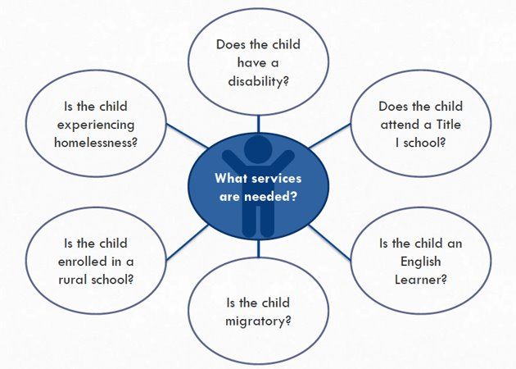
Questions to Consider While Planning
Source: U.S. Department of Education, National ESEA Conference, January 30, 2019
Notes:
Source: U.S. Department of Education, National ESEA Conference, January 30, 2019

Slide 11
Before You Allow Braiding or Blending
Keep in mind:
Federal grants have fiscal requirements.
SEA and LEA staff must understand these requirements.
Effective fiscal procedures are essential for a successful coordination and consolidation of funds.

Slide 12
Start Small
States and LEAs that have been successful did not jump in all at once.
Example: An LEA blends Title I and IDEA CEIS funds to:
  Hire interventionists for students at risk of being referred to special education.
  Fund professional development for general education teacher on behavioral supports and culturally responsive practices.
  Run family engagement sessions around early warning signs and supports.
Expected outcome: To reduce misidentification and build capacity.

Slide 13
Schoolwide Programs
“A Title I schoolwide program is a comprehensive reform strategy designed to upgrade the entire educational program in a Title I school in order to improve the achievement of the lowest-achieving students.” (ESEA section 1114(a)(1))
“When a school consolidates funds in a schoolwide program, those funds lose their individual identity, and the school may use the funds to support any activity of the schoolwide program without regard to which program contributed the specific funds used for a particular activity. Each SEA must ensure that it will modify or eliminate State fiscal and accounting barriers so that these funds can be more easily consolidated.” (ESEA section 1111(g)(2)(E))
Non-Regulatory Guidance 2016: ESSA Schoolwide Guidance September 2016 (PDF) (ed.gov)
Notes:
AKA = consolidation of funds

Slide 14

Mind Shift
“You don’t make progress by standing on the sidelines, whimpering and complaining. You make progress by implementing ideas.”
Congresswoman Shirley Chisholm

Slide 15
Partnerships Matter
State educational agencies must prioritize and model partnerships and communication across the agency with federal programs and other divisions.
Local educational agencies must be willing to have cross divisional buy-in and support. Generally, principals and senior leaders (like superintendents) are willing to consolidate funds and break down barriers. Local directors of finance and program directors generally need support and guidance to understand how consolidation is beneficial.

Slide 16
Schoolwide Consolidation of Funds Logistics
SEA allocates funding
LEAs complete needs assessment
LEAs determine school level allocations
LEAs determine consolidating schools
Must be a Schoolwide Program school
School Performance Considerations
Special Grants
Programs Considered for Consolidation
School Improvement
Title I, Part C
Other Considerations
State and local contributions
Staffing Needs
Title II, Part A
IDEA 611
Others…
Professional Development
Software
Flexibility

Slide 17
Why Should LEAs Consolidate Funds?
Why
Why Not
Efficiency
Effectiveness
Equity
Instructional Focus
Flexibility
Collaboration
Innovation
Positive Impact on Families
Federal Funds are heavily focused on central office staff serving multiple schools
Internal Controls Deficiency
Staff Turnover
New Processes and Procedures Must Be Developed

Slide 18
Local Educational Agency Impact
Focus is shifted
Funds are closer to the students
Less administrative burden
Fosters Collaboration
Promotes Innovation
Decreases Regulation

Slide 19
Support and Monitoring
State and Local Collaboration

Slide 20

Consolidation of Funds and Support
SEA/LEA quarterly check-ins
Review drawdowns
Technical assistance support

Slide 21
Consolidation of Funds and Monitoring
Monitoring
  Focus on Intent and Purpose
  Drawdowns
  Statute Requirements/Specific Program Requirements

Slide 22
Examples for Monitoring
Required | Not Required for Consolidating Accounts
Equitable Services | Time and Effort
Cash Management Procedures | Inventory (except state and local requirements)
Drawdown Reports and Reconciliation | Suspension and Debarment
Single Audit Reports | Procurement Levels (except state and local requirements)
Maintenance of Effort Documentation | Travel Policy (except state and local requirements)
Excess Cost Calculation

Slide 23
Additional Monitoring Requirements for Consolidating LEAs
34 CFR 200.29 a, b, c (3), d, e
The amount of funds consolidated may not exceed the amount received by the LEA under part B of IDEA for that fiscal year, divided by the number of children with disabilities in the jurisdiction of the LEA, and multiplied by the number of children with disabilities participating in the schoolwide program.
Must comply with all other requirements of part B of IDEA, to the same extent it would if it did not consolidate funds under part B of IDEA or section 7003(d) of the ESEA in the schoolwide program

Slide 24
Big Picture Questions
When you think about your current use of IDEA funds, are you funding programs or outcomes?
What funding silos are you currently operating in that might be working against each other?
If a student is served from multiple federal programs, who pays for their services?

Slide 25
Next Steps for Blending and Braiding
Strengthen collaboration structures within your organization.
  (e.g., federal program collaboration, state and local collaboration)
Contact your state educational agency (SEA) to ensure alignment with reporting obligations.
Review your needs assessment to develop overlap in priorities.
Request support!
  SEAs can request support from NCSI.

Slide 26


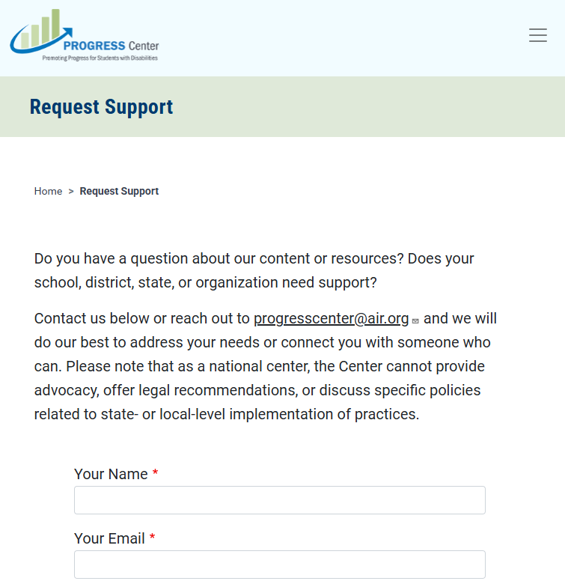
Find Additional Resources and Request Support
Visit our website
promotingprogress.org

Slide 27
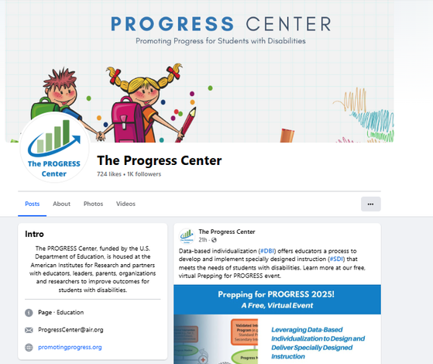
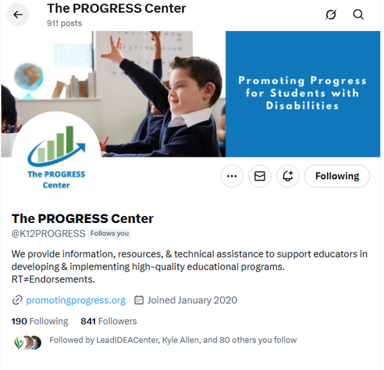
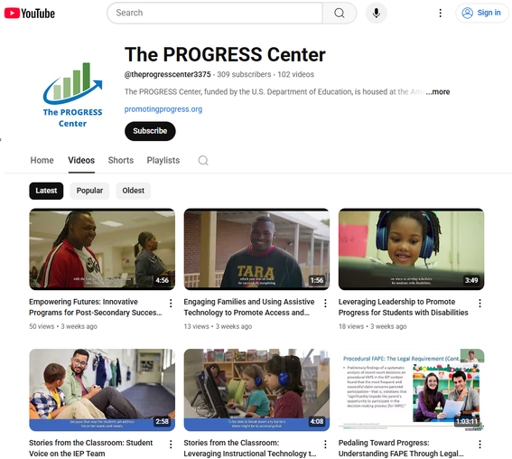





Stay connected with the PROGRESS Center!
@k12PROGRESS
@K12PROGRESS
@theprogresscenter3375

