Slide 1
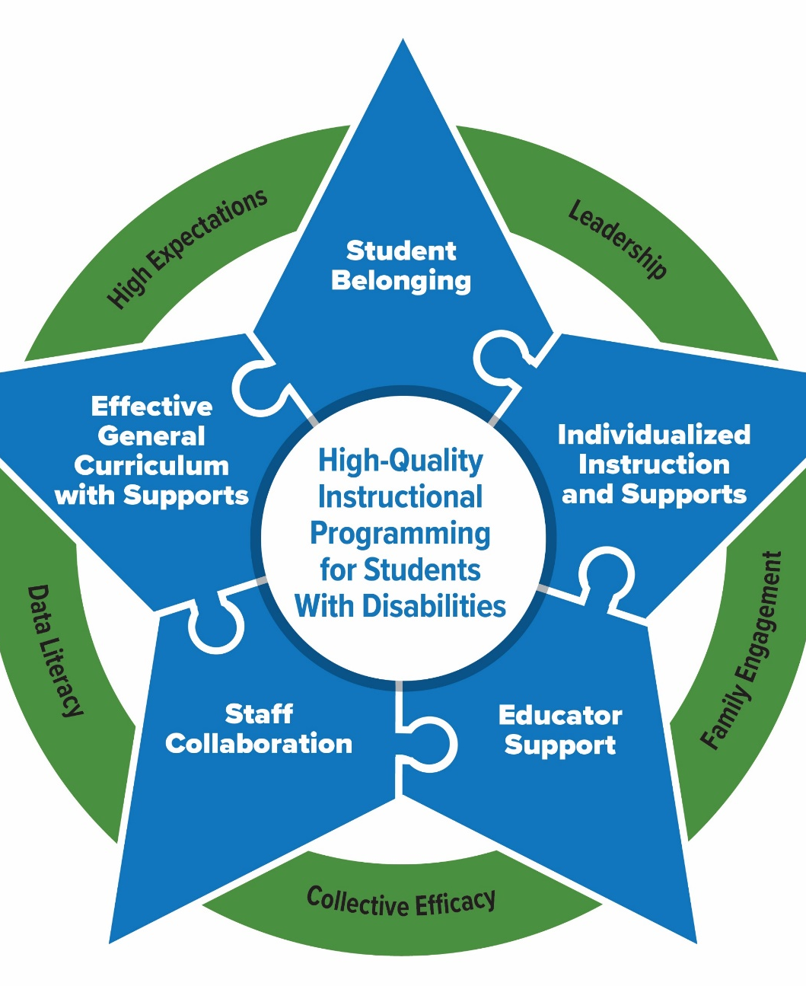
Prepping for PROGRESS 2025
Building a Successful System to Promote Progress for Students with Disabilities
August 2025

Slide 2

Welcome

Slide 3
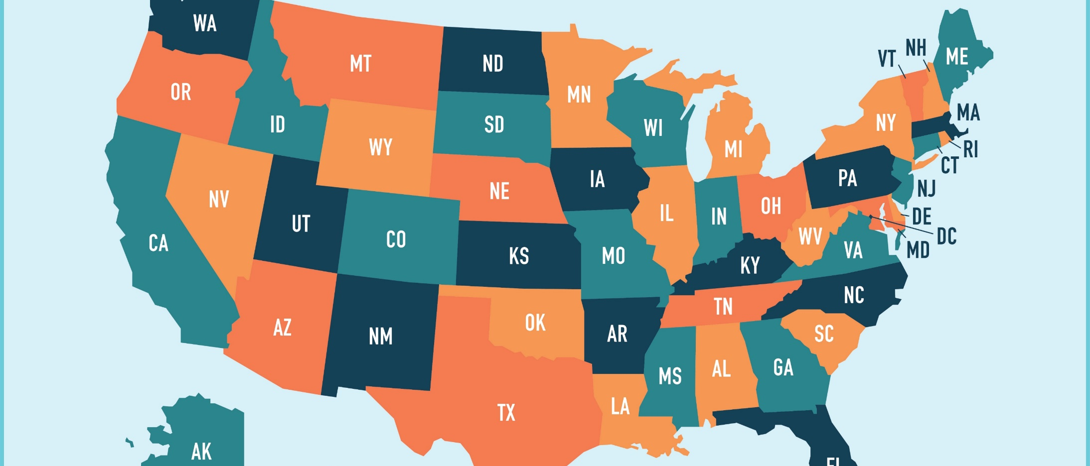
Where are you from? Share in the Chat!

Slide 4




Welcome from the PROGRESS Center!
The PROGRESS Center provides information, resources, tools, and technical assistance services to support local educators in developing and implementing high-quality educational programs that enable children with disabilities to make progress and meet challenging goals.
HOW WILL WE HELP IMPROVE OUTCOMES FOR STUDENTS WITH DISABILITIES?
Share current research,
policies, guidance, success stories, and experiences from students, parents, educators, and
other stakeholders.
Partner with selected
local educators to develop and implement high-quality educational programs.​
Provide tools, resources, and
training materials for ALL educators, leaders, and families.
Visit us at www.promotingPROGRESS.org to learn more!
≈

Slide 5

Why are we here?
Endrew F. v. Douglas County School District RE-1 (2017):
“To meet its substantive obligation under the IDEA, a school must offer an IEP that is reasonably calculated to enable a child to make progress appropriate in light of the child’s circumstances.” (emphasis added, p. 16)
Source: Endrew F. v. Douglas County School District, 580 U.S. 16 (2017)

Slide 6


How do we ensure that every student is on the path to PROGRESS?
Progress

Slide 7
Event Schedule: At A Glance
August 12 (11:00 am – 4:00 pm ET)
Welcome and Keynote
Strand Sessions
August 13 (11:00 am – 4:00 pm ET)
Keynote
Concurrent Sessions (repeated)
Closing Session

Slide 8
Today’s Schedule: August 12, 2025
11:00 a.m.–12:30 p.m. ET (10:00 a.m. CT/9:00 a.m. MT/8:00 a.m. PT) | General Session
12:30–1:00 p.m. ET (11:30 a.m. CT/10:30 a.m. MT/9:30 a.m. PT) | Break
1:00–4:00 p.m. ET (12:00 p.m. CT/11:00 a.m. MT/10:00 a.m. PT) | Strand Sessions (break included)

Slide 9
Day 1: Strand Options
Strand 1: Building Blocks of Progress: The Role of the IEP
Strand 1 is designed for those who are new to special education and the individualized education program (IEP) or who are looking for an overview or review of the basics.
Strand 2: Building Access and Belonging: Instructional and Behavioral Practices that Support Students with Disabilities in General Education
Strand 2 is designed for those who feel more confident in their understanding of the IEP and desire to dig deeper into strategies for promoting access and progress within general education
Strand 3: Supporting English Learners with Disabilities: From IEP Development to Supporting Instruction
Strand 3 is designed for those supporting the development and implementation of high-quality instructional programming for English learners with an identified disability.

Slide 10
Event Schedule Overview: Day 2!
11:00 a.m.–12:15 p.m. ET (10:00 a.m. CT/9:00 a.m. MT/8:00 a.m. PT) | General Session
12:15–12:45 p.m. ET (11:15 a.m. CT/10:15 a.m. MT/9:15 a.m. PT) | Break
12:45–1:45 p.m. ET (11:45 a.m. CT/10:45 a.m. MT/9:45 a.m. PT) | Concurrent Sessions
1:45–2:00 p.m. ET (12:45 p.m. CT/11:45 a.m. MT/10:45 a.m. PT) | Break
2:00–3:00 p.m. ET (1:00 p.m. CT/12:00 p.m. MT/11:00 a.m. PT) | Concurrent Sessions (sessions repeat)
3:00–3:15 p.m. ET (2:00 p.m. CT/1:00 p.m. MT/12:00 p.m. PT) | Break
3:15–4:00 p.m. ET (2:15 p.m. CT/1:15 p.m. MT/12:15 p.m. PT) | Closing Session

Slide 11
Day 2: Concurrent Sessions (sessions will repeat)
Doing More with Less: Strategic Blending and Braiding of IDEA Funds Amid Fiscal Shifts
Leveraging MTSS to Support Students with Disabilities
From Compliance to Impact: Crafting Meaningful IEP Goals
Unlocking Potential: How Leaders Can Support Strengthening Services for
Students with Disabilities Leveraging Data Based Individualization to Design and Deliver Specially Designed Instruction

Slide 12
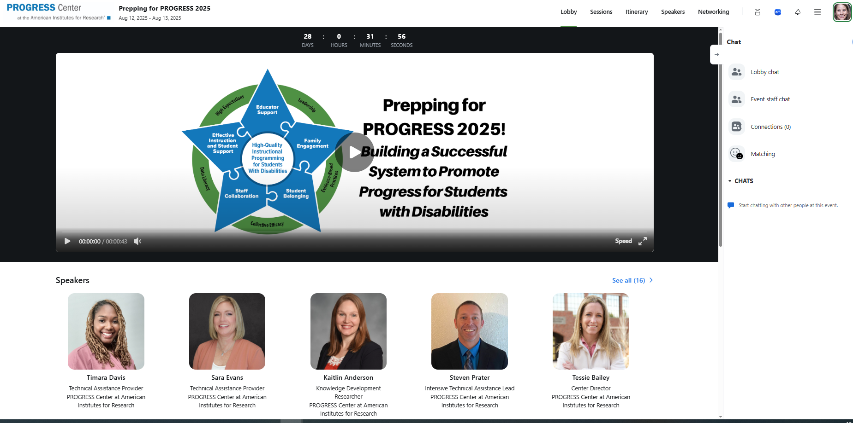
Navigating the Lobby

Slide 13
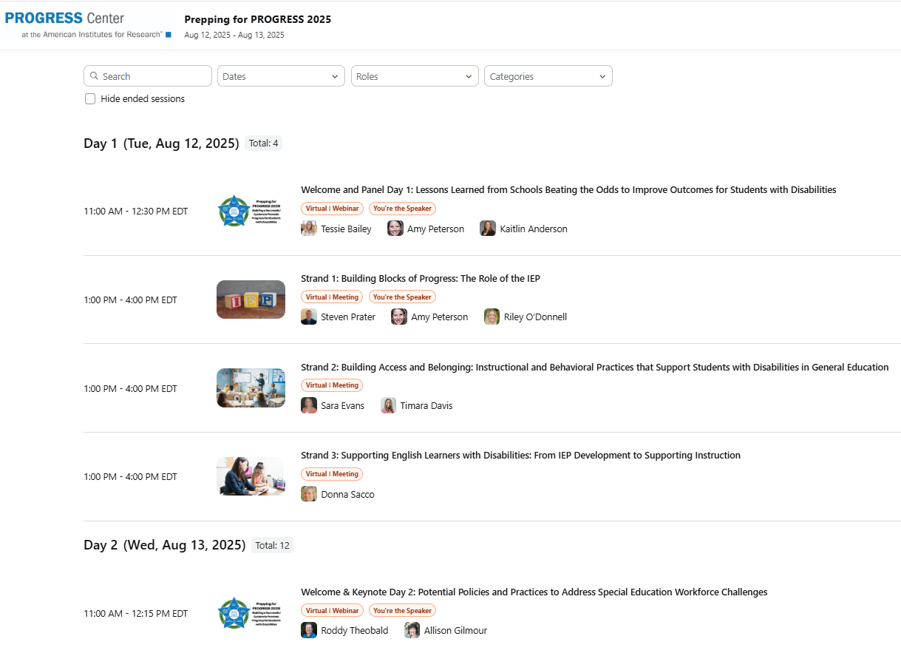

Viewing All Sessions
If you flag a session, it will show up on your itinerary

Slide 14
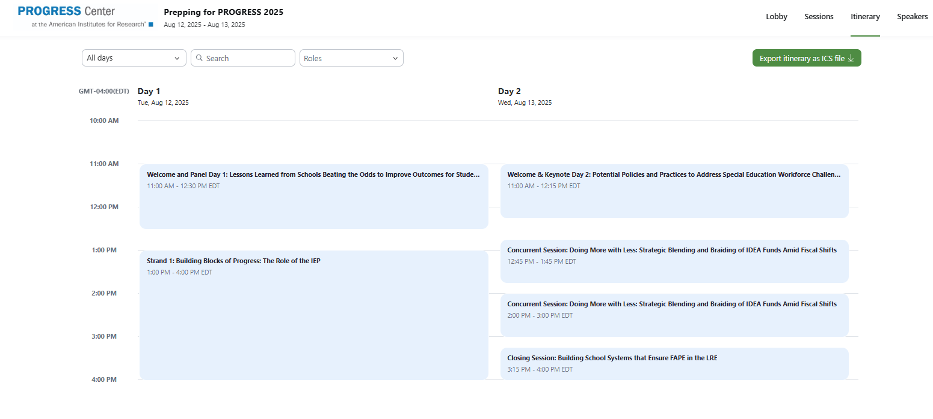
Itinerary (shows flagged sessions)
Download your itinerary to your calendar

Slide 15

Joining a Session
When sessions are available to join, you will see a green button saying Join and a red alert saying Now over the session picture.
When you click join, you will be taken to a Zoom meeting or webinar in a different window.
  You will still be able to see the lobby, but you will not be able to be in more than one Zoom session at a time.
Waiting rooms are enabled. If you join prior to the session start time, you will be let in from the waiting room promptly at the session start time.

Slide 16
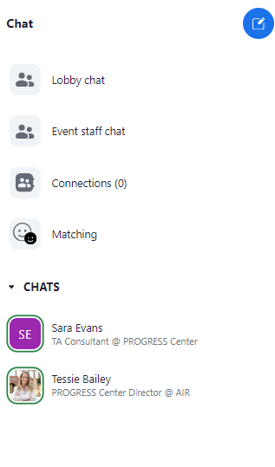
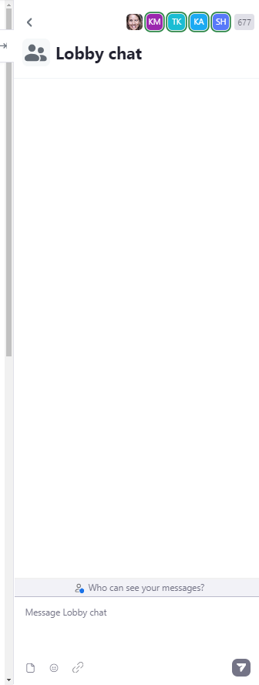
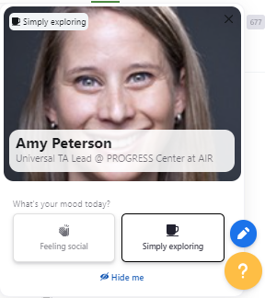
Networking and Connecting with Other Participants

Slide 17


Watching Recordings
Recordings will be available when sessions conclude.
Click the watch recording button from the Lobby/Session page to access the recording. (Note these recordings will not be edited)
The Lobby will be open through September 13, 2025.
After September 13, 2025, all materials will be archived on the PROGRESS Center website.

Slide 18
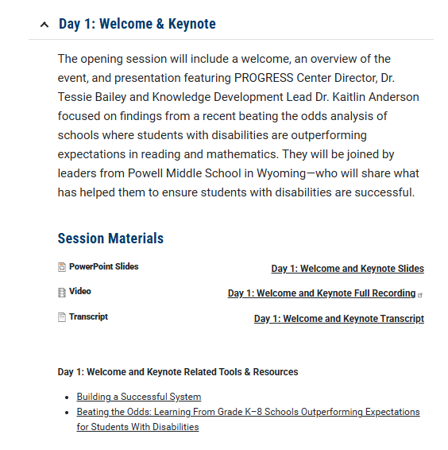
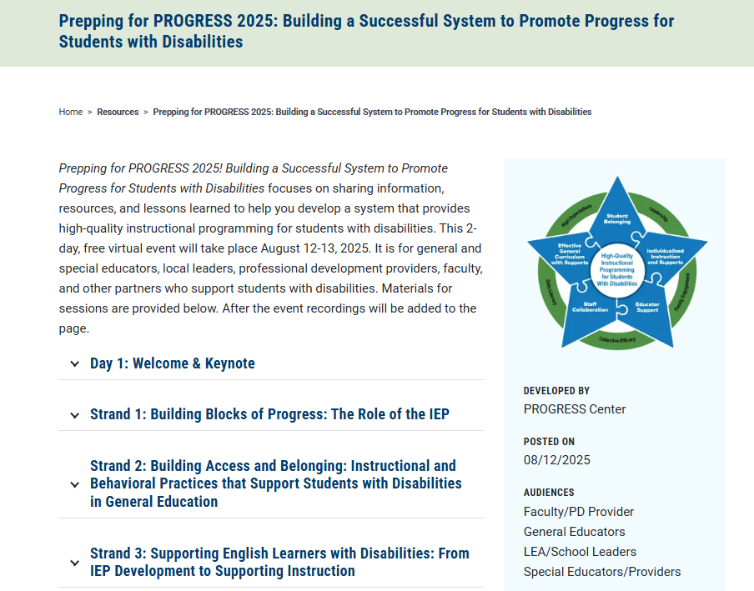
Where Can I Find Event Materials and Recordings After the Event?

Slide 19
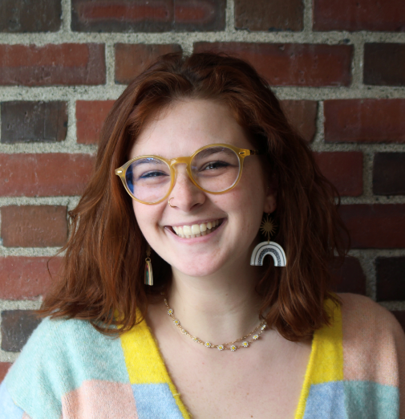
Technical Support
Do you have a question about the technology?
Do you need support in accessing a session?
Do you have questions about accessing materials?
Reach out to progresscenter@air.org or with any challenges and Cat will do her best to address any needs throughout the event.

Slide 20
Do you need a certificate of attendance?
A certificate will be sent to all participants who indicated in registration that they would like a certificate. If you are not sure if you requested a certificate, please email progresscenter@air.org to confirm your interest.
The certificate will represent the total amount of time you participated in the event. Sessions will be counted when you attended at least 75% of the live session.

Slide 21
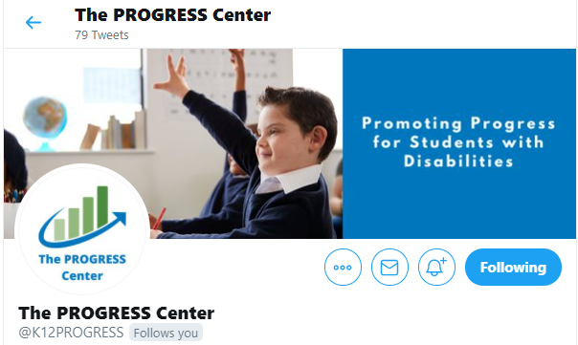
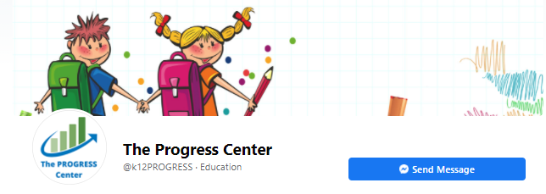
Connect with the
PROGRESS Center
Connect with us on Facebook and X @k12progress
Share your learning by using the hashtag #promotingprogress2025

Slide 22

Lessons Learned from Schools Beating the Odds to Improve Outcomes for Students with Disabilities

Slide 23
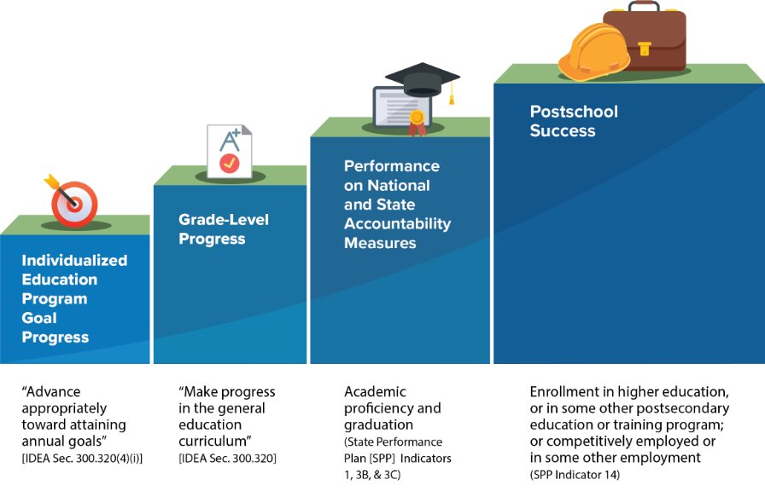
What is progress for students with disabilities?

Slide 24
Learning from Educators and Leaders
Our sources:
15 local partner sites over the 5 years.
8 multi-day training and coaching institutes.
62 educators in residence.
22 submitted impact stories.
Comprehensive evaluation activities.

Slide 25
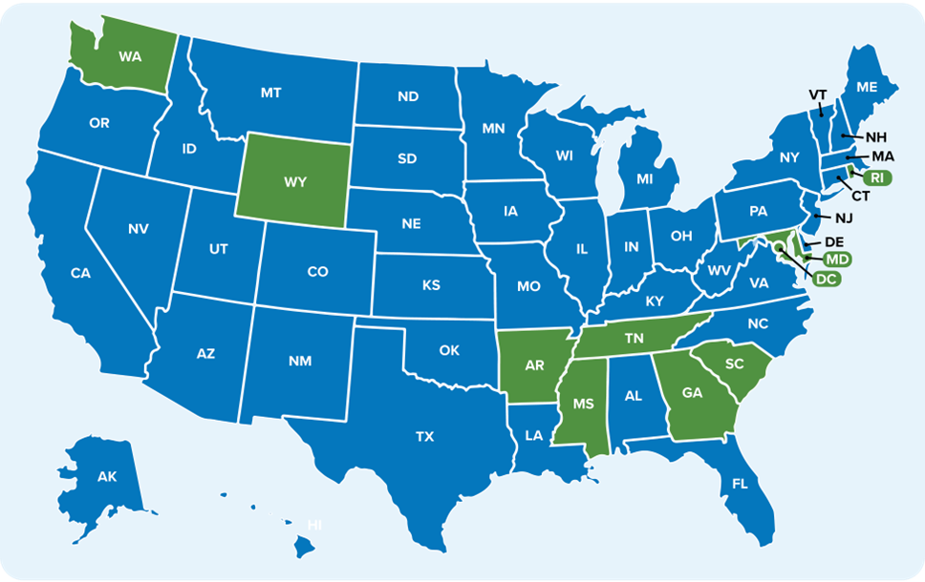
States Included in School-Level BTO Analysis Based on NAEP Reading and Math Performance
Note. NAEP = National Assessment for Educational Progress. Green states were included in our school-level quantitative data analysis, and blue states were not included.

Slide 26
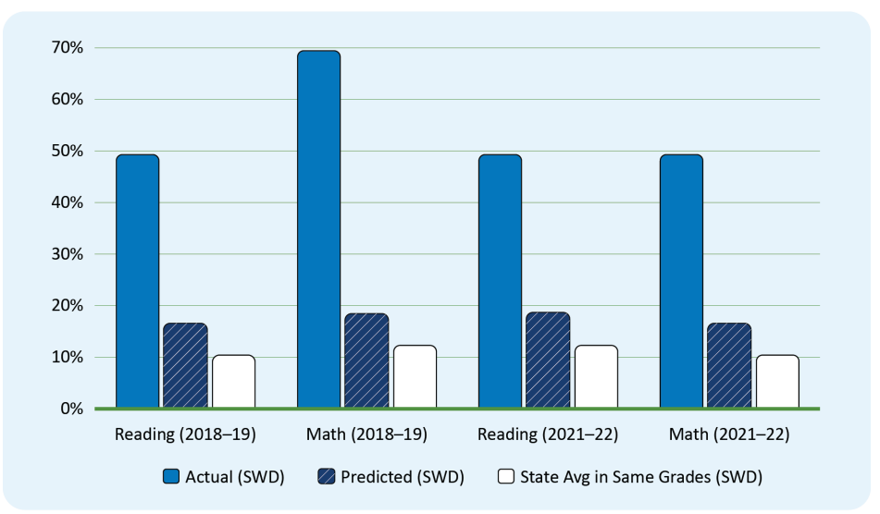
What does it look like to beat the odds in reading and math, grades 3-5 (School D)?
Exhibit Note. Predicted value is based on multiple regression methods as described in Appendix A. Schools were identified as “BTO” if they were one of the top performers in their state, relative to their predicted value. Specifically, we created lists of the top 20 schools in terms of the difference between their actual and predicted values. SWD = students with disabilities. Reading tests are inclusive of Reading and Language Arts.

Slide 27
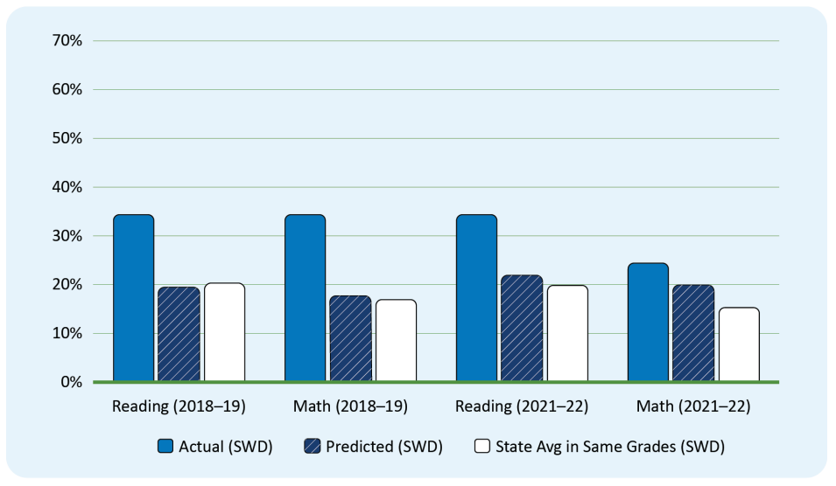
What does it look like to beat the odds in reading and math, grades 6-8 (School E)?
Exhibit Note. Predicted value is based on multiple regression methods as described in Appendix A. Schools were identified as “BTO” if they were one of the top performers in their state, relative to their predicted value. Specifically, we created lists of the top 20 schools in terms of the difference between their actual and predicted values. See Appendix A for more details. SWD = students with disabilities. Reading tests are inclusive of Reading and Language Arts. School E’s math performance in 2021-22 was lower than in reading and in prior years, but they were still selected as a BTO school for qualitative data collection because they were in the top 20 schools in their state in terms of actual performance, relative to expectations, in three out of the four cases. See Appendix A for more discussion of the priority order in which schools were selected for qualitative data collection.

Slide 28
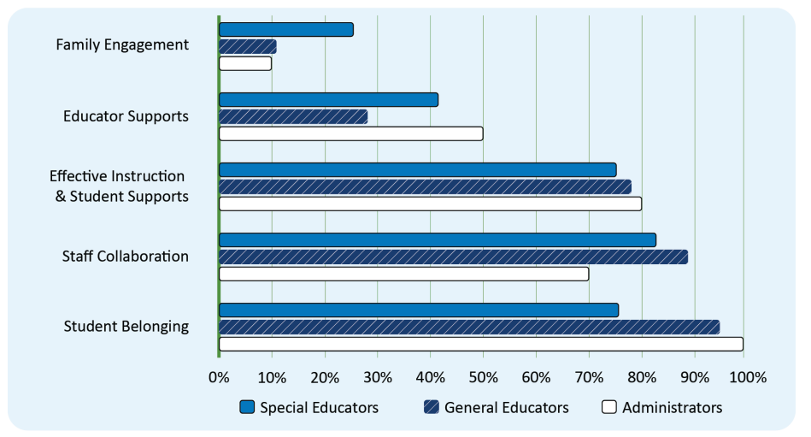
Priority areas were fairly similar across role types

Slide 29
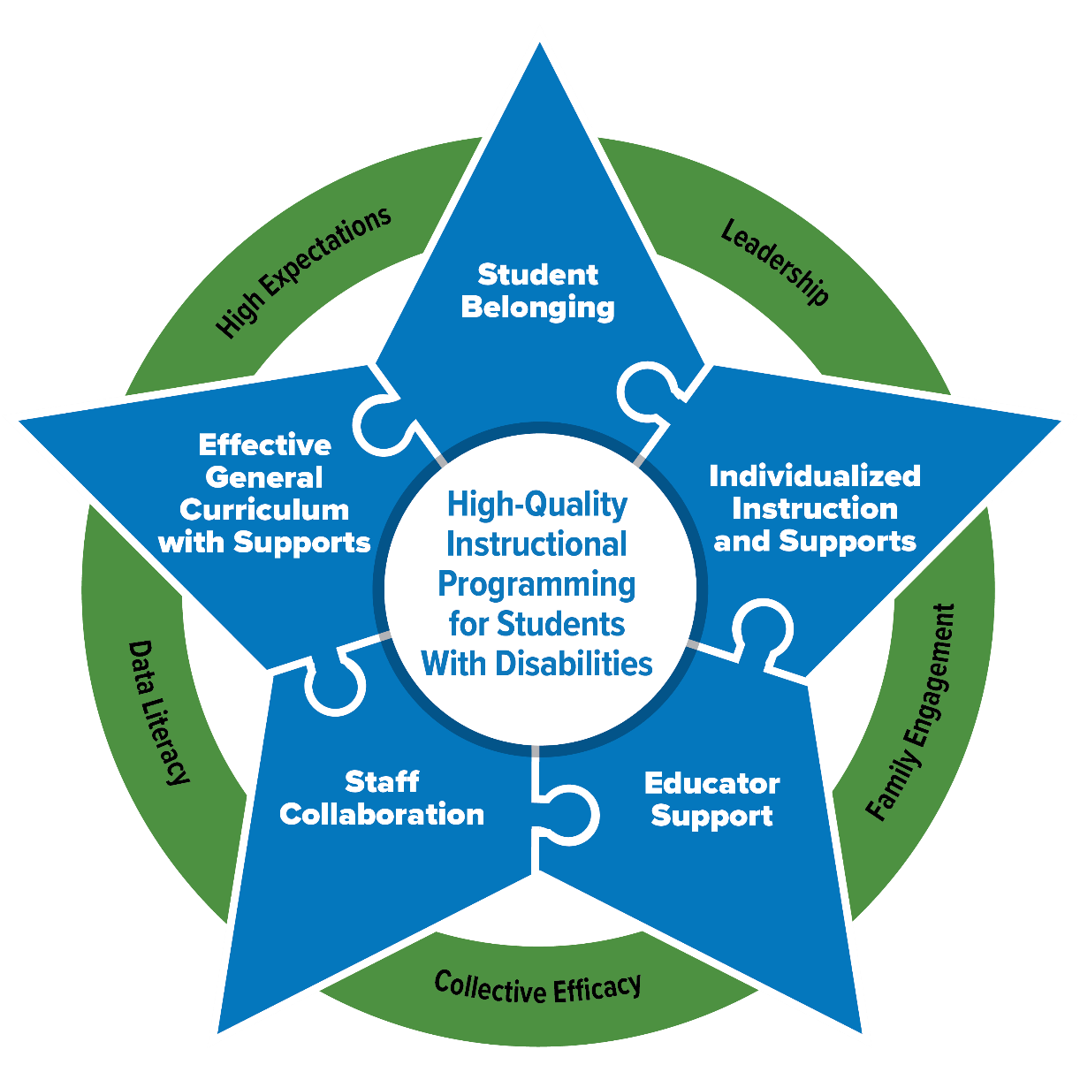
Findings: Essential Elements for Sustainable School Systems
The PROGRESS Center has identified Essential Elements in schools that support high-quality instructional programming for students with disabilities.

Slide 30
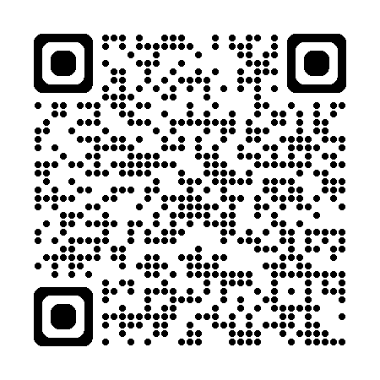
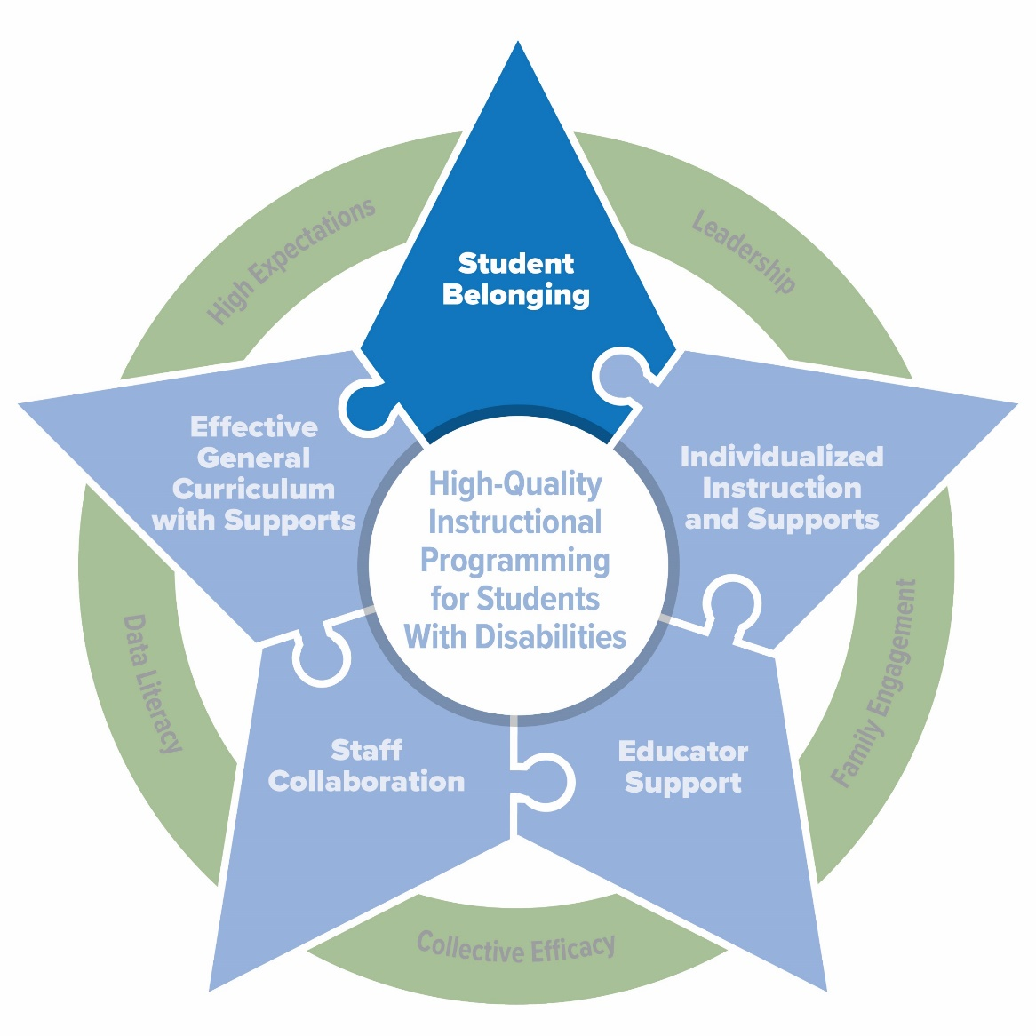
Element 1: Student Belonging
Students learn best and are most successful when they feel welcomed and feel a sense of belonging at school
Students with disabilities often struggle to achieve the same level of belonging as their peers
Biggs & Carter, 2017; Carter, 2021; Carter & Biggs, 2021; Cerda et al., 2018; Cullinane, 2020; Nepi et al., 2013; TNTP, 2025; SWIFT Center, 2025; PROGRESS Center, 2025

Slide 31
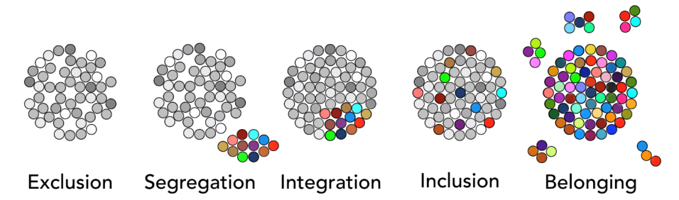
What is Belonging?

Slide 32
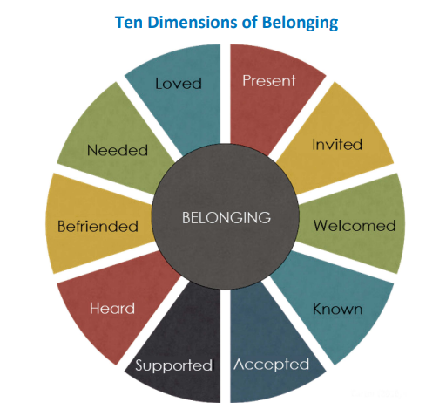
Ten Dimensions Of Belonging
Sources: Carter, 2021; Carter & Biggs, 2021

Slide 33
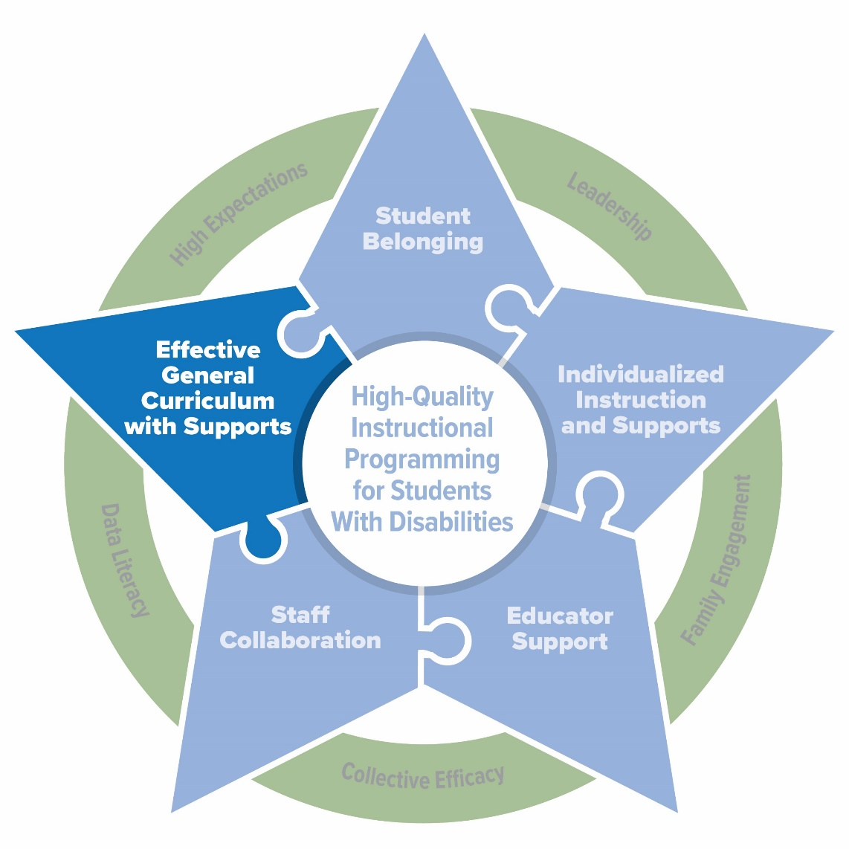
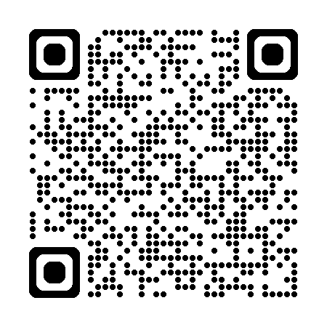
Element 2: Effective General Curriculum and Supports
PROGRESS Center, 2024

Slide 34



Considerations for High-Quality Instructional and Supports
How well is your core programming developed and delivered to promote progress and belonging for students with disabilities?
How well are your IEPs designed and delivered to promote progress for each student with a disability?

Slide 35
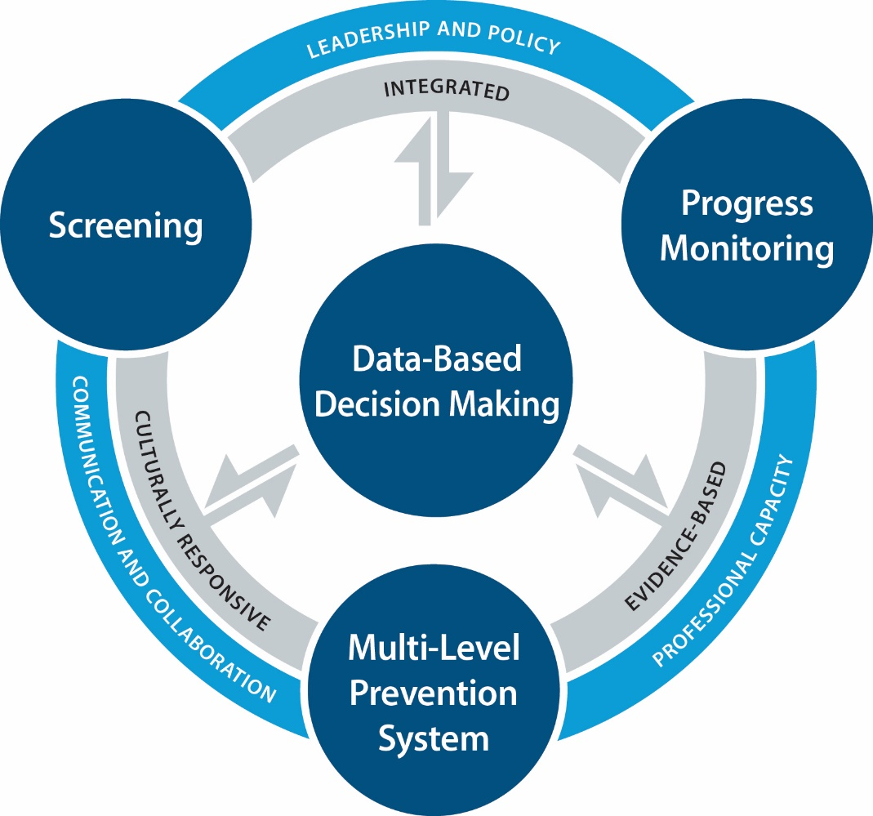
BTO School Practices that Promote Effective Instruction and Student Support
Lesson learned: Evidence-based practices are central
Multi-tiered system of supports (MTSS) with a focus on selecting evidence-based curriculum and interventions to address all tiers of learning and behavior
Importance of strong Tier 1 instruction
PROGRESS Center, 2024

Slide 36
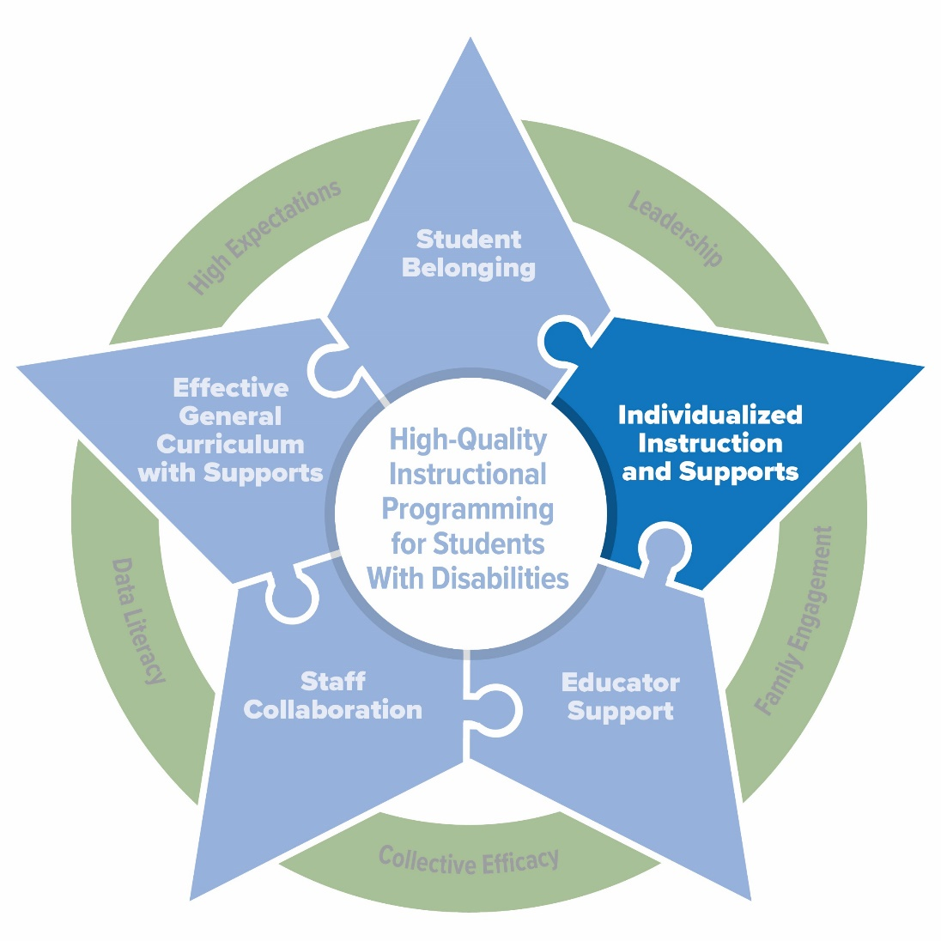
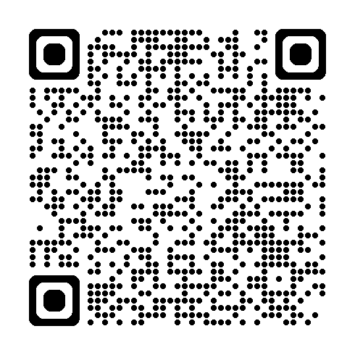
Element 3: Individualized Instruction and Supports

Slide 37
Considerations for High-Quality Instructional and Supports IEP
How well is your core programming developed and delivered to promote progress and belonging for students with disabilities?
How well are your IEPs designed and delivered to promote progress for each student with a disability?

Slide 38
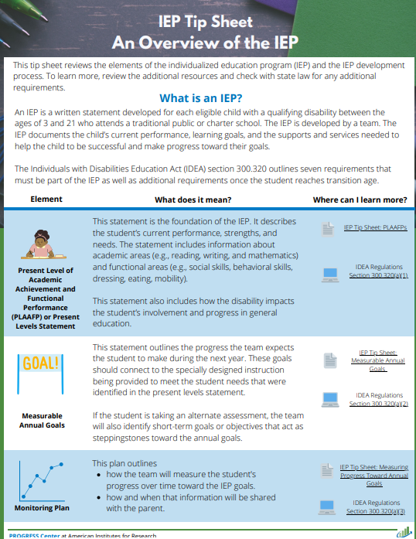
Which component ensures students make progress in the general education curriculum?
1. Present levels of academic achievement and functional performance (PLAAFP) statement
2. Statement of measurable annual goals
3. Monitoring plan
4. Statement of services and aids
5. Explanation of educational setting
6. Participation in State or districtwide assessment
7. Dates, frequency, location, and duration of services
https://sites.ed.gov/idea/regs/b/d/300.320

Slide 39
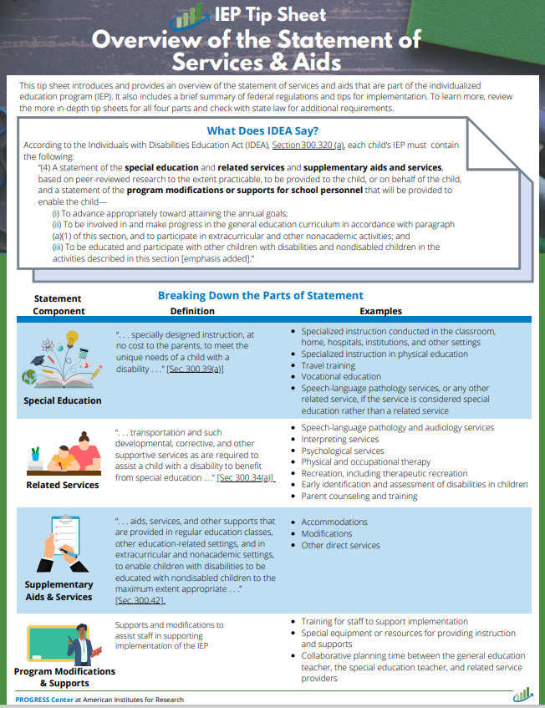
What does IDEA say about the statement of services and aids?
According to IDEA, Section 300.320 (a), each child’s IEP must contain the following:
“(4) A statement of the special education and related services and supplementary aids and services, based on peer-reviewed research to the extent practicable, to be provided to the child, or on behalf of the child, and a statement of the program modifications or supports for school personnel that will be provided to enable the child—… ″
Source: IDEA, Sec. 300.320(a)(4), emphasis added

Slide 40
What does IDEA say about the statement of services and aids? Cont.
“(i) To advance appropriately toward attaining the annual goals;
(ii) To be involved in and make progress in the general education curriculum in accordance with paragraph (a)(1) of this section, and to participate in extracurricular and other nonacademic activities; and
(iii) To be educated and participate with other children with disabilities and nondisabled children in the activities described in this section.”
Source: IDEA, Sec. 300.320(a)(4), emphasis added

Slide 41





The IEP’s Statement of Services and Aids Outlines Four Types of Supports
Special Education
Related Services
Supplementary Aids and Services
Program Modifications or Supports for School Personnel

Slide 42
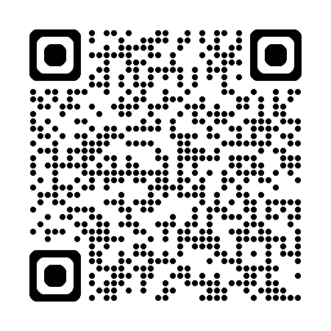
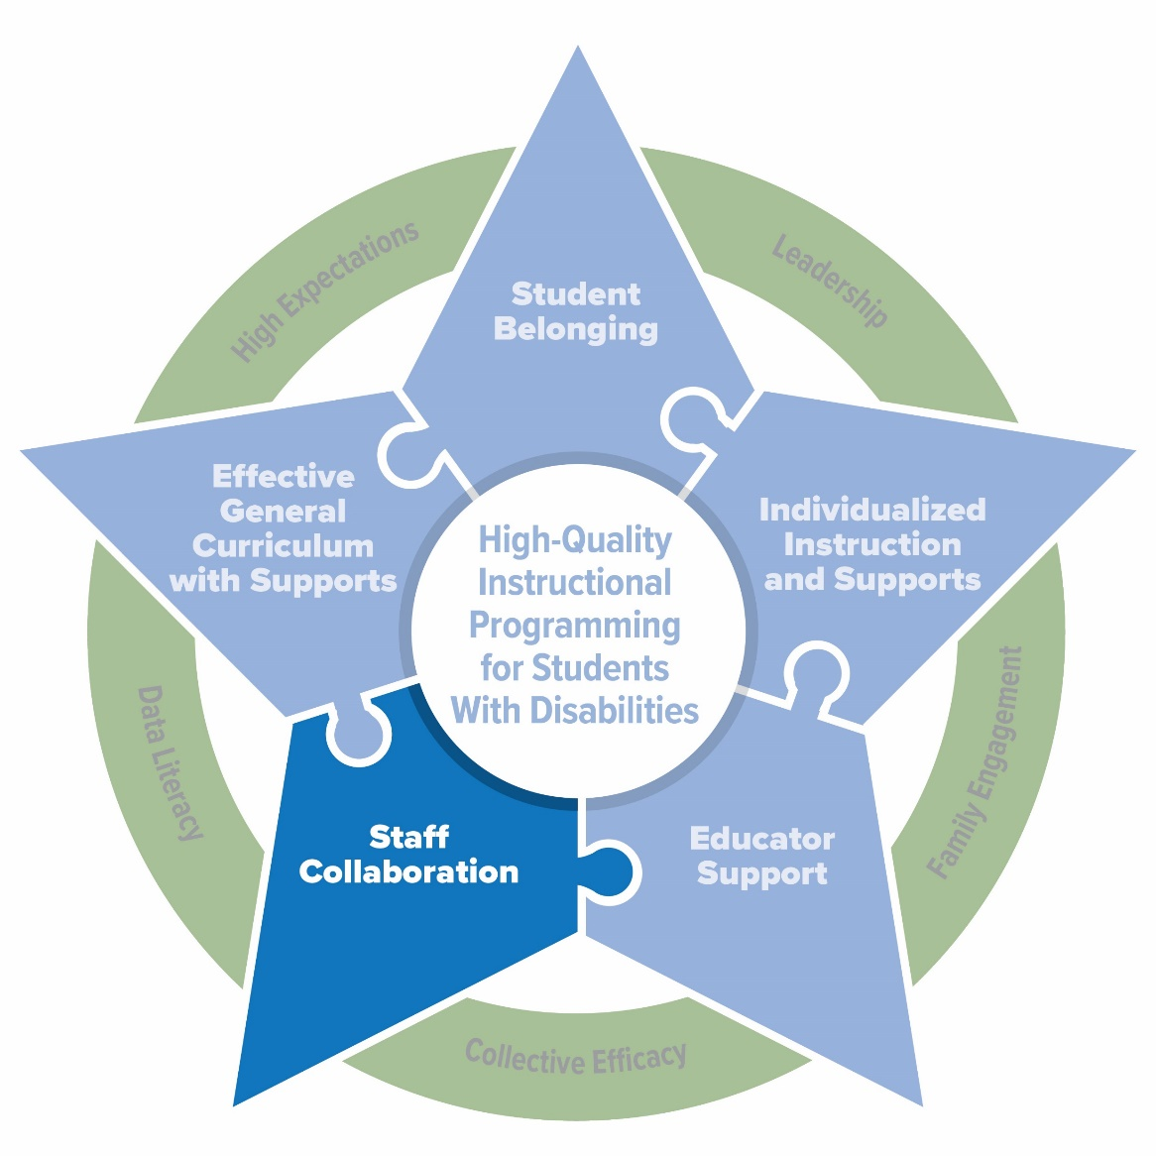
Element 4: Staff Collaboration
Role clarification is critical.
Staff collaboration is most effective when school leadership allocates time and resources to it and sets clear expectations for it

Slide 43
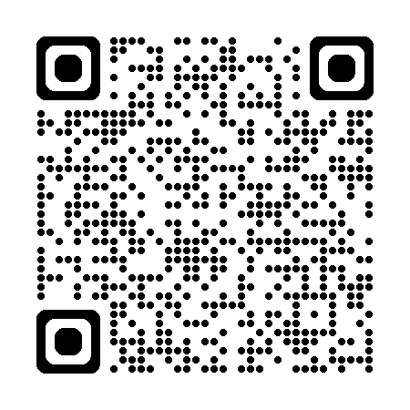
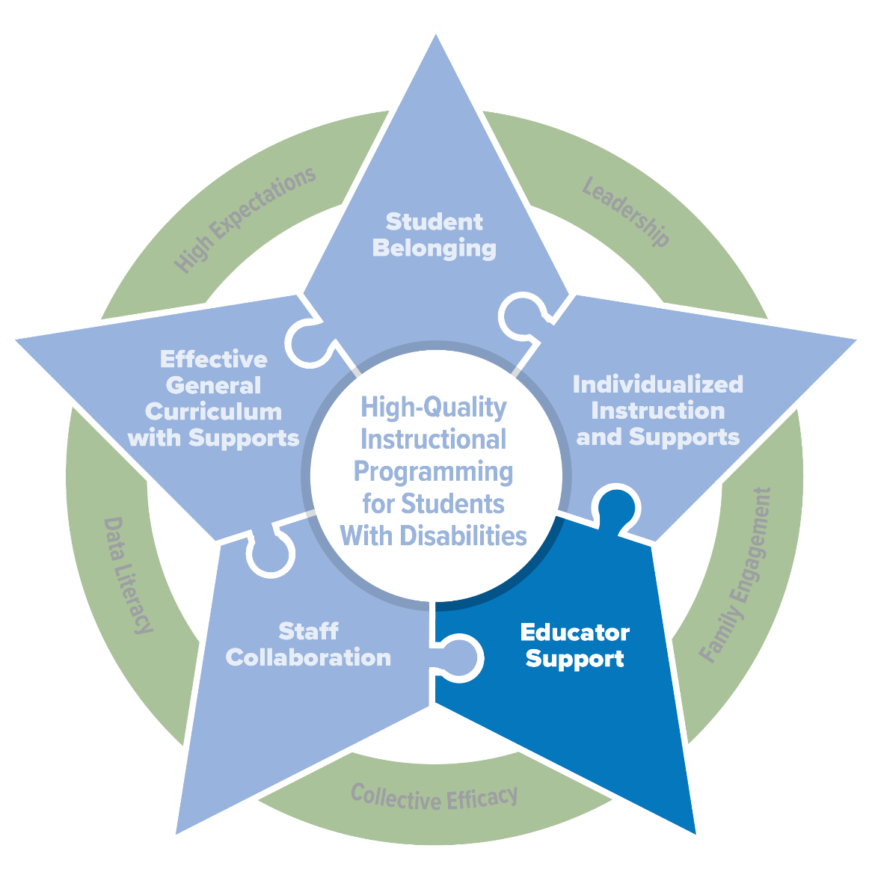
Element 5: Educator Support
Ongoing access to professional development and coaching
Access to instructional materials and resources
Supportive and collaborative working conditions
Schedules that provide collaborative opportunities and time for instructional delivery

Slide 44

Facilitators of a Sustainable System
Effective Leadership: Leaders proactively establish the working conditions necessary for collaborative planning and delivery of high-quality core and specialized instruction.
High Expectations: Educators and leaders believe all students, regardless of disability or circumstances, can achieve high expectations.
Family Engagement: Families are active and meaningful partners in the development and implementation of their child’s educational programming.
Data Literacy: Educators are equipped to engage in data-based decision making to drive instruction and continuous improvement.
Collective Efficacy: Educators and leaders believe they can positively affect student achievement, including students with disabilities.

Slide 45
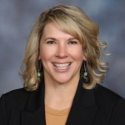
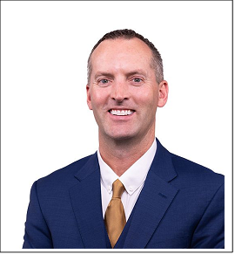
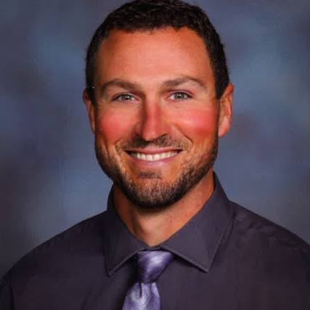
Meet the Panel
Ginger Sleep
Kyle Rohrer
Chanler Buck
Special Services Director
Park County School District #1
Powell, Wyoming
Principal
Powell Middle School
Powell, Wyoming
Assistant Principal and Activities Director
Powell Middle School
Powell, Wyoming

Slide 46
Reminder: Today’s Schedule: August 12, 2025
11:00 a.m.–12:30 p.m. ET (10:00 a.m. CT/9:00 a.m. MT/8:00 a.m. PT) | General Session
12:30–1:00 p.m. ET (11:30 a.m. CT/10:30 a.m. MT/9:30 a.m. PT) | Break
1:00–4:00 p.m. ET (12:00 p.m. CT/11:00 a.m. MT/10:00 a.m. PT) | Strand Sessions (break included)

Slide 47
Reminder: Event Materials

Slide 48
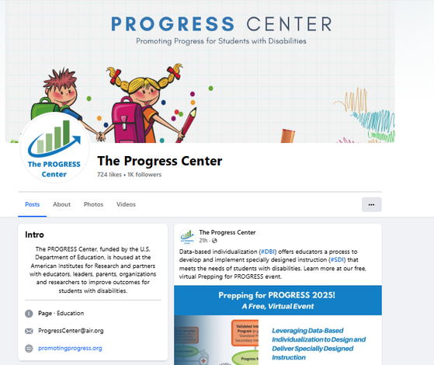
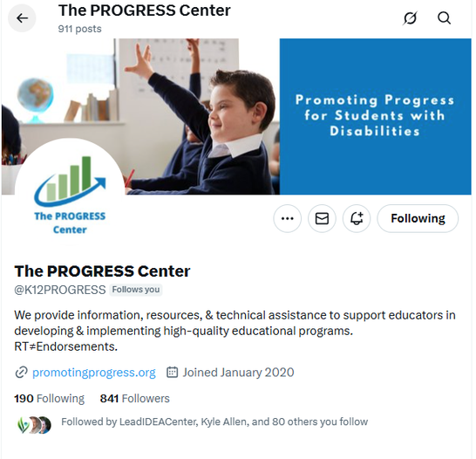
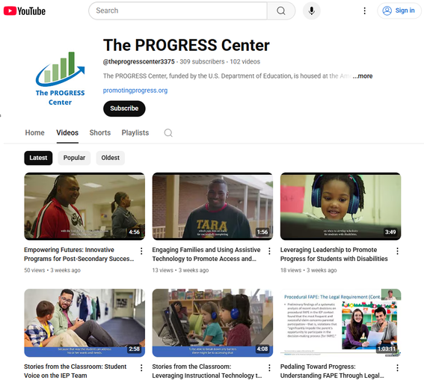



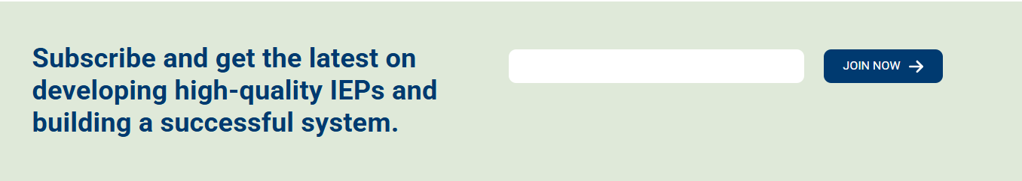
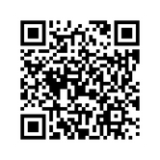
Stay connected with the PROGRESS Center!
@k12PROGRESS
@K12PROGRESS
@theprogresscenter3375

Slide 49
PROGRESS Center
progresscenter@air.org
1400 Crystal Drive, 10th Floor
Arlington, VA 22202-3289
202.403.5000
progresscenter@air.org
promotingprogress.org | www.air.org
https://www.facebook.com/k12PROGRESS/
https://twitter.com/K12PROGRESS
Notice of Trademark: “American Institutes for Research” and “AIR” are registered trademarks. All other brand, product, or company names are trademarks or registered trademarks of their respective owners.
This material was produced under the U.S. Department of Education, Office of Special Education Programs, Award No. H326C190002. David Emenheiser serves as the project officer. The views expressed herein do not necessarily represent the positions or policies of the U.S. Department of Education. No official endorsement by the U.S. Department of Education of any product, commodity, service, or enterprise mentioned in this presentation is intended or should be inferred.

