Slide 1


Leveraging Data-Based Individualization (DBI) to Design and Deliver Specially Designed Instruction (SDI)
Sara Evans| Kyle Allen
August 2025
04/2023

Slide 2





Who’s in the room?
Share the following in the chat:
What is one thing you hope to learn today?
What is your familiarity/comfort with using data-based individualization to design and deliver specially designed instruction?
0 | 1 | 2 | 3 | 4
None | Very Little | Somewhat | Pretty Good | I Got This!
National Center on Intensive Intervention at the American Institutes for Research
2

Slide 3
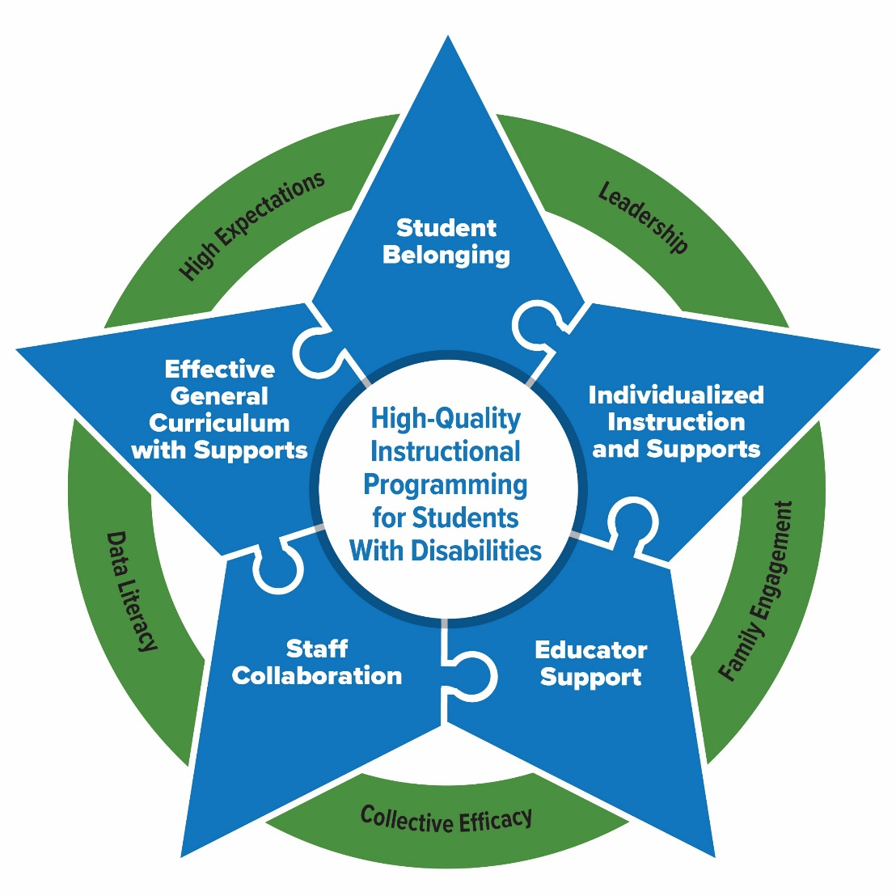
Essential Elements for Sustainable School Systems
The PROGRESS Center has identified Essential Elements in schools that support high-quality instructional programming for students with disabilities.
National Center on Intensive Intervention at the American Institutes for Research

Slide 4
The Development of SDI Starts with PLAAFP
PLAAFP Statement
Annual Goals
Measuring Progress Toward Annual Goals
Participation Outside Regular Education and in State and Districtwide Assessments
Statement of Special Education and Aids and Services
Date, Frequency, Duration, and Location of Services
National Center on Intensive Intervention at the American Institutes for Research

Slide 5
The Development of SDI (and the IEP) Starts with the PLAAFP Statement
PLAAFP Statement
Annual Goals
Measuring Progress Toward Annual Goals
Date, Frequency, Duration, and Location of Services
Participation Outside Regular Education and in State and Districtwide Assessments
Statement of Special Education and Aids and Services

Slide 6

Ensuring Appropriate Progress: Role of the PLAAFP
Endrew F. v. Douglas County School District RE-1 (2017)
“To meet its substantive obligation under the IDEA, a school must offer an IEP reasonably calculated to enable a child to make progress appropriate in light of the child’s circumstances.” [emphasis added]
National Center on Intensive Intervention at the American Institutes for Research

Slide 7

It starts with the right questions!
What do we want for the student?
What is the current reality of the student’s circumstances?
What does the student need to be successful?
How can we maximize our resources to support the student or support the parents and educators to assist the student?
National Center on Intensive Intervention at the American Institutes for Research

Slide 8
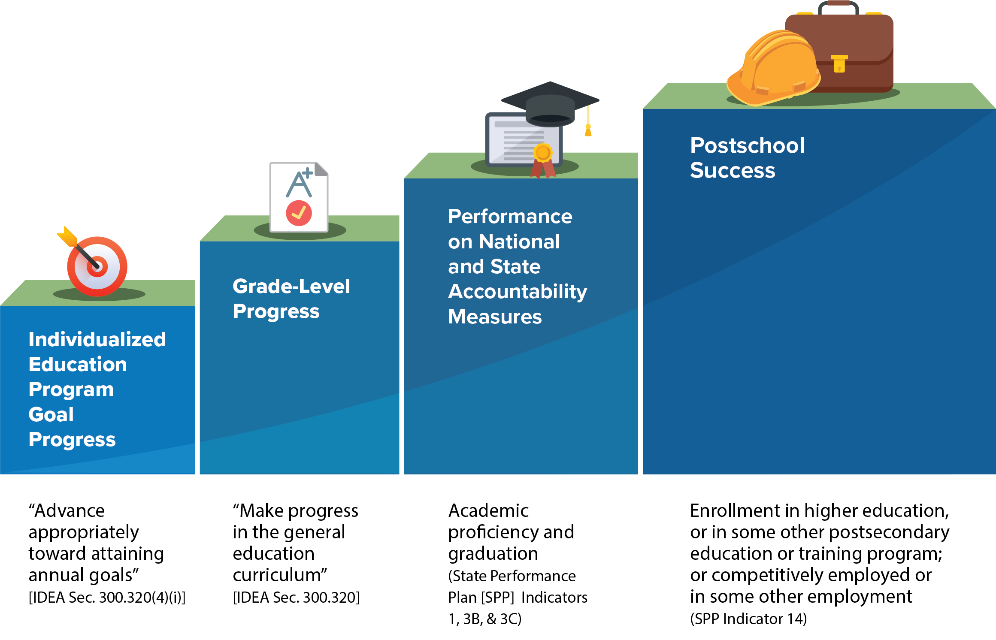
What is progress for students with disabilities?

Slide 9
SDI Description
Design and delivery of specially designed instruction depends on an evidence-based, iterative process that uses individual progress monitoring data to make decisions about adaptations to instructional delivery, content, and methodology.
National Center on Intensive Intervention at the American Institutes for Research

Slide 10
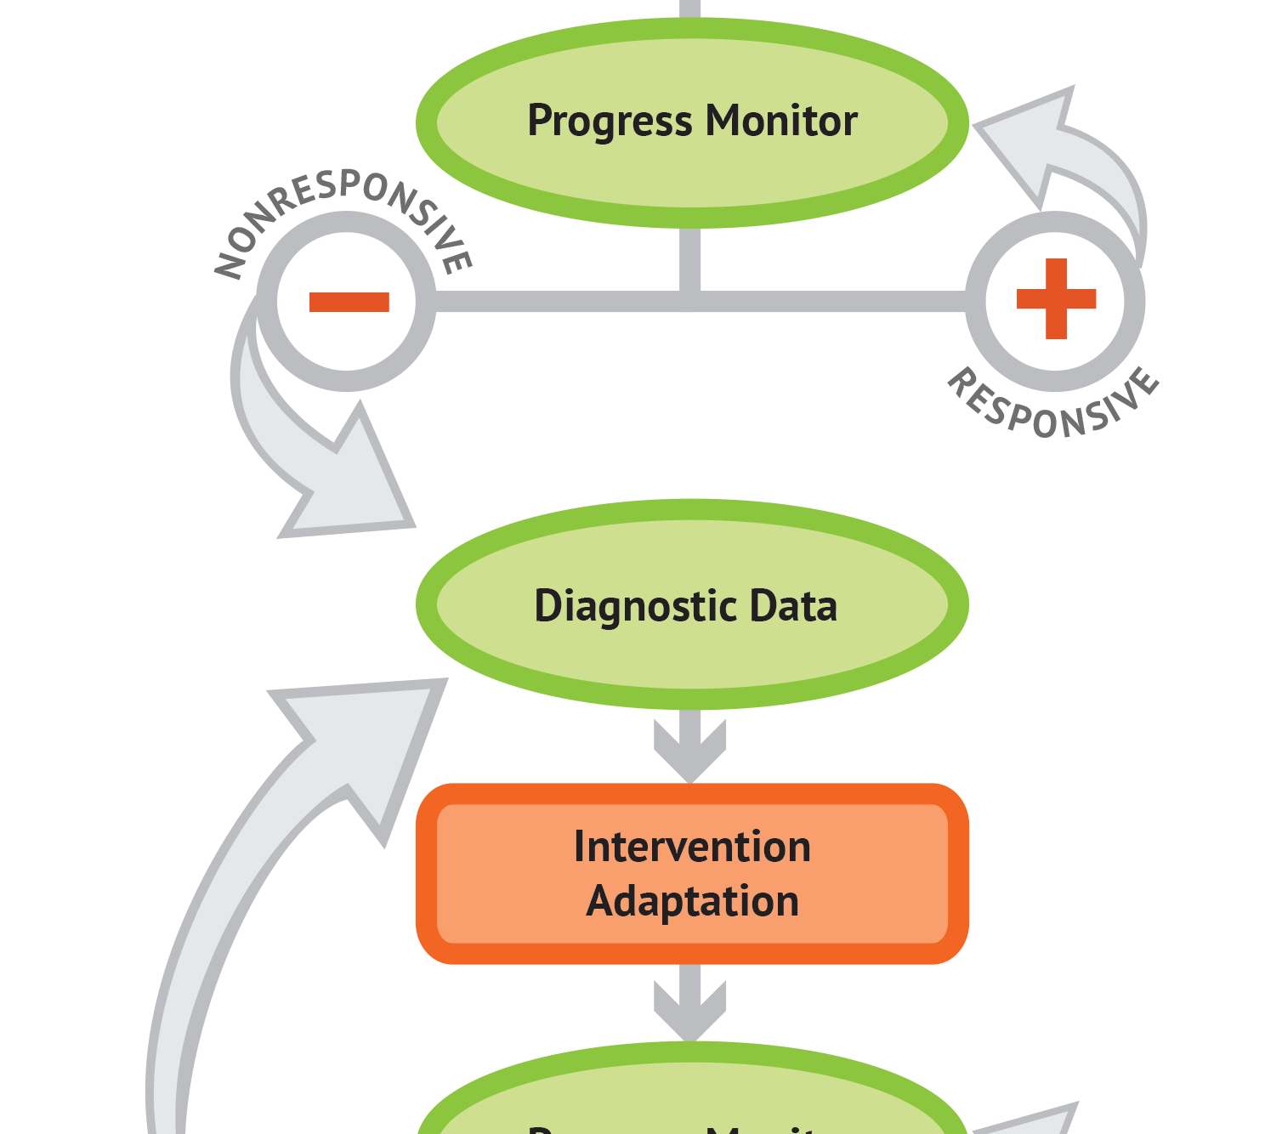

Introduction to the Five Steps of Data-Based Individualization

Slide 11
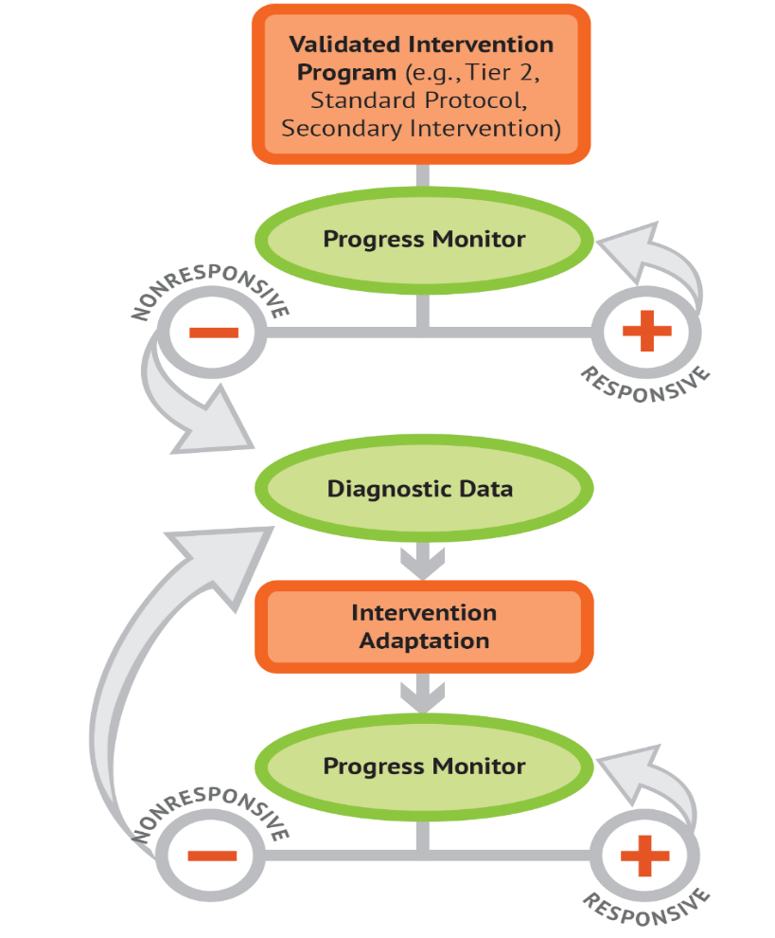
What is data-based individualization (DBI)?
DBI Process
DBI is an evidenced-based process for individualizing and intensifying interventions for students with severe and persistent learning and behavioral needs.
The process integrates evidence-based intervention, assessment, and strategies.
National Center on Intensive Intervention at the American Institutes for Research

Slide 12

Five DBI Steps
Validated intervention program, delivered with fidelity
Progress monitoring
Diagnostic data used to develop a hypothesis
Adaptation to a validated intervention
Continued progress monitoring, with adaptations occurring whenever needed to ensure adequate progress
National Center on Intensive Intervention at the American Institutes for Research

Slide 13

Laying the Foundation for DBI
STEP 1: Start with a standardized instructional program with known evidence for addressing the identified need(s).
National Center on Intensive Intervention at the American Institutes for Research

Slide 14
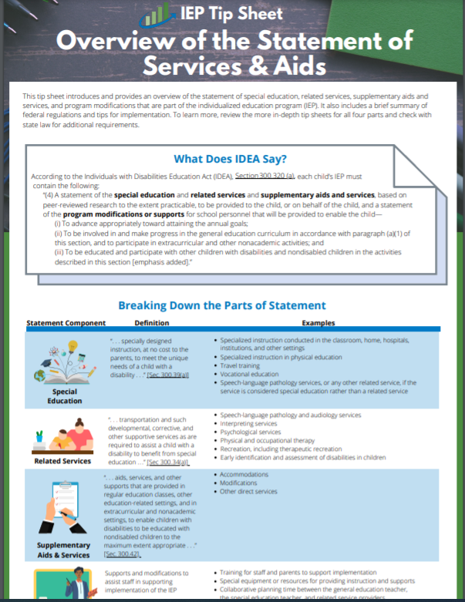
What does IDEA say about the statement of services and aids?
According to the Individuals with Disabilities Education Act (IDEA), Section 300.320 (a), each child’s IEP must contain the following:
“(4) A statement of the special education and related services and supplementary aids and services, based on peer-reviewed research to the extent practicable, to be provided to the child, or on behalf of the child, and a statement of the program modifications or supports for school personnel that will be provided to enable the child—… ″[emphasis added]
IDEA, Sec. 300.320(a)(4)
National Center on Intensive Intervention at the American Institutes for Research

Slide 15
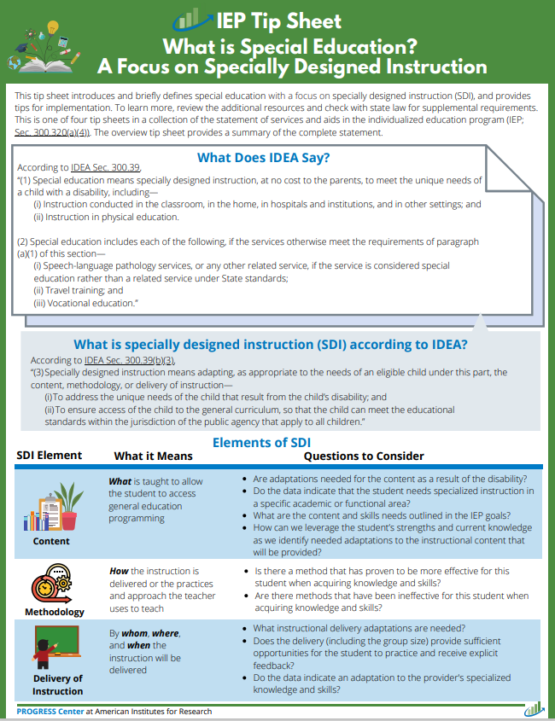
What does IDEA say about special education?
(2) Special education includes each of the following, if the services otherwise meet the requirements of paragraph (a)(1) of this section—
  (i) Speech-language pathology services, or any other related service, if the service is considered special education rather than a related service under State standards;
  (ii) Travel training; and
  (iii) Vocational education.”
Source IDEA, Sec. 300.39, emphasis added

Slide 16
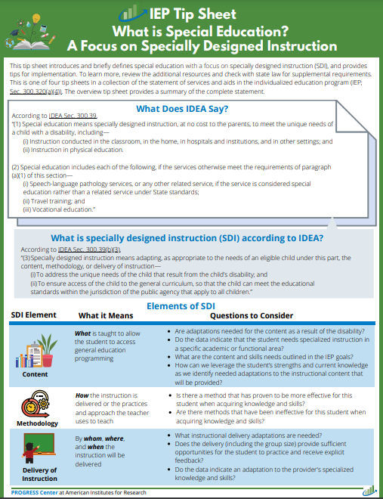
What does IDEA say about SDI?
(3) Specially designed instruction means adapting, as appropriate to the needs of an eligible child under this part, the content, methodology, or delivery of instruction—
  (i) To address the unique needs of the child that result from the child’s disability; and
  (ii) To ensure access of the child to the general curriculum, so that the child can meet the educational standards within the jurisdiction of the public agency that apply to all children.
Source IDEA, Sec. 300.39, emphasis added

Slide 17
Specifically adapting the instructional…
Elements of SDI | What it Means
Content | What is taught to allow the student to access general education programming
Methodology | How the instruction is delivered or the practices and approach the teacher uses to teach
Delivery of Instruction | By Whom, where, and when the instruction is delivered

Slide 18
Not sure where to start?
Elements of SDI | What it Means
Content What is taught | Social behaviors, communication, or language skills Five big ideas of reading (knowledge and strategies) Cognitive and metacognitive strategies Math language, math calculation, word problems, fractions, and number sense Functional life skills, vocational skills, or adapted physical education Handwriting, spelling, sentence construction, typing, and word processing
Methodology How the instruction is delivered or the practices and approaches the teacher uses to teach | Systematic, explicit instruction delivered in small groups or 1:1; coteaching Timed activities to build fluency Concrete and semi-concrete representations and number lines Scaffolding, repeated reading, and peer-assisted learning strategies Use of instructional technology or computer-based teaching
Delivery of Instruction Who, where, and when | Where: Special classroom, general education classroom, or community-based classroom Who: Content or behavioral specialist, special education teacher, or related service provider When: Providing 10–30 additional practice opportunities distributed across the day; 30–45 minutes daily

Slide 19
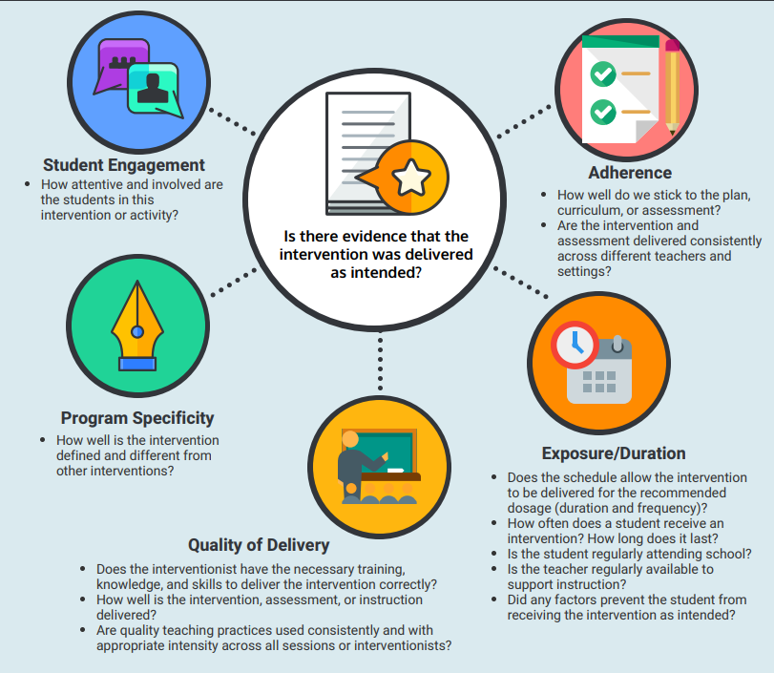
The Importance of Fidelity to SDI
The effectiveness of SDI depends on the extent to which educators implement the SDI content, methodology, and delivery with fidelity.
https://intensiveintervention.org/resource/five-elements-fidelity
National Center on Intensive Intervention at the American Institutes for Research

Slide 20
Laying the Foundation for DBI –Progress Monitoring
STEP 2: Use the IEP to develop a progress monitoring plan for reporting progress and guiding instructional decision making.
National Center on Intensive Intervention at the American Institutes for Research

Slide 21
Analyzing Data to Guide Decision Making 1
Do data indicate that the SDI is working?
Initiation of current IEP
Many students with disabilities will respond to the initial delivery of high-quality SDI aligned to the needs resulting from the disability.
National Center on Intensive Intervention at the American Institutes for Research

Slide 22
Analyzing Data to Guide Decision Making 2
Do data indicate that the SDI is working?
Initiation of current IEP
For some students with disabilities, our initial design of SDI will not be adequate.
National Center on Intensive Intervention at the American Institutes for Research

Slide 23
Laying the Foundation for DBI –Diagnostic Data
STEP 3: Use informal diagnostic data to develop a hypothesis about WHY the student is not responding.
National Center on Intensive Intervention at the American Institutes for Research

Slide 24
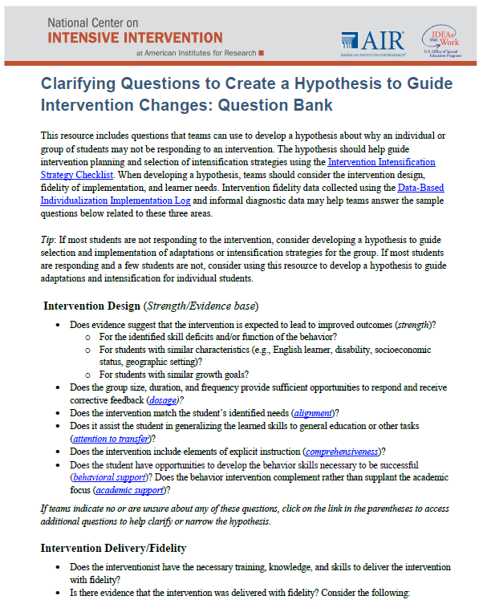
What should be considered when developing a hypothesis?
Instructional design (content and methodology)
Intervention delivery/fidelity
Learner needs and circumstances
Taxonomy of Intervention Intensity Dimensions—Refining the Hypothesis
National Center on Intensive Intervention at the American Institutes for Research

Slide 25
Using Diagnostic Data to Develop a Hypothesis to Guide Adaptations 1
Teacher reviews classroom assessment data and conducts observations of the student’s learning behavior. Behavior observations suggest that the student struggles to master skills as quickly as their same-age peers and needs more practice opportunities than their peers.
Hypothesis: If the student is provided additional opportunities of direct instruction, feedback, and practice on target skills, then the student would move to mastery of these skills more quickly.
Elements of SDI
Content What is taught
Methodology How the instruction is delivered or the practices and approach the teacher uses to teach
Delivery of Instruction Who delivers the instruction and where and when the instruction is delivered
National Center on Intensive Intervention at the American Institutes for Research

Slide 26
Using SDI to Meet the Unique Needs
STEP 4: Intensify and individualize the intervention to address the hypothesis.
National Center on Intensive Intervention at the American Institutes for Research

Slide 27
Using Diagnostic Data to Develop a Hypothesis to Guide Adaptations 2
Teacher reviews classroom assessment data and conducts observations of the student’s learning behavior. Behavior observations suggest that the student struggles to master skills as quickly as their same-age peers and needs more practice opportunities than their peers.
Hypothesis: If the student is provided additional opportunities of direct instruction, feedback, and practice on
target skills, then the student would move to mastery of these skills more quickly.
What element(s) of instruction needs to be adapted? | What the element means
Content | What is taught to allow the student to access general education programming
Methodology | How the instruction is delivered or the practices and approach the teacher uses to teach
Delivery of instruction | Who delivers the instruction and where and when the instruction is delivered
National Center on Intensive Intervention at the American Institutes for Research

Slide 28
Connecting the Hypothesis to the Instructional Adaptation of SDI 3
Diagnostic data indicate the student has difficulty applying decoding strategies to words with short and long vowels, especially “I” and “e.”
Hypothesis: If the student is provided additional instructional time in decoding short and long vowels, then the student will improve their decoding and oral reading fluency.
What element(s) of instruction needs to be adapted? | What the element means
Content | What is taught to allow the student to access general education programming
Methodology | How the instruction is delivered or the practices and approach the teacher uses to teach
Delivery of instruction | Who delivers the instruction and where and when the instruction is delivered
National Center on Intensive Intervention at the American Institutes for Research

Slide 29
Using Data to Intensify the Intervention
Fidelity and observation data indicate that the student is becoming more frustrated and less engaged in the intervention.
Hypothesis: If the student was more engaged and able to control their frustration, then the student would benefit more from the academic instruction.
What element(s) of instruction needs to be adapted? | What the element means
Content | What is taught to allow the student to access general education programming
Methodology | How the instruction is delivered or the practices and approach the teacher uses to teach
Delivery of instruction | Who delivers the instruction and where and when the instruction is delivered
National Center on Intensive Intervention at the American Institutes for Research

Slide 30
Monitoring Response to Adaptation
STEP 5: Monitor the student’s response to the additional SDI adaptations (at least 6-8 data points)
National Center on Intensive Intervention at the American Institutes for Research

Slide 31
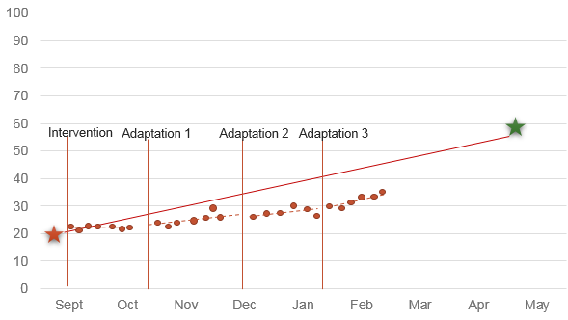
Documenting Progress from Adaptations
Initiation of current IEP
SDI Adaptation 1 Phase Line
National Center on Intensive Intervention at the American Institutes for Research

Slide 32
DBI is an ongoing process based on student responsiveness to the SDI.
National Center on Intensive Intervention at the American Institutes for Research

Slide 33
The Ongoing Process of SDI
Adaptation 3
Adaptation 2
Initiation of current IEP
Adaptation 1
National Center on Intensive Intervention at the American Institutes for Research

Slide 34

Building Capacity to Use DBI for SDI

Slide 35
Example Objectives: DBI for SDI Series
At the end of the series, staff will be able to:
Understand the role of SDI and supplementary aids and services.
Define the five steps in the DBI process.
Explain how DBI can be used to provide intensive intervention for students with severe and persistent academic and behavioral difficulties.
Build capacity to use the Taxonomy of Intervention Intensity to select, evaluate, and intensify instruction.

Slide 36
Current Implementation Practices
5 Part Series
Virtually or In-person
Free Online Modules or Live Presentations
Activity Based Approach to Align with Current Teaching Practices

Slide 37
Most Successful Scope and Sequence
Session | Title
Session 1 | Leveraging Data Based Individualization (DBI) to Design and Deliver Special Designed Instruction (SDI)
Session 2 | Building an Effective Progress Monitoring System
Session 3 | Utilizing DBI to Intensify Instruction: Fidelity of Implementation and Developing a Hypothesis to Intensify Instruction
Session 4 | Responding to Non-Responders Using Progress Monitoring Data and the Taxonomy of Intervention Intensity
Session 5 | Utilizing the Teaming Process to Maximize Instruction

Slide 38
Educators’ Response to the DBI for SDI Series
Useful for making practical decisions that are impactful for SDI. – AL Educator
It applied to current issues with our MTSS.-
AL Educator
This helped build my confidence-
WY Educator
It’s doable and aligns to my current work!
-NCY Educator
My progress monitoring is more effective now.
-NYC Educator

Slide 39
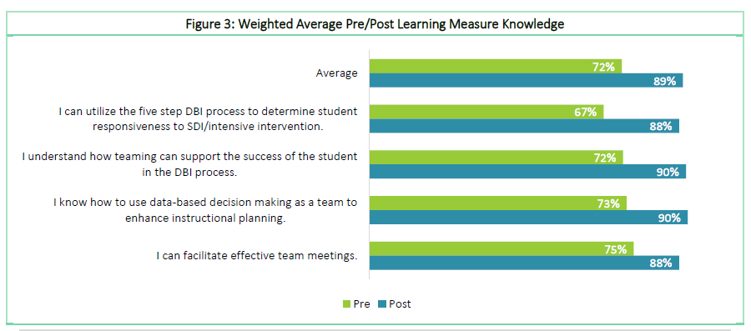
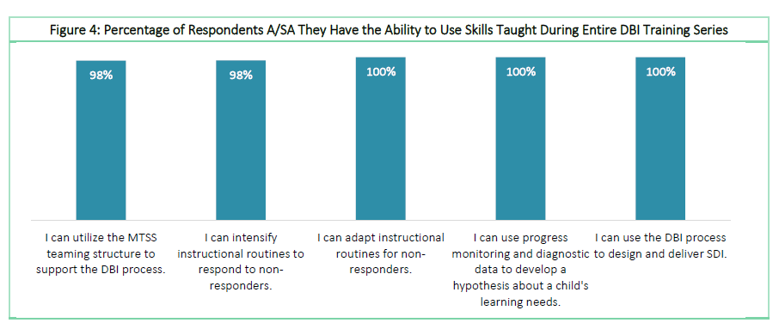
Growing Confidence with Educators-Alabama
Alabama State Department of Education

Slide 40
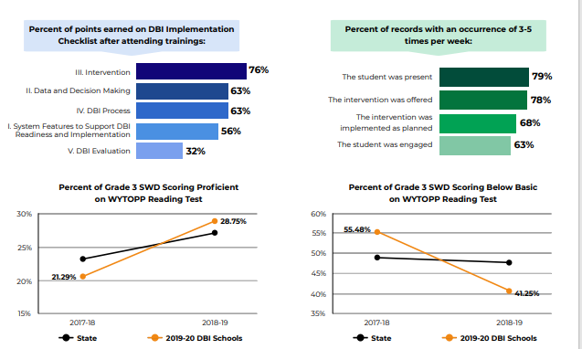
Who is engaged in the work? Wyoming

Slide 41


Learn More About DBI Implementation
https://intensiveintervention.org/data-based-individualization/state-stories/wyoming
National Center on Intensive Intervention at the American Institutes for Research

Slide 42
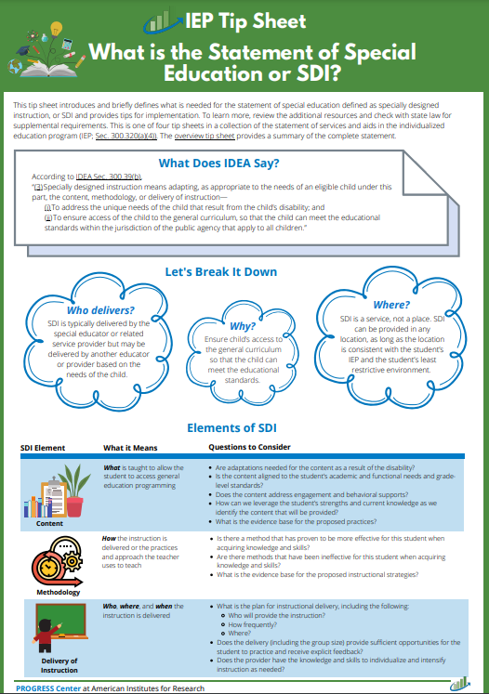
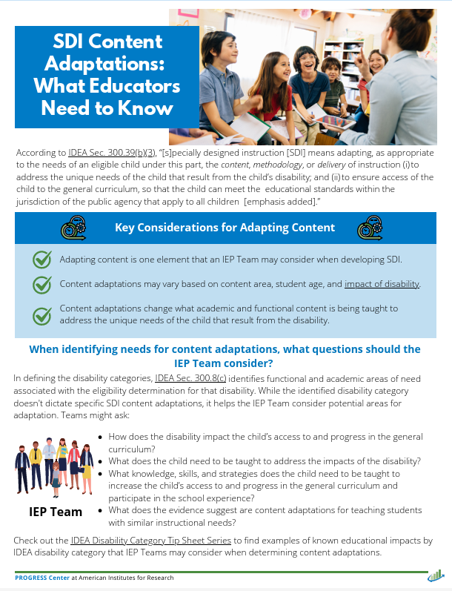
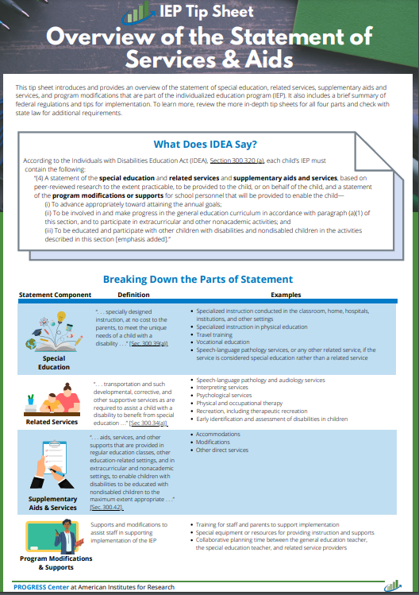



Learn More About SDI
National Center on Intensive Intervention at the American Institutes for Research

Slide 43


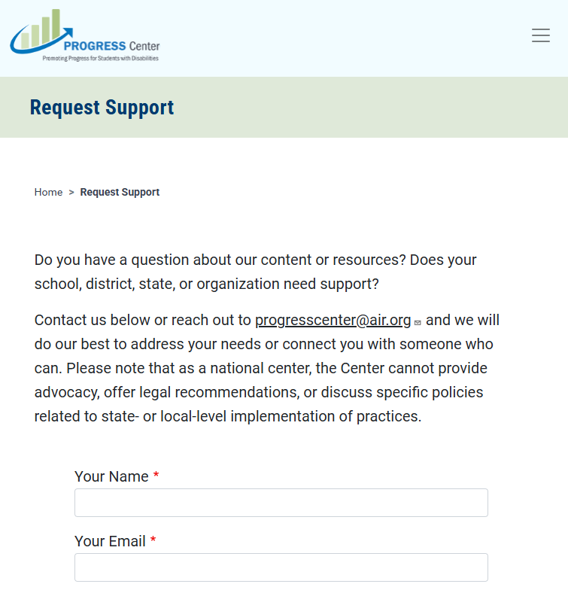
Find Additional Resources and Request Support
Visit our website
promotingprogress.org
National Center on Intensive Intervention at the American Institutes for Research

Slide 44
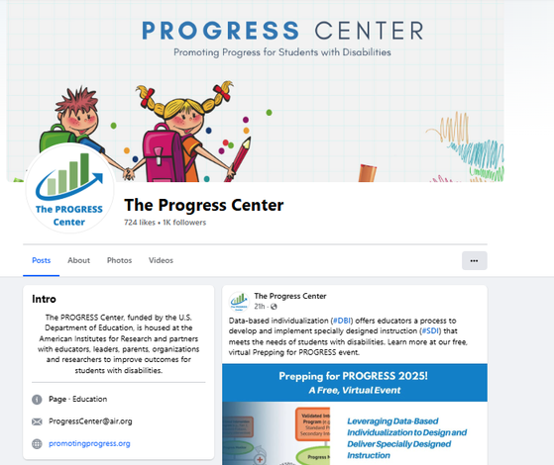
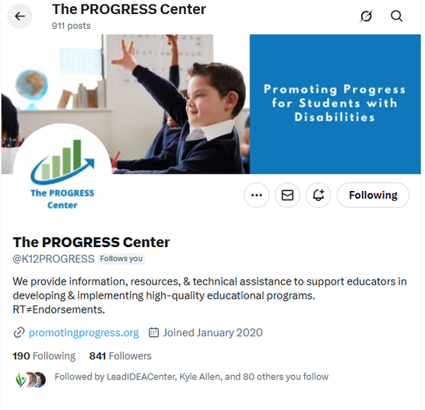
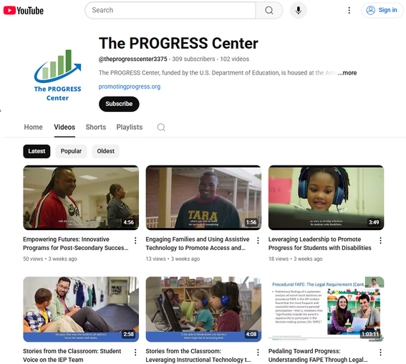





Stay connected with the PROGRESS Center!
@k12PROGRESS
@K12PROGRESS
@theprogresscenter3375
National Center on Intensive Intervention at the American Institutes for Research

Slide 45
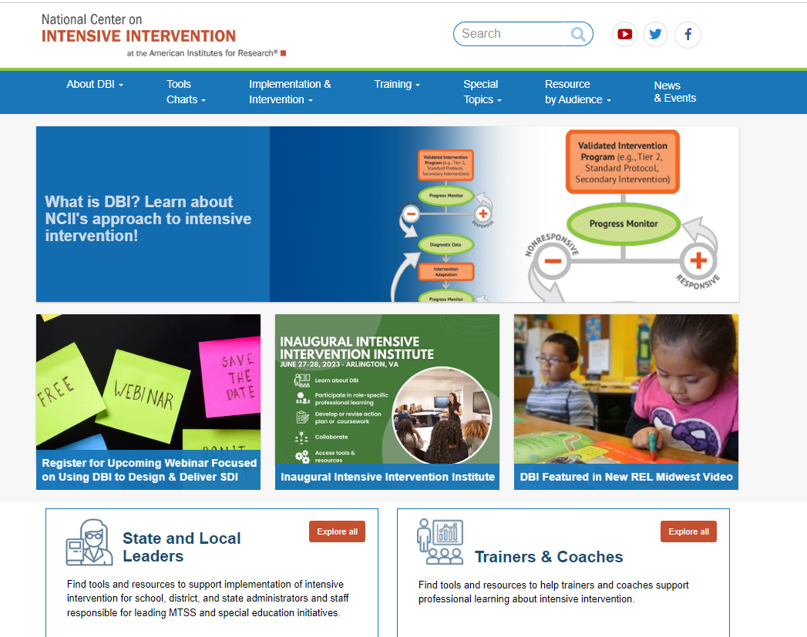

Find Additional Resources and Connect with NCII
https://www.facebook.com/TheNCII/
https://x.com/TheNCII
Sign-up on the bottom of each page of the NCII website)
www.intensiveintervention.org
National Center on Intensive Intervention at the American Institutes for Research
Notes:
We want to be sure that you have access to a wealth of resources from each of these Centers – [talk through the resources]

Slide 46
Disclaimer
This material was produced under the U.S. Department of Education, Office of Special Education Programs, Award No. H326C190002 and H326Q210001. David Guardino and Celia Rosenquist serve as the project officers. The views expressed herein do not necessarily represent the positions or policies of the U.S. Department of Education. No official endorsement by the U.S. Department of Education of any product, commodity, service, or enterprise mentioned in this webinar is intended or should be inferred.
National Center on Intensive Intervention at the American Institutes for Research

Slide 47

Kyle Allen Sara Evans
kyallen@air.org sevans@air.org
1400 Crystal Drive, 10th Floor
Arlington, VA 22202-3289
202.403.5000
ncii@air.org
intensiveintervention.org
1400 Crystal Drive, 10th Floor
Arlington, VA 22202-3289
202.403.5000
progresscenter@air.org
promotingprogress.org
XXXXX_MO/22

