Slide 1
Supporting English Learners with Disabilities
From IEP Development to Supporting Instruction
Donna Sacco, PhD, Senior Technical Assistance Consultant | Brenda Arellano, PhD, Principal Researcher
dsacco@air.org | barellano@air.org
Prepping for PROGRESS| August 2025
Copyright © 2025 American Institutes for Research®. All rights reserved.

Slide 2

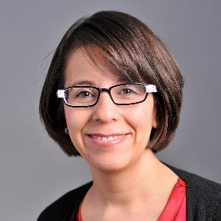

Welcome & Introductions
Donna Sacco, Ph.D.
Brenda Arellano, Ph.D.
Senior TA Consultant
American Institutes for Research
Principal Researcher
American Institutes for Research

Slide 3
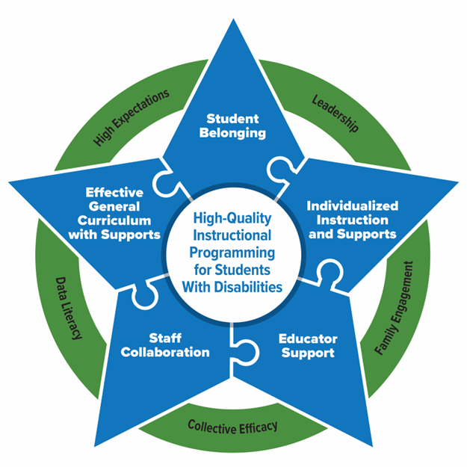
Essential Elements for Sustainable School Systems
The PROGRESS Center has identified Essential Elements in schools that support high-quality instructional programming for students with disabilities.
PROGRESS Center at the American Institutes for Research
Notes:
.

Slide 4

Presentation Objectives
In today’s presentation we will facilitate the exploration of -
Considerations for developing high quality IEPs for English learners (ELs)
Examples of evidence-based practices for ELs with disabilities
A teacher collaboration framework

Slide 5

Agenda
Welcome & Introductions
Developing IEPs for English Learners
Break
Evidence-Based Practices for English Learners
Break
Collaboration Framework

Slide 6
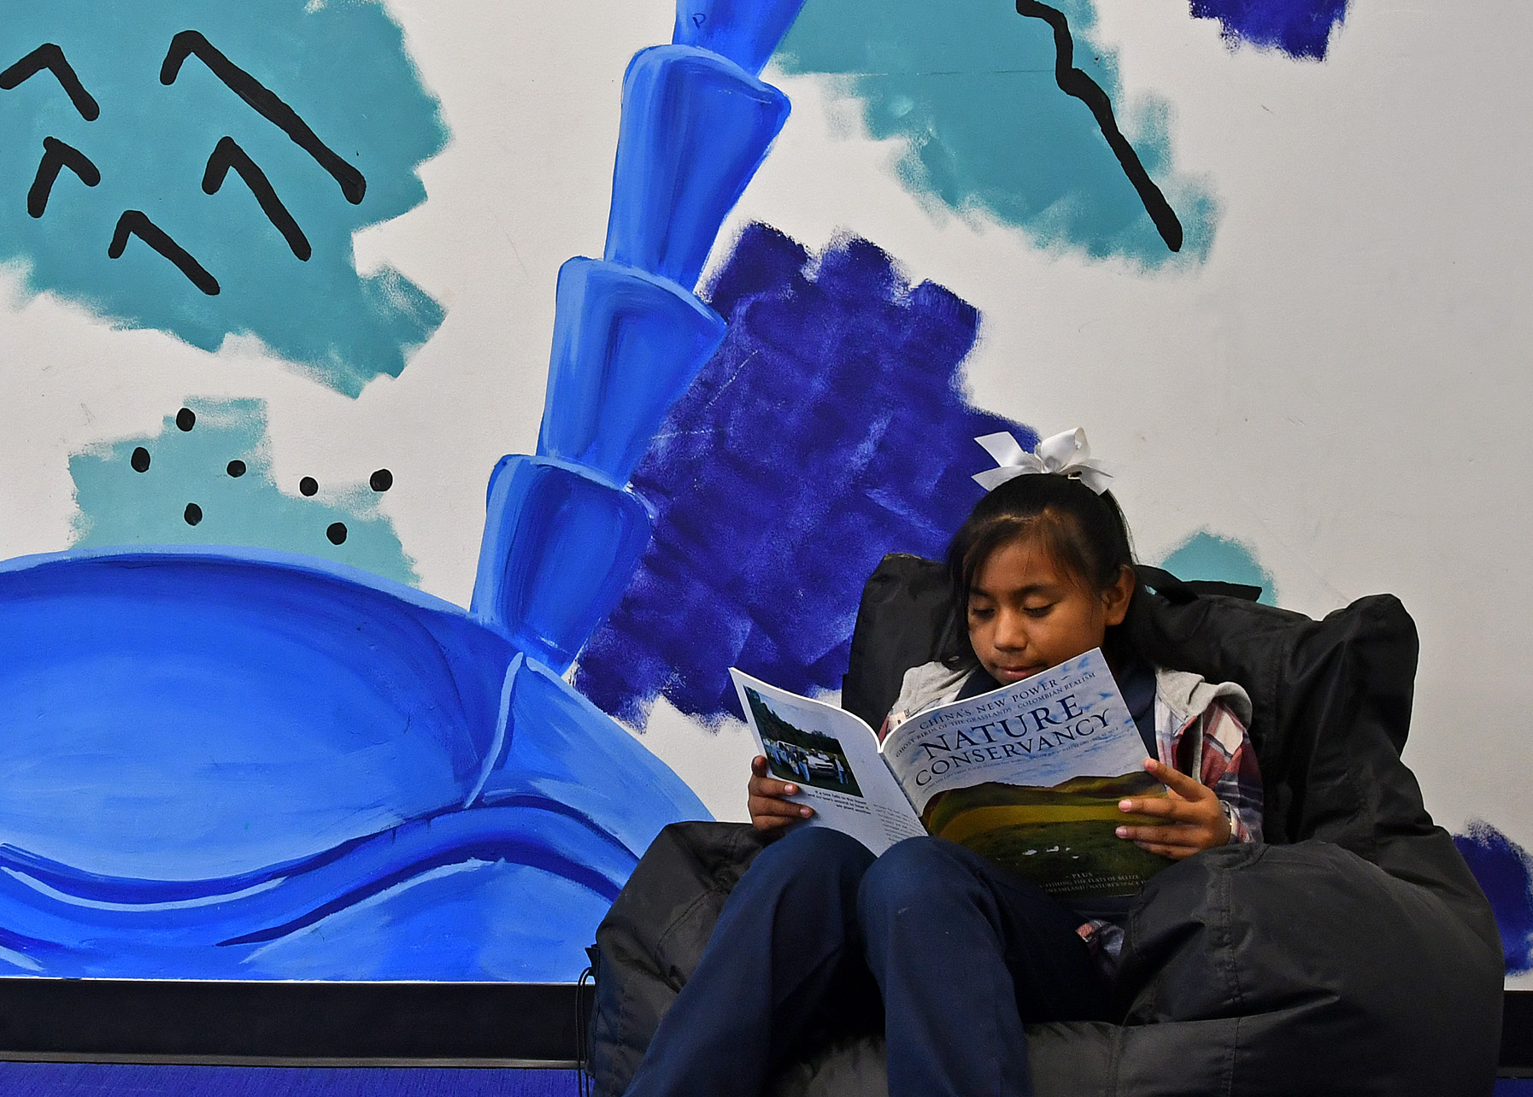
Let’s Hear From You!
In the chat, please tell us -
Where are you from?
What is your role?
What do you hope to learn today?

Slide 7
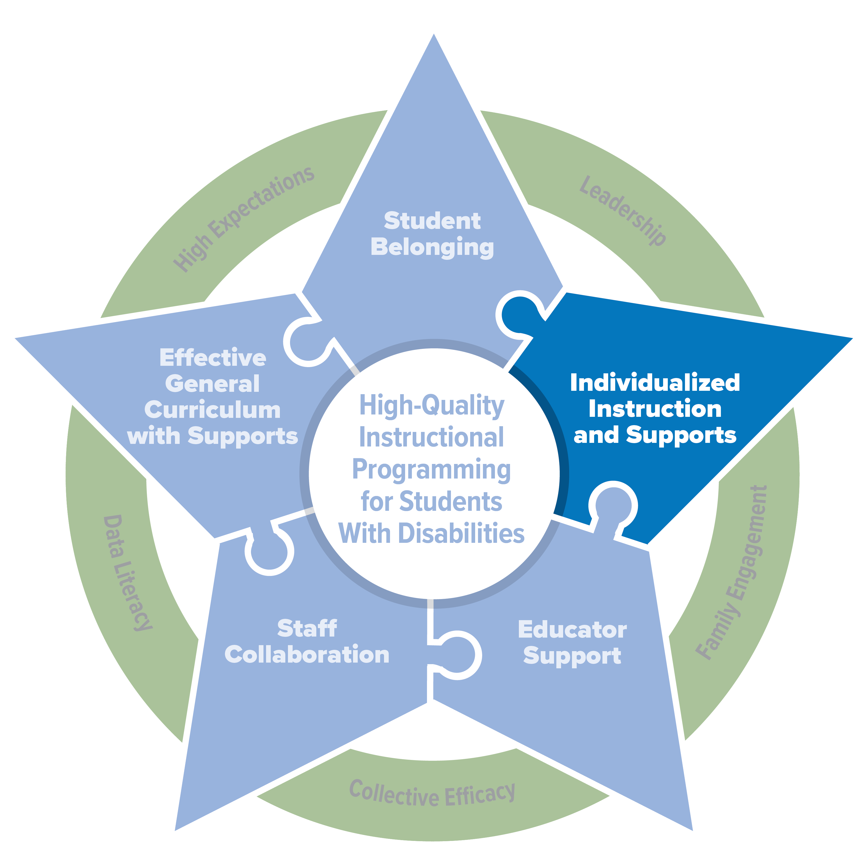
Developing IEPs for English Learners
PROGRESS Center at the American Institutes for Research

Slide 8
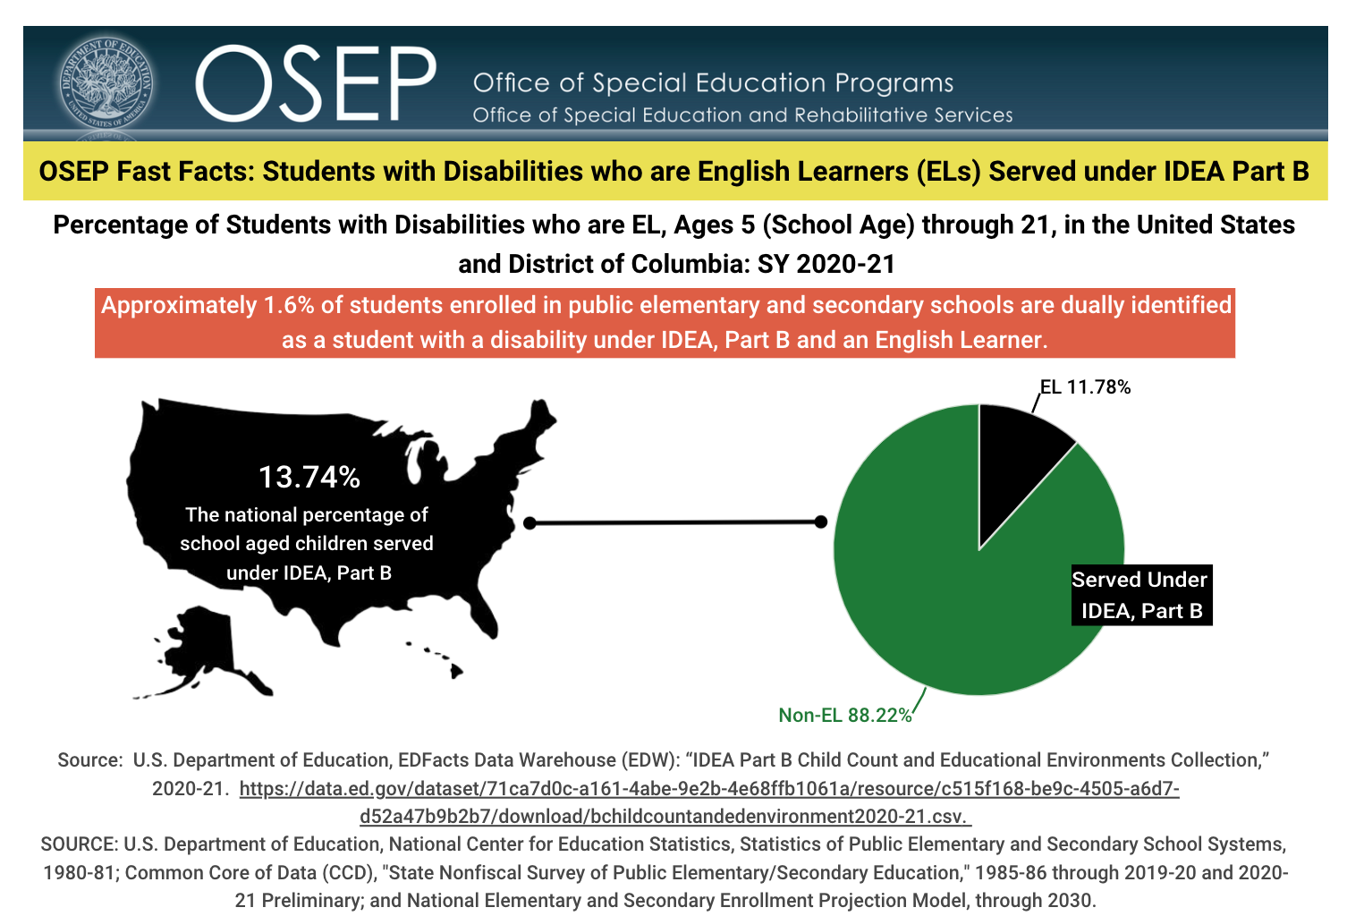
Fast Facts U. S. Department of Education

Slide 9
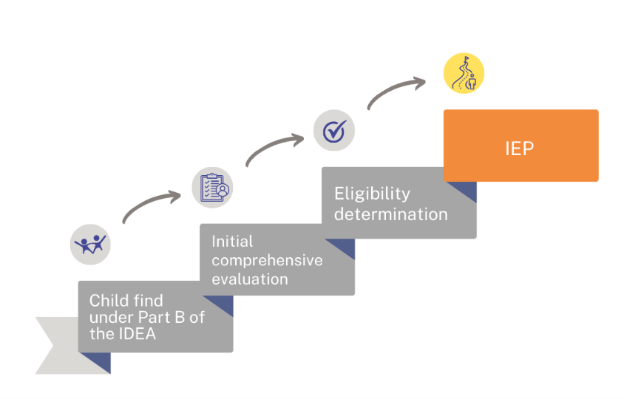
The Special Education Process
Child find
Initial comprehensive evaluation
Eligibility determination
IEP Development

Slide 10
Did you know?
According to IDEA eligibility requirements:
A group of qualified professionals and the parent of the child determine whether the child meets the criteria for at least one of 13 disability categories,
needs special education and related services because of the disability (not due to a lack of academic instruction or limited English proficiency).
AND

Slide 11
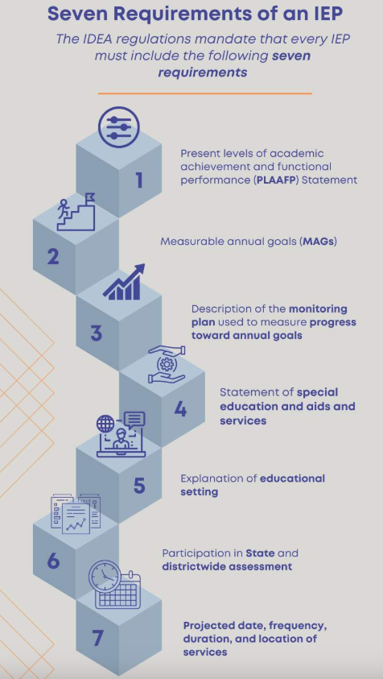
Seven Required Components of an IEP
Statement of present levels of academic achievement and functional performance (PLAAFP)
Statement of measurable annual goals
Description of the monitoring plan used to measure progress toward annual goals.
Statement of special education and aids and services
Explanation of educational setting
Statement of participation in assessment
Projected date, frequency, duration, and location of services

Slide 12
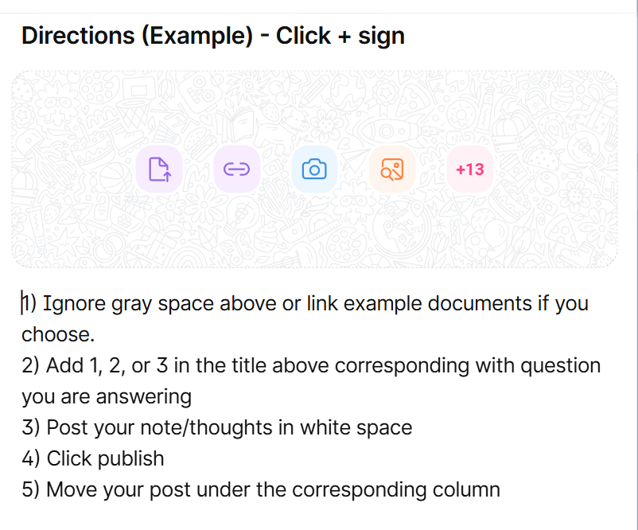
Reflection
Padlet Directions
How does your district or State address IEPs for ELs?
Is there any additional guidance for ELs’ IEPs?
Do educators collaborate to align IEPs with the individual language plans (ILPs) if you have them?
Log onto Padlet link to enter your responses:
https://tinyurl.com/sta44yve

Slide 13
Internal Consistency of the IEP
PLAAFP
Statement
Annual Goals
Measuring Progress Toward Annual Goals
Date, Frequency, Duration, and Location of Services
Participation Outside Regular Education and in State and Districtwide Assessments
Statement of Special Education and Services and Aids
PROGRESS Center at the American Institutes for Research

Slide 14
Let’s Look at the PLAAFP!
PLAAFP
Statement
Annual Goals
Measuring Progress Toward Annual Goals
Date, Frequency, Duration, and Location of Services
Participation Outside Regular Education and in State and Districtwide Assessments
Statement of Special Education and Services and Aids
PROGRESS Center at the American Institutes for Research

Slide 15

The PLAAFP
All PLAAFP statements should include:
a description of how the disability impacts the student’s involvement and progress in general curriculum;
the student’s disability-related needs that will be addressed in the IEP;
the student’s current level of performance that can be used as baseline for IEP goals; and
additional information, such as strengths, previously successful and unsuccessful aids and services, and progress since the most recent IEP, to support the development of IEP requirements.
PROGRESS Center at the American Institutes for Research
Tip Sheets in English
Tip Sheets in Spanish

Slide 16
Considerations for PLAAFP Statement for ELs
How does the student’s English language proficiency (ELP) affect special education and related services? What is the ELP score?
What instructional practices have been effective in supporting the student’s access to academic content?
What collaboration supports between the ELD teacher, general education teachers, and special education teachers are required?
What are the culturally and linguistically sustaining instructional strategies with which the student best learns? How do these strategies support access to specially designed instruction?
What cultural and background information is relevant to the development and implementation of the IEP?

Slide 17
Additional Information from the Family
What is the student’s formal education history?
Has the student had interrupted formal education?
How is the student’s social-emotional well-being?
Did the student experience any trauma either coming to the United States or here in the United States?
What are the student’s interests?
What are the parents’ hopes for the student?

Slide 18
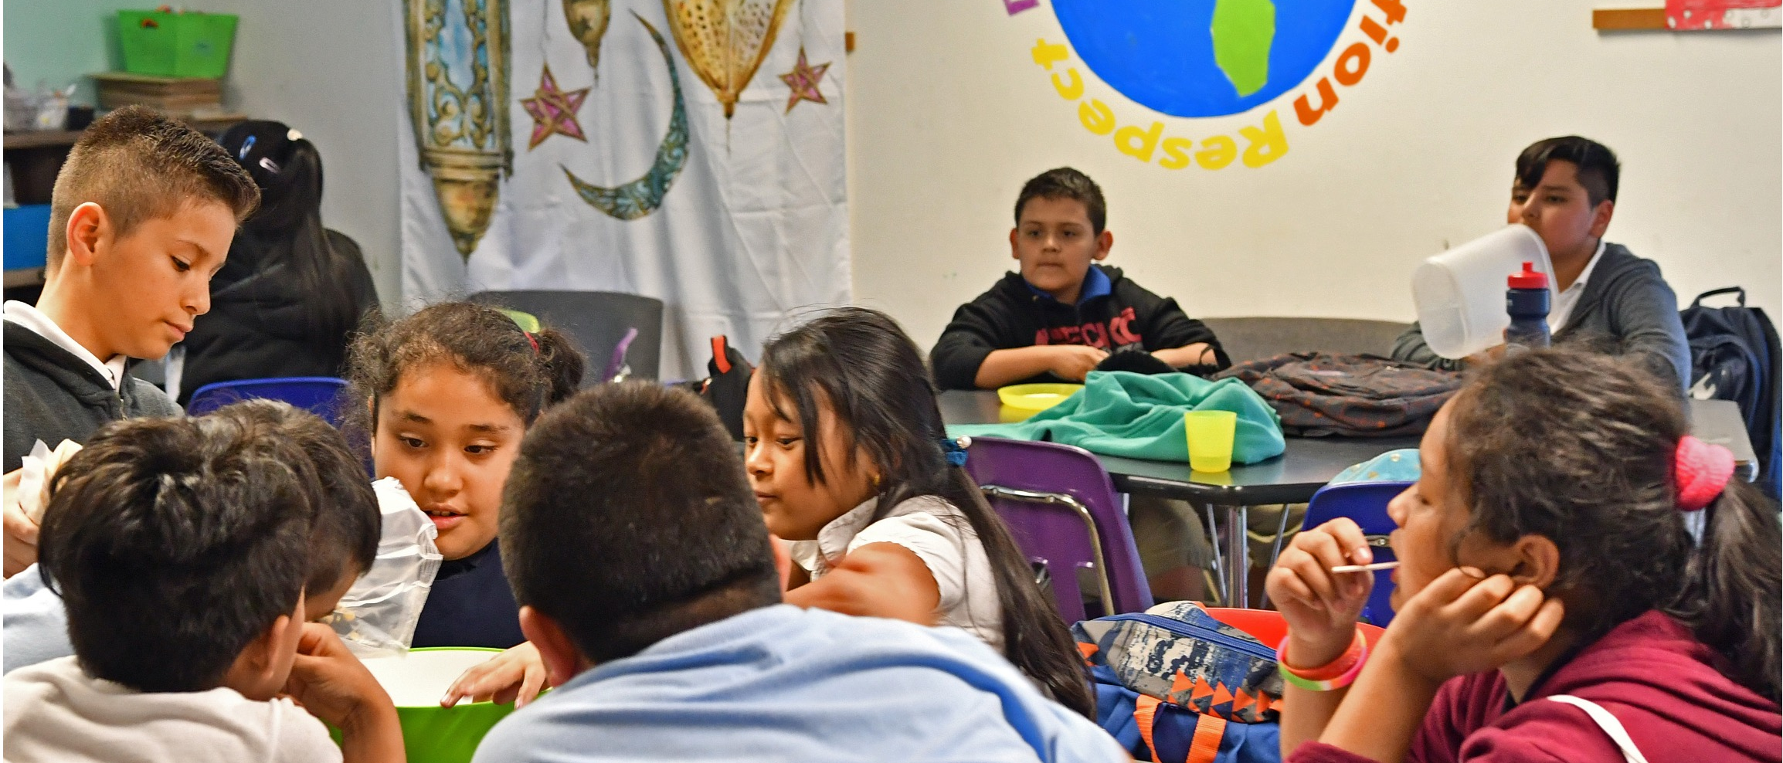
Students with Limited or Interrupted Formal Education (SLIFE)

Slide 19

Statement of Measurable Annual Goals
The following are considerations for measurable annual goals for all students:
What is the condition under which the behavior or skill will be demonstrated?
What is the target behavior for the student to be able to do?
What is the level of performance or proficiency that will demonstrate mastery of the goal?
PROGRESS Center at the American Institutes for Research
Tip Sheets in English
Tip Sheets in Spanish
This Photo by Unknown Author is licensed under CC BY-SA

Slide 20

Statement of Measurable Annual Goals for ELs
For English Learners
What are the specific conditions under which the behavior or skill will be demonstrated? These conditions may have been included in the PLAAFP statement as strategies that have been beneficial to the student in accessing specially designed instruction. The following is not an exhaustive list but rather includes examples of conditions or strategies:
  When provided extended wait time…
  Using a personal bilingual dictionary…
  When working with a peer who speaks the same first language…
  When provided sentence frames with fading support over time…

Slide 21

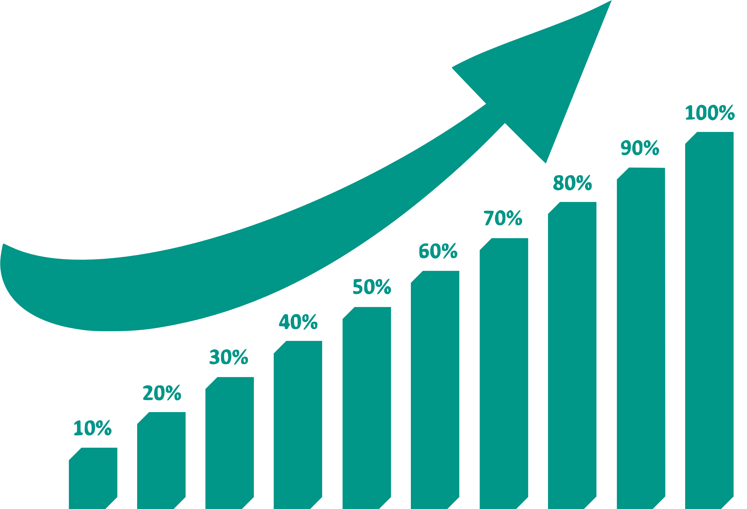
Monitoring Plan
IEP Goals
Language Development
PROGRESS Center at the American Institutes for Research
Tip Sheets in English
Tip Sheets in Spanish

Slide 22









Statement of Special Education and Aids and Services
Related Services
Special Education
Access to and Progress in General Education Curriculum
School and Postschool Success (e.g., graduation, meeting grade-level expectations)
Supplementary Aids and Services
(in general education)
Program Modifications or Supports for School Personnel

Slide 23

Explanation of Educational Setting
According to IDEA Sec. 300.320 (a)(5), each student’s IEP must contain an “explanation of the extent, if any, to which the child will not participate with nondisabled children in the regular class...”
For ELs, the least restrictive environment is critical so that they have peer language models and they have multiple opportunities to practice speaking, listening, reading, and writing, across the course of the day (Chapman et al., 2022).

Slide 24


Participation in State and Districtwide Assessment
…or other State determined language proficiency assessment.

Slide 25




Projected Date, Frequency, Duration, and Location of Services

Slide 26

Reflection
How do you prepare staff for an IEP meeting for an EL?
How do you prepare families of ELs for IEP meetings?
What needs to be in place for these meetings?
Log onto Padlet link to enter your responses:
https://tinyurl.com/aa8e9xb2

Slide 27

Engaging and Preparing the IEP Team

Slide 28
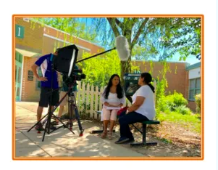
Great Resource for Spanish Speaking Families
Stories from the Classroom
Arlington, Virginia Public School’s Parent Resource Center
Telenovela
PROGRESS Center at the American Institutes for Research Stories from the Classroom: Using a Telenovela to Explain the Special Education Process. https://promotingprogress.org/resources/stories-classroom-telenovela-special-education-process

Slide 29

Collaboration

Slide 30

Break!
Please return in 10 minutes.

Slide 31
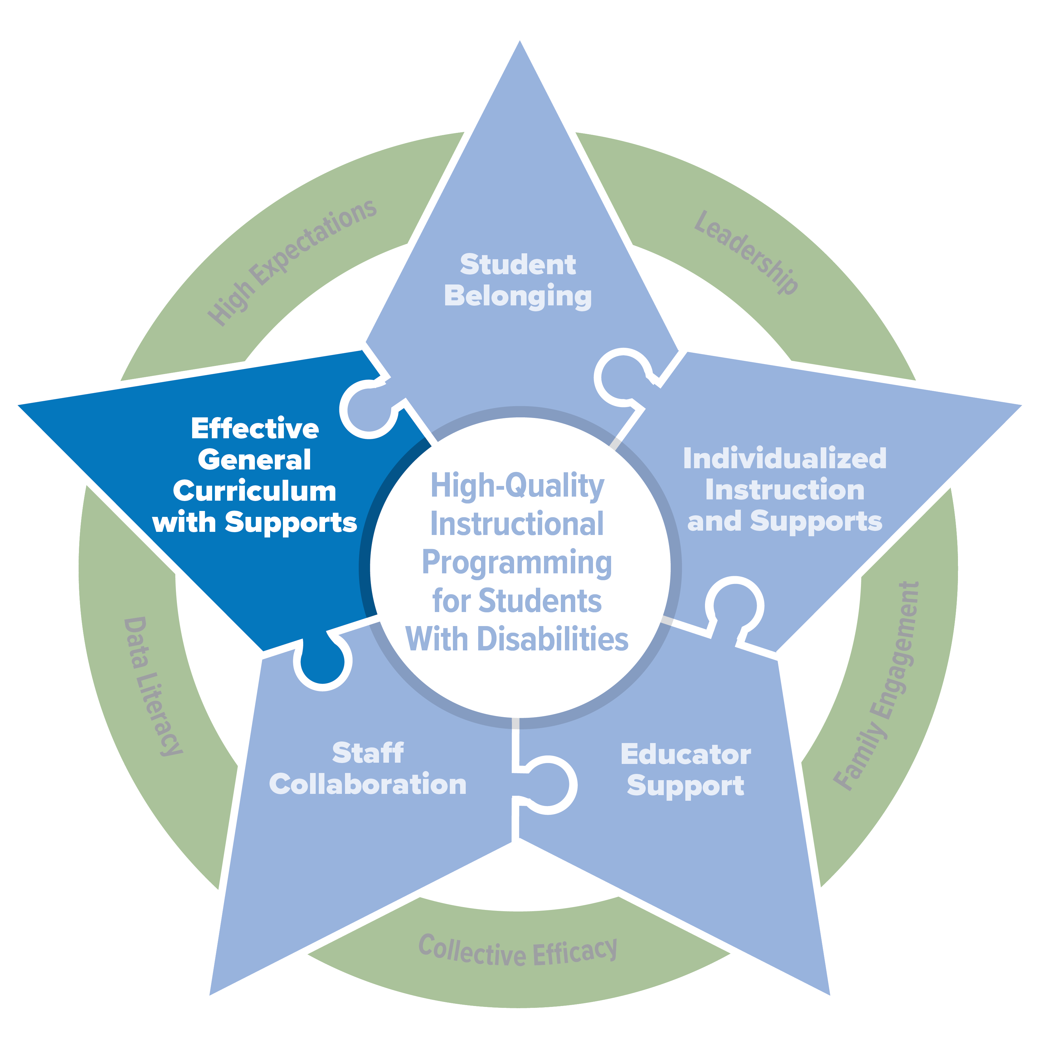
Evidence-Based Practices for English Learners
PROGRESS Center at the American Institutes for Research

Slide 32

Simulation activity – listening domain
We will listen to a story twice:
    First round audio only
    Second round video with audio
  Participants will write what they comprehend as they listen to the story on their double bubble sheets.
  After participants listen to the story twice, they will discuss the following prompts in small groups:
    What implications does this have for your teaching?
    What is one change that you could make to your instruction to make it more accessible for ELs?
    The Lion’s Share

Slide 33



The What Works Clearinghouse Practice Guides

Slide 34
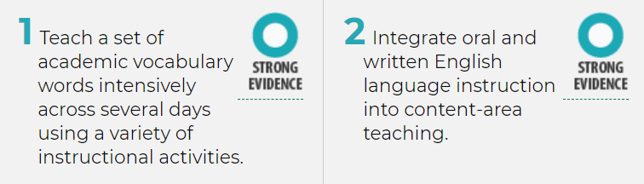
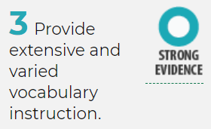
Supporting ELs’ Achievement
Fostering ELs’ vocabulary knowledge is fundamental to improving their odds of academic achievement.
Two What Works Clearinghouse practice guides endorse vocabulary instruction as a research-based way of cultivating ELs’ language and literacy skills.
Teaching Academic Content and Literacy to English Learners in Elementary and Middle School (2014)
Effective Literacy and English Language Instruction for English Learners in the Elementary Grades (2007)

Slide 35
Why Focus on Vocabulary?
Vocabulary is a high-leverage skill and knowledge set.
Supports academic language learning and use.
General academic vocabulary supports learning across content areas.
Enables access to content across subject areas.
Facilitates strong writing.
Most ELs need more opportunities to develop sophisticated, abstract, academic vocabulary.
Snow & Uccelli, 2009; August & Shanahan, 2006

Slide 36
Key Questions About Vocabulary Instruction for ELs
What is the content to be taught?
What target word characteristics connect to the home language?
What instructional approach is best suited to each target word?
What criteria figure into choosing target words and instructional strategies?

Slide 37
Key Questions: Instructional Strategies
Selecting Vocabulary | Teaching Vocabulary | Assessing Vocabulary
Text & Content Relevance | Direct Instruction | Regular Formative Assessment
Cross Language Links | Word Learning Strategies
Complexity
What instructional approach is best suited to each target word?

Slide 38
Step 1: Select target words.
Frequency in the language versus frequency in the text or lesson
Relevance to single text versus applicability across texts or subjects
Dimensions of complexity include imageability, concreteness, relatedness
Frequency | Importance to Text | Complexity
Frequently encountered words may be higher leverage across texts and content areas. | Words of central importance to target texts support comprehension and inference making. | Conceptually complex words may support understanding of abstract, sophisticated ideas.
First 4,000 Words List [link] Academic Word List Highlighter [link] WordSift [link] | Target lesson texts Multiple uses in lesson materials | Words in a topic that have related meanings Words without concrete referents

Slide 39
Step 2A: Use direct instruction to teach target words.
Extended Instruction
  More intensive instruction for abstract words
Embedded Instruction
  Less intensive instruction for concrete words

Slide 40
Step 2A: Extended Instruction
Extended Instruction
  More intensive instruction for abstract words
    Use an illustration and synonym to explain a word’s meaning.
    Provide a definition. Make sure it is the one used in the target text.
    Provide the home language definition and cognate status.
    Repeat the sentence from the text that uses the word.
    Invite students to talk about the word.

Slide 41
Step 2A: Embedded Instruction
Embedded Instruction
  Less intensive instruction for concrete words
    Define the word.
    Use gestures to demonstrate the word.
    Show the word in illustrations from the text.

Slide 42
Step 2B: Use word-learning strategies to teach target words.
When feeling less confident in their understanding of a target word, students can…
…look at their glossary for anchors in examples, definitions, exemplary depictions, and translations.
…search for context clues in the surrounding sentence and paragraph, as well as accompanying images and graphics.
…posit a cognate in their home language and consider whether that meaning makes sense in the text they are reading.
…break a word down into its morphological constituents to reveal a word’s part of speech, its relationship to shorter or more familiar words, and so on.
…consult a variety of dictionaries, online resources, and applications to support their word mastery.

Slide 43
Step 3: Assess target word learning.
Varying the assessment modality supports ongoing student learning as well as changes to instructional approaches.
Why assess target word learning?
To measure –
Yearlong learning
Depth of word knowledge
Fluency and proficiency
Breadth of conceptual knowledge

Slide 44
Reflecting on Vocabulary for ELs
Selecting
Teaching
Assessing
Thinking about your past interactions with your EL students, which of these steps have you felt most comfortable with? Least comfortable? How could collaboration be leveraged in these steps?

Slide 45
Break time!
Please return in 10 minutes.

Slide 46
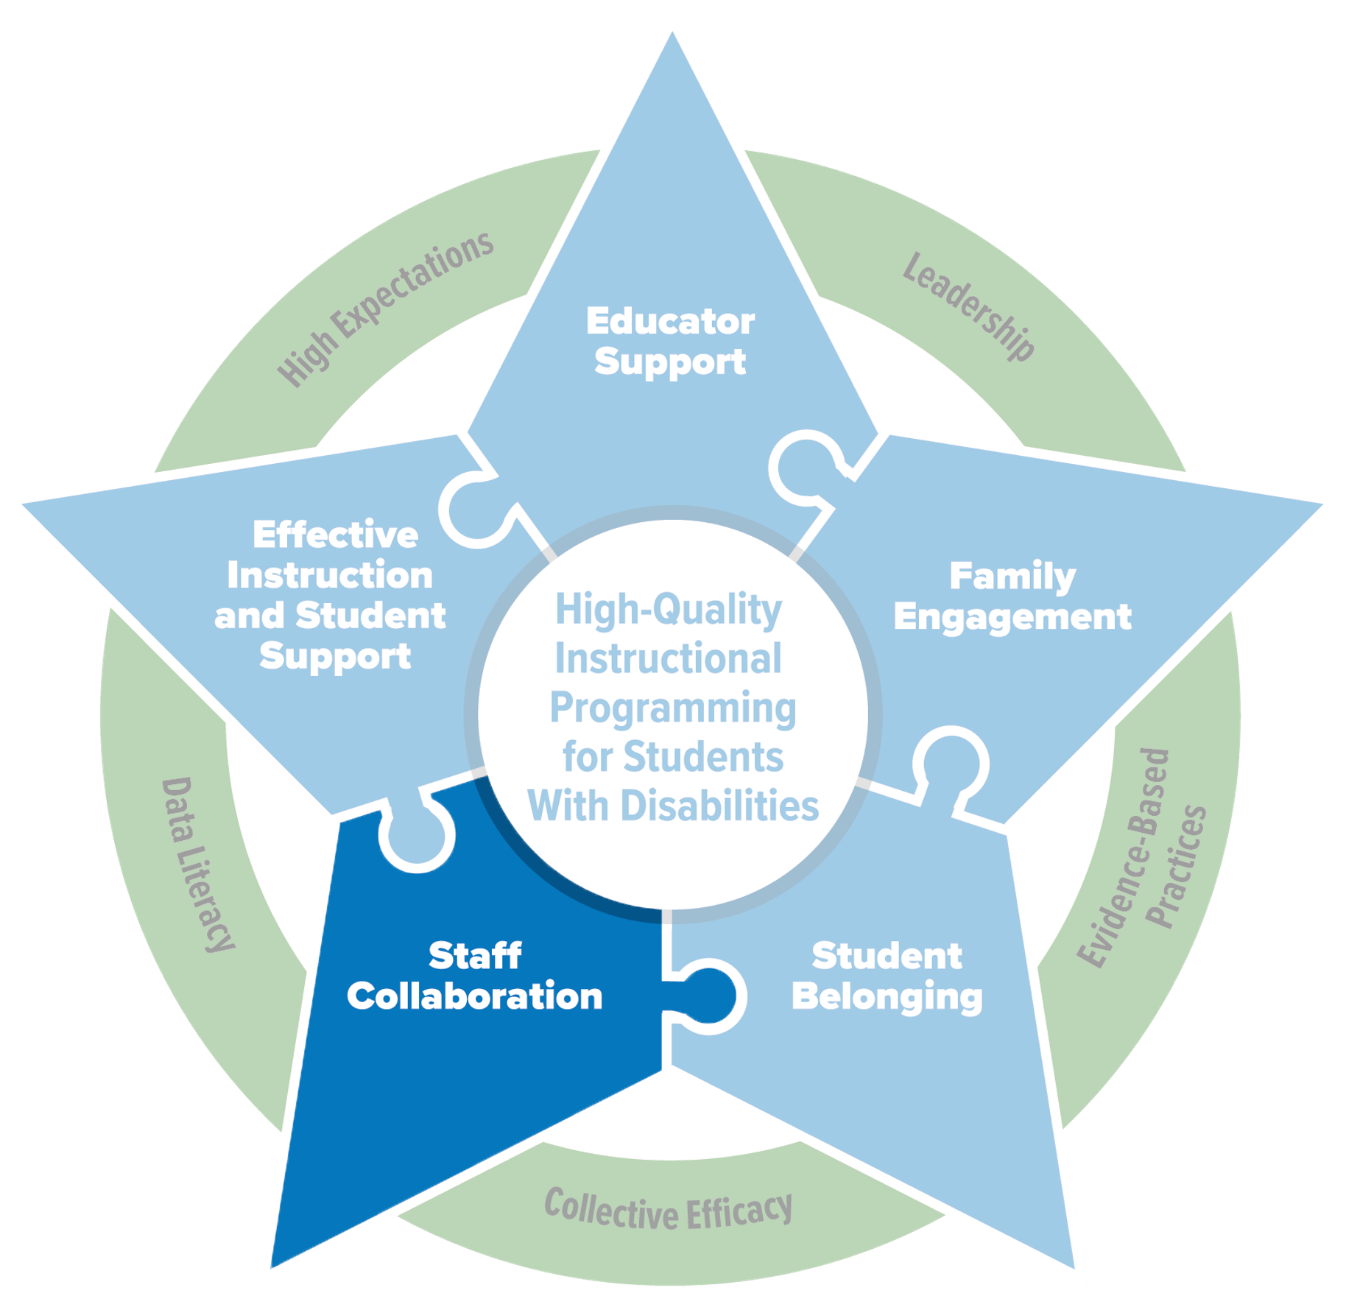
Overview of the Teacher Collaboration Framework
PROGRESS Center at the American Institutes for Research

Slide 47

Connection
Poll
When you think about you experiences with teacher collaboration in the past, what were challenges? What were the successes?
When you think about you experiences with teacher collaboration in the past, what were challenges? What were the successes?
Notes:
-

Slide 48

Teacher Collaboration
When teachers within schools and districts collaborate, there is an opportunity to learn from each other.
Source:
Hopkins, M., Lowenhaupt, R., & Sweet, T. M. (2015). Organizing English learner instruction in new immigrant destinations: District infrastructure and subject-specific school practice. American Educational Research Journal, 52(3), 408–439.
Sun, M., Penuel, W. R., Frank, K. A., Gallagher, H. A., & Youngs, P. (2013). Shaping professional development to promote the diffusion of instructional expertise among teachers. Educational Evaluation and Policy Analysis, 35(3), 344–369.

Slide 49
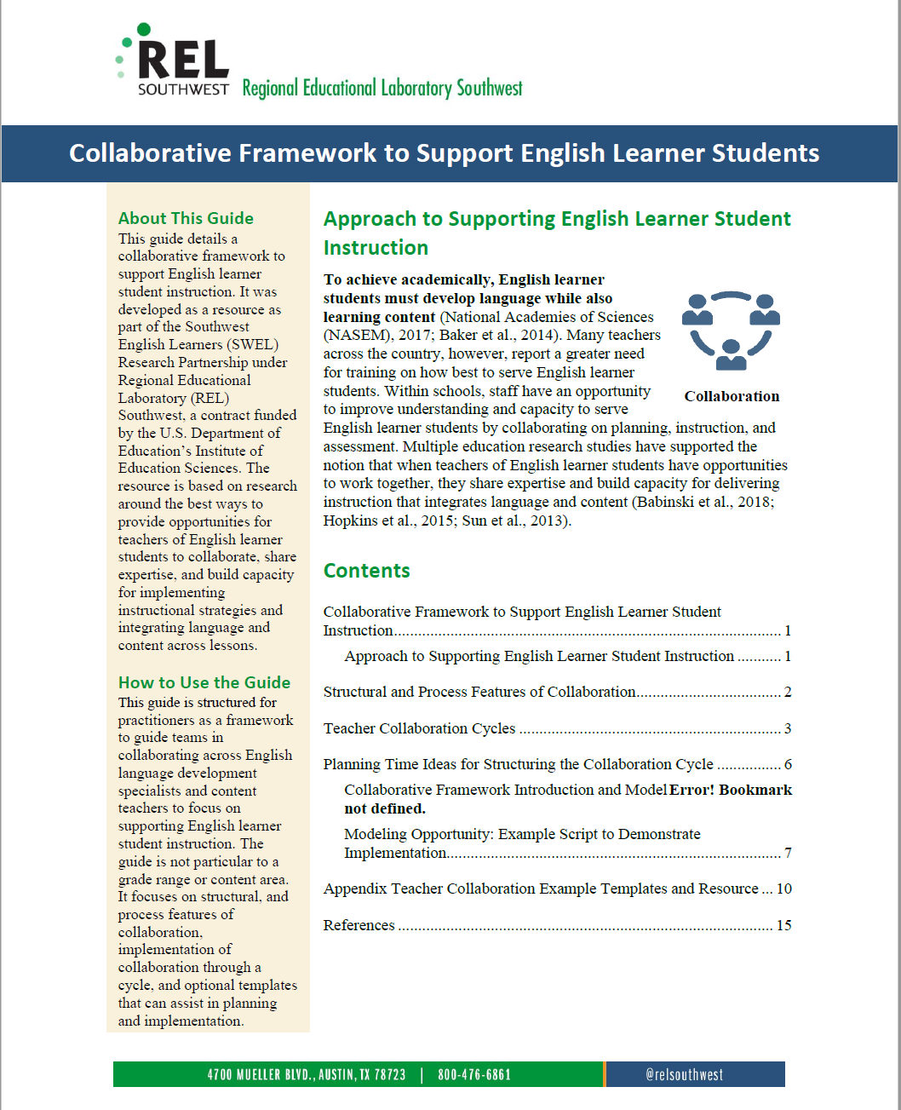

Resource Overview

Slide 50

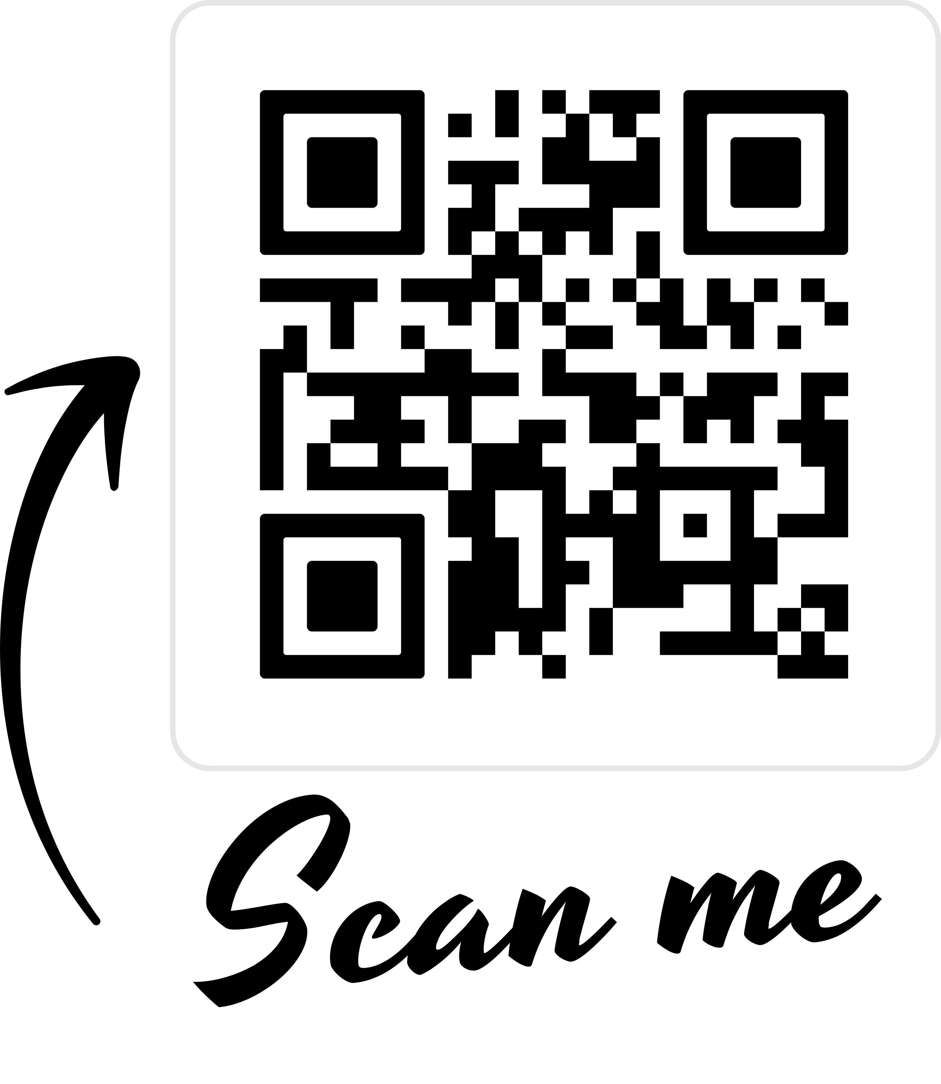

Research on Practices to Support Language & Content Development

Slide 51


Evidence-Based Framework for Teacher Collaboration
Builds on a research base of teacher collaboration within schools to enhance English learner students’ language and literacy development.*
Evidence gleaned from a small randomized field trial of a school-based professional developed focused on language and literacy skills for elementary age-Latino English learner students (Babinski et al., 2018).
WIDA Collaboration: Working Together to Serve Multilingual Learners. Resource on defining collaboration for multilingual learners.
* Sources: Babinski, Amendum, Knotek, Sánchez, & Malone, 2018; Martin-Beltran & Peercy, 2014; Pawan & Ortloff, 2011; York-Barr, Ghere, & Sommerness, 2007

Slide 52



Teacher Collaboration Framework
A guide to support collaboration through a series of purposeful interactions among ELD specialists and general education teachers
Structural Features
Establish a time for meeting.
Develop group roles and norms.
Process Features
Communication
Relationship building
Mutual respect
Note: This framework follows guidance from Babinski et al. (2018).

Slide 53
Features of the Teacher Collaboration Framework
Co-Planning
Co-Teaching
Co-Assessing
Co-Reflecting
Collaborations are conceptualized as cycles.
Each cycle has a goal for content instruction, which integrates and is supported by a language instructional goal.

Slide 54
Cycles of Collaboration: Co-Planning
Co-Planning
Co-Teaching
Co-Assessing
Co-Reflecting
Purpose | Context | Key Activities | Guiding Questions
Develop appropriate plans for pursuing content and language goals. | Educators-only shared meeting | Identify language and content goals for common students. Review instructional resources. Develop lessons and materials. Distribute instructional aims among participants. | What is the content to be taught? What features of the content might be more challenging for (our) EL students? What instructional approaches can be brought to bear on those features? What are the specific English language development (ELD) goals that can be served by these approaches around this content?

Slide 55
Cycles of Collaboration: Co-Teaching
Co-Planning
Co-Teaching
Co-Assessing
Co-Reflecting
Purpose | Context | Key Activities | Guiding Questions
Convey key content and language lessons. | Likely in separate instructional settings, with students (see seven WIDA collaboration models) | Embed ELD supports into the general education classroom lesson. Engage English learner students and non–English learner students in language-learning activities. Reinforce ELD targets in any English language specialist’s instructional time. | How do we respond to students’ reactions to these instructional approaches? In what ways can we draw on the contributions students make during lessons?

Slide 56
Cycles of Collaboration: Co-Assessing
Co-Planning
Co-Teaching
Co-Assessing
Co-Reflecting
Purpose | Context | Key Activities | Guiding Questions
Evaluate effectiveness of instructional approach(es). | Likely begin in separate settings, sharing findings face to face or asynchronously | Summarize or track the strategies applied. Gather information about students’ progress toward learning goals. | What was I able to do in my instruction? Were the students able to apply their new learning? What did I see that I want to report back to my collaboration partner(s)?

Slide 57
Cycles of Collaboration: Co-Reflecting
Co-Planning
Co-Teaching
Co-Assessing
Co-Reflecting
Purpose | Context | Key Activities | Guiding Questions
Examine assessment data and collaboration process critically. | Educators-only shared meeting | Review student assessment data. Review structure and process features of collaboration. Consider improvements for next collaboration cycle | How do our assessment findings complement or inform each other? How can the collaboration process be improved? What more would it be useful to know during the upcoming cycle? Am I bringing all my relevant expertise to the relationship?

Slide 58
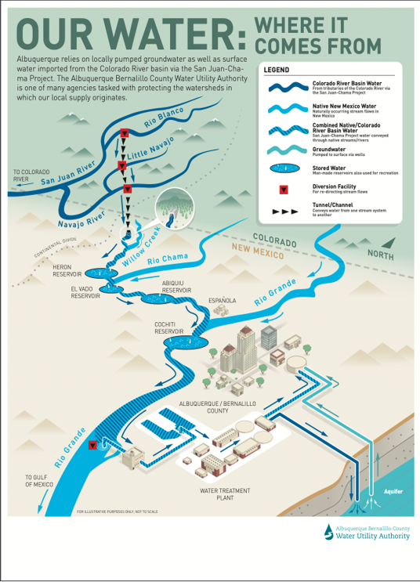
Model unit: Water rights in New Mexico
Big Idea: Students will explore the various factors that have led to water scarcity in New Mexico and how this water scarcity impacts the state’s diverse communities.
Culminating Tasks:
Independently write an informational essay that explains the factors that lead to water scarcity in the students’ community, and how water scarcity is affecting the students’ & their community’s well-being.
Collaboratively create a Student’s Water Bill of Rights.

Slide 59
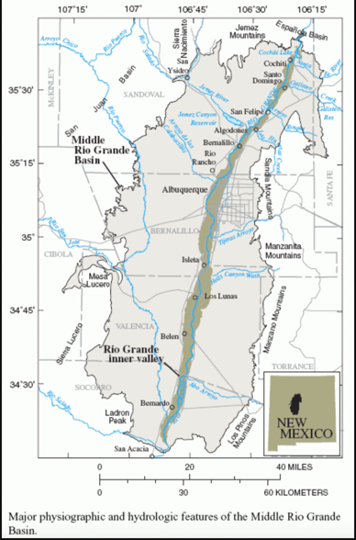
Application continued: Water rights in New Mexico
Instructions: Think about how to collaborate across grade level, with an English language development (ELD) coordinator, with other specialists that support ELs (gifted & talented, instructional coaches), peer/content teachers.
Pick one area for collaboration and write your ideas in Padlet:
What kinds of instruction and language goals you would identify for this unit for English learner students?
How would you develop lessons and materials to support English learners?

Slide 60

Questions?

Slide 61

Thank you!

Slide 62
Links to Resources
OSEP Fast Facts: Students with Disabilities Who Are English Learners Served Under IDEA Part B: https://sites.ed.gov/idea/osep-fast-facts-students-with-disabilities-english-learners
Policy letters from the U.S. Department of Education, Office of Special Education Programs: U.S. Department of Education Office of Special Education Programs Policy Letter November 15, 2021. Retrieved from: https://sites.ed.gov/idea/idea-files/policy-letter-november-15-2021-to-boals/
IEP Tip Sheet Series in English: https://promotingprogress.org/resources/iep-tip-sheet-series
IEP Tip Sheet Series in Spanish: https://promotingprogress.org/resources/iep-tip-sheet-spanish
What Works Clearinghouse Practice Guides: https://ies.ed.gov/ncee/wwc/practiceguides
Training to Support Collaborative Conversation Between EL Specialists and Classroom Teachers for English Learner Students in New Mexico: https://ies.ed.gov/use-work/resource-library/resource/training-material/training-support-collaborative-conversations-between-el-specialists-and-classroom-teachers-english
What Works Clearinghouse Practice Guide 19: https://ies.ed.gov/ncee/wwc/PracticeGuide/19
Promoting the Educational Success of Children and Youth Learning English: Promising Futures: https://nap.nationalacademies.org/read/24677/chapter/1#ix
Teaching Academic Content and Literacy to English Learners in Elementary and Middle School (2014)
Effective Literacy and English Language Instruction for English Learners in the Elementary Grades (2007

Slide 63
References
August, D., Shanahan, T., & Escamilla, K. (2009). English language learners: Developing literacy in second-language learners—Report of the National Literacy Panel on Language-Minority Children and Youth. Journal of literacy research, 41(4), 432-452.
Babinski, L. M., Amendum, S. J., Knotek, S. E., Sánchez, M., & Malone, P. (2018). Improving English Learners’ Language and Literacy Skills Through Teacher Professional Development: Randomized Controlled Trial. American Educational Research Journal, 55(1), 117-143. Retrieved from: https://files.eric.ed.gov/fulltext/EJ1167074.pdf
Baker, S., Lesaux, N., Jayanthi, M., Dimino, J., Proctor, C. P., Morris, J., ... & Newman-Gonchar, R. (2014). Teaching Academic Content and Literacy to English Learners in Elementary and Middle School. IES Practice Guide. NCEE 2014-4012. What Works Clearinghouse.
Gersten, R., Baker, S. K., Shanahan, T., Linan-Thompson, S., Collins, P., & Scarcella, R. (2007). Effective Literacy and English Language Instruction for English Learners in the Elementary Grades. IES Practice Guide. NCEE 2007-4011. What Works Clearinghouse.
Hopkins, M., Lowenhaupt, R., & Sweet, T. M. (2015). Organizing English learner instruction in new immigrant destinations: District infrastructure and subject-specific school practice. American Educational Research Journal, 52(3), 408–439.
Martin-Beltran, M., & Peercy, M. M. (2014). Collaboration to teach English language learners: opportunities for shared teacher learning. Teachers and Teaching, 20(6), 721–737. https://doi.org/10.1080/13540602.2014.885704
Pawan, Faridah & Ortloff, Jeremy. (2011). Sustaining collaboration: English-as-a-second-language, and content-area teachers. Teaching and Teacher Education - TEACH TEACH EDUC. 27. 463-471. 10.1016/j.tate.2010.09.016.

Slide 64
References (con’t)
Regional Educational Laboratory Southwest (2022). Collaborative Framework to Support English Learner Instruction. Retrieved from https://ies.ed.gov/use-work/resource-library/resource/training-material/training-support-collaborative-conversations-between-el-specialists-and-classroom-teachers-english
Snow, C. E., & Uccelli, P. (2009). The challenge of academic language. The Cambridge handbook of literacy, 112, 133.
Sun, M., Penuel, W. R., Frank, K. A., Gallagher, H. A., & Youngs, P. (2013). Shaping professional development to promote the diffusion of instructional expertise among teachers. Educational Evaluation and Policy Analysis, 35(3), 344–369.
WIDA (2020). Collaboration. Working Together to Serve Multilingual Learners. Retrieved at https://wida.wisc.edu/sites/default/files/resource/FocusBulletin-Collaboration.pdf
York-Barr, Jennifer & Ghere, Gail & Sommerness, Jennifer. (2007). Collaborative Teaching to Increase ELL Student Learning: A Three-Year Urban Elementary Case Study. Journal of Education for Students Placed at Risk (jespar). 12. 301-335. 10.1080/10824660701601290.

