Slide 1
From Compliance to Impact: Crafting Meaningful IEP Goals
Timara Davis | Brittany Sterrett
August 2025

Slide 2


Meet the Presenters
Timara Davis, PhD
Brittany Sterrett, PhD
PROGRESS Center
Technical Assistance Consultant
PROGRESS Center
Technical Assistance Consultant

Slide 3
Section Outcomes
By the end of the portion, participants will be able to do the following:
Learn strategies for writing IEP goals that are aligned with student needs.
Understand how a single well-constructed IEP goal can reflect collaboration across IEP Team members to promote shared ownership.
Access resources that support effective goal writing and collaborative planning.

Slide 4
Using the PLAAFP Statement to Develop Measurable Annual IEP Goals

Slide 5

Why are IEP goals important?
Endrew F. v. Douglas County School District RE-1 (2017):
“To meet its substantive obligation under the IDEA, a school must offer an IEP that is reasonably calculated to enable a child to make progress appropriate in light of the child’s circumstances.” (emphasis added, p. 16)
Source: Endrew F. v. Douglas County School District, 580 U.S. 16 (2017)

Slide 6
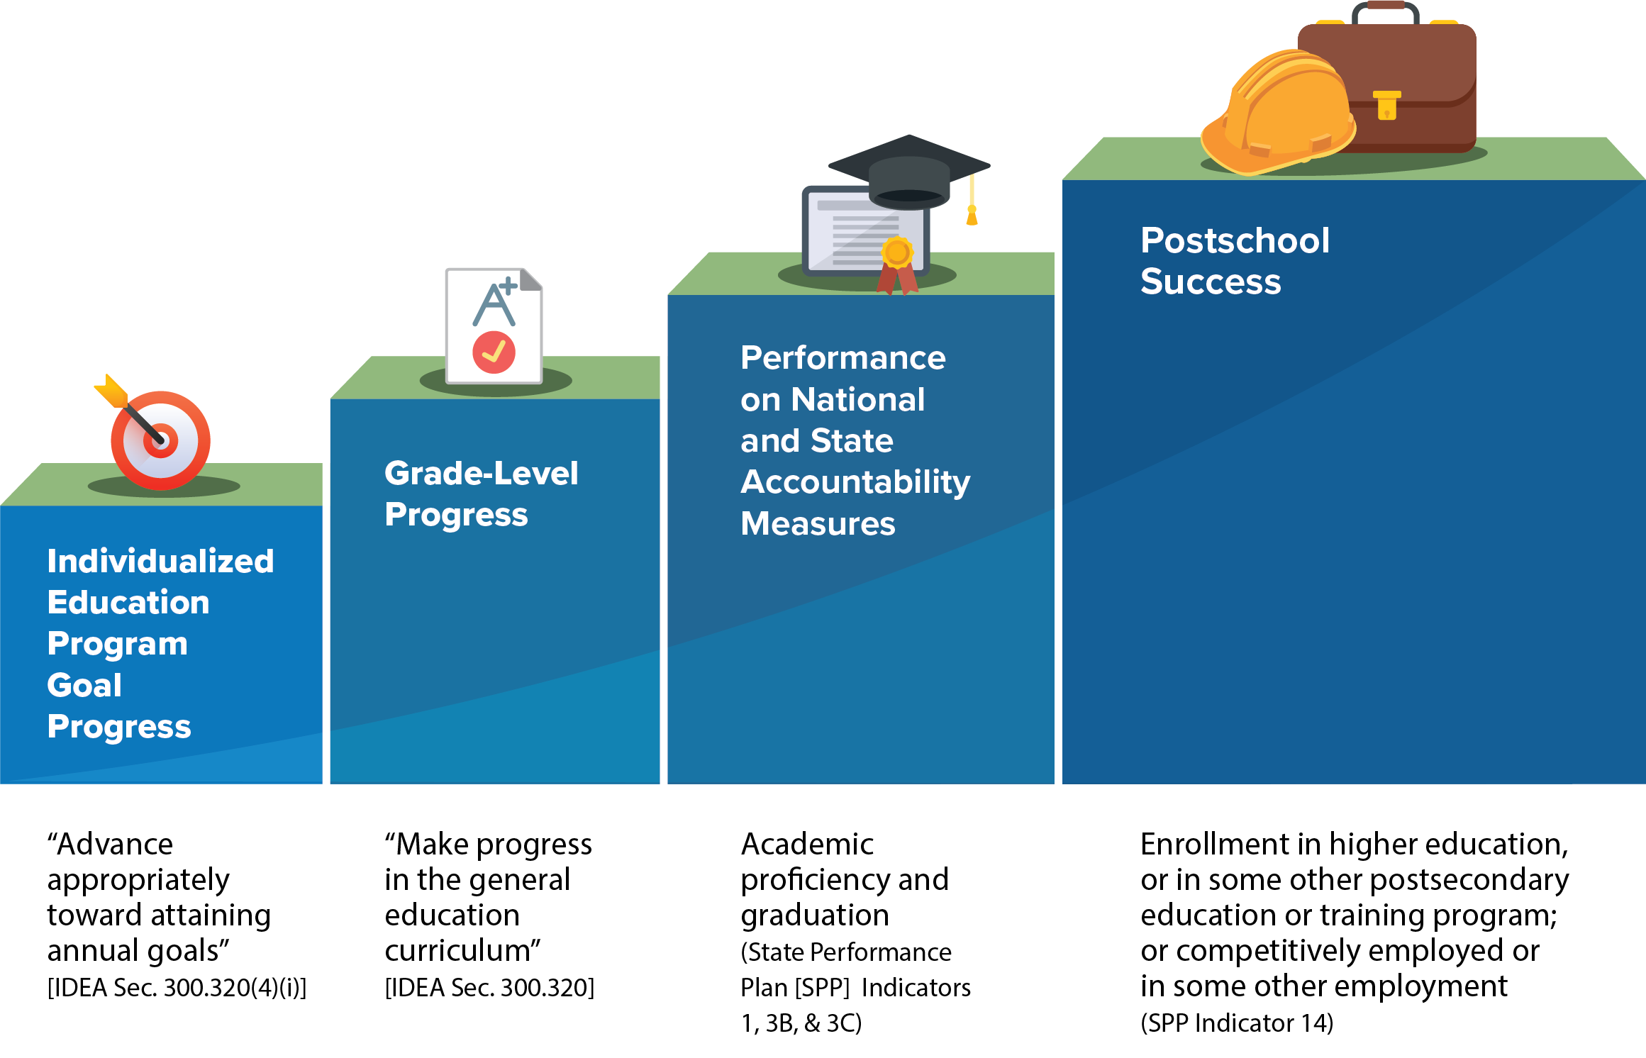
What is progress for students with disabilities?

Slide 7
The Development of Individualized Education Programs starts with the PLAAFP Statement
PLAAFP
Statement
Annual Goals
Measuring Progress Toward Annual Goals
Date, Frequency, Duration, and Location of Services
Participation Outside Regular Education and in State and Districtwide Assessments
Statement of Special Education and Aids and Services

Slide 8
Did you know? According to IDEA Eligibility Requirements:
A group of qualified professionals and the parent of the child determine whether the child meets the criteria for at least one of 13 disability categories,
needs special education and related services because of the disability (not due to a lack of academic instruction or limited English proficiency).
AND
IEP goals should address the disability-related need(s) identified in the evaluation report.
Source: IDEA Sec. 300.306: Eligibility Requirements

Slide 9
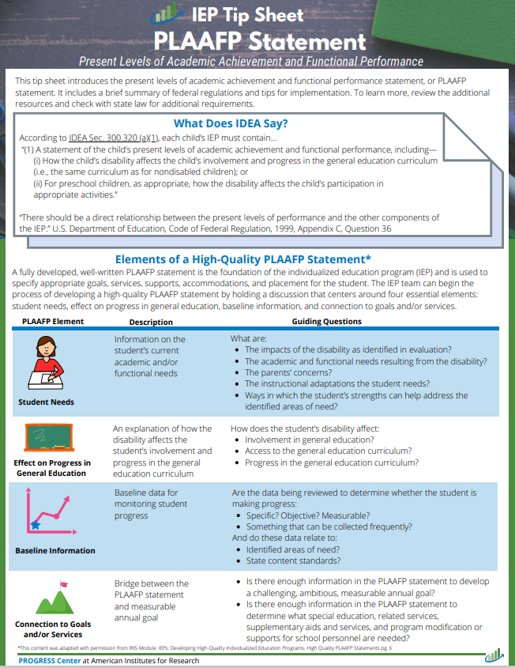
What does IDEA say about the PLAAFP statement?
(1) A statement of the child’s present levels of academic achievement and functional performance, including—
(i) How the child’s disability affects the child’s involvement and progress in the general education curriculum (i.e., the same curriculum as for nondisabled children); or
(ii) For preschool children, as appropriate, how the disability affects the child’s participation in appropriate activities.
Source: IDEA, Sec. 300.320 (a)(1); emphasis added
Notes:
https://promotingprogress.org/resources/iep-tip-sheet-plaafps

Slide 10
What is meant by present levels of academic achievement?
Examples of Areas Covered by
Academic Achievement
“Academic achievement” generally refers to a child’s performance in academic areas. It could vary depending on a child’s circumstance or situation; therefore, a definition of academic achievement is not included in the IDEA regulations.
History
Math
Reading
Writing
Science
Source: 71 Fed. Reg. at 46662.

Slide 11
What is meant by present levels of functional performance?
“Functional performance” generally refers to activities that are not considered academic or related to a child’s academic achievement.
“Functional” often is used in the context of routine activities of everyday living.
“The range of functional skills is as varied as the individual needs of children with disabilities.”
What functional skills might a student with disability need to develop to benefit from academic instruction and participate in the school experience?
Source: 71 Fed. Reg. at 46662.

Slide 12
Examples of Functional Skills
Mobility
Dressing
Eating
Toileting
We commonly think of these
BUT…
Behavior
Social Skills
Communication
Executive Function
Did you think about these?

Slide 13
Tips for Developing PLAAFP
Statements
Address all the student’s educational needs identified in the evaluation.
Include a description of changes in student functioning since the last IEP was developed.
Include objective, measurable data to describe current performance.
Explain how specific accommodations and modifications are needed and will be used by the student.

Slide 14
Quick Tips for Developing PLAAFP
Statements
Structure the baseline statement using the same structure as the annual goal.
Compare the student’s baseline performance to grade-level expectations.
Include administration dates and names of measurement tools to the extent possible.

Slide 15
IDEA Requirements for the Statement of Measurable Annual Goals

Slide 16
The Role of the Goal
PLAAFP
Statement
Annual Goals
Measuring Progress Toward Annual Goals
Date, Frequency, Duration, and Location of Services
Participation Outside Regular Education and in State and Districtwide Assessments
Statement of Special Education and Aids and Services

Slide 17
Why are Measurable Annual Goals Important?
Address academic and functional individual needs that require special education and related services that are outlined in the PLAAFP statement.
Assess whether the special education program is reasonably calculated to enable a child to make progress appropriate.
Promote high expectations and access and progress in the general education curriculum, in light of the child's circumstances.

Slide 18
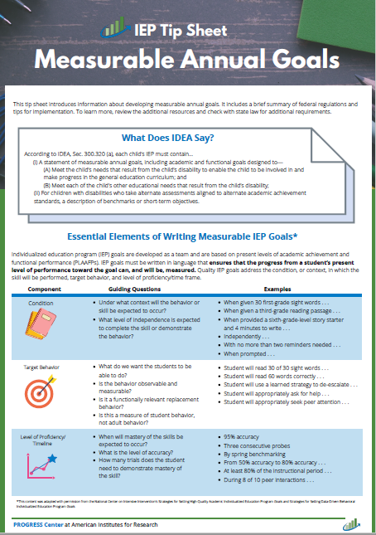
What does IDEA say about goals?
(i) A statement of measurable annual goals, including academic and functional goals designed to—
    (A) Meet the child’s needs that result from the child’s disability to enable the child to be involved in and make progress in the general education curriculum; and
    (B) Meet each of the child’s other educational needs that result from the child’s disability;
(ii) For children with disabilities who take alternate assessments aligned to alternate academic achievement standards, a description of benchmarks or short-term objectives
Source: IDEA, Sec. 300.320(a)(2)(i-ii)

Slide 19
How do goals connect to the other components in the IEP?
X
Annual Goal
(1-year projection)
PLAAFP
Statement
(baseline)
X
Special Education Services

Slide 20
IEP goals should….
focus on student behavior, not educator behavior.
be monitored with enough frequency to determine progress and make timely instructional/intervention decisions.
be measured using an objective, valid, and reliable measure (e.g., curriculum-based measure, Direct Behavior Rating (DBR), systematic direct observation) rather than a more subjective measure (e.g., teacher anecdotal notes).
be realistic, yet ambitious.

Slide 21
Determining the Focus of the Goal
What knowledge, skill, or strategy does the child need to the develop to reduce the impact of the disability on the child’s access to and progress in the general curriculum?

Slide 22

Identifying the Focus of the Goal
Meet G.H, a 6th grade student with SLD in math calculation.
Impact of Disability
Affects his ability to complete sixth-grade math assignments at the same rate as his peers and efficiently use mental math calculation skills to complete word problems without a calculator.
Needs
Struggled to solve simple +, -, x, and / problems with performance comparable to the average individual at grades 1-7
Math facts fluency standard score is in the very low range (percentile rank of 7)
Mixed math fluency: accurately recalled, on average, 18 facts compared with grade-level expectations of 75 facts in 2 minutes.
Waterfall Activity
What should be the area of focus for the goal?
Type your response into the Chatbox.
WAIT until prompted to send your response.

Slide 23
Strategies for IEP Goal Development

Slide 24
Questions to keep in mind when developing Measurable Annual Goals
What information do we need to create an annual goal?
What are the primary needs that require special education and related services?
How is each target need being described?
What are expected target goals for these behaviors? What are unique circumstances impacting this student in achieving grade level expectations?
What is the measurable baseline for each target goal?

Slide 25
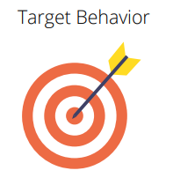

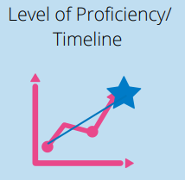
What Are the Three Essential Elements of Measurable Annual Goals?
Measurable

Slide 26
Target Behavior
What do we want the student to be able to do?
Is the behavior observable and measurable?
Is it a functionally relevant replacement behavior?
Is this a measure of student behavior, not adult behavior?
The academic or functional skill to be changed.

Slide 27
Condition
The context or environment in which the target behavior is to be exhibited and measured.
Under what context will the behavior or skill be expected to occur?
What level of independence is expected to complete the skill or demonstrate the behavior?

Slide 28
Level of Proficiency
The level of performance with which the IEP team can determine that a student has achieved the goal.
When will mastery of skills be expected to occur?
What is the level of accuracy?
How many trials does the student need to demonstrate mastery of the skill?

Slide 29
Write a Measurable Goal
Quality IEP goals address the condition, or context in which the skill will be performed, target behavior, and level of proficiency/timeframe.
Sample template for IEP structure:
When given [grade level and tool], the student will [observable behavior and goal] [level of proficiency and timeframe].

Slide 30

Academic Goal Example
Academic goals should focus on skills necessary for the student to access and benefit from general education instruction that is aligned with state standards.
Revised Goal: Given a second-grade reading probe, Jesse will read 65 words correctly in
1 minute with
95% accuracy on three consecutive probes.
Draft Goal: Jesse will read 65 words per minute.
Essential Elements of Goals
Condition
Target behavior
Level of proficiency/ timeline

Slide 31

Functional Goal Example
Functional goals should increase access, participation, and/or independence in the general education curriculum or setting.
Revised Goal: During each 40-minute class period, José will remain academically engaged at least 70% of the class for five consecutive days as monitored by daily DBRs.
Draft: During each 40-minute class, José will pay attention and be engaged 95% of the time.
Essential Elements of Goals
Condition
Target behavior
Level of proficiency/ timeline

Slide 32

Caution: Goals That Are Not Measurable
“The student’s annual goals and objectives in each IEP simply do not contain objective criteria which permit measurement of Student’s progress. . . . A goal of ‘increasing’ reading comprehension skills or ‘improving decoding skills’ is not a measurable goal . . . . Even if [present levels of performance] were clearly stated, an open-ended statement that the student will ‘improve’ does not meet the requirement . . . for a ‘measurable’ goal” (Rio Rancho Public Schools, 40 IDELR 140, SEA N.M. 2003, p. 563)
Measurable goals should pass the stranger test (different evaluators can agree if the goal has been achieved)

Slide 33
Caution: Goals That Are Not Measurable (2)
A goal which called for a student to “develop writing skills by monitoring usage of rubrics provided in class” was not measurable or was it verifiable (Northville Public Schools, SEA MI 2015)
Carefully consider the words you use in goals and make sure they can be measured
If you can’t graph it, it is not measurable

Slide 34
Caution: Misuse of Percentages
Annual goals that contain percentage of accuracy is not helpful where the IEP fails to define a starting point, an ending point, or the curriculum in which student will achieve 80 to 85% accuracy (Rio Rancho Public Schools, 2003, p. 563)
Percentages, by themselves, are meaningless!

Slide 35
Most Importantly, Keep Your Annual IEP Goals FAIR
Feasible | Is the goal appropriately ambitious given the student’s unique circumstances? Can the goal realistically be achieved during the school year and reflected in the IEP?
Acceptable | Is the goal acceptable to the student, family, and educators on the IEP team?
Impactful | Will achieving the goal positively impact the student access and benefit from the general curriculum and other educational outcomes?
Relevant | Does the goal connect to a meaningful outcome for the student and his or her family?
Notes:
Learn more about the FAIR Test https://ncsi.wested.org/resource/guiding-questions-the-fair-test/

Slide 36
Opportunities to Collaborate for Goal Development
Use data and insights from teachers, families, students, and other providers
Align goals to student needs that require special education and related services
Facilitate open communication across all IEP Team members
Document contributions and confirm shared understanding during meetings

Slide 37
We must continue to ask ourselves:
Are the goals we write adequate and appropriate to determine effectiveness of our special education and related services?

Slide 38
Closing and Next Steps

Slide 39

What is on your mind?

Slide 40
IEP Tip Sheet:
Present Levels of Academic Achievement and Functional Performance
RESOURCE

Slide 41
IEP Tip Sheet: Measurable Annual Goals
RESOURCE

Slide 42
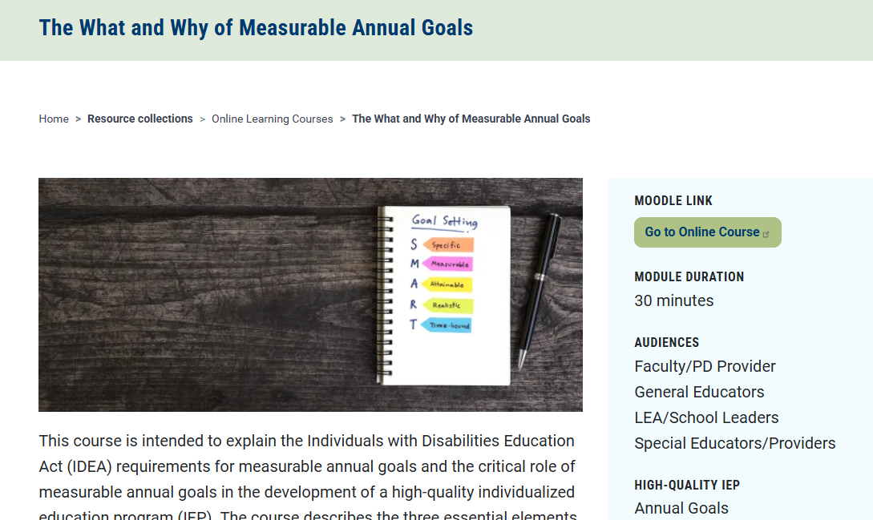
PROGRESS Center Modules
RESOURCE

Slide 43

PROGRESS Center Webinar
RESOURCE

Slide 44
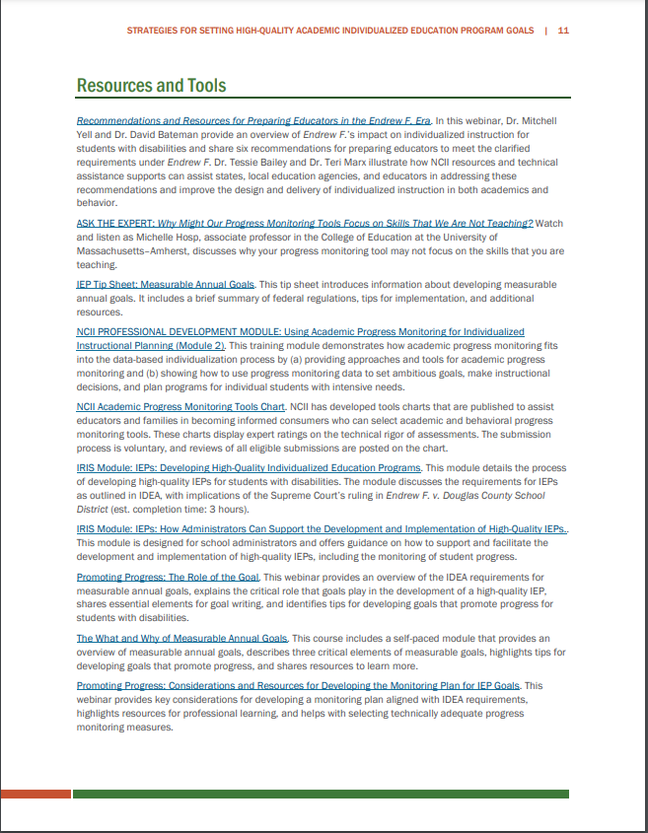


Academic and Behavioral Goal Setting
RESOURCE
Notes:
https://intensiveintervention.org/implementation-intervention/goal-setting

Slide 45

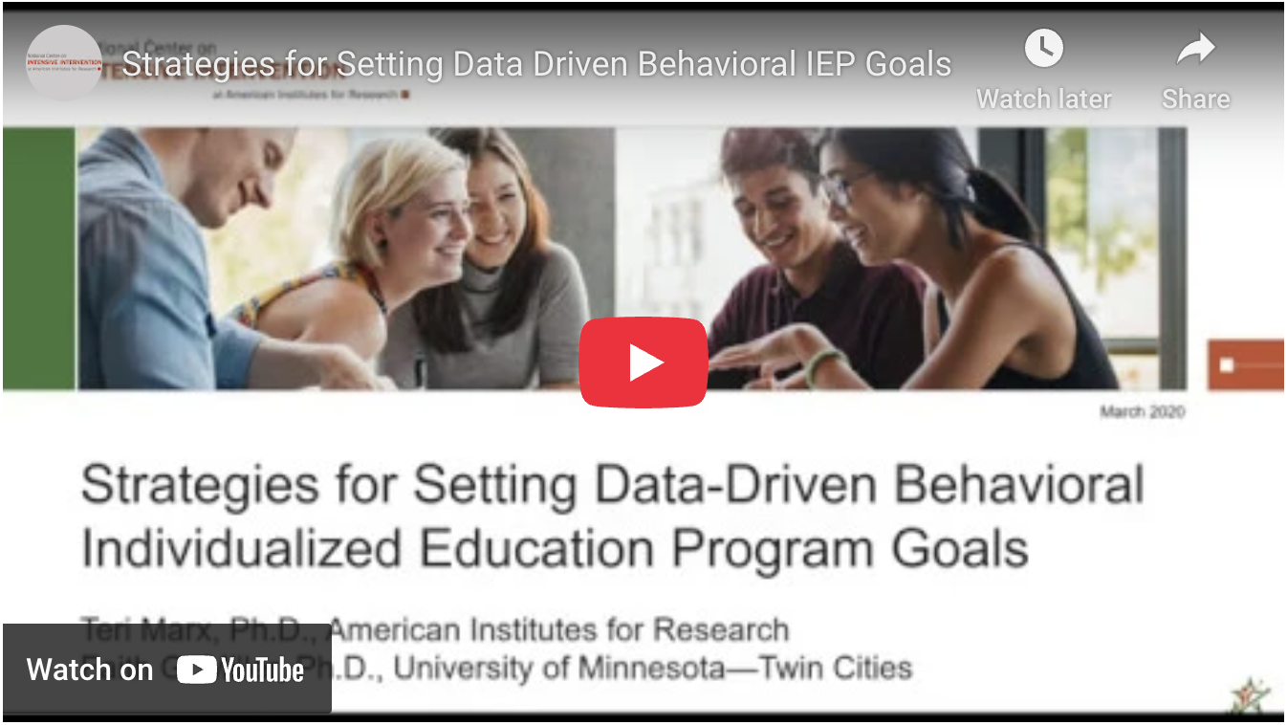
Strategies for Setting High Quality Goals
RESOURCE

Slide 46



Equation showing importance of development and implementation
Development of high-quality educational programming
Implementation of high-quality educational programming
Improved access and outcomes - FAPE

Slide 47


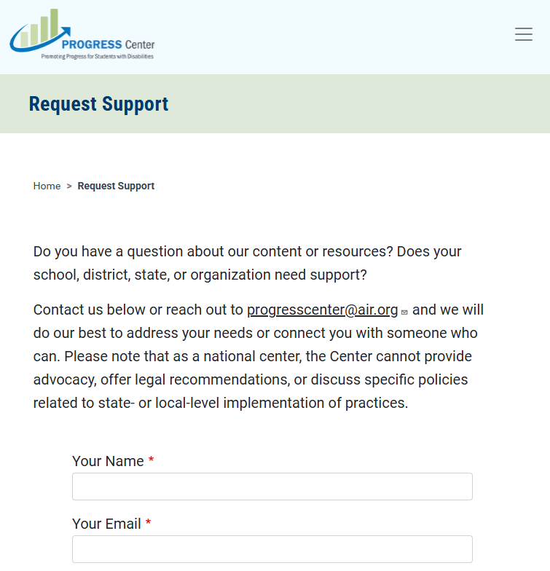
Find Additional Resources and Request Support
Visit our website
promotingprogress.org

Slide 48
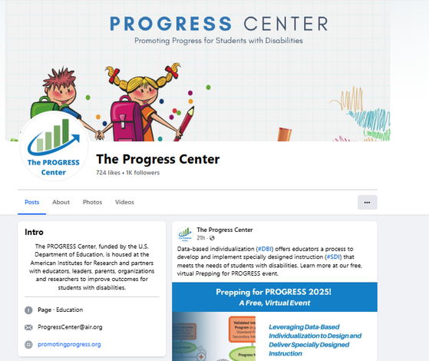
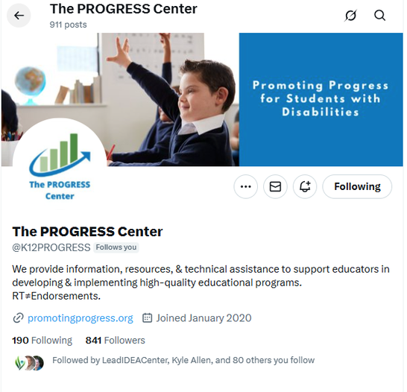
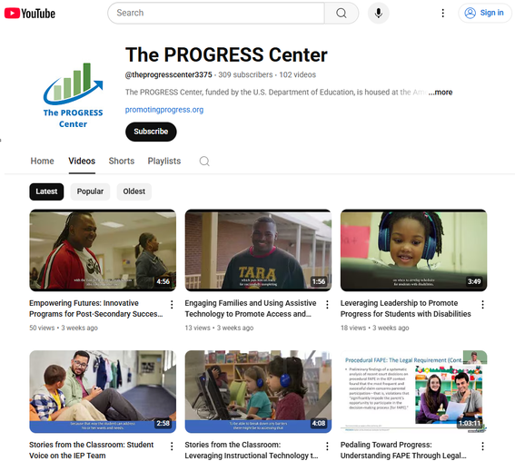





Stay connected with the PROGRESS Center!
@k12PROGRESS
@K12PROGRESS
@theprogresscenter3375

Slide 49
PROGRESS Center
1400 Crystal Drive, 10th Floor
Arlington, VA 22202-3289
202.403.5000
progresscenter@air.org
promotingprogress.org | www.air.org
https://www.facebook.com/k12PROGRESS/
https://twitter.com/K12PROGRESS
Notice of Trademark: “American Institutes for Research” and “AIR” are registered trademarks. All other brand, product, or company names are trademarks or registered trademarks of their respective owners.
This material was produced under the U.S. Department of Education, Office of Special Education Programs, Award No. H326C190002. David Emenheiser serves as the project officer. The views expressed herein do not necessarily represent the positions or policies of the U.S. Department of Education. No official endorsement by the U.S. Department of Education of any product, commodity, service, or enterprise mentioned in this presentation is intended or should be inferred.
23664_-01/24

