Slide 1


Unlocking Potential: How Leaders Can Support Strengthening Services for Students with Disabilities
Overview of the Principal Navigator for Strengthening Special Education Services
1

Slide 2
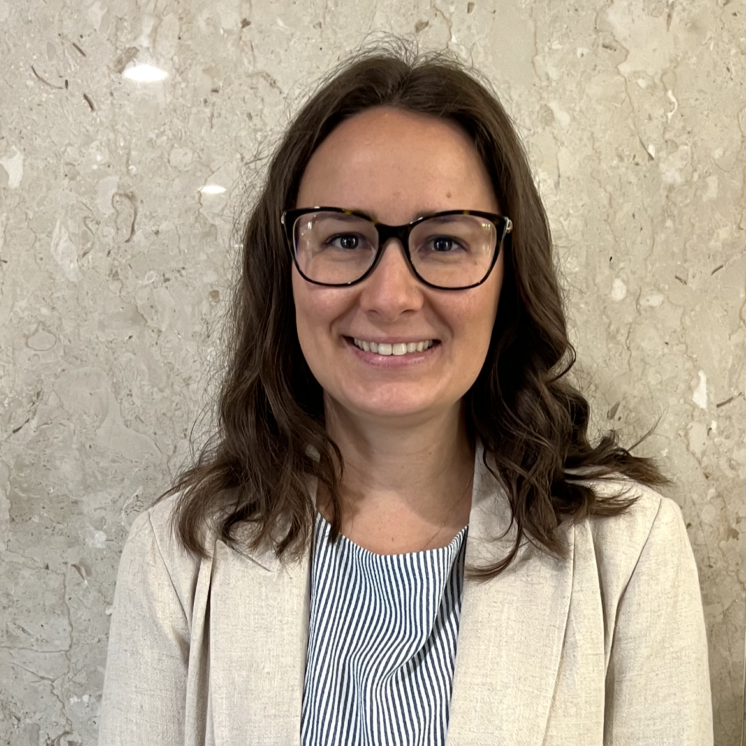

Meet the Presenters
Maggie Trout, M.A.
Paul Steinle, Ph.D.
American Institutes for Research
TA Consultant
Lead IDEA Center
American Institutes for Research
Researcher
Lead IDEA Center

Slide 3
Which of the following challenges resonate most with you?
1
General education teachers are overwhelmed due to the growing number of students with disabilities in their classrooms.
2
General education teachers lack a sense of shared ownership for serving students with disabilities, which is strained by increasing ambiguity around who is responsible for what.
3
Special and general education teachers rarely have sufficient time to plan together to meet the needs of students with disabilities.
4
General educators lack the skills needed to use data to accommodate or modify instruction that allows students with disabilities to access the general education curriculum.
5
General education teachers are hesitant to include students with disabilities in their classrooms due to their lack of confidence and skills to meet their academic and behavioral needs.

Slide 4


Our Mission
We work with leaders to improve systems serving children with disabilities and their families through effective implementation of the Individuals with Disabilities Education Act (IDEA).
4

Slide 5




Our Vision
Through partnerships with states, districts, and other leadership networks, we implement transformative learning solutions that equip early intervention (EI) & school administrators with the essential IDEA leadership knowledge and skills needed to:
Enhance workforce effectiveness
Improve working conditions and culture
Strengthen special education/EI programming
Promote progress & belonging for all children
Understand & comply with IDEA requirements

Slide 6
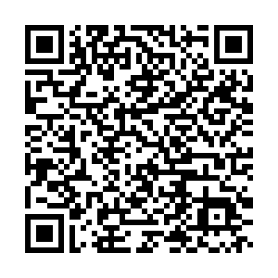
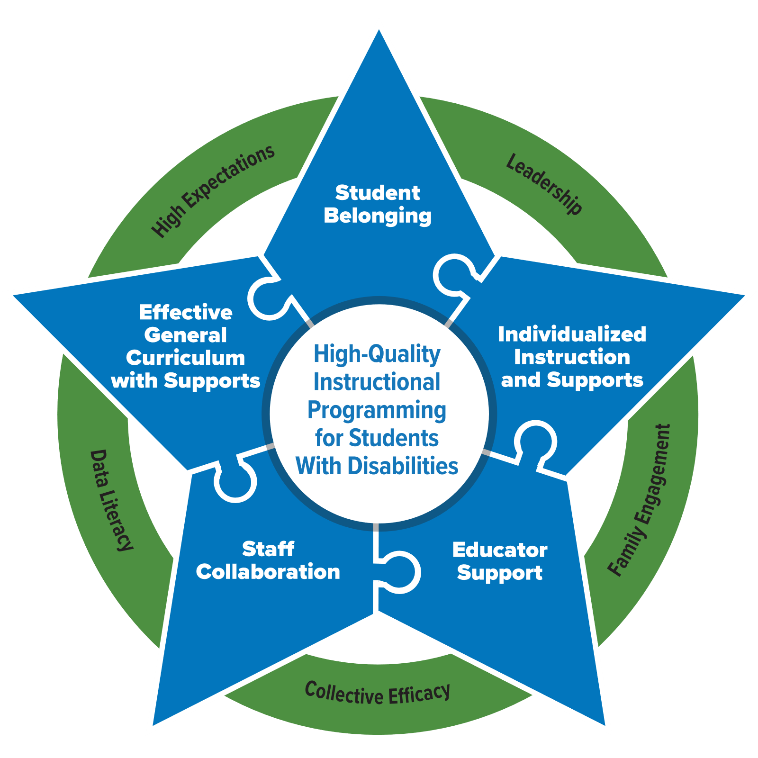
Progress Center's Beating the Odds Report
High quality instructional programming for students with disabilities necessitates five essential elements supported by five key facilitators.
  The five essential elements are depicted in the star graphic.
  The five facilitators are detailed in the surrounding circle.

Slide 7
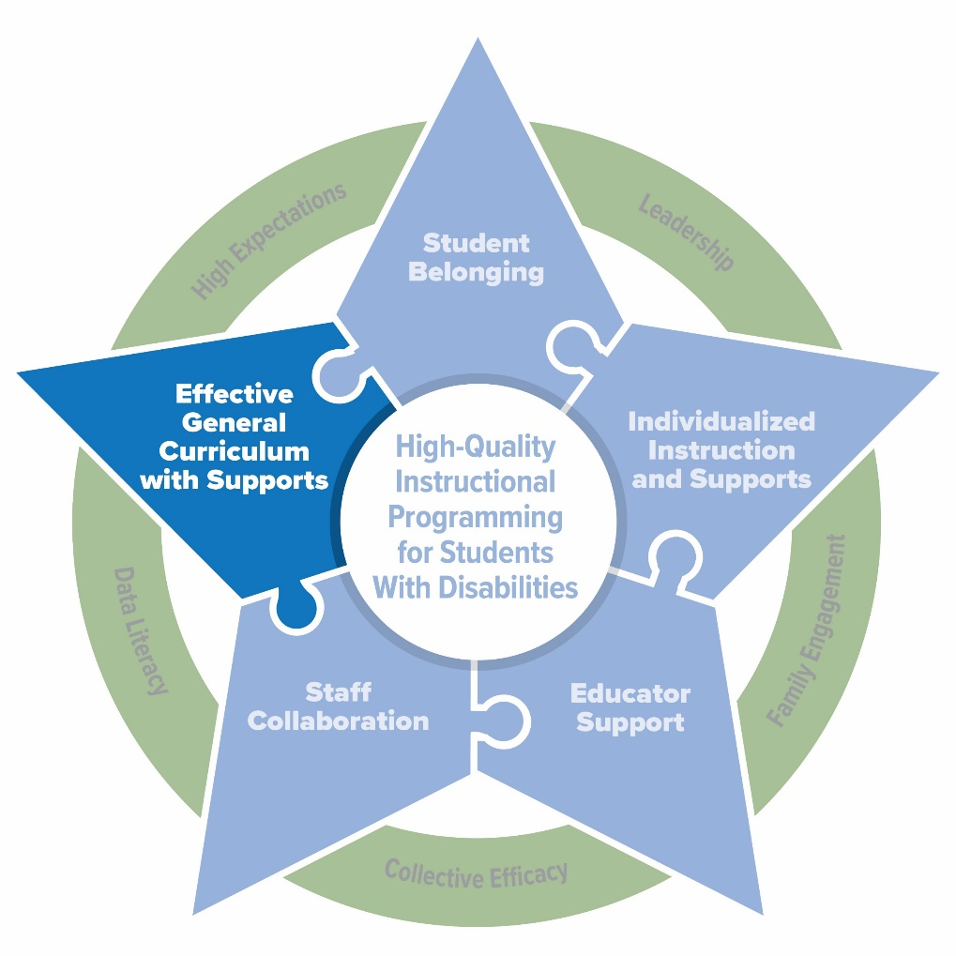
The Leader’s Role in Supporting High Quality Instructional Programming
Today’s Focus:
How principals can create the conditions for students with disabilities to access effective general curriculum with supports!

Slide 8
Two things are true
Two Things Are True:
Principals play a key role in establishing data-driven schoolwide systems that foster and ensure the success of students with disabilities; and
Principals need more support to have the capacity to meet this charge.

Slide 9
In the chat, answer the following questions:
What percentage of students served under IDEA Part B were educated inside the regular classroom at least 80% of their day?
What percentage of fourth grade students with disabilities were proficient on the NAEP reading assessment in 2024?

Slide 10



Why strengthening services is crucial for student success
The majority (67%) of students ages 5 through 21 served under IDEA Part B were educated inside the regular class 80% of the day or more (OSEP, 2024).
Builds instructional and behavior management skills through professional learning.
Ensures data-based decision-making that promotes progress towards IEP goals.
11% of fourth grade students with disabilities were proficient on the 2024 NAEP reading measure (NCES, 2025).
Reduces inequitable or hindered access to general curriculum.

Slide 11
Lead IDEA Center’s
Navigator Tools

Slide 12
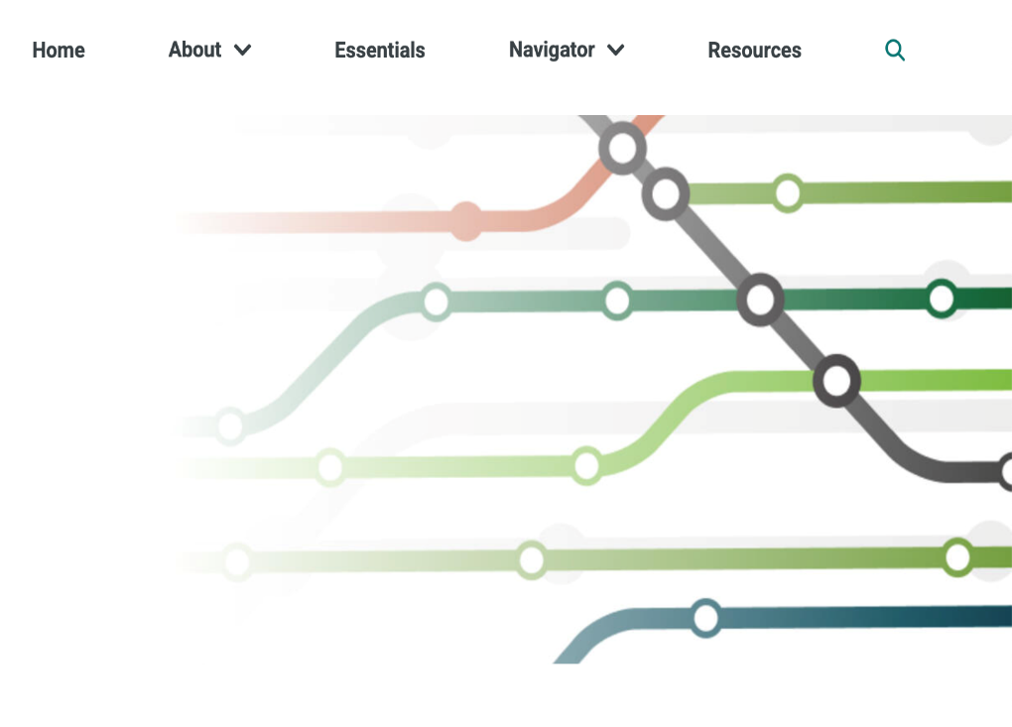
Navigator Tools
School Stories
  Relatable, application-based scenarios
  Provide clear action steps to address issues
Toolkits
  Strategies to address issues
  Short-, medium-, and
  long-term solutions
  Possible actions
  Resources to implement strategies
  Videos
  Related IDEA considerations
Interactive resources
Customizable to your needs and resource preferences

Slide 13


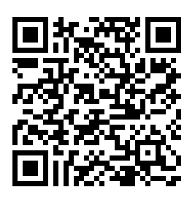




Principal Navigator: Strengthening Services for Students with Disabilities
https://bit.ly/systems_nav

Slide 14
Key Issues: Strengthening Services for Students with Disabilities
1. Missing the Mark: Decisions without Data
2. High-Intensity Needs: Student Challenges

Slide 15
Issue 1. Decisions without Data 1/5
Issue 1. Decisions without Data
Educators struggle using data to ensure access to the general curriculum and to measure students' instructional response.
Widened achievement gaps and diminished educational outcomes
Ineffective instruction
Limited data literacy

Slide 16
Issue 1. Decisions without Data 3/5
Issue 1. Decisions without Data
Educators struggle using data to ensure access to the general curriculum and to measure students' instructional response.
Leaders must:
Build staff data literacy
Offer professional development and coaching
Ensure time for data review and responsive instructional decision-making
Foster collaboration and reinforce shared accountability
Promote a culture of continuous improvement
Ineffective instruction
What strategies can leaders leverage to strengthen data-informed instruction?

Slide 17
Issue 1. Decisions without Data 5/5
Issue 1. Decisions without Data
Educators struggle using data to ensure access to the general curriculum and to measure students' instructional response.
Leaders must:
Build staff data literacy
Ensure time, resources, and infrastructure for data collection, review, and analysis
Empower teams to use data to intensify and individualize instruction
Foster collaboration and reinforce shared accountability
Promote data use for continuous improvement
Limited data literacy
What obstacles do teachers face in using data to make instructional decisions and monitor progress towards IEP goals?

Slide 18
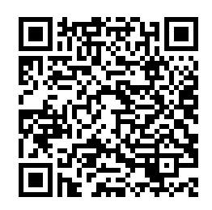

Resources: School Stories Principal Donahue
Resource: School Stories Scenario
Scenario
Principal Donahue notices that teachers face significant challenges in using data effectively to support and monitor the progress of all students, especially students with disabilities.

Slide 19
School Stories Principal Donahue Action Steps
Resource: School Stories
Principal Donahue’s Action Steps
  What action steps would you recommend Principal Donahue take?
Training
Systems
Collaboration
  Plan and deliver relevant, hands-on, actionable professional development
  Establish biweekly data meetings with clear protocols and decision rules
  Utilize digital dashboards for real-time data
  Facilitate PLCs
  Adjust teachers' schedules

Slide 20
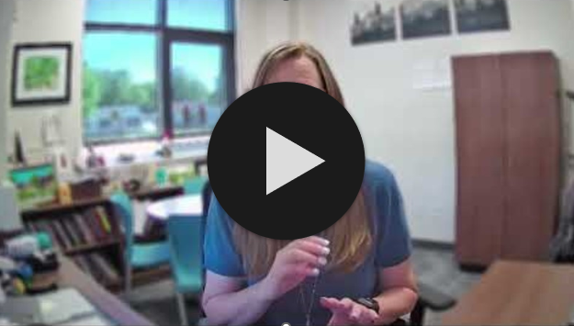
Resources: Solutions in Action
Resource: Solutions in Action
In this video, discover how an elementary school principal facilitates problem-solving meetings aimed at supporting teachers and related service providers to review student data and identify data-driven solutions for supporting students with disabilities.
Video available here: https://www.youtube.com/watch?v=QTIrquBMlK0&t=1s&ab_channel=LeadIDEACenter
Advancing Data-Driven Decisions & Solutions
Karla Miller, Elementary School Principal,
Great Falls Public Schools

Slide 21

Resource: Toolkit
Resource: Toolkit
Short-Term Solutions
Mid-Term Solutions
Long-Term Solutions
  Deepen Knowledge
  Support Staff
  Influence Systems
Strategy A
Use data to guide instructional and service decisions, as well as to monitor student access to and progress in the general curriculum and toward IEP goals.
Strategy B
Tailor general education and specially designed instruction (SDI) to meet students’ academic and functional needs.

Slide 22
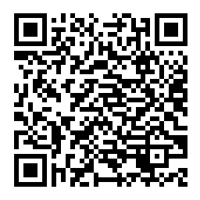
Activity: Toolkit Review
Activity: Toolkit Review
Strategy A
Use data to guide instructional and service decisions, as well as to monitor student access to and progress in the general curriculum and toward IEP goals.
Preview the possible actions and resources for both Strategy A and B within the Toolkit
Identify:
1 action you could take
1 resource you want to explore
Strategy B
Tailor general education and specially designed instruction (SDI) to meet students’ academic and functional needs.

Slide 23
Debrief: Toolkit
Debrief: Toolkit
In the chat, share one takeaway that resonated with you.
Strategy A
Use data to guide instructional and service decisions, as well as to monitor student access to and progress in the general curriculum and toward IEP goals.
Strategy B
Tailor general education and specially designed instruction (SDI) to meet students’ academic and functional needs.

Slide 24
Issue 2. High-Intensity Needs 1/2
Issue 2. High-Intensity Needs
Schools face persistent challenges in meeting complex and multifaced needs of students with disabilities, hindering student access to the general curriculum and progress toward achieving their IEP goals.
Aligned Service Delivery
Specially Designed Instruction
Intensive Interventions
Student Support System

Slide 25
Issue 2. High-Intensity Needs 2/2
Issue 2. High-Intensity Needs
Schools face persistent challenges in meeting the complex and multifaced needs of students with disabilities.
Leaders must:
Support staff understanding of collaborative service delivery through the IEP
Prioritize systems that support student well-being and behavioral needs
Ensure delivery of specially designed instruction
Foster strong, trusting relationships among teachers, students, and families
Systemic Barriers
What systemic barriers do students face preventing them from being fully included in school support systems?

Slide 26
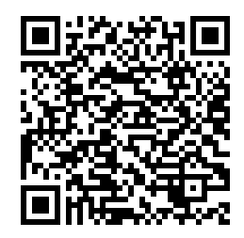

Resource: School Stories Principal Carter
Resource: School Stories
Scenario
Principal Carter notices SWDs’ access to the general curriculum is limited due to the lack of educator expertise on meeting significant behavioral needs and connecting functional skills within the general curriculum.

Slide 27

Resource: School Stories, Principal Carter
Resource: School Stories
Principal Carter’s Action Steps
  What action steps would you recommend Principal Carter take?
Student Well-being
Instructional Practices
Family Engagement
  Schoolwide behavior management
  Behavior intervention training
  Sensory and emotional regulation
  Professional learning for UDL and SDI
  Collaboration within master schedule
  IEP workshops
  Family portal
  Student recognition

Slide 28
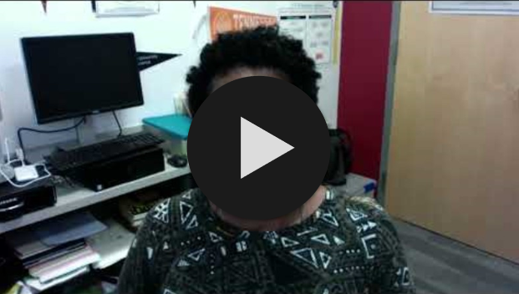
Resource: Solutions in Action, Principal Priester
Resource: Solutions in Action
In this video, learn how a high school principal intentionally designs schedules to promote a school culture where educators collaboratively design and implement supports for students with high-intensity needs during the school day.
Video available here: https://www.youtube.com/watch?v=Xos99OaFUoU&t=1s&ab_channel=LeadIDEACenter
Promoting Shared Ownership and Collaboration
Lonice Priester, Principal, Fairmont Heights High School

Slide 29

Resource: Toolkit Strategies
Resource: Toolkit
Short-Term Solutions
Mid-Term Solutions
Long-Term Solutions
  Deepen Knowledge
  Support Staff
  Influence Systems
Strategy A
Create a learning environment that supports the well-being and behavioral needs of students of disabilities.
Strategy B
Support educator capacity to design and deliver general education and specially designed instruction tailored to students’ academic and functional needs.
Strategy C
Build strong, supportive relationships between teachers, students, and families.

Slide 30
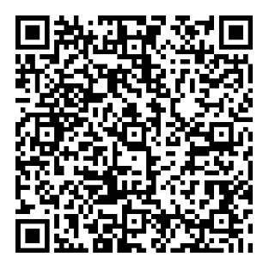
Activity: Toolkit
Activity: Toolkit Review
Preview the possible actions and resources for Strategies A, B and C within the Toolkit.
Identify:
1 action you could take
1 resource you want to explore
Strategy A
Create a learning environment that supports the well-being and behavioral needs of students of disabilities.
Strategy B
Support educator capacity to design and deliver general education and specially designed instruction tailored to students’ academic and functional needs.
Strategy C
Build strong, supportive relationships between teachers, students, and families.

Slide 31
Debrief: Toolkit for High Intensity Needs
Debrief: Toolkit
In the chat, share one takeaway that resonated with you.
Strategy A
Create a learning environment that supports the well-being and behavioral needs of students of disabilities.
Strategy B
Support educator capacity to design and deliver general education and specially designed instruction tailored to students’ academic and functional needs.
Strategy C
Build strong, supportive relationships between teachers, students, and families.

Slide 32
Closing

Slide 33
Key Takeaways
Students with disabilities face complex academic and behavioral challenges, and gaps in educator skills limit their access to grade-level learning and progress on IEP goals.
District and school leaders play an essential role in building data literacy that drives better support for students with disabilities.
LEAD IDEA supports leaders with this multi-faceted issue through the Navigator Tool – a structured, research-based path from problem identification to practical solutions, all rooted in IDEA requirements and designed to support leaders at every step.

Slide 34
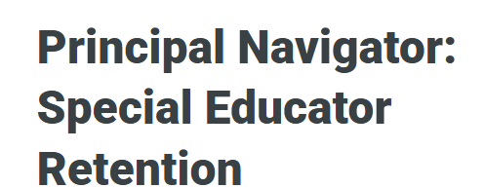


Principal Navigator: Special Educator Retention
https://bit.ly/reten-nav
Notes:
Principal Navigator: Special Educator Retention | Lead IDEA

Slide 35

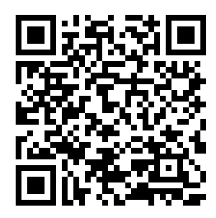
Access the Navigators and Other Resources on Our Website
Subscribe to Our Newsletter:
https://lead-idea.org

Slide 36
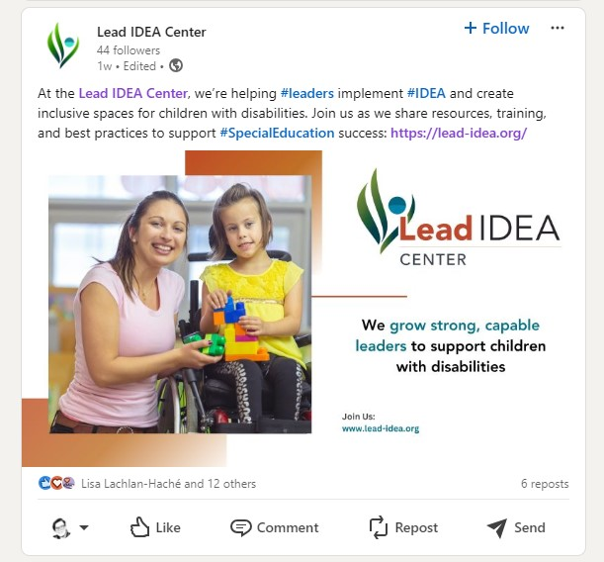
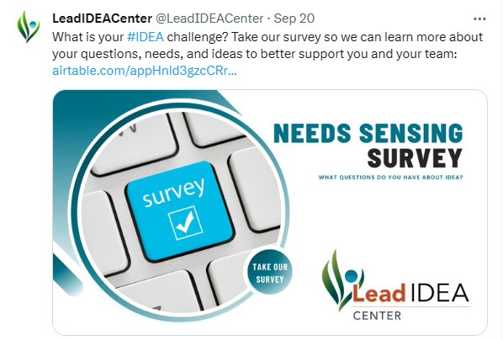
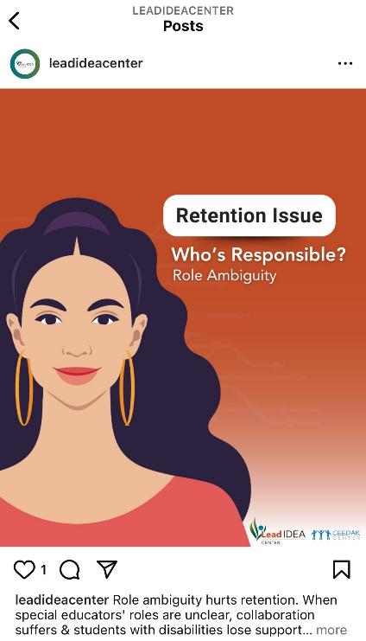
Follow Us on LinkedIn, Instagram, and X!
Notes:
https://www.linkedin.com/company/lead-idea-center/
https://www.instagram.com/leadideacenter/
https://x.com/LeadIDEACenter

Slide 37
Contact Us
Lead IDEA Center
leadidea@air.org
Maggie Trout
mtrout@air.org
Paul Steinle
psteinle@air.org
American Institutes for Research (AIR)
1400 Crystal Drive, 10th Floor
Arlington, VA 22202-3289
202.403.5000
https://lead-idea.org/
This material was produced under the U.S. Department of Education, Office of Special Education Programs, Award No. H325Z230007. Anna Macedonia serves as the project officer. The views expressed herein do not necessarily represent the positions or policies of the U.S. Department of Education. No official endorsement by the U.S. Department of Education of any product, commodity, service, or enterprise mentioned on this website is intended or should be inferred.
28156_05/25

