Slide 1
Leveraging MTSS to Support Students with Disabilities
Jason Harlacher, PhD

Slide 2

Questions?
In the chat, share:
  Name
  Role
  A question you have around MTSS and students with disabilities.
Photo by Volodymyr Hryshchenko on Unsplash

Slide 3




Jason Harlacher, PhD
Jason is a senior researcher at American Institutes for Research (AIR), where he provides technical assistance to state agencies and school districts on intensive intervention, classroom management, data-based decision making, and implementation of a multi-tiered system of supports (MTSS). He currently serves as the director of the MTSS Center, co-director for the Wyoming MTSS Center, and TA provider for the National Center on Intensive Intervention (NCII).

Slide 4

Types of supports
Daily 45-minutes of
direct instruction in reading
Speech services to address articulation needs
Audio enhancement in all instructional settings
Behavioral support to reduce
off-task/disruptive behavior

Slide 5
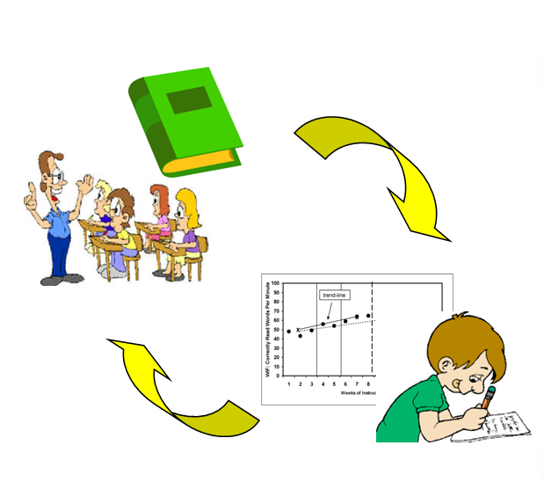
MTSS for Students with Disabilities
      MTSS provides a structure to support all students, including SWD
      Schools implementing MTSS for students end up with better outcomes for all students, including SWD
      Implementation of MTSS supports obligations under IDEA

Slide 6

Agenda
What is MTSS?
How does MTSS support SWD?
Access to general education curriculum
Individualized support
Staff collaboration
Student belonging

Slide 7
What is MTSS?

Slide 8
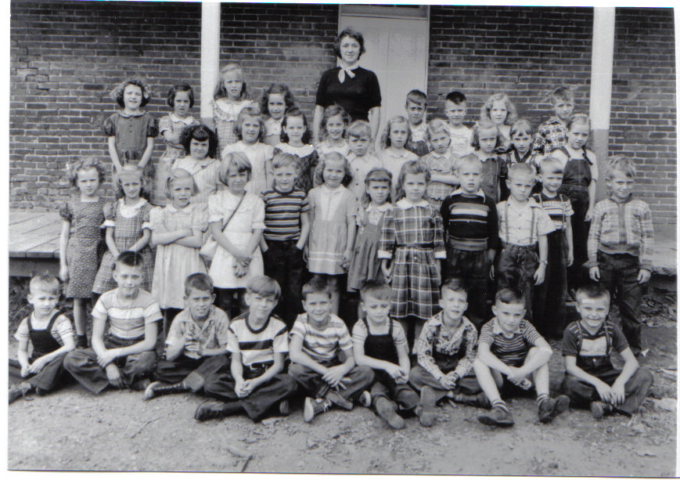
Schooling in Past Generations

Slide 9
General Education
Special Education
Gifted & Talented
Title I
Families, Community
Tutors
After-School
Second-language

Slide 10

Silos

Slide 11
With MTSS, Silos are Deconstructed
General Education
Additional support
Teacher Raises Concerns
Core
Data
Targeted
Data
Intensive

Slide 12
Provides a continuum of supports using data-based decision making
Intensive level of support
Provided to few students
Students receive services at all levels, depending on need
Targeted level of support
Provided to some students
Universal level of prevention
Provided to all students
Goal of MTSS is to match supports to “data-based needs of students”
(Graden, Stollar, & Poth, 2007, p.295)

Slide 13
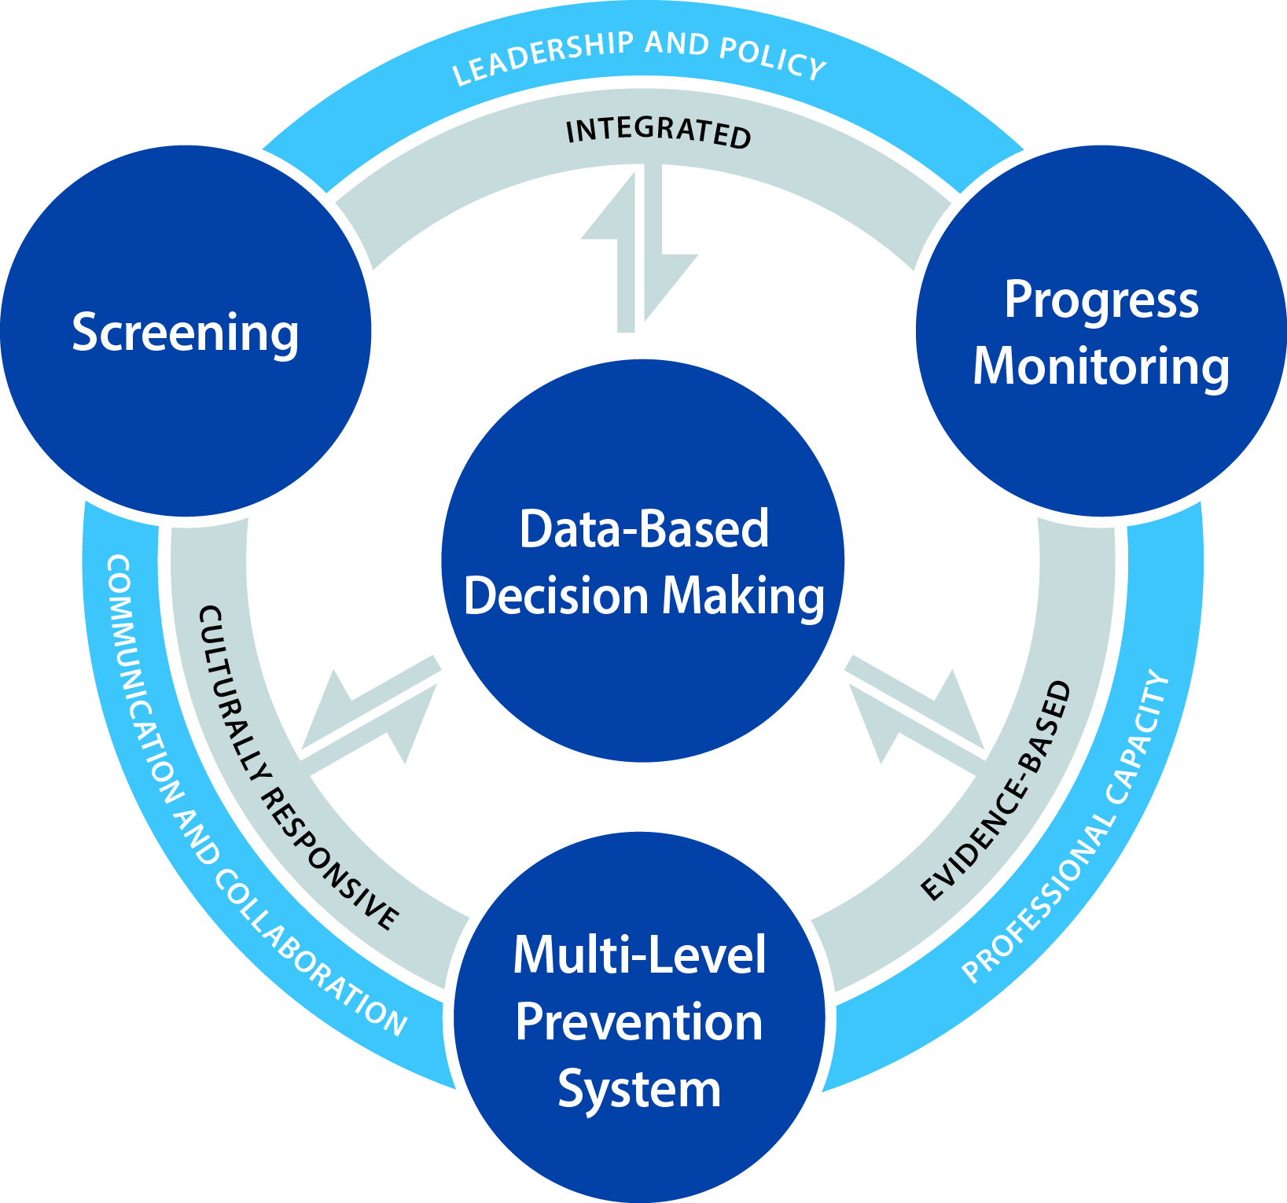
Defining MTSS
MTSS is a proactive and preventative framework that integrates data and instruction to maximize student success.
Schoolwide framework that integrates instruction/intervention and assessment within a multi-level prevention system.

Slide 14
MTSS Components
Screening
systematic process for identifying students who may be at risk for poor learning outcomes
Multi-Level
Prevention System
three tiers of intensity used to match a student’s need to a corresponding level of support
Progress Monitoring
ongoing, frequent collection and use of formal data (gathered with reliable and valid measures) to assess students’ performance
Data-Based Decision Making
use of screening, progress monitoring, and other forms of data to make decisions to support student and implementation outcomes
Infrastructure and Support Mechanisms
knowledge, resources, and organizational structures necessary to operationalize and implement all components of MTSS to meet the identified implementation and outcome goals

Slide 15

Why do students experience challenges?​

Slide 16
High Expectations:
All Students Can Learn, Given the Right Support
Are you doing right by kids?
If it was your kid, would you be happy with the support?
Instruction (Methodology)
Curriculum (Content)
Environment
(Delivery)

Slide 17

One Teacher Can’t Do It All
Photo by Ergo Zakki on Unsplash

Slide 18

Collective Efficacy:
Co-Ownership of Student Achievement is Key
Photo by Vasily Koloda on Unsplash

Slide 19
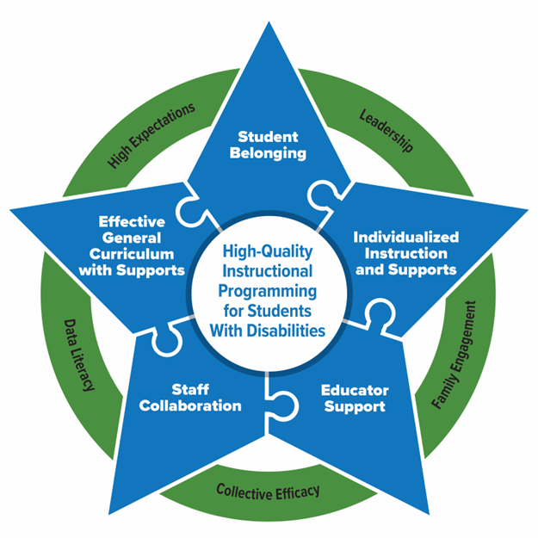
Essential Elements for Sustainable School Systems
The PROGRESS Center has identified Essential Elements in schools that support high-quality instructional programming for students with disabilities.

Slide 20
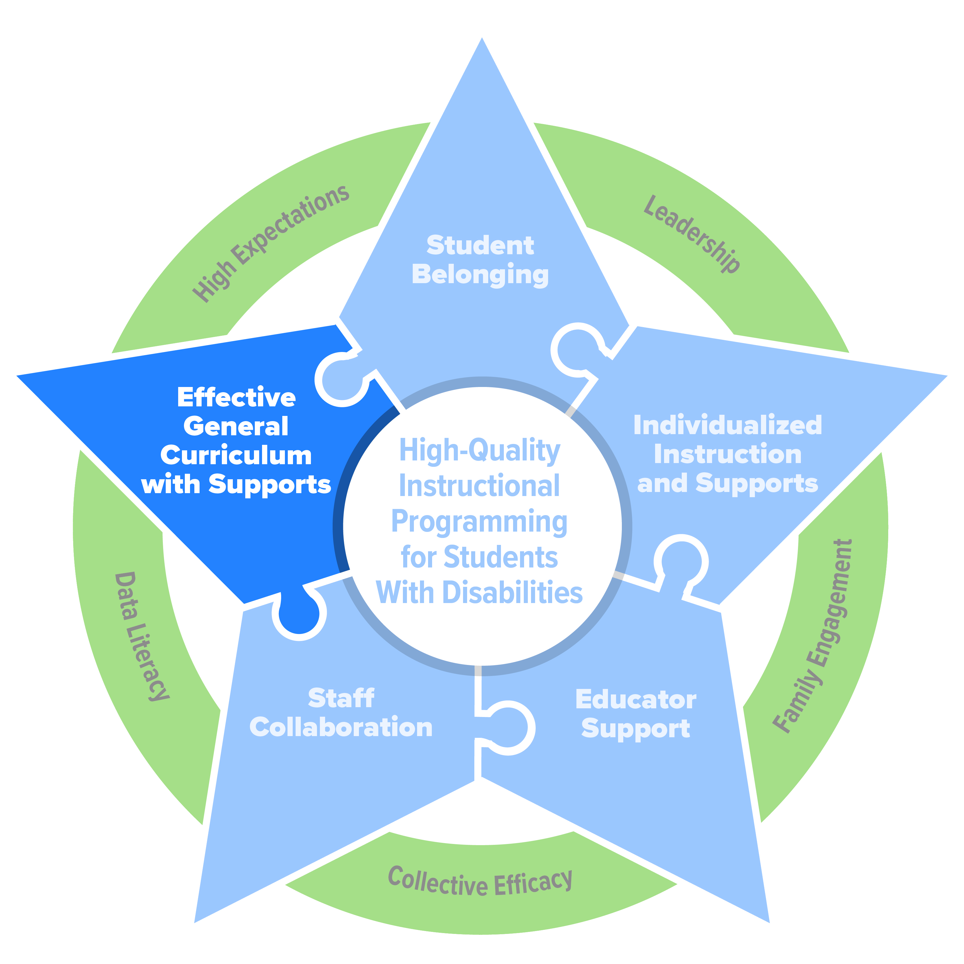
Effective General Curriculum

Slide 21
Foundation of effective instruction and support
MTSS outlines a range of support and services that includes effective interventions and evidence-based practices available to all students, including SWD.
Special education leverages tiers to support SWD.
Students receive services at all levels, depending on need

Slide 22
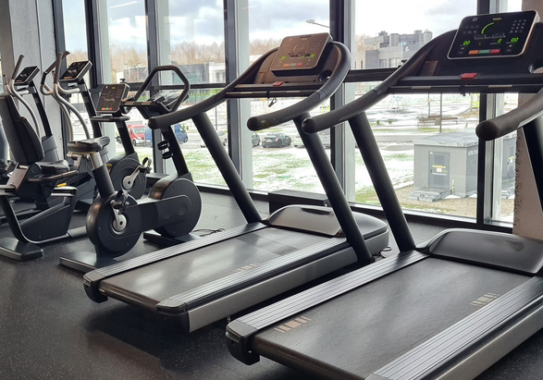



Your Exercise Routine Isn’t Just The Trip to the Gym

Slide 23





Your IEP Isn’t Just the Trip to the Special Education Room

Slide 24

MTSS addresses the needs of all students by aligning supports, including students with disabilities.
Phonics, Fluency
Addresses needs of SWD by providing access to all services and supports.
Students aren’t isolated to one tier or service.
Reading Comprehension
Self-Regulation
Engagement
Math Calculation
Communication Skills
Written Expression
Science
Social Skills
Attendance
Credit: George Sugai

Slide 25
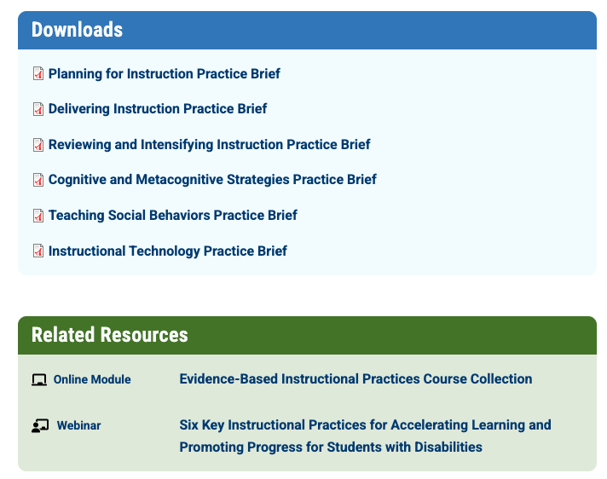
Effective Instruction and Support
General education classroom uses effective practices to support SWD.
https://promotingprogress.org/resources/instructional-briefs

Slide 26
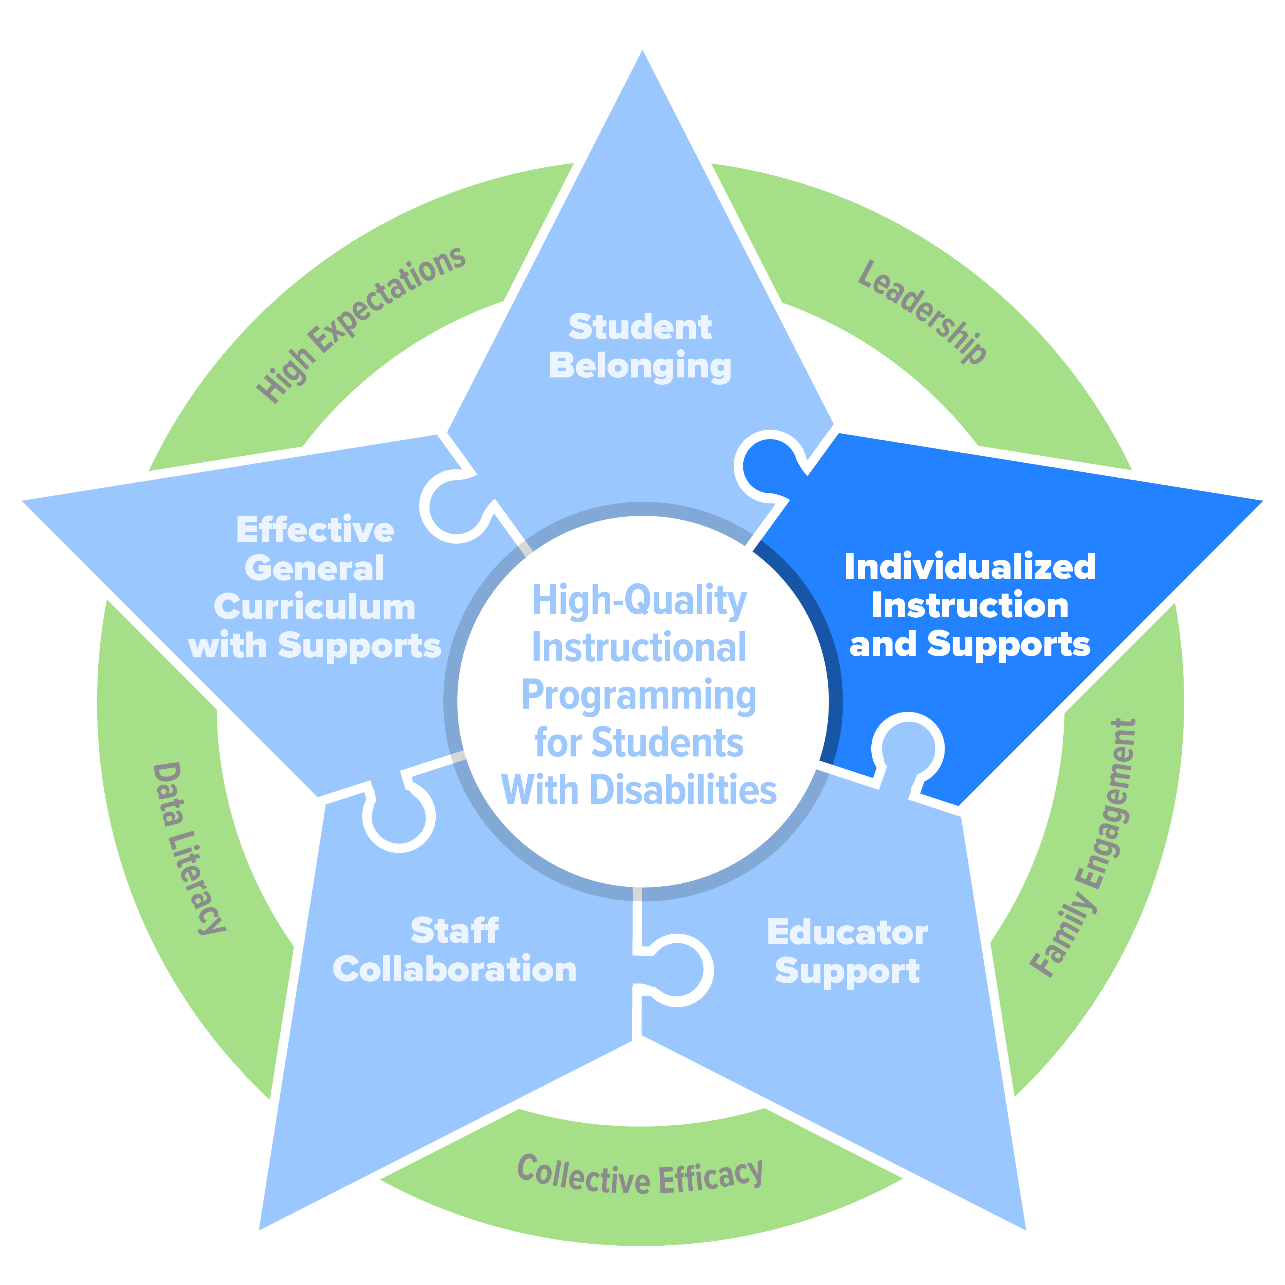
Individualized Instruction
Notes:
Individualization occurs across all the tiers.

Slide 27




Focus on Individualizing Instruction
Methodology:
How we teach
Methodology
Content:
What we teach
Student with Disability
Delivery:
Where we teach
Delivery
Content

Slide 28



What Might This Look Like?
Generally speaking, individualize instruction across methodology, content, and delivery.
  Increase dosage/time of intervention
  Increase explicitness (e.g., opportunities to respond, corrective feedback)
  Adjust focus of instruction or skills being targeted
  Ensure sufficient background skills or knowledge
  Increase feedback
  Ensure a positive, supportive environment
  Ensure environment considers learner characteristics
Methodology
Content
Delivery

Slide 29

What was your first car?

Slide 30


Acquisition Stage:
Initial learning of skills.
Requires a lot of working memory.

Slide 31

Fluency (Automaticity) Stage:
Developing automaticity. Requires less working memory

Slide 32

Generalization Stage:
Can perform skill in new context; skills easily transfer

Slide 33
Instructional Hierarchy and Instructional Recommendations
Stage | Goal | Student Responses | Instructional Recommendations
Acquisition | To perform the skill accurately and independently | Initial learning of skill Inconsistent responding and performance | Model and prompt (I do, We do, You do) Use “think aloud” Feedback on effort and accuracy
Automaticity | Can perform skill accurately with fluency, and can combine skill with other skills | Student performs skill accurately (e.g., 93% and up), but is slow and laborious | Provide practice, repetition, and blend with other skills Reinforcement for reaching standards or improving fluency.
Generalization | Use of skills across situations and settings; can apply to real world settings | Accurate and fluent in responding Does not perform the skill well in new settings or settings different from the instructional setting | Model, practice, and reinforce across different settings and contexts. Feedback for applying and using skill
Adaptation | Can modify skill based on new context or settings | Accurate and fluent with skill Can perform in novel settings Does not modify skill to adapt to situations | Provide opportunities for adaptation Have the student identify “big ideas” of the skill(s). Feedback on adaptation of skill
Harlacher, 2015; Harlacher et al., 2024

Slide 34
Supporting Generalization
Special Education Setting
Transfer Setting
(Gen-Ed)
Methodology:
Be respectful with examples, non-examples
Methodology:
Teach what respect is in that setting
Example
Check-in at start of period with visual cue.
Delivery:
Prompting and feedback on use of skill
Environment:
Prompting and feedback on use of skill
Methodology :
Be respectful with limited examples
Methodology:
No teaching in this setting
Non-example
Environment:
Prompting and feedback on use of skill
Environment:
No prompting,
limited feedback

Slide 35
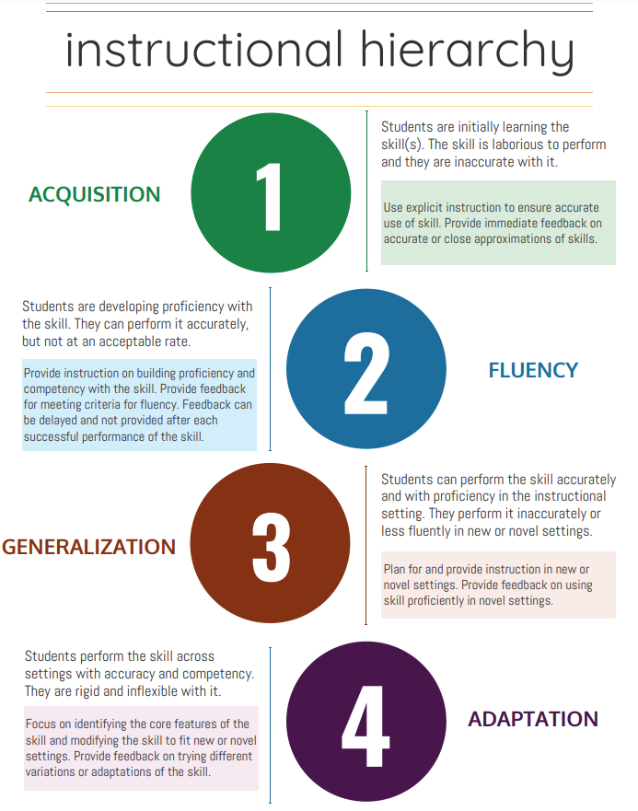
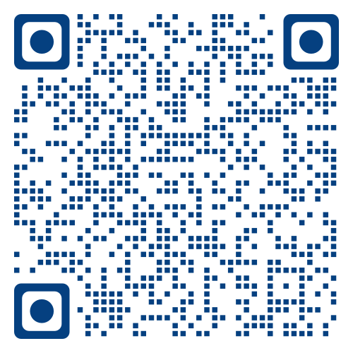
Content Matched to Need:
Instructional Hierarchy Resource
The IH summarizes a general progress of skill development. Educators can adjust and match the type of instruction to the stage for each skill.
https://mtss4success.org/resource/instructional-hierarchy

Slide 36
Opportunity to Respond (OTR):
Anytime a student has an opportunity to respond to a task or to demonstrate a skill
Provides a measure of dosage, as well as pacing and engagement
Prompt
Opportunity to Respond (OTR)
Feedback (Corrective
or Praise)

Slide 37






Types of OTRs
Who
Responses
Choral (Unison)
Peer to Peer
Individual
Verbal
Written
Action

Slide 38
Leverage Tiers to Increase and Provide Opportunities to Respond
Typically, a person needs 3-8 repetitions to learn a word.
Students with disabilities may required upwards of 30 repetitions.

Slide 39
Assessing Student OTR’s
Guiding Question: How many student opportunities to respond (OTRs) are we providing across settings and activities, and where can OTRs can be increased?
https://mtss4success.org/resource/assessment-opportunities-respond

Slide 40
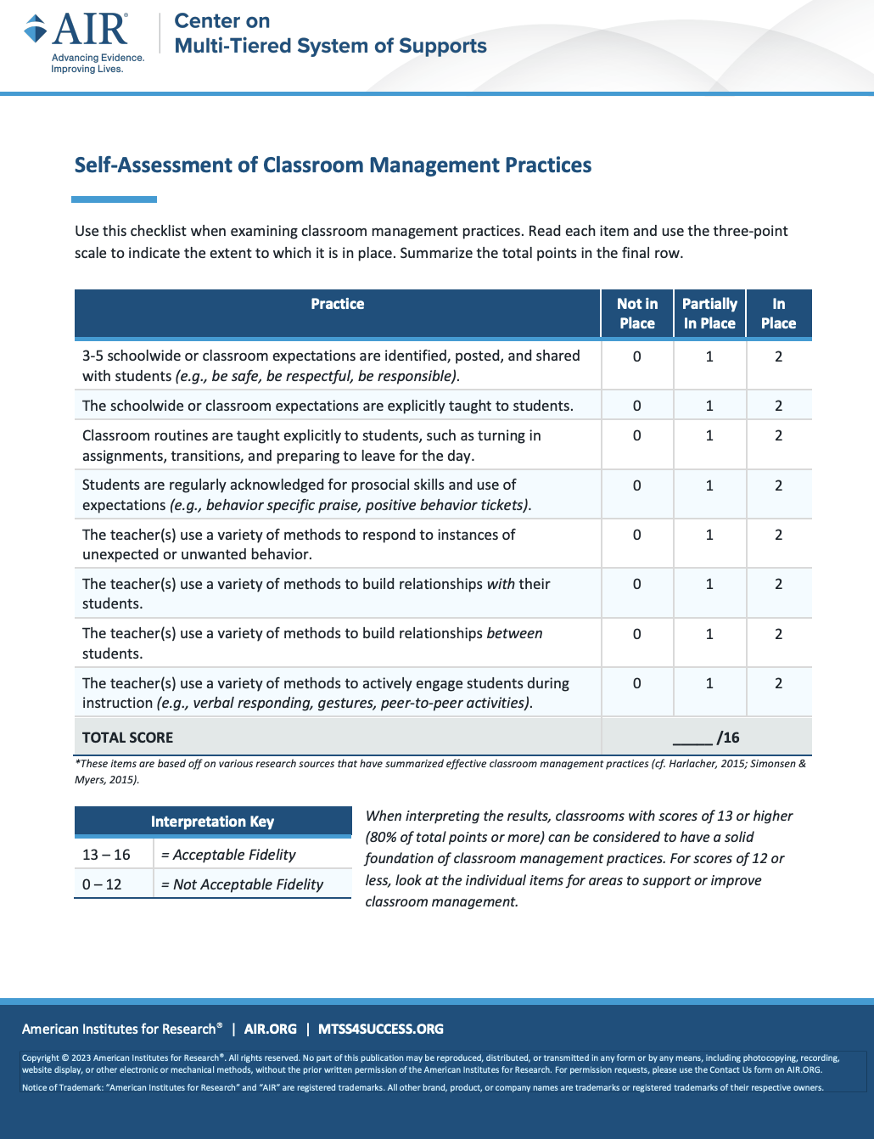
Self Assessment of Classroom Management
Can be used as a self-assessment or interview questionnaire to gauge overall use of practices and improve areas of need.
  Identify, teach, and reinforce expectations
  Methods to manage unwanted behavior
  High engagement
  Relationship-building
Source. https://mtss4success.org/resource/self-assessment-classroom-management

Slide 41
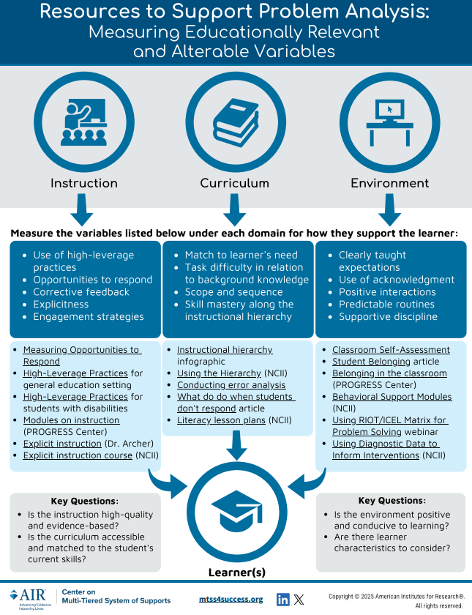
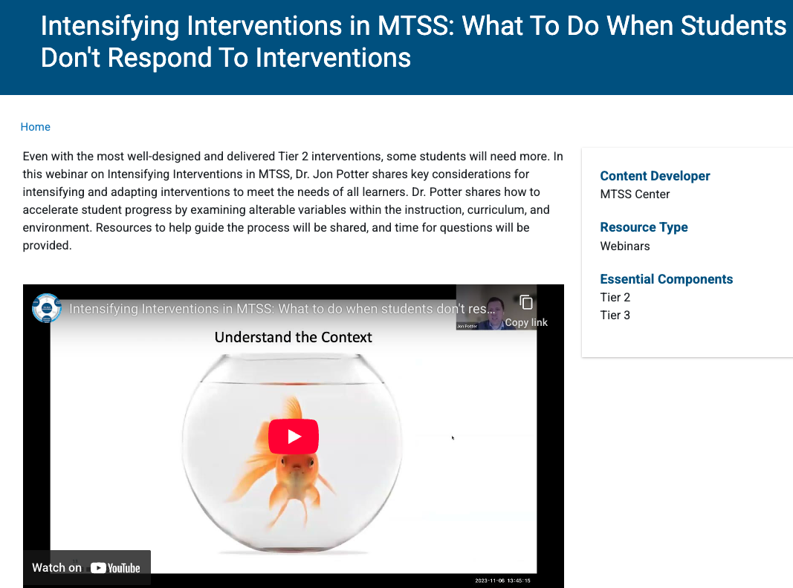
Resources:
https://mtss4success.org/resource/webinar-intensifying-interventions-mtss
https://mtss4success.org/sites/default/files/2023-07/problem_analysis_infographic.pdf

Slide 42
Interventions Are Coordinated to Ensure Comprehensive Support
Student’s instructional plan is shared across tiers.
Structure tiers to ensure access to grade-level curriculum and standards while using interventions to address skill needs.

Slide 43
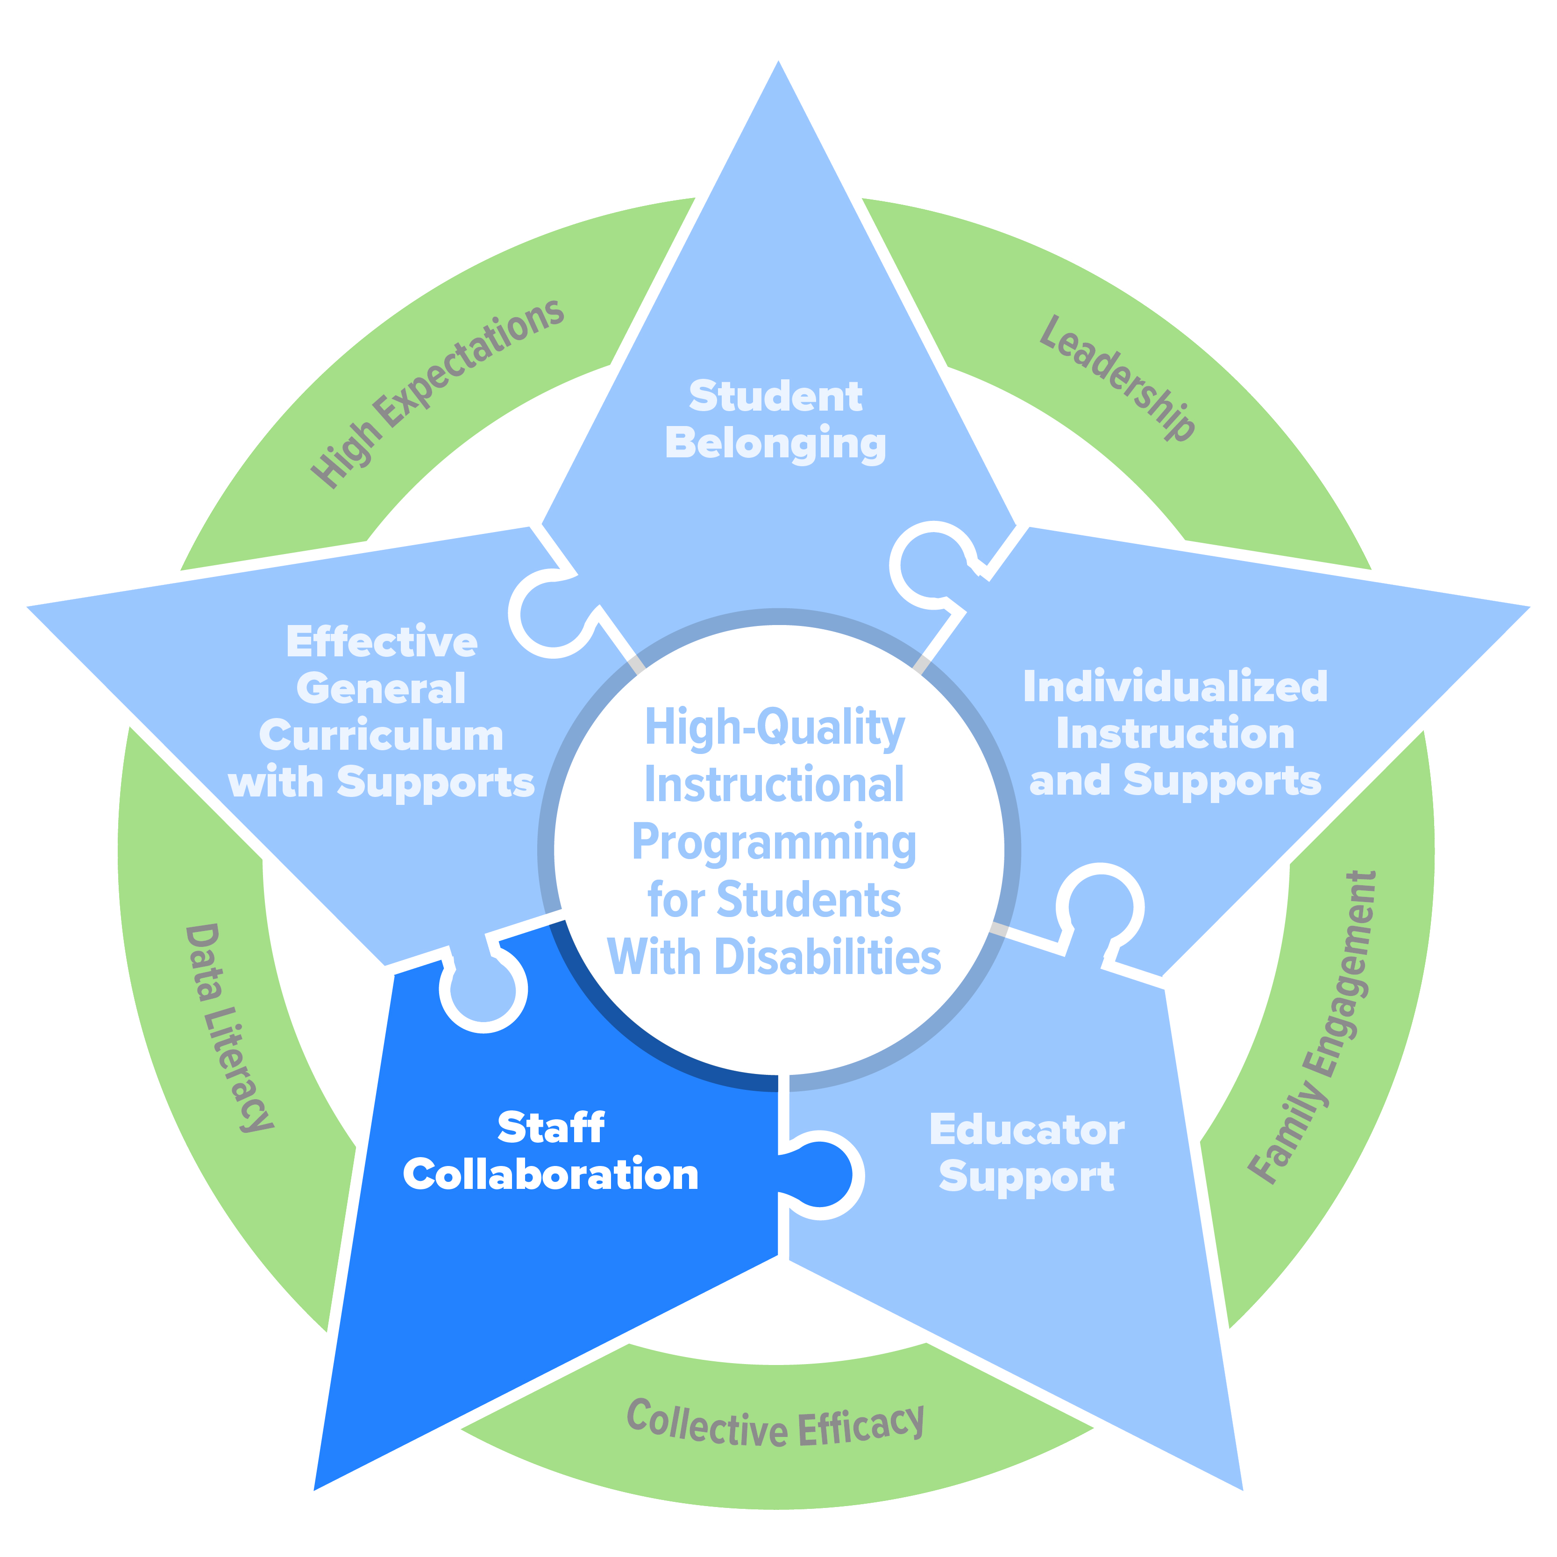
Staff Collaboration

Slide 44
Example MTSS Teams
Examples of MTSS teams | Description of responsibilities
School leadership team | Creates vision and schoolwide MTSS implementation plan Develops or identifies processes and structures for MTSS, including interventions and high-leverage practices to use Monitors and evaluates the effectiveness of schoolwide MTSS implementation
Student-focused team(s) | Monitors and evaluates impact of general education instruction Uses a validated screening process to identify students in need of additional support Supports implementation and monitors students receiving additional interventions
IEP | Supports and communicates with general education regarding SWD Supports monitoring and/or case manages SWD and their progress Conducts evaluations of students referred for services
MTSS provides the teaming structure to promote collaboration between general education and special education for student success.

Slide 45
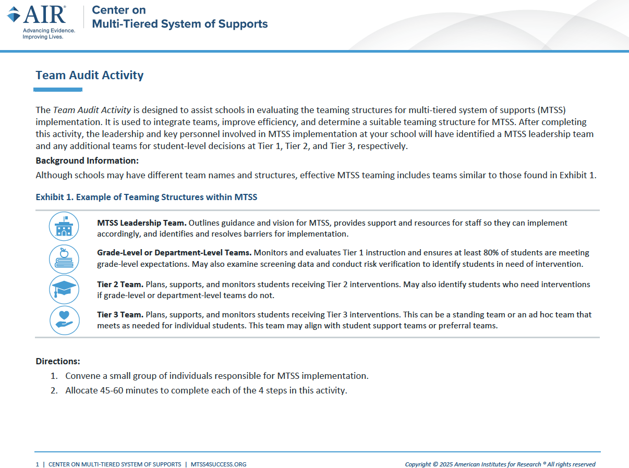
Team Audit Activity
Resource used by leadership or school-wide team to identify key teams for MTSS.
https://mtss4success.org/resource/mtss-team-audit-activity

Slide 46
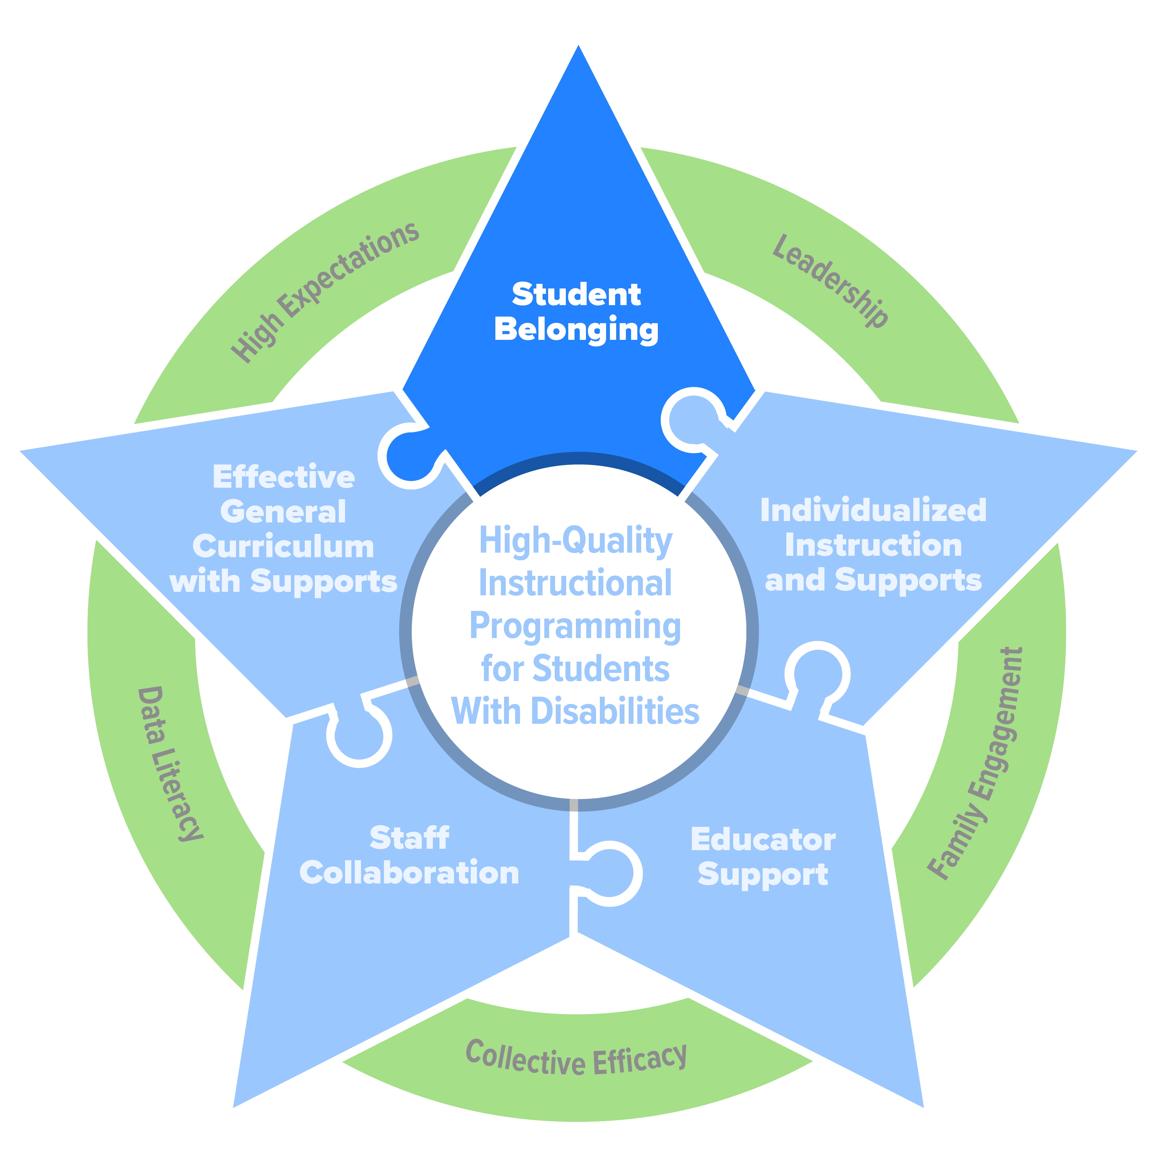
Student Belonging

Slide 47
Do your students feel connected to the school?
Student belonging for SWD is the connection and attachment they feel within the school community.
Welcomed
Supported
Are they receiving the assistance they need to participate fully and meaningfully in all aspects of the life of their school?
Are students received by others at the school with warmth, friendliness, and authentic delight?
https://promotingprogress.org/building-successful-system/student-belonging

Slide 48
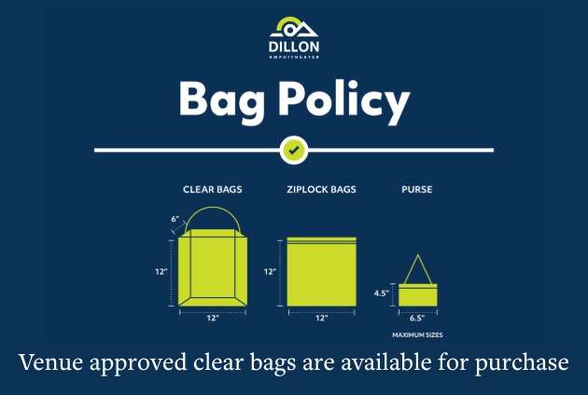

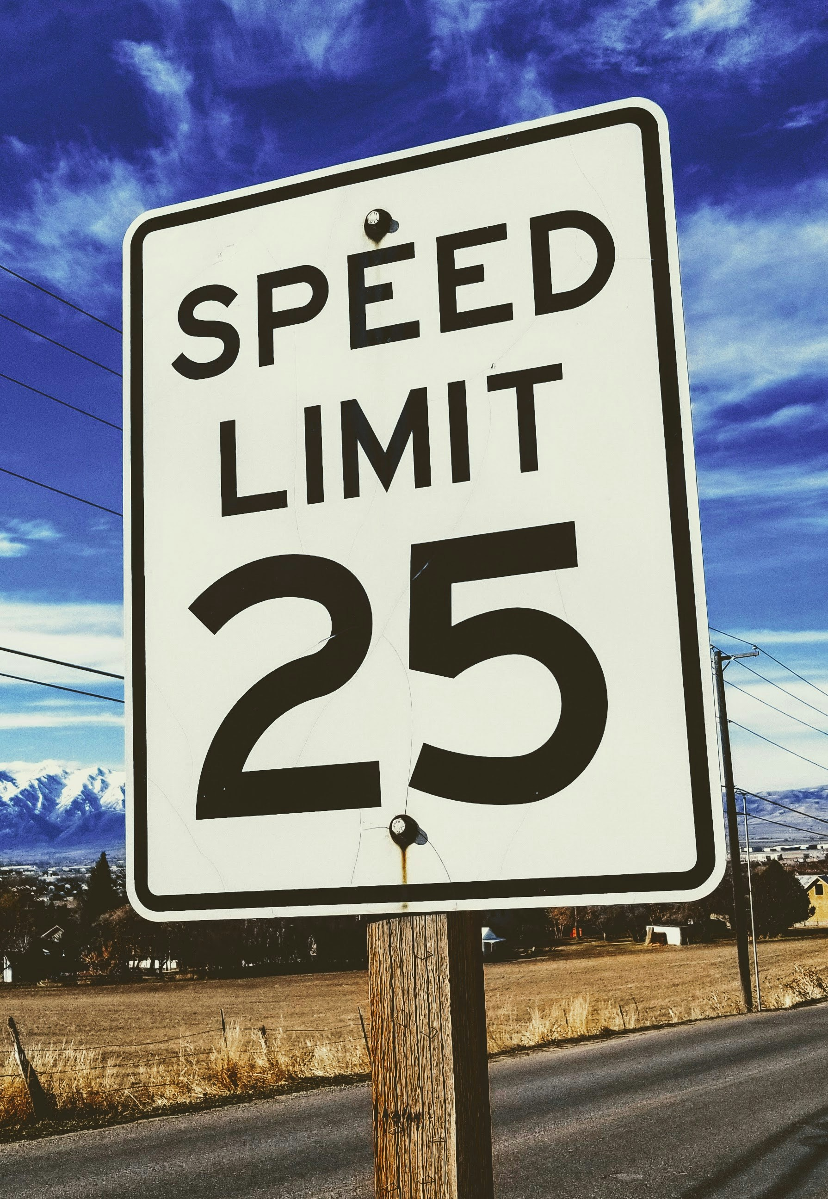
Use schoolwide expectations to establish feeling welcomed.
Photo by Clay Banks on Unsplash
Photo by Joshua Hoehne on Unsplash

Slide 49
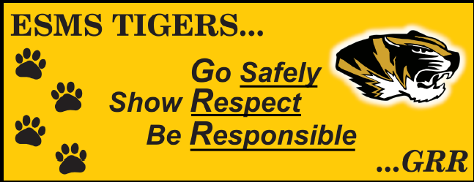
Schoolwide Expectations
Schoolwide expectations outline the culture and expectations for how staff, students, and families engage with each other.
Include belonging or building relationships as part of your schoolwide expectations.

Slide 50
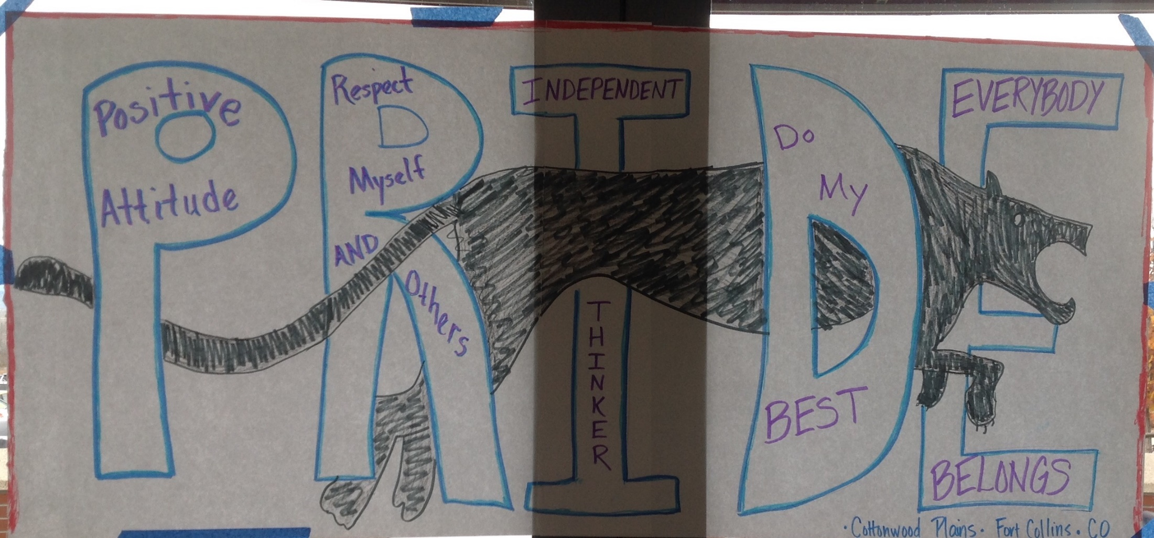
Examples of Schoolwide Expectations

Slide 51

Use Screening to Ensures SWD Feel Supported
Having at least 1 adult they feel connected to reduces dropout risk.
Screen students and simply ask one of these:
  Who are the adults at school you feel connected to?
  Is there a teacher you feel supported by?
  Do you have a favorite teacher?
  Do you have a high caring adult on campus?
Students who don’t report at least 1 adult may be at risk and require follow-up

Slide 52
Summary Point:
MTSS Makes Providing Special Education Easier
Students with disabilities have full access to general education curriculum.
With MTSS, special education can leverage existing systems to provide students their support/services.

Slide 53
“MTSS is not about how we organize our kids, it’s about how we organize ourselves for collective impact.”
-George Sugai

Slide 54

Center through AIR that provides support on implementation of MTSS
Professional learning, technical assistance, consultation, and coaching available
Over 25 qualified experts
Variety of free resources and packages customized to your needs
Email: mtsscenter@air.org
X/Twitter: @MTSSCenter
LinkedIn: www.linkedin.com/showcase/mtss-center
www.mtss4success.org

Slide 55

Questions?
Photo by Camylla Battani on Unsplash

Slide 56
Contact us
Jason Harlacher (jharlacher@air.org)

