Slide 1
The Composition, Distribution, and Stability of the Special Education Teacher Workforce
Allison Gilmour, Principal Researcher at AIR | Roddy Theobald, Managing Researcher at AIR
Prepping for PROGRESS | August 2025
The research reported here was supported by the Institute of Education Sciences, U.S. Department of Education, through Grant R324C240002 to American Institutes for Research. The opinions expressed are those of the authors and do not represent views of the Institute or the U.S. Department of Education.

Slide 2
Special education staffing challenges are persistent and multi-dimensional
Staffing Challenges
Composition
Stability
Distribution
Effectiveness
Note. Theoretical framework from Bettini et al. (2023).

Slide 3
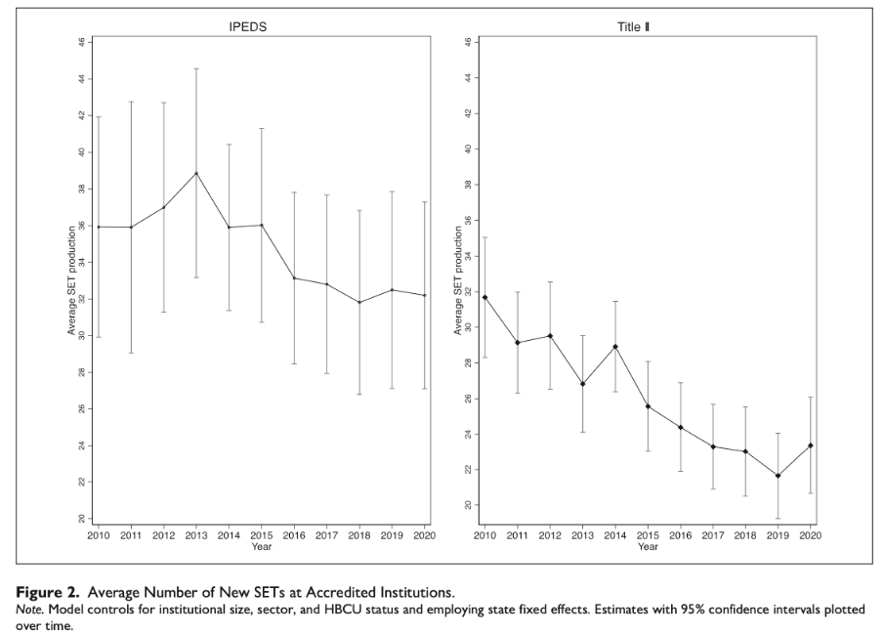
Composition
Number of special education teachers
  Decreases in the number of people pursuing special education degrees
Characteristics of the special education teacher workforce
  Mismatch between students and special educators
  Reliance on inexperienced, uncertified teachers
Bettini et al., 2025; Goldhaber & Theobald, 2023; Nguyen et al., 2024 (Figure source); Scott, Bettini, & Brunsting, 2023

Slide 4
Distribution
Special education teachers are inequity distributed across schools.
  More novice special education teachers in schools serving traditionally underserved students.
  In general education, inequitable distribution of teachers across schools account for a meaningful proportion of achievement gaps.
Cooc & Yang, 2016; Fall & Billingsley, 2008; Goldhaber et al., 2015; Mason-Williams, 2015

Slide 5
Stability
Historically higher rates of turnover
Costly
  Student achievement
  Disrupts schoolwide initiatives and reforms
  Financial costs
McLeskey & Billingsley, 2008; Theobald et al., 2021; Sindelar et al., 2006

Slide 6
Effectiveness
Unclear if the special education teacher workforce is effective at improving student outcomes
Gilmour et al., 2019; NAEP Data Explorer, 2024

Slide 7
But how pervasive are these challenges?
What we currently know is from:
  National survey data
  Single state studies
  Studies that use inconsistent methods for identifying special education teachers and for analyzing the data
Gilmour et al., 2025

Slide 8
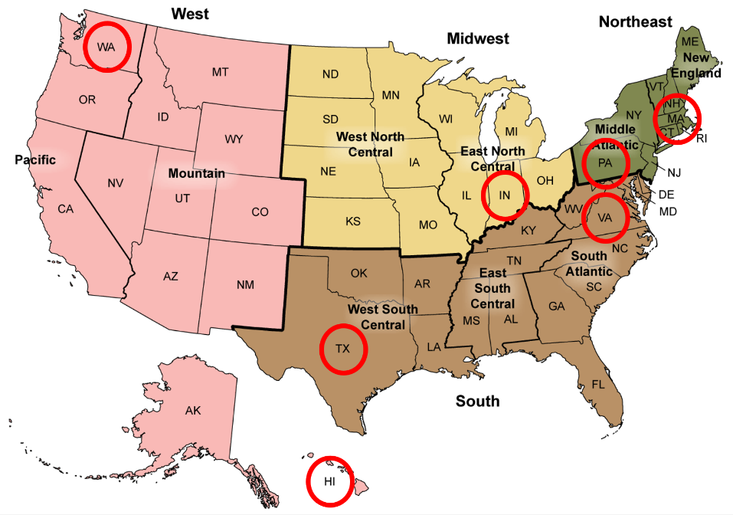
IES NCSER Funded National Research Center
The Special Educator Workforce: A Research Collaborative (SPARC Center)
Center Overview
The SPARC Center aims to address challenges related to the special education teacher workforce, including composition, distribution, stability, and effectiveness. It is a five-year $5 million IES NCSER grant covering research in partnership with seven states (Hawai`i, Indiana, Massachusetts, Pennsylvania, Texas, Virginia, and Washington).

Slide 9
Five Conclusions from Preliminary Analyses

Slide 10
1. States vary considerably in how they identify special education teachers in their data and staff special education.

Slide 11
Ratio of Students with Disabilities to Special Education Teachers by State
Note. Ratios from 2021-2022 618 data

Slide 12
2. Special education teacher certification rates are not always lower than other teacher certification rates.

Slide 13
3. Special education teacher attrition rates are higher than attrition rates for other teachers.

Slide 14
4. Special education teacher attrition rates declined after the first year of the pandemic, spiked, then stabilized.

Slide 15
5. Special education teacher turnover rates are generally, but not always, higher in higher-poverty schools.
Hawai`i | Indiana | Massachusetts | Pennsylvania | Texas | Virginia | Washington

Slide 16
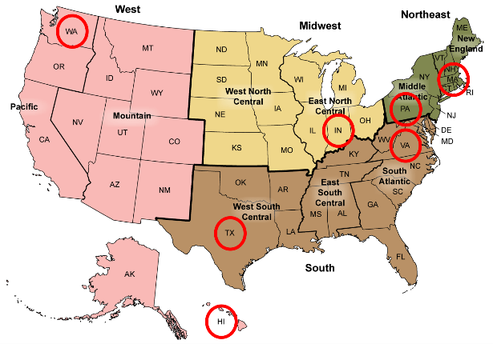
Some states are “beating the odds” yet they still report special education teacher staffing challenges.
Challenges varied by state and within states.
Each state has unique contexts that influence their staffing.
What are some states doing to beat the odds and address special education staffing challenges?

Slide 17
Lessons and Policy Responses in 3 States

Slide 18
Outline
What do we know about teacher shortages specifically in special education (Washington)?
What was the impact of a financial incentive designed to address special education teacher shortages (Hawai`i)?
What else are states doing to address special education teacher shortages in the future (Pennsylvania)?

Slide 19
Outline
What do we know about teacher shortages specifically in special education (Washington)?
What was the impact of a financial incentive designed to address special education teacher shortages (Hawai`i)?
What else are states doing to address special education teacher shortages in the future (Pennsylvania)?

Slide 20
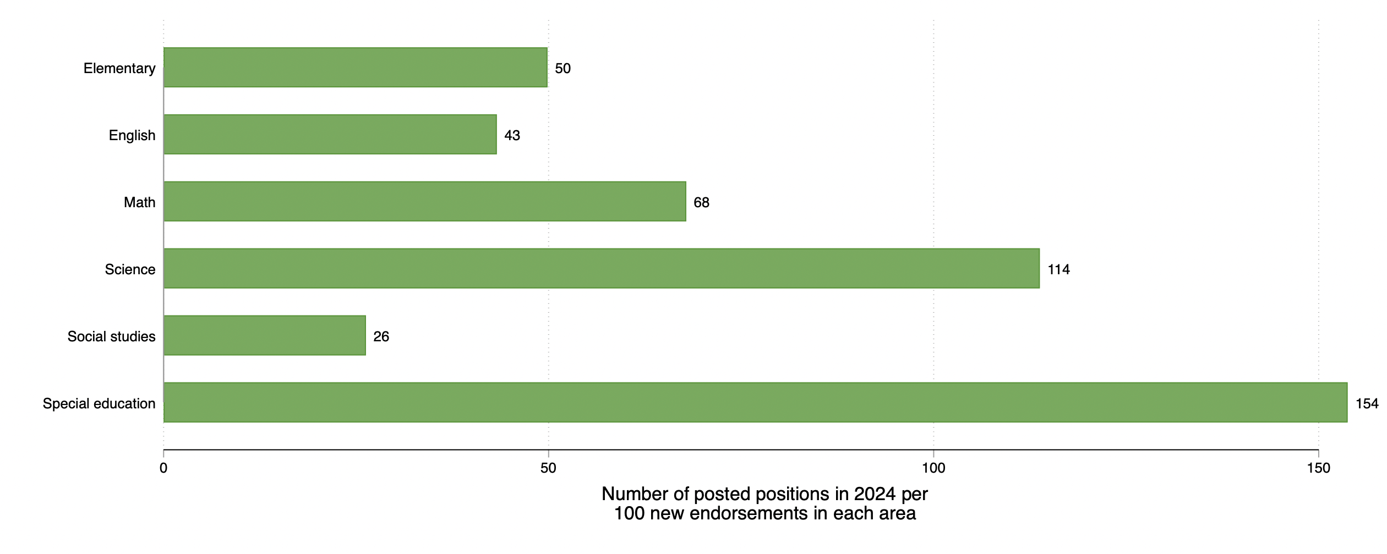
Supply Relative to Demand by Subject Area in Washington
Subject/Endorsement Area
Source: Goldhaber et al., 2025

Slide 21
Supply Relative to Demand by Subject Area in Washington 1
100
just as many job postings
There are fewer
job postings than new teachers
There are more
job postings than new teachers
Subject/Endorsement Area
Source: Goldhaber et al., 2025

Slide 22
Supply Relative to Demand by Subject Area in Washington 2
100
just as many job postings
There are fewer
job postings than new teachers
There are more
job postings than new teachers
Subject/Endorsement Area
Source: Goldhaber et al., 2025

Slide 23
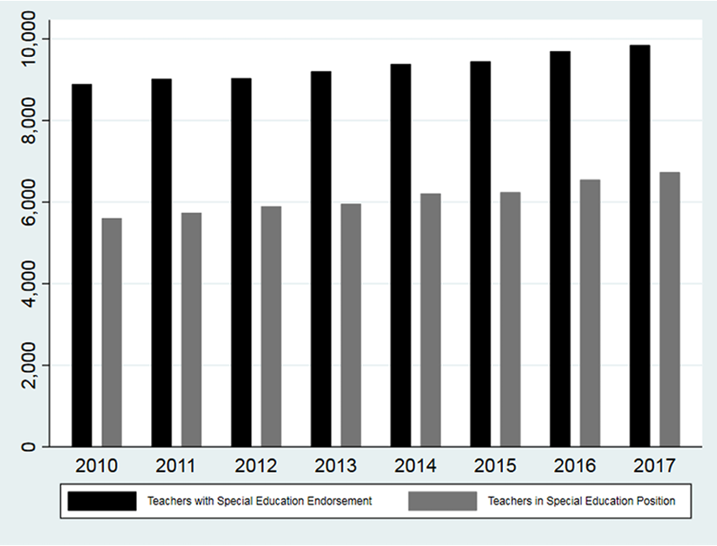
The Special Education Teacher Workforce in Washington
Source: Theobald et al., 2021

Slide 24
The Special Education Teacher Workforce in Washington
Source: Theobald et al., 2021

Slide 25
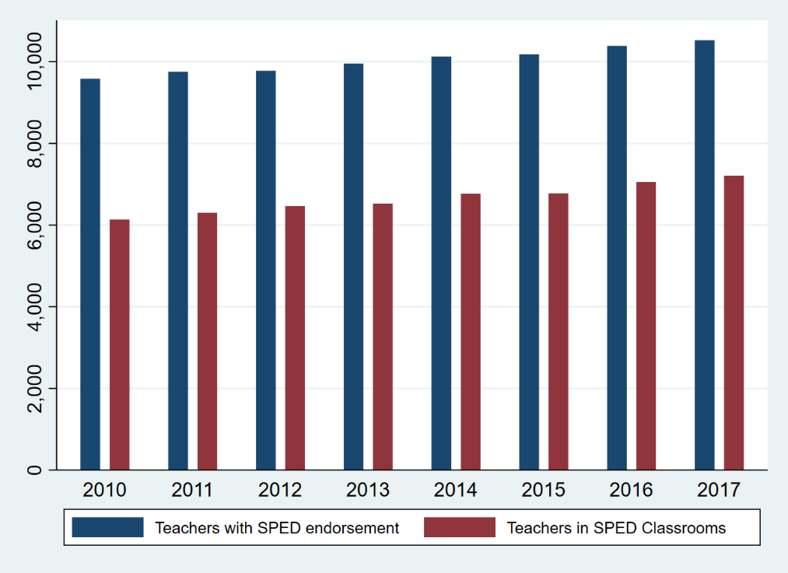
The Special Education Teacher Workforce in Washington
Source: Theobald et al., 2021

Slide 26
The Special Education Teacher Workforce in Washington
Source: Theobald et al., 2021

Slide 27
Outline
What do we know about teacher shortages specifically in special education (Washington)?
What was the impact of a financial incentive designed to address special education teacher shortages (Hawai`i)?
What else are states doing to address special education teacher shortages in the future (Pennsylvania)?

Slide 28
Background
Hawaii Public Schools implemented a bonus policy starting in the 2020-21 school year that raised the salaries of all special education teachers in the state by $10,000
McCoy, 2022; Theobald et al., 2025

Slide 29
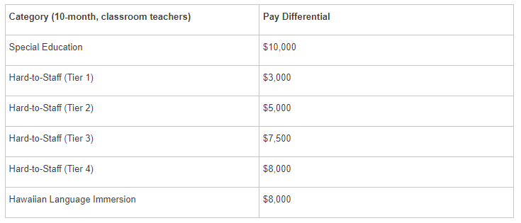
Background
Hawaii Public Schools implemented a bonus policy starting in the 2020-21 school year that raised the salaries of all special education teachers in the state by $10,000
McCoy, 2022; Theobald et al., 2025

Slide 30
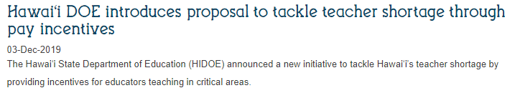
Background
Hawaii Public Schools implemented a bonus policy starting in the 2020-21 school year that raised the salaries of all special education teachers in the state by $10,000
McCoy, 2022; Theobald et al., 2025

Slide 31
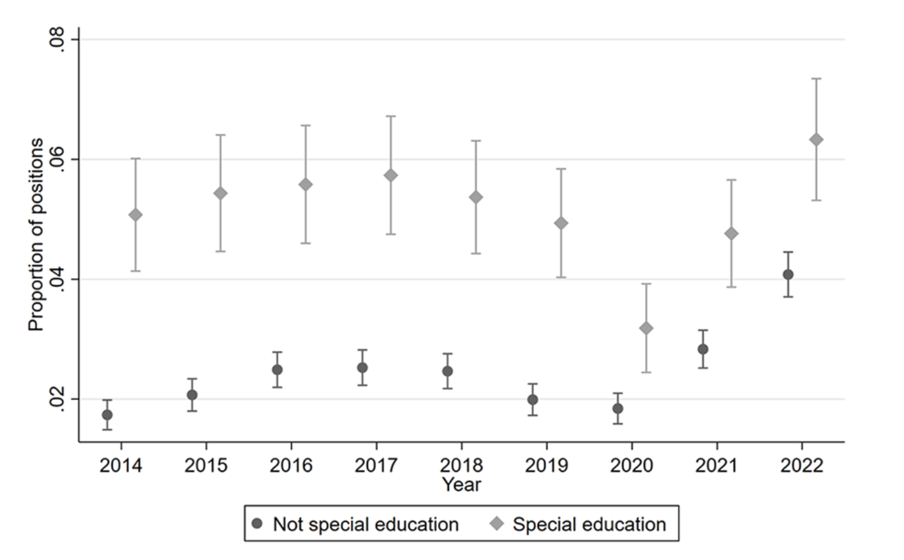
Event Study Plots, Vacancies
Source: Theobald et al., 2025

Slide 32
Event Study Plots, Vacancies
Source: Theobald et al., 2025

Slide 33
Event Study Plots, Vacancies
Source: Theobald et al., 2025

Slide 34
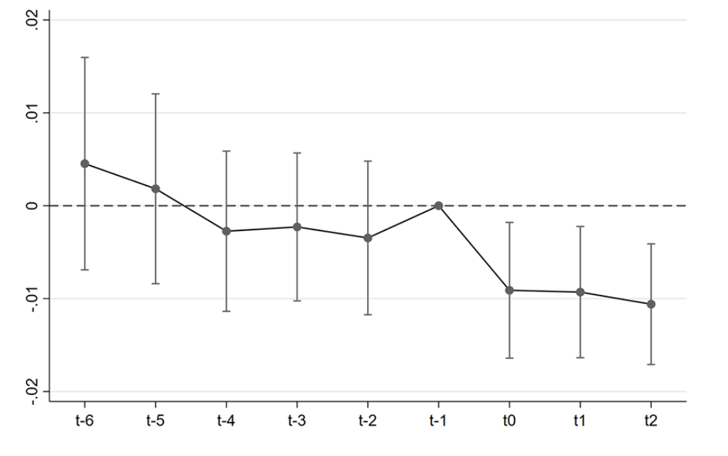
Event Study Plots, Vacancies
Source: Theobald et al., 2025

Slide 35
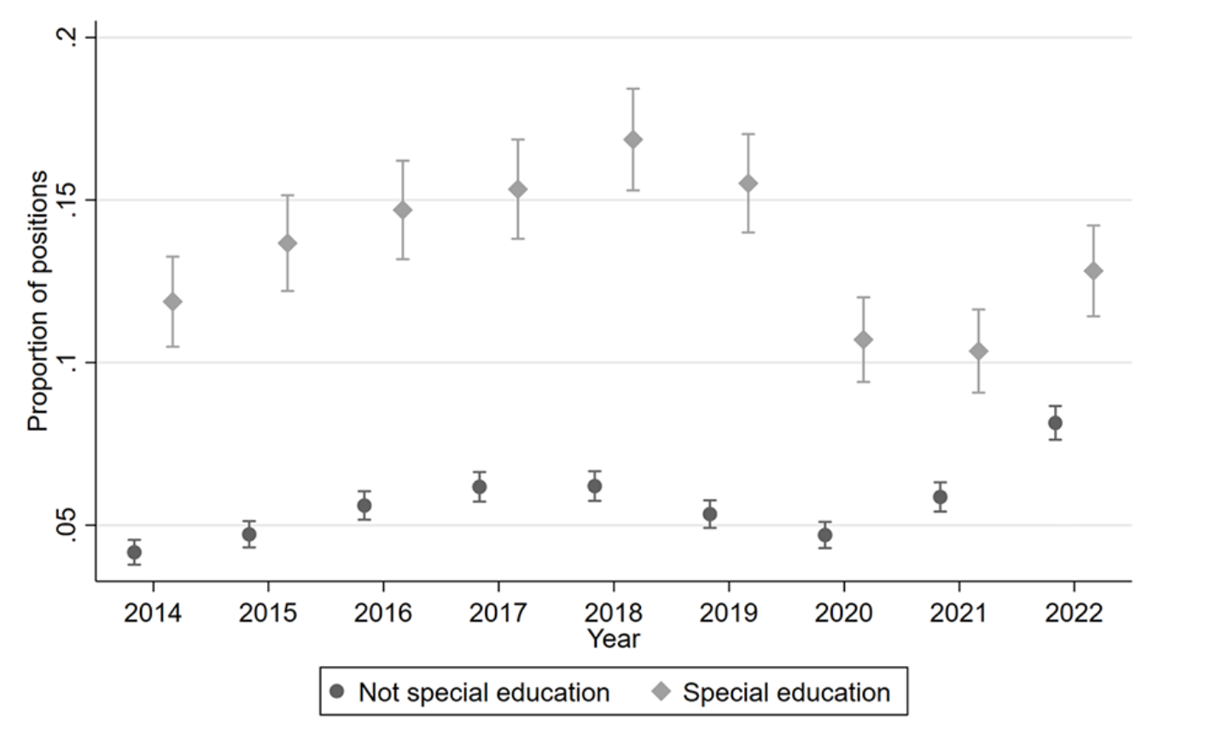
Event Study Plots, Vacancies and Unlicensed Teachers
Proportion positions vacant or filled by unlicensed teacher
Source: Theobald et al., 2025

Slide 36
Event Study Plots, Vacancies and Unlicensed Teachers
Proportion positions vacant or filled by unlicensed teacher
Source: Theobald et al., 2025

Slide 37
Event Study Plots, Vacancies and Unlicensed Teachers
Proportion positions vacant or filled by unlicensed teacher
Source: Theobald et al., 2025

Slide 38
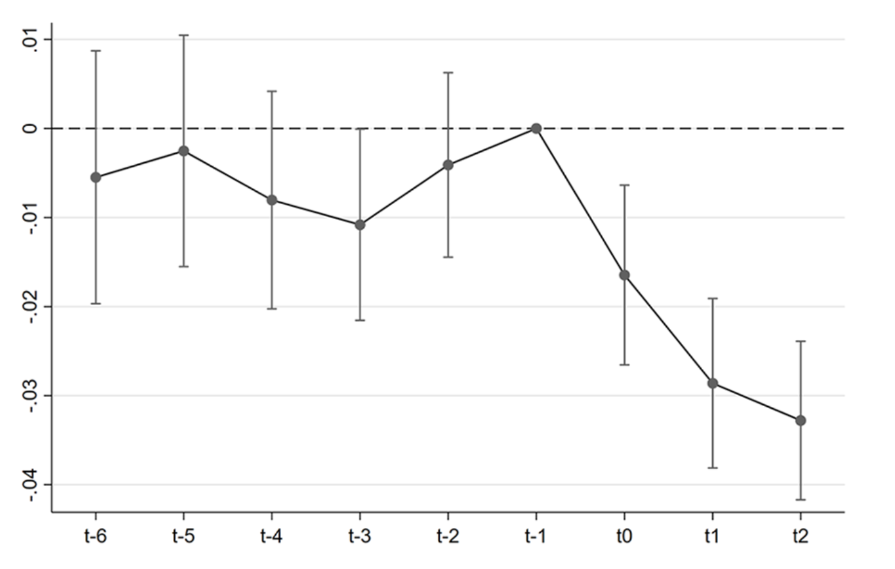
Event Study Plots, Vacancies and Unlicensed Teachers
Proportion positions vacant or filled by unlicensed teacher
Source: Theobald et al., 2025

Slide 39
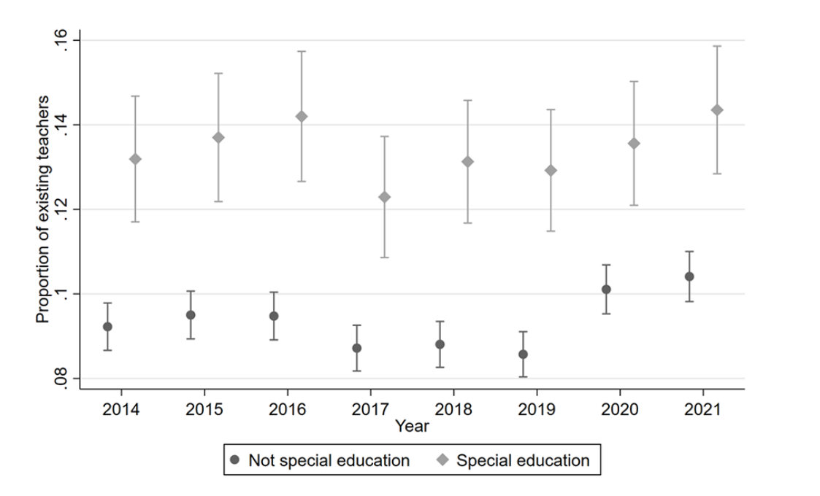
Event Study Plots, Teacher Attrition
Source: Theobald et al., 2025

Slide 40
Event Study Plots, Teacher Attrition
Source: Theobald et al., 2025

Slide 41
Event Study Plots, Teacher Attrition
Source: Theobald et al., 2025

Slide 42
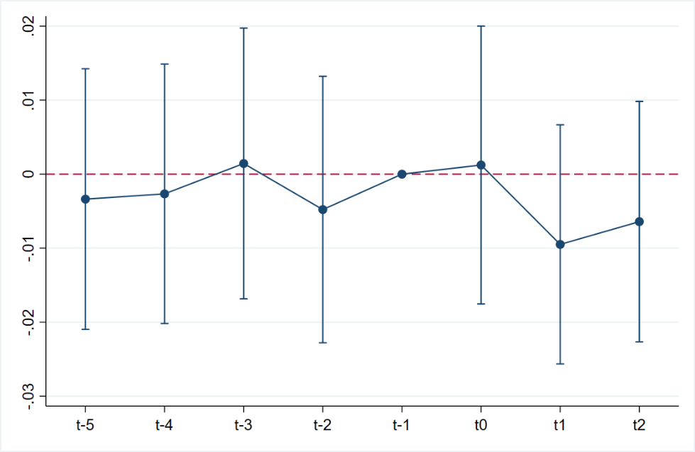
Event Study Plots, Teacher Attrition
Source: Theobald et al., 2025

Slide 43
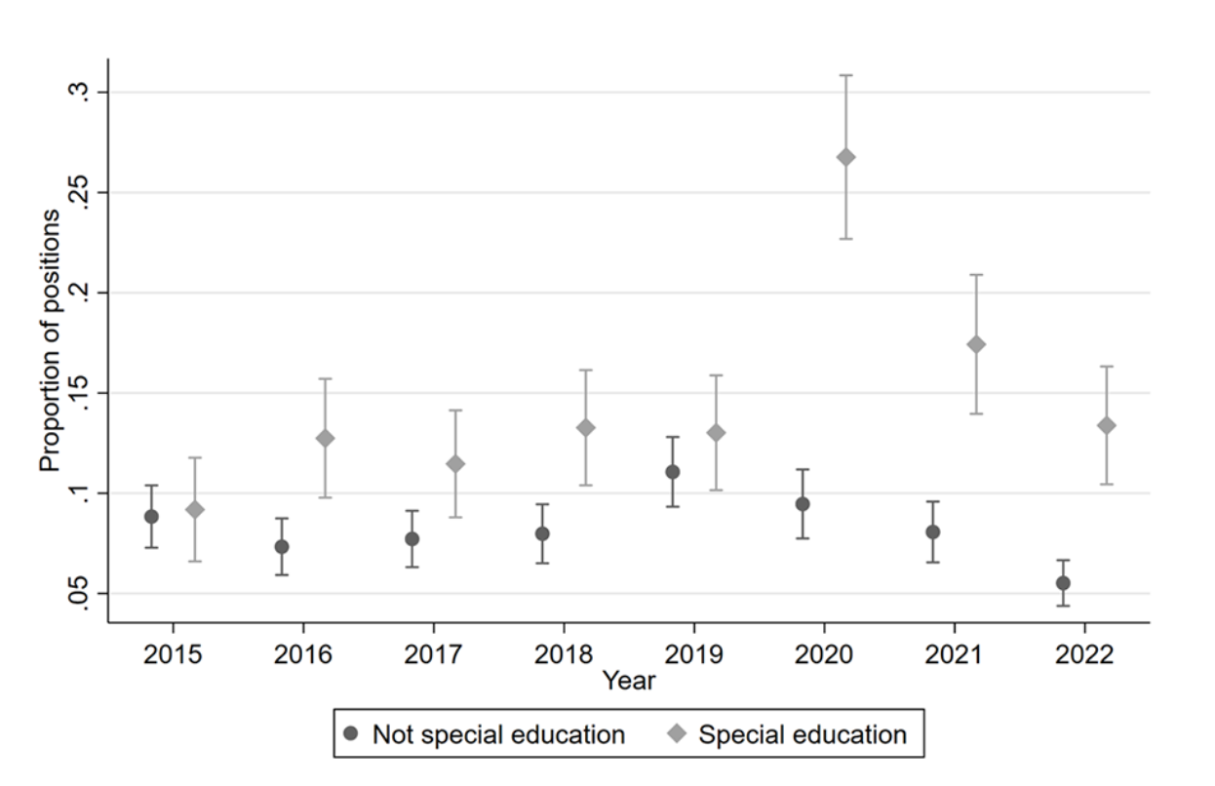
Event Study Plots, Teacher Movement Between SPED and GEN
Proportion open positions filled by position switcher
Source: Theobald et al., 2025

Slide 44
Event Study Plots, Teacher Movement Between SPED and GEN
Proportion open positions filled by position switcher
Source: Theobald et al., 2025

Slide 45
Event Study Plots, Teacher Movement Between SPED and GEN
Proportion open positions filled by position switcher
Source: Theobald et al., 2025

Slide 46
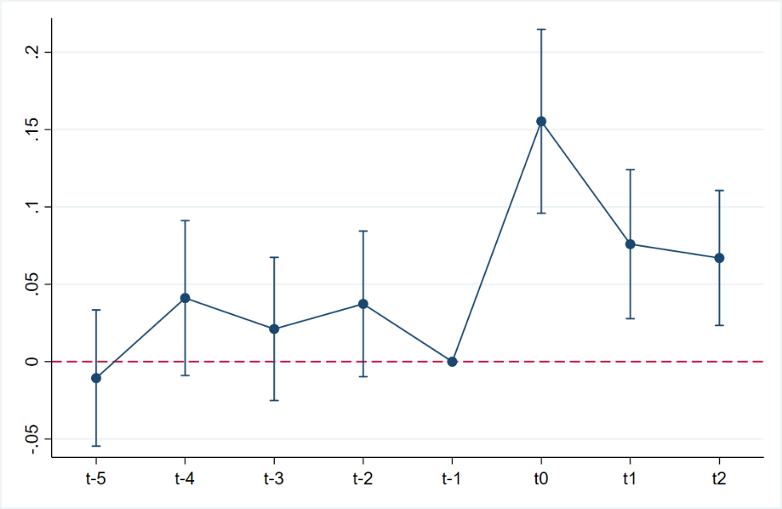
Event Study Plots, Teacher Movement Between SPED and GEN
Proportion open positions filled by position switcher
Source: Theobald et al., 2025

Slide 47
Outline
What do we know about teacher shortages specifically in special education (Washington)?
What was the impact of a financial incentive designed to address special education teacher shortages (Hawai`i)?
What else are states doing to address special education teacher shortages in the future (Pennsylvania)?

Slide 48

APR Projects in Pennsylvania
Developing Future Special Educators Grants (ATTRACT)
Accelerated Program for PK-12 Special Education Teacher Certification Grant (PREPARE)
APR Mentoring Project (RETAIN)

Slide 49
Developing Future Special Educators Grants
The purpose of the Developing Future Special Educators Grant is to:
  Establish/expand experiential learning opportunities (ELOs)
  Support current educators in advancing future special educators’ knowledge and understanding of opportunities in the field
  Increase interest of secondary/postsecondary students in pursuing a career as a special educator
46 Local Education Agencies and Institutes of Higher Education were awarded funds from the Pennsylvania Bureau of Special Education in the 2021-22 school year.

Slide 50
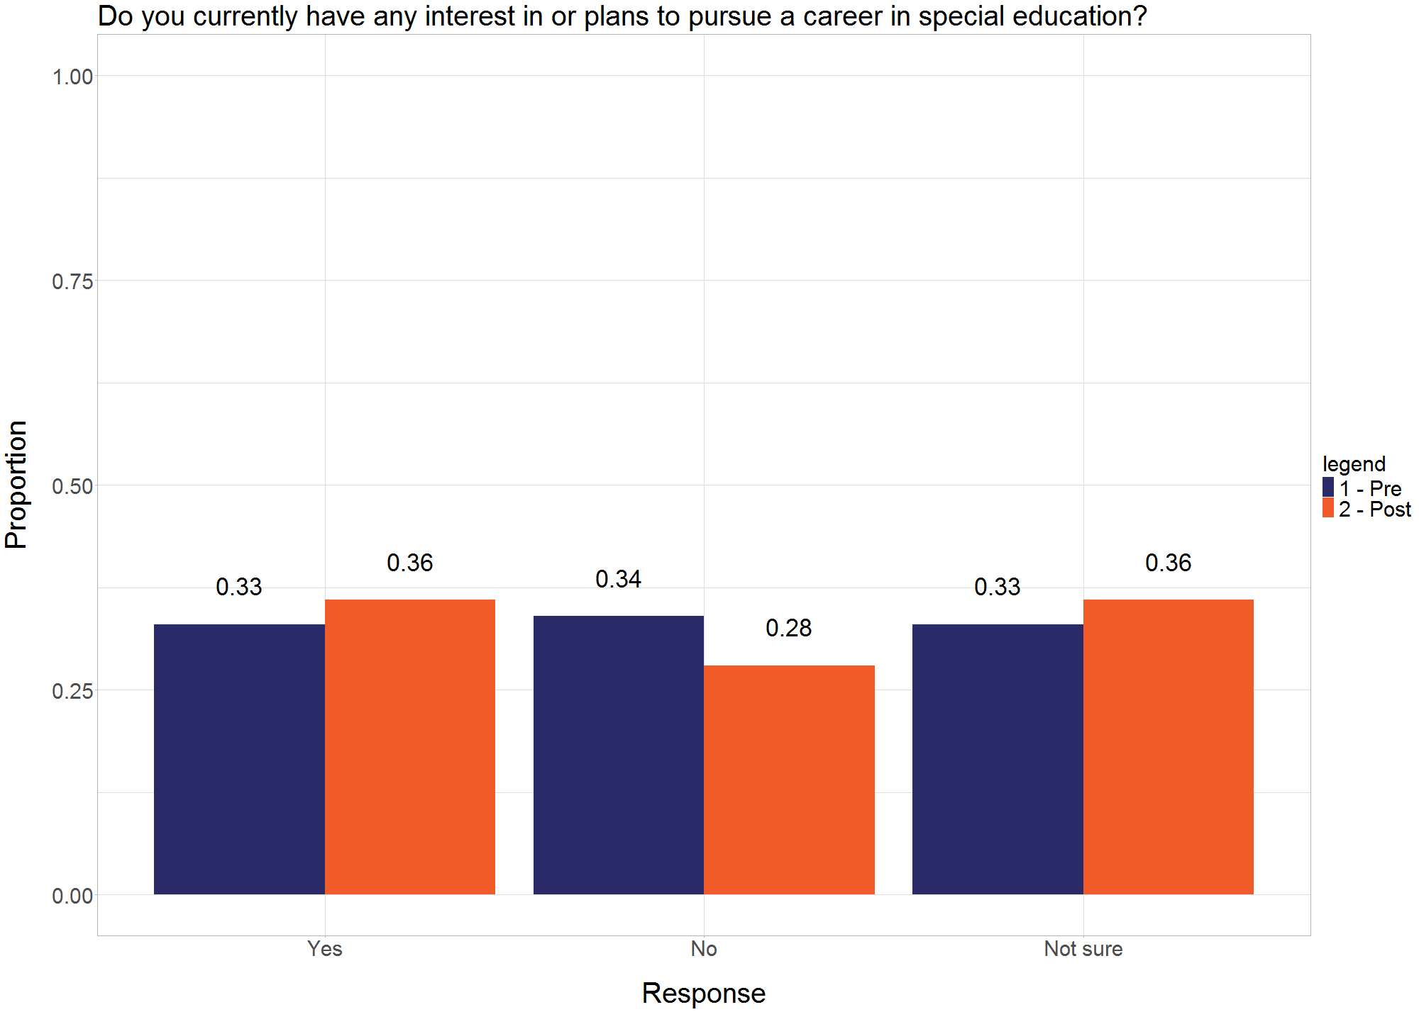
Developing Future Special Educators Grants
Source: Theobald et al., 2023

Slide 51
Accelerated Program for PK-12 Special Education Certification
The purpose of this grant is to provide individuals currently employed by an LEA an expedited pathway with the required college/university coursework, summer field experiences, and mentoring to obtain their PK-12 special education teaching certification
Goal to increase the number of certified special educators in PA
15 IHEs were funded in the first round of the Accelerated Program
There were 142 completers of these programs in the first year
We interviewed grant coordinators/faculty of all 15 funded programs and surveyed recent completers of these programs

Slide 52
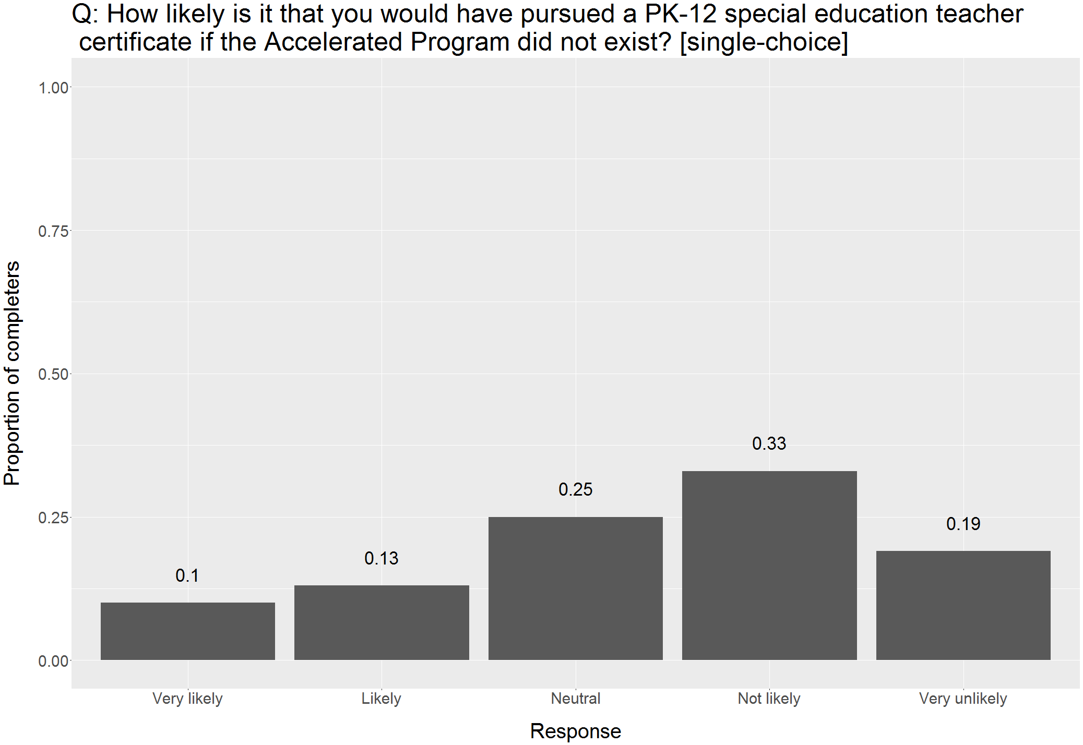
Accelerated Program for PK-12 Special Education Certification (cont’d.)
Source: Theobald et al., 2025

Slide 53
APR Mentoring Project
The purpose of the APR Mentoring Project is to:
  Facilitate strong relationships with highly-qualified mentors to promote maximum growth in novice professionals
Over 110 mentees were paired with experienced school psychologists, special education administrators, and special education teachers last school year

Slide 54
APR Mentoring Project (cont’d.)
Source: Theobald et al., 2024

Slide 55
States can beat the odds in recruiting and retaining special education teachers.
More states and districts are implementing policies and programs to address special education teacher shortages.
To be successful, these policies need to:
  Consider the local context
  Address multiple elements of the special education teacher pipeline
  Use data to determine what is not working, what can be changed, and what is working

Slide 56
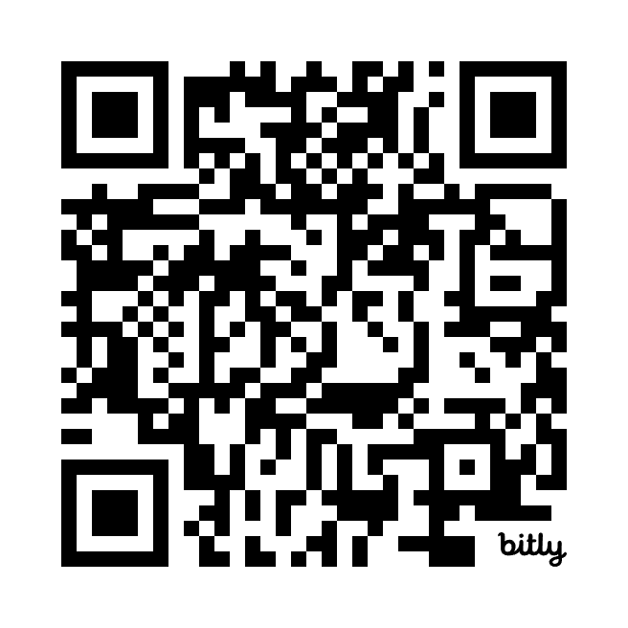

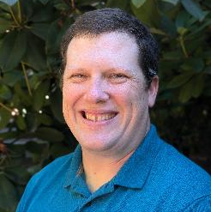
Thank you!
Alli Gilmour
Roddy Theobald
American Institutes for Research
Principal Researcher
agilmour@air.org
American Institutes for Research
Managing Researcher
rtheobald@air.org

Slide 57
References
Bettini, E., Nguyen, T. D., Ellis-Robinson, T., Mason-Williams, L., Allen-Barrett, A., & Bass, A. (2025). Ethnoracial diversity of the special educator workforce over time. Exceptional Children, 91(2), 144-165.
Bettini, E., Scott, L. A., Meyer, K. M., Mathews, H. M., & Shaheen, T. (2024). Challenges facing the special education teacher workforce: Composition, distribution, and effectiveness. In J. Kauffman, D. Hallahan, & P. Pullen (Eds.), Handbook of special education (3rd ed).
Cooc, N., & Yang, M. (2016). Diversity and equity in the distribution of teachers with special education credentials: Trends from California. AERA Open, 2(4). https://doi.org/gcd5z4
Fall, A.-M., & Billingsley, B. S. (2008). Disparities in teacher quality among early career special educators in high- and low-poverty districts. In T. E. Scruggs and M. A. Mastropieri (Eds.), Personnel preparation (Advances in Learning and Behavioral Disabilities, Vol. 21, pp. 181–208). Emerald Group Publishing.
Gilmour, A. F., Fuchs, D., & Wehby, J. H. (2019). Are students with disabilities accessing the curriculum? A meta-analysis of the reading achievement gap between students with and without disabilities. Exceptional Children, 85(3), 329-346.
Gilmour. A. F., Feng, L., & Theobald, R., (2025). Leveraging administrative data to study the special education teacher workforce. Remedial and Special Education, 46(2) 118-131. https://doi.org/10.1177/07419325241262971
Goldhaber, D., Falken, G., & Theobald, R. (2025). Supply and demand in the postpandemic teacher labor market. CALDER Working Paper 313-0325.

Slide 58
References (cont’d.)
Goldhaber, D., Lavery, L., & Theobald, R. (2015). Uneven playing field? Assessing the teacher quality gap between advantaged and disadvantaged students. Educational Researcher, 44(5), 293–307. https://doi.org/10.3102/0013189X15592622
Goldhaber, D., & Theobald, R. (2023). Teacher turnover three years into the pandemic era: Evidence from Washington state: Flash brief (CALDER Policy Brief No. 32-0223). National Center for Analysis of Longitudinal Data in Education Research (CALDER).
Mason-Williams, L. (2015). Unequal opportunities: A profile of the distribution of special education teachers. Exceptional Children, 81(2), 247–262. Nguyen, T., Bettini, E., Gilmour, A., & Redding, C. (2024). Examining the supply of new special educators: Variations by institutional characteristics and for-profit status. Remedial and Special Education. https://doi.org/10.1177/07419325241270044
McCoy, D. (2022). Schools are struggling to hire special education teachers. Hawaii may have found a fix. National Public Radio, April 21, 2022.
McLeskey, J., & Billingsley, B. S. (2008). How does the quality and stability of the teaching force influence the research-to-practice gap? A perspective on the teacher shortage in special education. Remedial and Special Education, 29(5), 293–305.
NAEP Data Explorer. (2024). https://www.nationsreportcard.gov/ndecore/
Scott, L. A., Bettini, E., & Brunsting, N. (2023). Special education teachers of color burnout, working conditions, and recommendations for EBD research. Journal of Emotional and Behavioral Disorders, 31(2), 97–108.
Sindelar, P. T., Shearer, D. K., Yendol-Hoppey, D., & Liebert, T. W. (2006). The sustainability of inclusive school reform. Exceptional Children, 72(3), 317–331. https://doi.org/gf8rrh

Slide 59
References (cont’d.)
Theobald, R., Aniagyei-Cobbold, E., & Stein, M. (2023). The special education teacher pipeline in Pennsylvania: Year 1 report. CALDER Working Paper No. 289-0723.
Theobald, R., Aniagyei-Cobbold, E., & Stein, M. (2024). The special education teacher pipeline in Pennsylvania: Year 2 report. CALDER Working Paper No. 304-0724.
Theobald, R., Aniagyei-Cobbold, E., Gilmour, A., & Stein, M. (2025). The special education teacher pipeline in Pennsylvania: Year 3 report. CALDER Working Paper.
Theobald, R., Xu, Z., Gilmour, A., Lachlan-Hache, L., Bettini, E., & Jones, N. (2025). The impact of a $10,000 bonus on special education teacher shortages in Hawai`i. Educational Evaluation and Policy Analysis.
Theobald, R., Goldhaber, D., Naito, N., & Stein, M. (2021). The special education teacher pipeline: Teacher preparation, workforce entry, and retention. Exceptional Children, 88(1), 65-80.

Slide 60
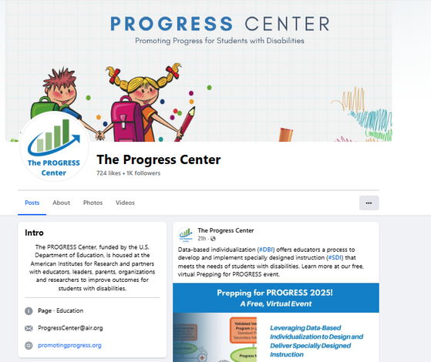
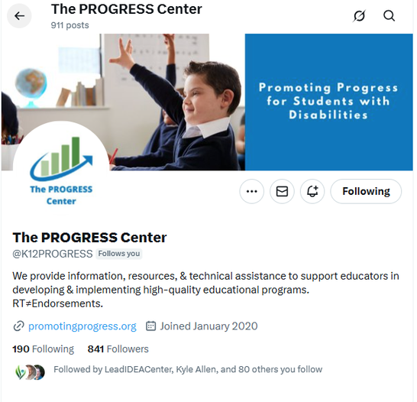
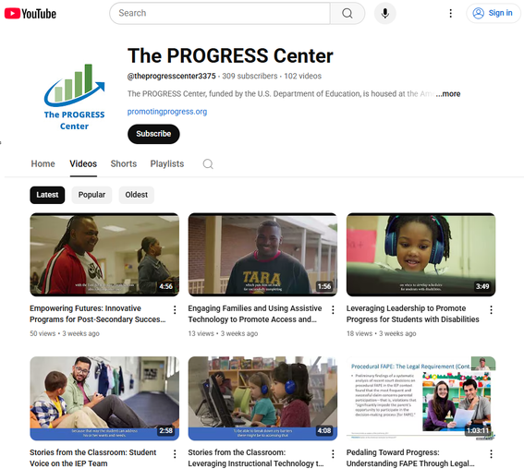



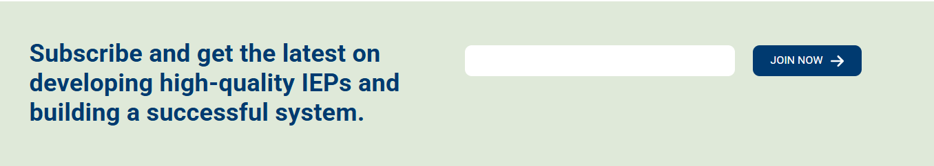
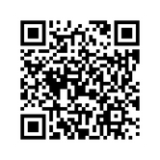
Stay connected with the PROGRESS Center!
@k12PROGRESS
@K12PROGRESS
@theprogresscenter3375

Slide 61
PROGRESS Center
progresscenter@air.org
1400 Crystal Drive, 10th Floor
Arlington, VA 22202-3289
202.403.5000
progresscenter@air.org
promotingprogress.org | www.air.org
https://www.facebook.com/k12PROGRESS/
https://twitter.com/K12PROGRESS
Notice of Trademark: “American Institutes for Research” and “AIR” are registered trademarks. All other brand, product, or company names are trademarks or registered trademarks of their respective owners.
This material was produced under the U.S. Department of Education, Office of Special Education Programs, Award No. H326C190002. David Emenheiser serves as the project officer. The views expressed herein do not necessarily represent the positions or policies of the U.S. Department of Education. No official endorsement by the U.S. Department of Education of any product, commodity, service, or enterprise mentioned in this presentation is intended or should be inferred.

